Slide 1

ICC CRICKET T-20 WORLD CUP 2024
Venue : WEST INDIES AND USA[Pre-Analysis]
Sudharshan Vishwa M . S
B.Tech AI&DS

Slide 2

This Analysis consists of the Dataset which consists of International T20 cricket Data that happened after the completion of the Previous T20 World Cup in Australia, on 13th Nov 2022.[I have extracted the particular set of data]
The Tournament takes place in the USA and the Windies, but the major part of the tournament takes place only in the west indies. Only the Group stage takes place in the USA. Also, Cricket is new to the USA and there is no data regarding cricket in the USA. So, Let us analyze only the data Available.
This T20 World Cup is in the WEST INDIES, where we expect some dry and slow pitches also some pitches are new and fresh as in the USA. We might see some low-scoring thrillers as well as high-scoring entertainers.

Slide 3
Total 20 Teams divided into 4 groups , top two teams from each group moves to super 8 round
Also ,there are total 20 teams taking part in this World Cup including Associate Nations such as Uganda ,Scotland ,Canada ,USA etc.. But ,there is no realistic chances for these teams to make the playoffs.[A normal basic cricketing Aspect]
So ,Let us analyze the teams that have realistic chances ,so I choose the teams which lie in Top 10 according to the current ICC T20 Rankings which Include,
[India ,Australia ,England ,New Zealand ,South Africa ,Pakistan ,Sri lanka ,Afganisthan ,Bangladesh, West Indies]
There are data of various aspects of the game, i.e, Batting ,bowling ,Fielding ,Team results.
Since there are only two t20 international series occured in West-Indies after the T20 World cup 2022,there is no enough data to analyze the pitches in west Indies since the sample size is very small. So I have taken the data of last Caribean Primear League's[CPL-2023] Data to analyze the pitch condition in West Indies

Slide 4
Team wise squad Analysis and Winning chance
[Group-A] [India, Pakistan,Ireland, USA, Canada]
In this group, the two main teams are India and Pakistan where they are firmly believed to make it into the next round.
Other teams like USA , Canada, and Ireland can give the fight to the other two main teams
Important Fixture: India vs Pakistan,9th June, New York

Slide 5

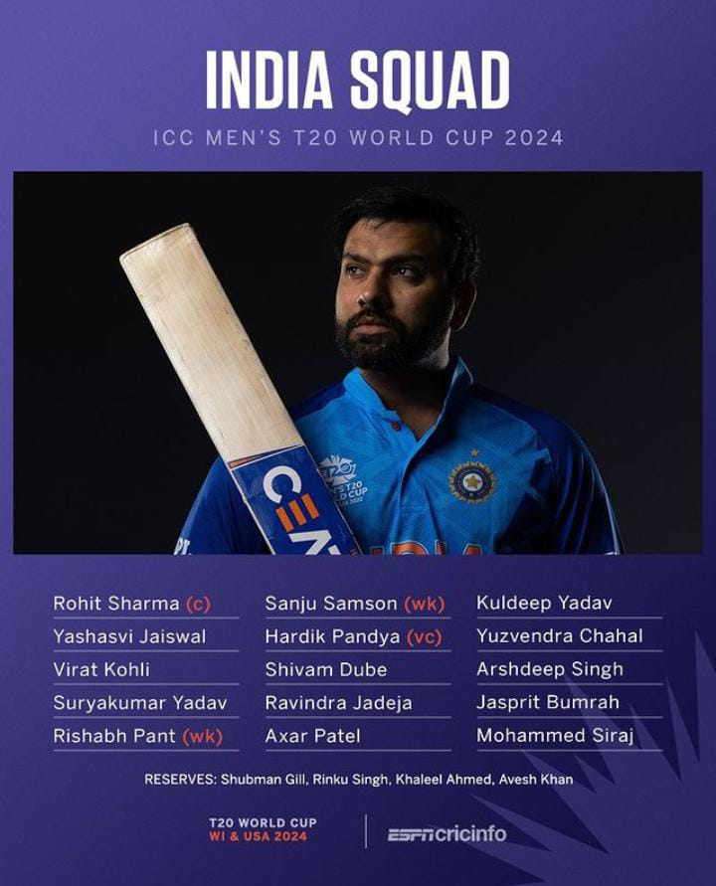
TEAM INDIA- A last Dance for the Big two?
Probable Playing 11
Rohit Sharma©
YBJ Jaiswal
Virat Kohli
Surya kumar Yadav
Shivam Dube
Rishab Pant(wk)
Hardik Pandya (vc)
Ravindra Jadeja
Kuldeep Yadav
Jasprit Bumrah
Arshdeep Singh

Slide 6
India is always a consistent performer in the ICC Tournaments based on qualifying to the knock-out stages. But, when it comes to knock-out stages, they have failed consistently since 2013. India are yet to win an ICC Trophy since their last win in the Champions trophy at the UK back in 2013.
They came close to the trophy at almost every ICC Tournament but weren’t able to clinch the final dessert. India, coming from a tragic heartbreak of the 2023 World Cup Finals at Ahmedabad, has the fire to win a trophy.
When it comes to the players, the two Giants of Indian Cricket ROHIT SHARMA and VIRAT KOHLI are returning to the T-20 Setup[they haven’t played International T20 cricket since India's semifinal exit from T20 World Cup 2022 in Australia]. They have just been brought up into the side in the recent IND-AFG T20 series that happened in India in 2024.
The form of some players is a concern, but If India can replicate the way they played in the 2023 World Cup under the Hats of Rohit Sharma, Nobody knows, this could be the end of their search for the ICC Trophy.
Most Runs- Virat Kohli
Most Wickets-Kuldeep Yadav
X-Factor- Suryakumar Yadav

Slide 7

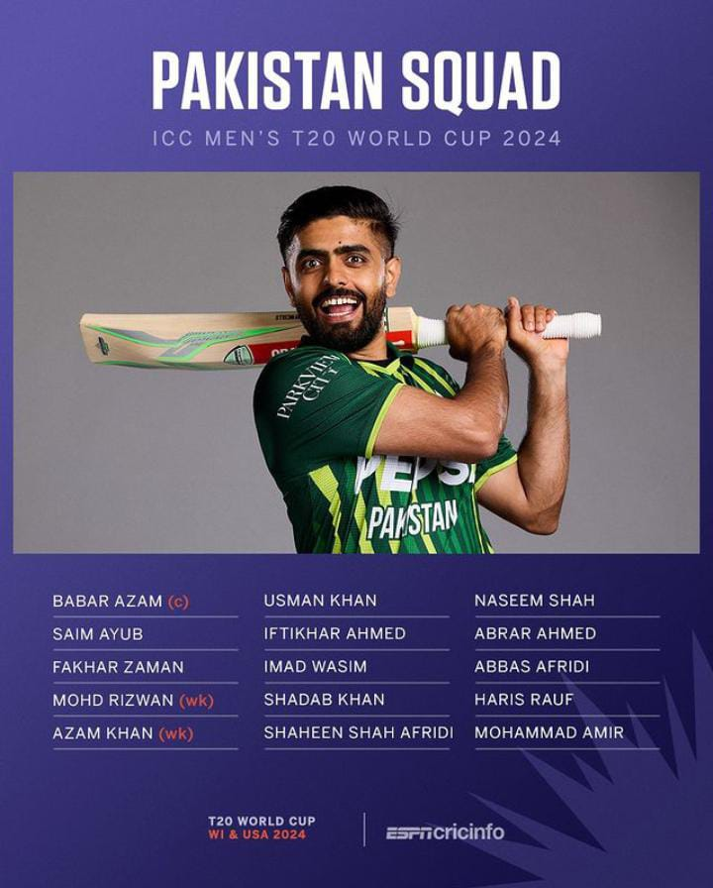
TEAM PAKISTAN
Probable Playing 11
Saim Ayub
Mohammad Rizwan(wk)
Babar Azam©
Fakhar Zaman
Iftikhar Ahmed
Azam Khan
Imad Wasim
Shadab Khan/Mohammad Amir
Shaheen Shah Afridi
Naseem Shah
Haris Rauf

Slide 8
Looks like a Balanced Team in both Batting and Bowling.
Pace Bowling is a real strength.
Form of certain players is so Vital
Needs to get the right Combination
Very Important to get gel as a team.
Most Runs- Mohammad Rizwan
Most Wickets-Shaheen Shah Afridi
X-Factor-Imad Wasim

Slide 9
GROUP B[England,Australia,Namibia,Scotland,Oman]
In this group, the two main teams are England and Australia where they are firmly believed to make it into the next round.
Other teams like USA, Canada, and Ireland can give a tough fight to the two main teams
Important Fixture: Sat, 8 June 2024
AUSTRALIA v ENGLAND, Barbados

Slide 10
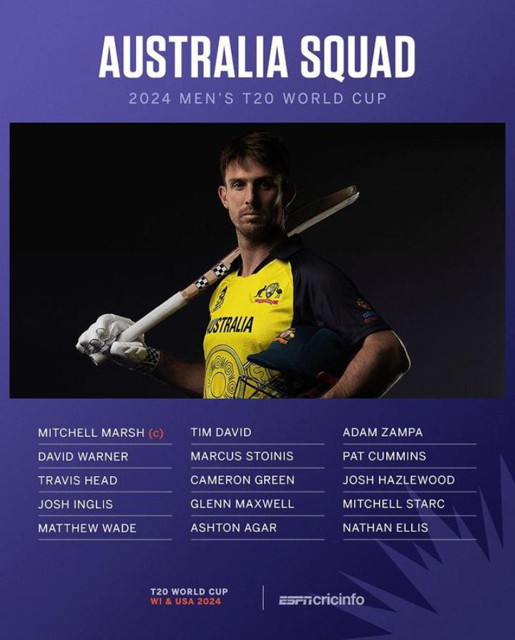

TEAM AUSTRALIA- WTC-23!,ODI-23!,T20-24..?
Probable Playing 11
David Warner
Travis Head
Mitchell Marsh©
Glenn Maxwell
Josh Inglis(wk)
Marcus Stoinis/Cameron Green
Tim David
Pat Cummins
Mitchell Starc
Josh Hazlewood
Adam Zampa

Slide 11
World Champions knows the formula to win the Trophy
Last Dance for David Warner
New Captain in this Particular Format
No Steve Smith in the Squad
Still has the strong team to target the Trophy
Most Runs- David Warner
Most Wickets-Adam Zampa
X-Factor-Glenn Mazwell

Slide 12
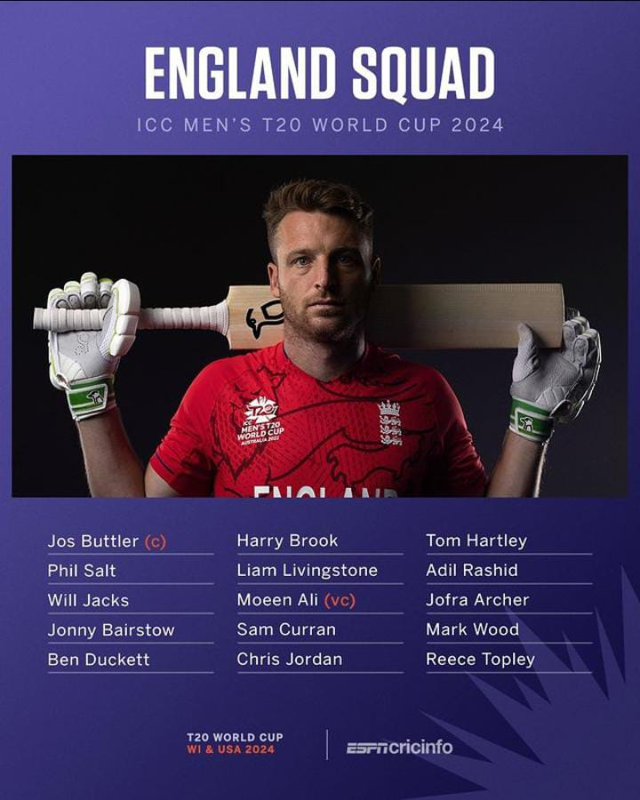

TEAM ENGLAND- Resurgence 2.0??
Probable Playing 11
Jos Buttler©(wk)
Phil Salt
Will Jacks
Jonny Bairstow
Harry Brook
Liam Livingstone
Moeen Ali
Sam Curran/Reece Topley
Jofra Archer
Mark Wood
Adil Rashid

Slide 13
Raining Champions of T20 World cup
On the Verge of resurgence from the Early exit of 2023 World Cup
Remember What Happened after the exit of 2015 World cup[Similar situation]
Dangerous Batting Line-up
Comeback of Jofra Archer
Most Runs- Phil Salt
Most Wickets-Adil Rashid
X-Factor-Will Jacks

Slide 14
GROUP C[New Zealand,West Indies,Afganistan,Uganda,PNG]
Not like the previous two groups, This team has three quality teams that fight for two spots. New Zealand, West Indies, and Afghanistan are the three teams that fight for two spots.
West Indies at home, with their recent form, New zealand with their consistent performance at ICC Tournaments and finally the rise of Afghanistan Cricket in the last four years, particularly in this format of the game, This group is going to be a Box-Office Collection
*Important Fixture: Fri, 7 June 2024 NEW ZEALAND v AFGHANISTAN Guyana**
*Important Fixture: Wed, 12 June 2024 WEST INDIES v NEW ZEALAND Trinidad**
*Important Fixture: Mon, 17 June 2024 WEST INDIES v AFGHANISTAN St. Lucia**

Slide 15
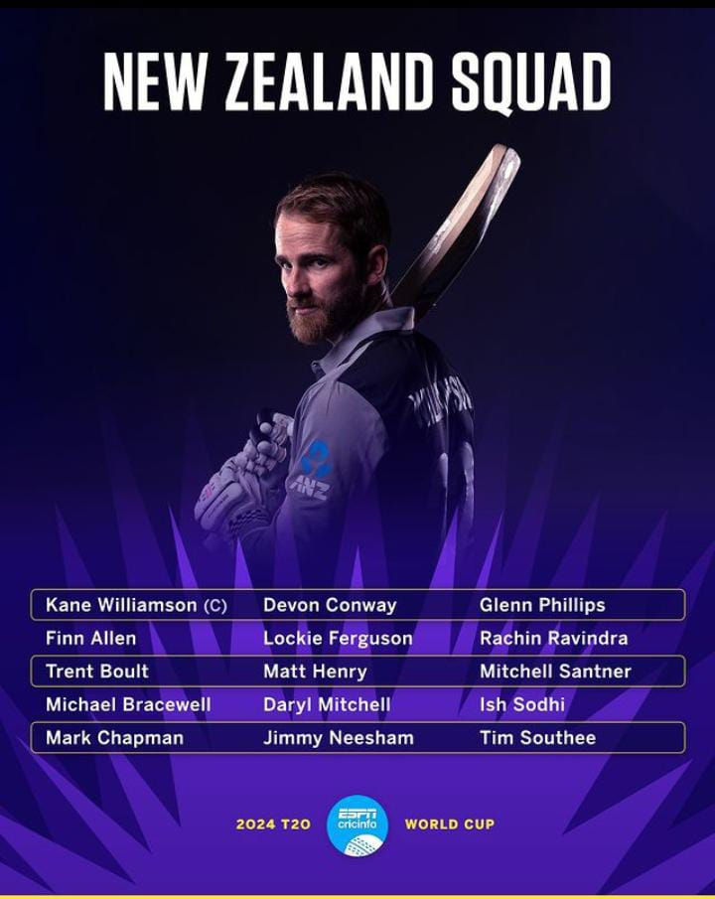

TEAM New Zealand
Probable Playing 11
Finn Allen
Devon Conway(wk)
Kane Williamson©
DarlylMitchell
Glenn Phillips
Michael Bracewell/Mark chapman
Mitchell Santner
Trent Boult
Tim Southee
Lockie Ferguson/Matt Henry
Ish Sodhi

Slide 16
Black caps are always Dark-horses
Minimum Resources ,Maximum efforts
Devon Conway coming from an injury
Form of certain Players
Most Runs- Finn Allen
Most Wickets-Tim Southee
X-Factor- Mitchell Santner

Slide 17
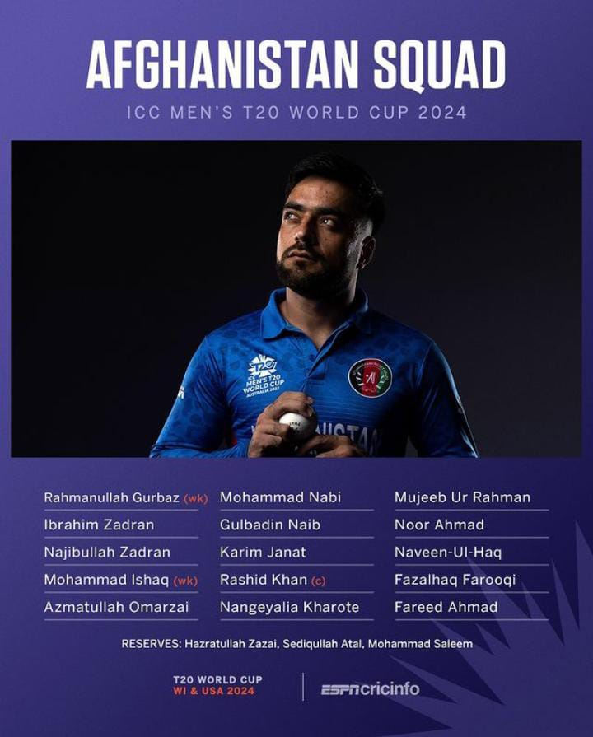

TEAM AFGANISTHAN
Probable Playing 11
Rahmanullah Gurbaz(wk)
Ibrahim Zadran
Mohammad Ishaq
Azmatullah Omarzai
Mohammad nabi
Gulbadin Naib
Najibullah Zadran
Rashid Khan©
Mujeeb ur Rahman/Noor Ahmed
Fazalhaq Farooqi
Naveen-ul-Haq

Slide 18
Emergence of Afganisthan Cricket
Better suited Format
Very Good Bowling attack with a deadly spin trio along with the pace attack of Omarzai and Naveen in the slow and dry pitches of Windies
If their batters come good, they can pull off a miracle at caribeann Islands
Most Runs-Ibrahim Zadrran
Most Wickets-Rashid Khan
X-Factor- Azmattulah Omarzai

Slide 19

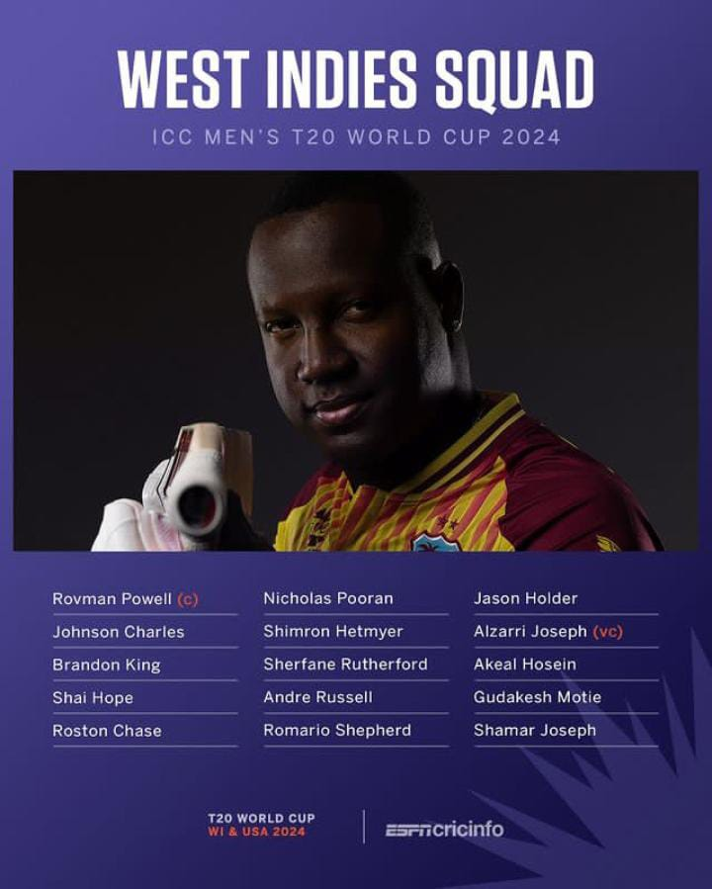
TEAM WEST INDIES
Probable Playing 11
Brandon King
Johnson Charles
Shai Hope(wk)
Nicholos Pooran
Rowman Powell©
Andre Russell
Romario Shepherd
Akeal Hosein
Roston Chase
Alzarri Joseph
Shamar Joseph

Slide 20
Ressurgence of West-Indian cricket??
Batting Powerhouse
Return of Dre-Russ
In-form Batters with home advantage
Decent Bowling attack
Let’s say,” West Indies is a Dangerous side” Period
Most Runs-Nicholas Pooran
Most Wickets-Akeal Hoseain
X-Factor- Andre Russell

Slide 21
GROUP D[South Africa,Srilanka,Bangladesh,Netherlands,Nepal]
This Group is also quite interesting. South Africa stands tall apart from all other teams and is expected to qualify for the next round. For the remaining one spot, two teams are going to fight, namely Srilanka and Bangladesh. The team that is going to win this Asian battle is going to be the second team to be qualified for the next round in South Africa
**Important Fixture: Mon, 3 June 2024 SRI LANKA v SOUTH AFRICA New York**
**Important Fixture: Fri, 7 June 2024 SRI LANKA v BANGLADESH Dallas**
**Important Fixture: Mon, 10 June 2024 SOUTH AFRICA v BANGLADESH New York**

Slide 22
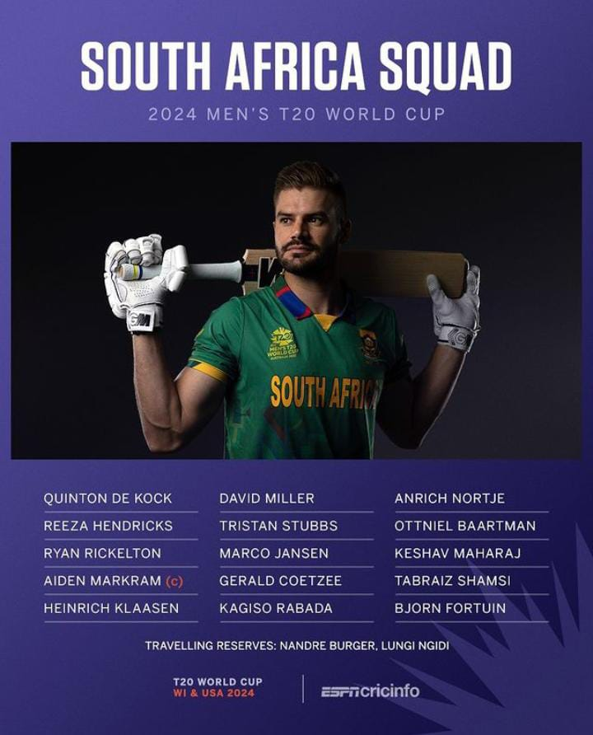

TEAM SOUTH AFRICA
Probable Playing 11
Quinton De Kock(wk)
Reeza Hendricks
Aiden Markram©
Heinrich Klassen
David Miller
Tristan Stubbs
Marco Jansen
Kagiso rabada
Anrich Nortje
Gerald Coetzee/Taibraz Shamsi
Keshav Maharaj

Slide 23
Dangerous Batting Lineup
Deadly Middle-order
Fear-factor of Heinrich Klassen
Good bowling lineup
If they play as a team,definitely yes
Most Runs-Aiden Markram
Most Wickets-Kagiso Rabada
X-Factor- Heinrich Klassen

Slide 24
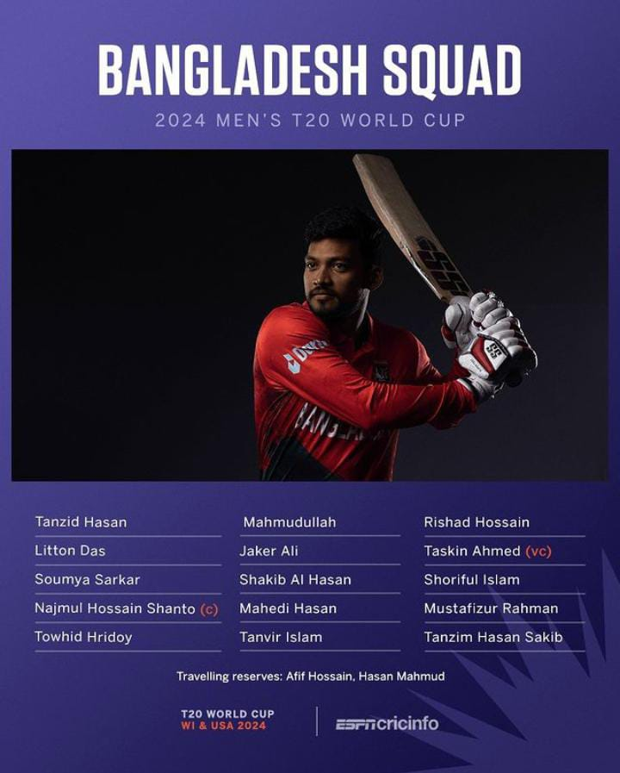

TEAM BANGLADESH
Probable Playing 11
Litton Das(wk)
Soumya Sarkar
Najmul Hossain Shanto©
Shakib Al-Hassan
Mahmadullah
Jaker Ali
Mahedi Hasan
Taskin Ahmed
Mustafizur Rahman
Shoriful Islam
Rishad Hossain

Slide 25
Experienced Batting Lineup
Decent Bowling line-up
Lot’s of All-rounders
Multiple bowling Options
The Caribbean conditions might suit them
Most Runs-Litton Das
Most Wickets-Mustafizur Rahman
X-Factor- Mahedi Hasan

Slide 26
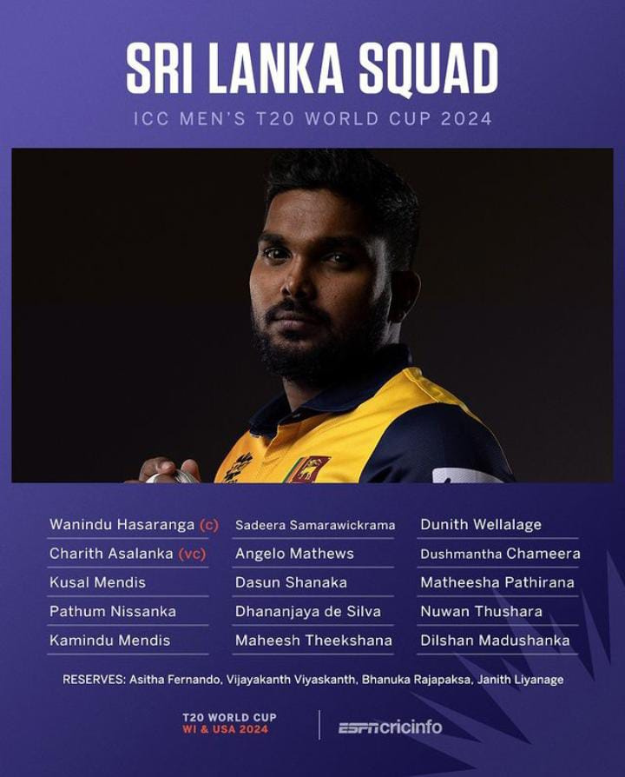

TEAM SRI LANKA
Probable Playing 11
Kusal Mendis(wk)
Pathum Nissanka
Sadeera Samarwickrama
Charith Asalanka
Dhananjaya De-Silva
Dasun Shanaka
Wanindu Hassaranga©
Maheesh Theekshana
Dilshan Madushanka
Nuwan Thushara
Mateesha Pathirana

Slide 27
Very-well balanced bowling attack
Hassaranga,the Leg Spinner,Theekshana the Mystery Spinner
Madushanka with new ball,Pathirana at Death and Thushara to support them
If their batting comes good,there is high possibility of qualifying to super 8s
Most Runs-Kusal Mendis
Most Wickets-Wanindu Hassaranga
X-Factor- Mateesha Pathirana

Slide 28
Top 4 Predictions

Slide 29
Thank you!
Let’s Have a cracker of a T20 World cup

