Slide 1
Polymer SMILES invariance

Slide 2
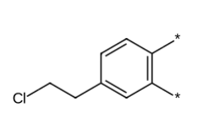
Translational invariance
[*]C1=CC=C(CCCl)C=C1[*]
[*]C1=CC=C(C=C1[*])CCCl
[*]C1=C(C=C(CCCl)C=C1)[*]

Slide 3
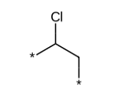
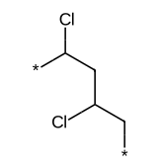
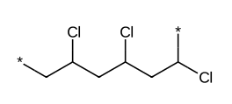
Oligomer representation
*CC(Cl)* - Monomer
*CC(C)CC(C)* - Dimer
*CC(Cl)CC(Cl)CC(Cl)* - Trimer

