Slide 1
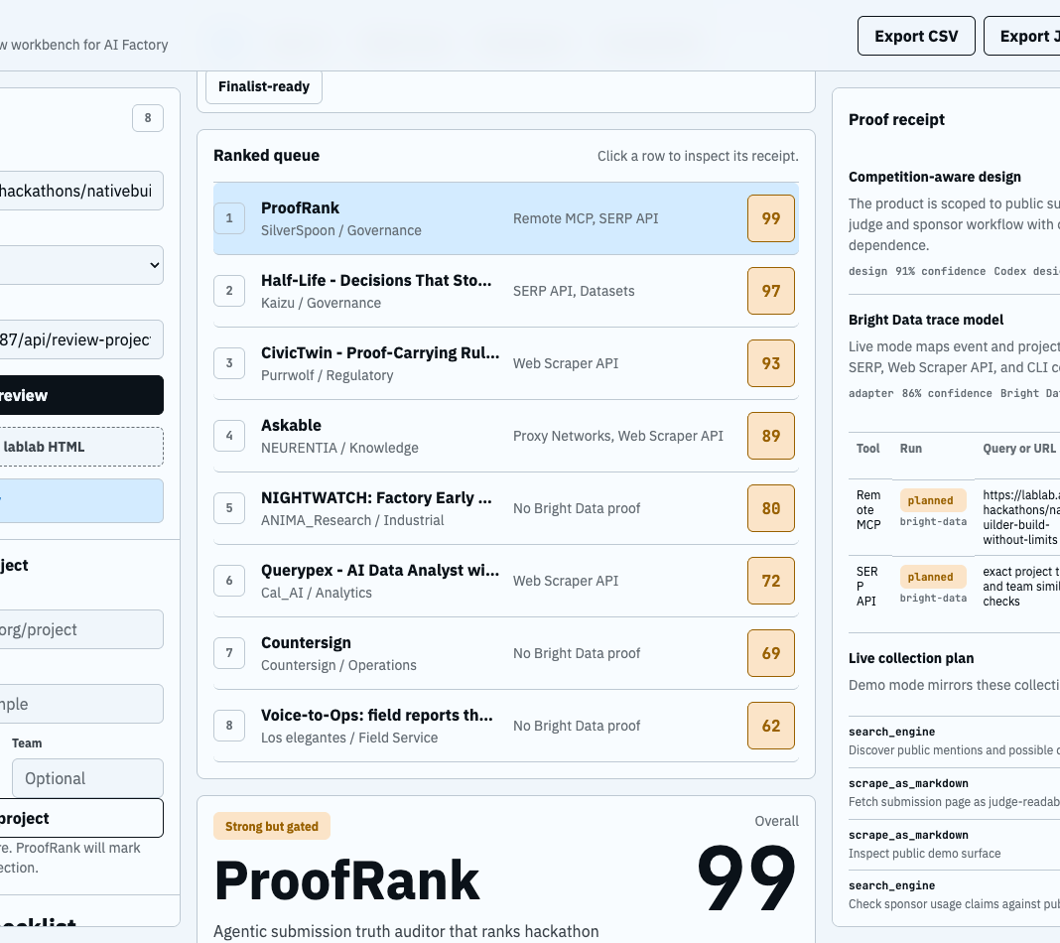
BRIGHT DATA SPONSOR SUBMISSION
ProofRank
Public AI product diligence for hackathon judges, sponsors, accelerators, and grant reviewers.
The product is not another submitted app. It is the evidence workbench a sponsor would use to decide which submitted apps are real.
ProofRank
1
Notes:
[Sources]
- submission/project-description.md
- submission/demo-assets/01-overview.png

Slide 2
THE REVIEW PROBLEM
Polished pitches hide weak evidence.
Judges need a fast way to separate working products from unsupported claims.
Broken or thin demos
A good-looking page may not prove a working end-to-end workflow.
Decision output
Sponsor logos without dependency
Shortlist, verify live, request proof, or hold.
Mentioning Bright Data is not the same as making live web evidence load-bearing.
Originality is hard to check
The field already includes strong proof, video, compliance, and agentic web entries.
Review output needs receipts
Sponsors need cited evidence, uncertainty, trace state, and recommended action.
ProofRank
2
Notes:
[Sources]
- research/bright-data-readiness.md
- submission/project-description.md

Slide 3
HOW PROOFRANK WORKS
Every score opens into evidence.
The app makes the review chain visible instead of hiding it behind a single AI verdict.
Collect
Normalize
Challenge
Export
Event pages, demos, repos, package files, commits, and public prior-art signals.
to
Claims become receipt items with confidence, limitations, provenance, and hash.
to
Sponsor judge, skeptical judge, business buyer, and Originality Radar dispute the result.
to
CSV queue, selected JSON receipt, all receipts JSON, and Markdown submission packet.
ProofRank
3
Notes:
[Sources]
- README.md
- app/src/liveReviewer.js
- app/src/liveEventReviewer.js
- app/src/exporters.js

Slide 4
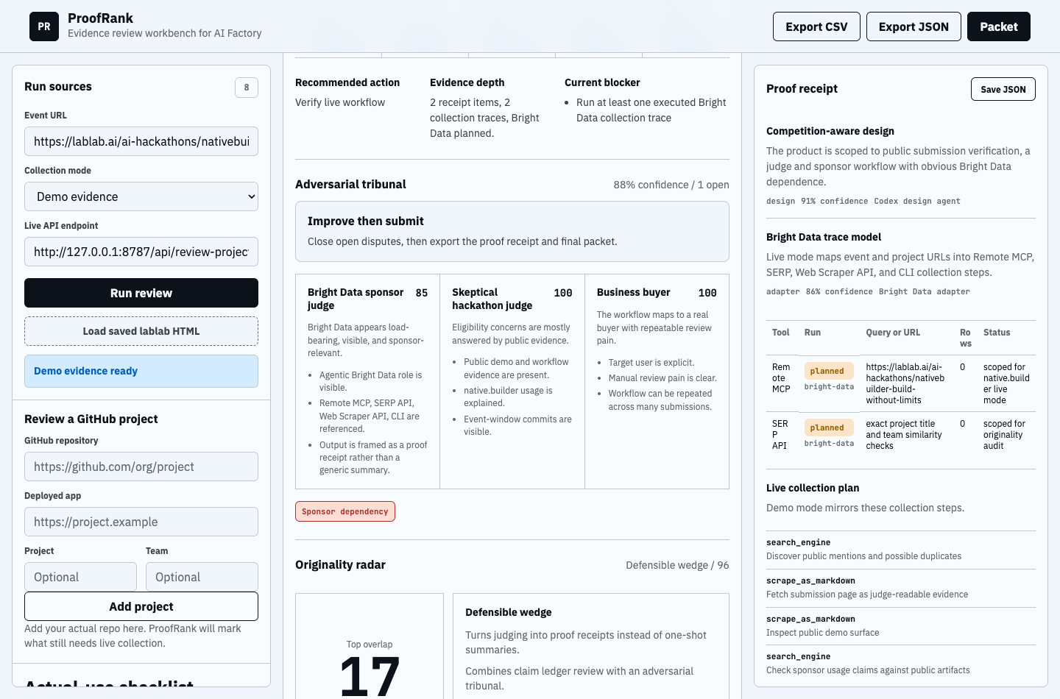
BRIGHT DATA ARCHITECTURE
The sponsor tool is the acquisition layer.
Bright Data is where live public evidence enters the workflow, not a badge in the footer.
Event intake
/api/review-event fetches the field and marks intake traces as non-scoring provenance.
Project review
/api/review-project checks repos, demos, package manifests, license, commits, and secret-risk signals.
Prior-art radar
search_engine and discover queries are prepared for overlap and copied-claim review.
Trace discipline
Only provider=bright-data and traceStatus=executed closes sponsor-fit proof.
ProofRank
4
Notes:
[Sources]
- app/src/scoring.js
- app/src/liveReviewApi.js
- submission/bright-data-setup.md
- submission/demo-assets/03-proof-receipt.png

Slide 5

WHAT CHANGED SINCE THE FIRST PROTOTYPE
The app now argues with itself.
That is the differentiator: ProofRank surfaces the objections a sponsor judge would raise.
Adversarial Tribunal
Three lenses: Bright Data sponsor, skeptical hackathon judge, and business buyer.
Originality Radar
Similar-project overlap with defensible-wedge bullets and live prior-art queries.
Honest blockers
A missing native.builder URL or failed Bright Data token stays visible in the receipt.
ProofRank
5
Notes:
[Sources]
- app/src/tribunal.js
- app/src/originality.js
- submission/demo-assets/02-claim-ledger.png

Slide 6
READINESS
The fallback is ready. The final proof is account-gated.
This is deliberately transparent so the submission does not overclaim.
Item | Status | Evidence
Fallback app | Ready | GitHub Pages deploy is green.
Demo video | Ready | Release MP4 refreshed to current UI.
Bright Data execution | Blocked | Current token returns HTTP 401.
Native.builder URL | Blocked | Requires team-owner login and publish.
The product is stronger because it refuses to score planned Bright Data traces as executed proof.
ProofRank
6
Notes:
[Sources]
- submission/operator-handoff.md
- README.md
- scripts/verify.sh

Slide 7
ASK
Fund proof-based AI review.
The hackathon wedge is judge diligence. The broader product is sponsor, accelerator, grant, and procurement review.
Next live run
Prize fit
1. Fix Bright Data token
2. Publish native.builder URL
3. Run live event and project receipts
4. Submit with refreshed video
Best Agentic Use of Bright Data
ProofRank
7
Notes:
[Sources]
- research/bright-data-readiness.md
- submission/operator-handoff.md

