Slide 1
Task 4 – Dashboard Design
Elevate Lab – Data Analyst Virtual Internship
Presented by: Vishwa Patel
Tool Used: Tableau

Slide 2
Dataset Overview
- Dataset Name: index_1.csv
- Columns Used:
• Coffee Name
• Cash Type
• money
• Card
• Date
- Data Size: Small product sales dataset
- Goal: Analyze coffee sales and payment preferences

Slide 3
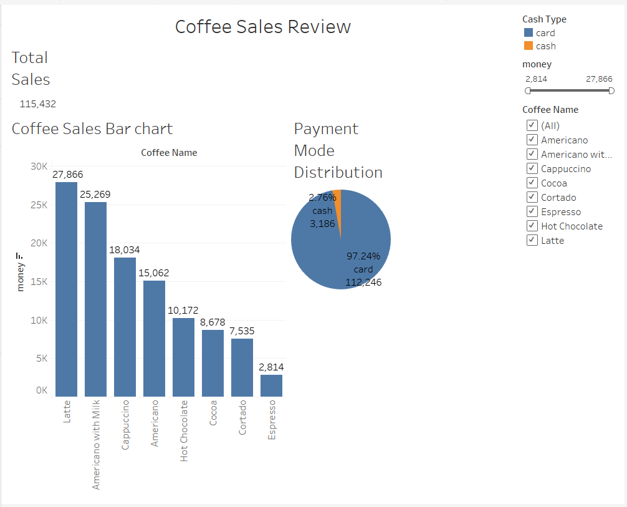
Final Dashboard – Coffee Sales Review

Slide 4
Key KPIs Visualized
🧾 Total Sales: ₹115,432
☕ Top-Selling Product: Latte (₹27,866)
💳 Payment Method Split:
- Card: ₹112,246 (97.24%)
- Cash: ₹3,186 (2.76%)

Slide 5
Key Insights from Dashboard
- Card payments dominate with over 97% of total revenue
- Latte and Americano with Milk are the top-selling items
- Espresso generates the lowest sales
- Dashboard provides quick insights into sales and customer behavior

