Slide 1

EV Fleet Monitoring and Predictive Analysis
Optimizing Performance and Efficiency with Data-Driven Insights

Slide 2
Introduction
This project focuses on developing a comprehensive solution for managing electric vehicle (EV) fleets with real-time monitoring and predictive analytics.
Designed to enhance operational efficiency, reduce costs, and support sustainability goals, this system provides fleet managers with critical insights and tools to manage EV performance, optimize routes, and schedule maintenance proactively.

Slide 3
Project Overview & Tech Stack
Programming Languages: Python for backend (Flask), with HTML and CSS for frontend development.
Platform: Deployed on a web-based platform that allows access via web browsers for both driver and manager interfaces.
Database: SQL-based database managed through SQLAlchemy for storing user data.
Fleet Monitoring Dashboard:
Real-time data on battery status and working condition.
Data Analytics:
Insights into usage patterns, and maintenance cost
Driver Behavior:
Analyze the driver behavior using speed of vehicle
Range Prediction:
To predict how much km vehicle can travel with respect to the battery levels.

Slide 4
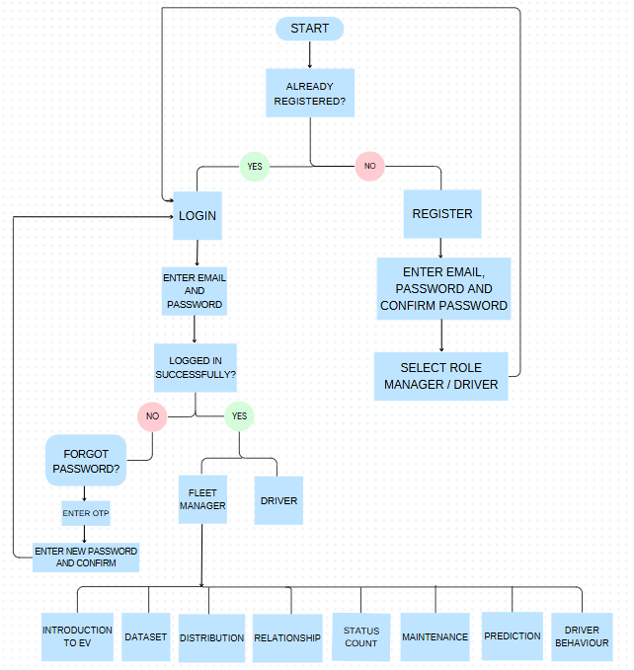
Flow Chart

Slide 5
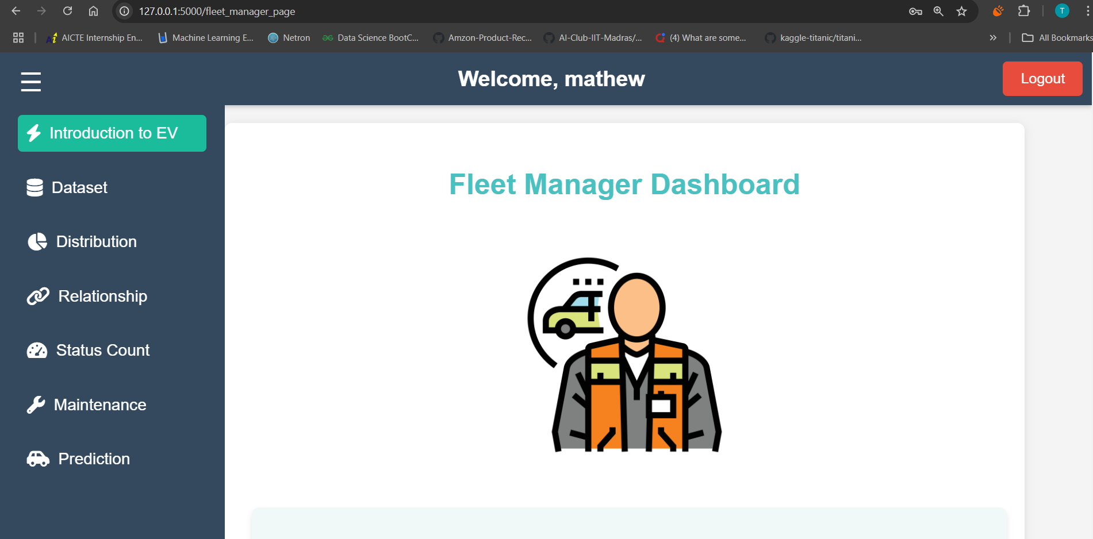
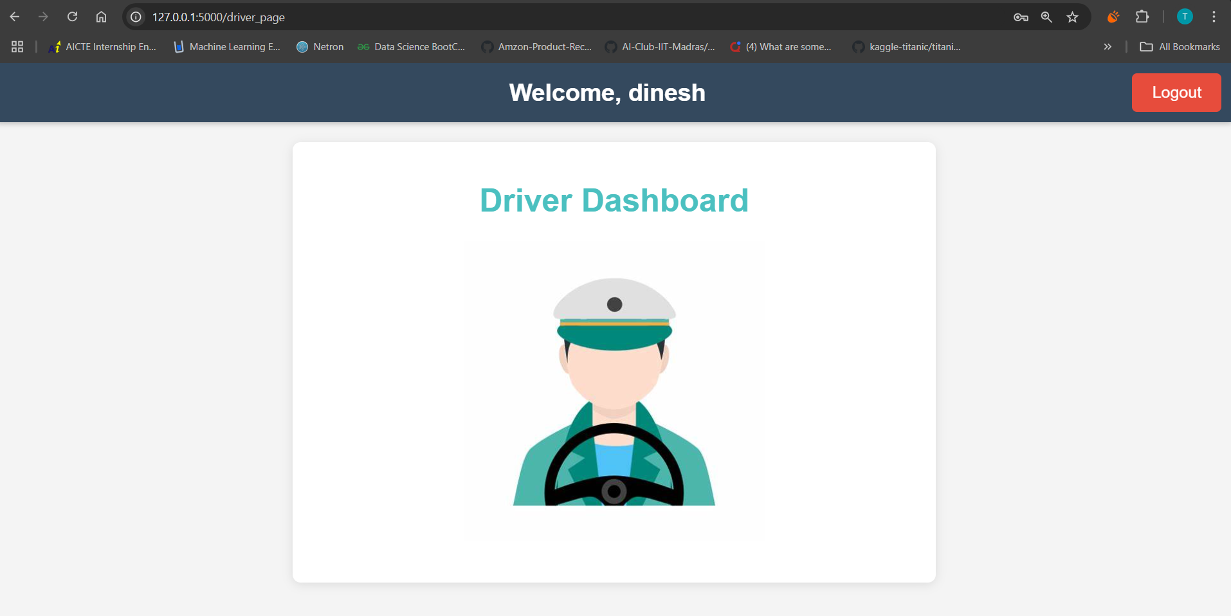
Home Page for Fleet Manager and Driver

Slide 6
Methodology
Data creation
Synthetic data generation
True data collection
Merging both data.
Splitting data into Train and Test data
Developing the ML models
Linear Regression
Ridge Regression
Elastic Net
Training the ML models
Testing the ML models
Comparing accuracies of ML models
Saving the best model for production
Feature Selection

Slide 7
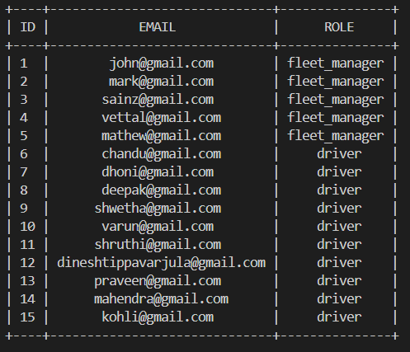
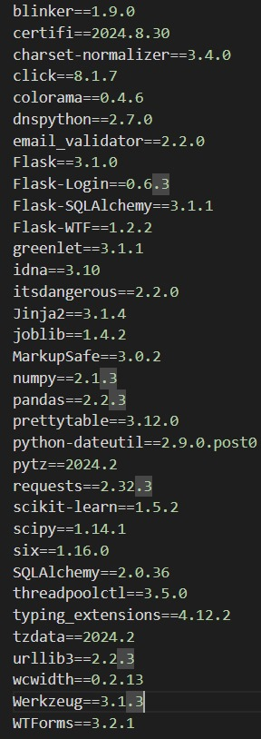
Registered users Database Details & Versions

Slide 8
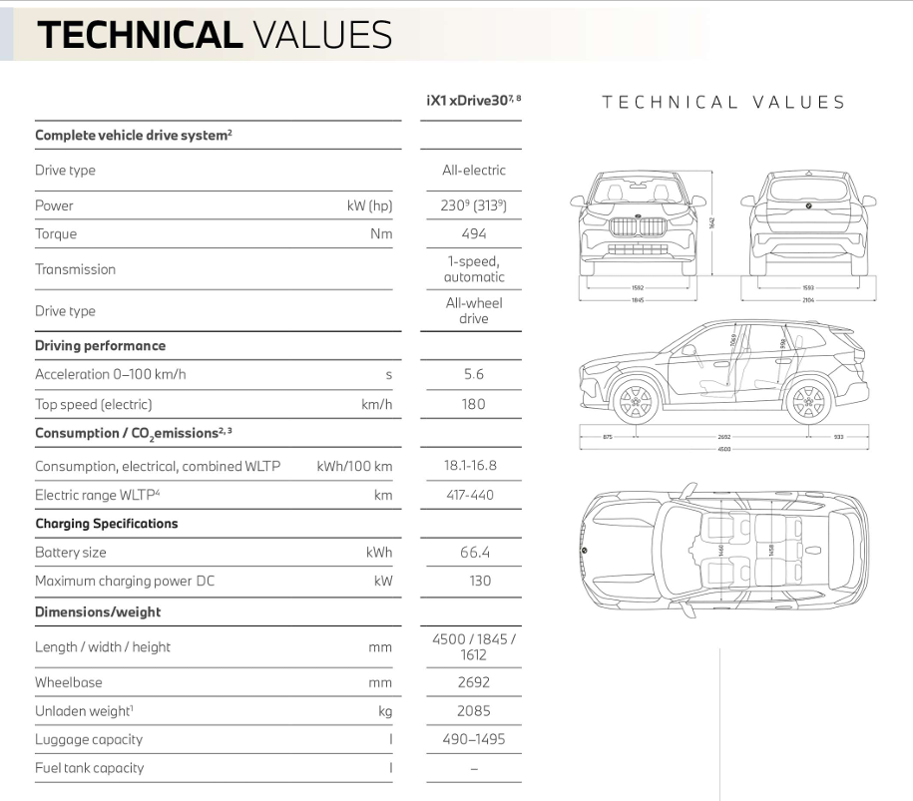
Data Features
Id : Unique id for vehicle
Make : Name of the vehicle manufacturer
Range(km) : Maximum distance travelled by vehicle for given battery level
Battery level(%) : Capacity of battery
Latitude, Longitude & Pincode : Tracks vehicle location
Maintenance cost and Charging cost($)
Energy Consumed(kW) : Energy consumed since vehicle started
Day-Month-Year: To retrieve user’s data on a specific day
Speed (km/h) : Speed at which vehicle moves
Working condition : Tells activity of vehicle
Charging status : Tells activity of battery

Slide 9
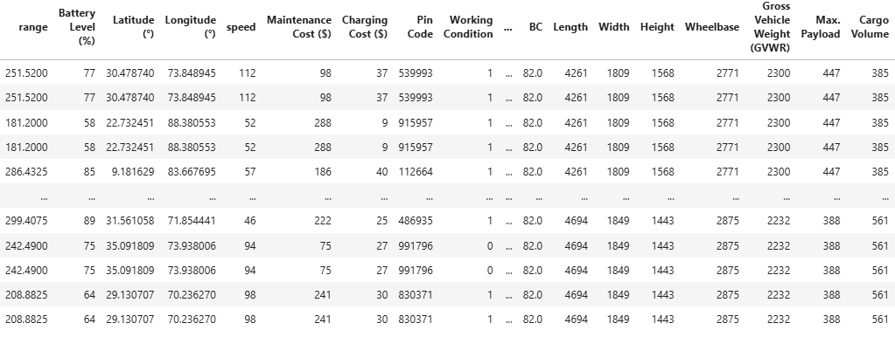
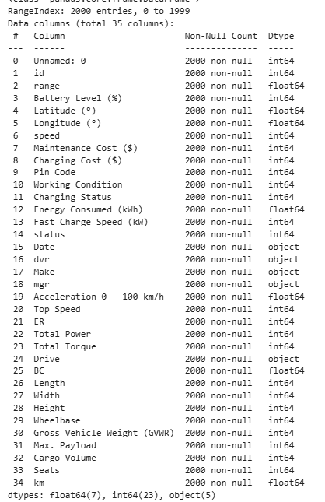
Synthetic Dataset Creation and Sample Data
We have created a synthetic dataset with some set of predefined rules that has 2000 rows of data and 34 parameters. This dataset is for a period of 1 year, covering 5 electric vehicles.

Slide 10
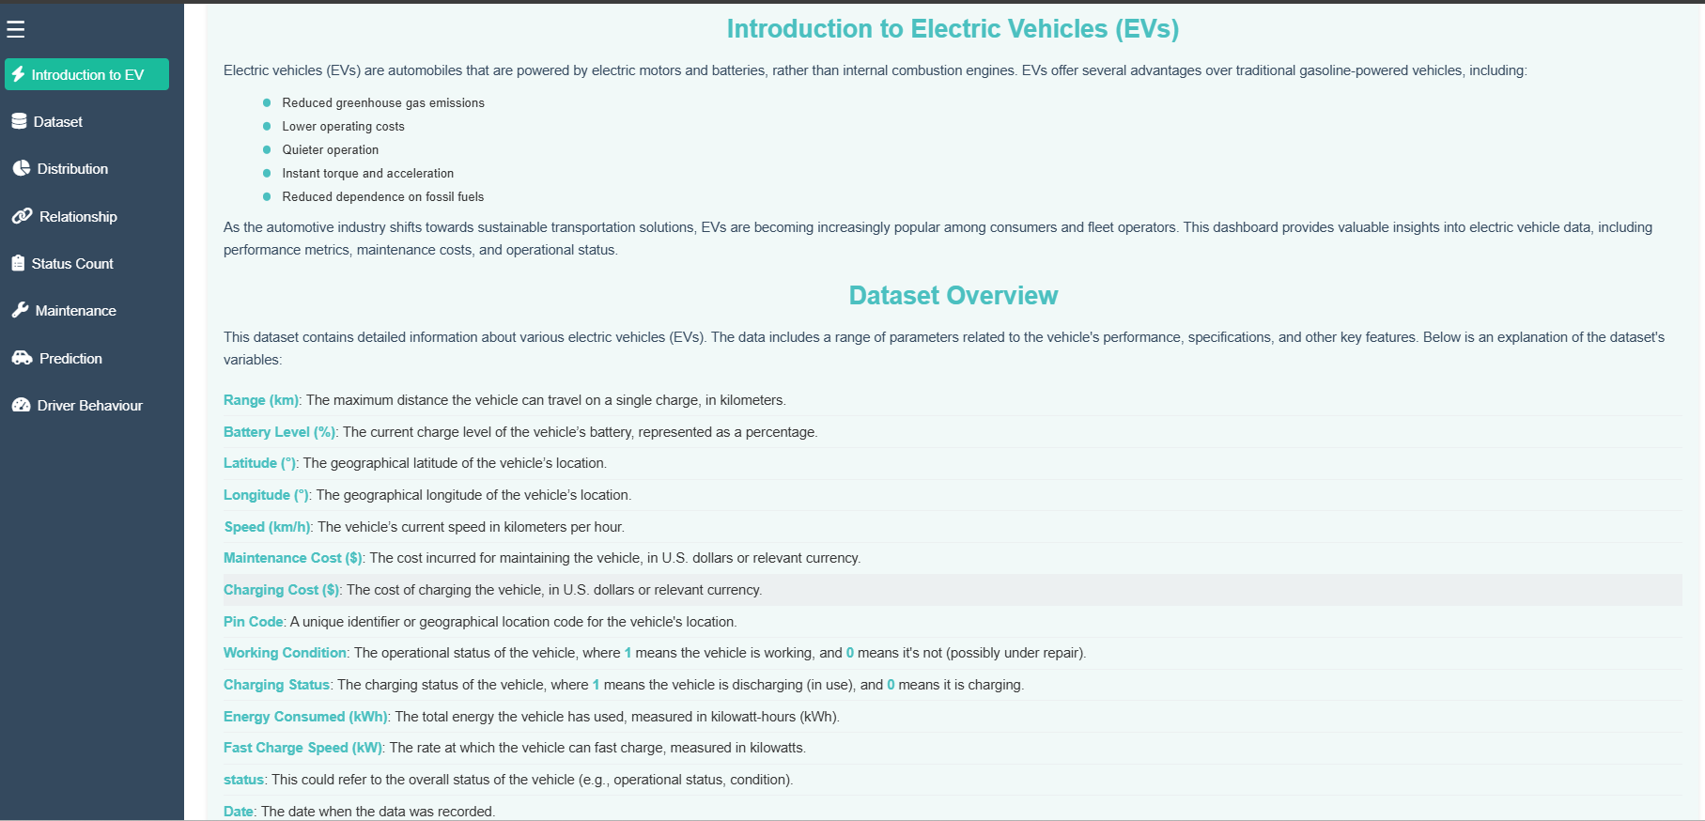
Dash Board - Introduction

Slide 11
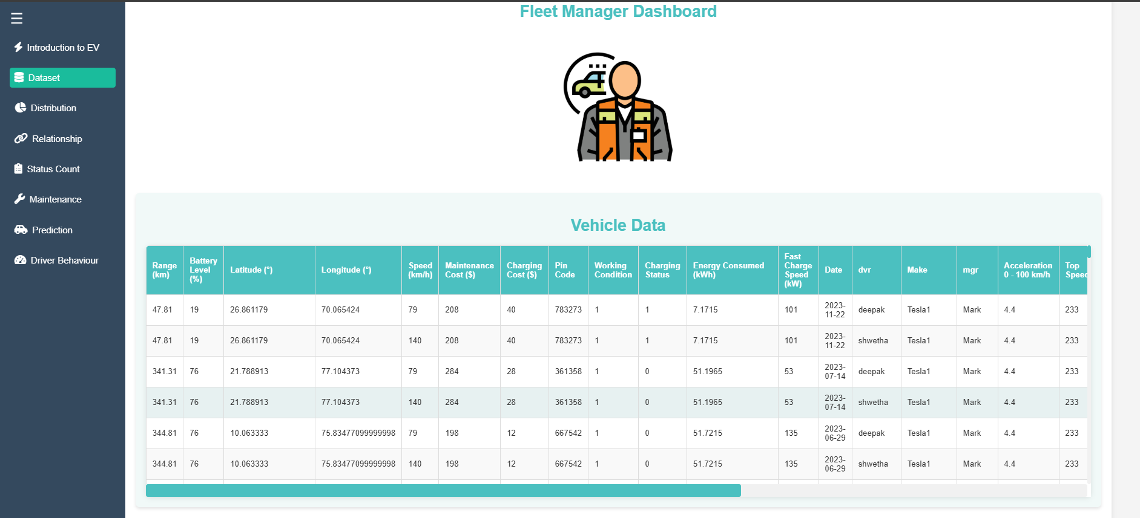
Dash Board - Dataset

Slide 12
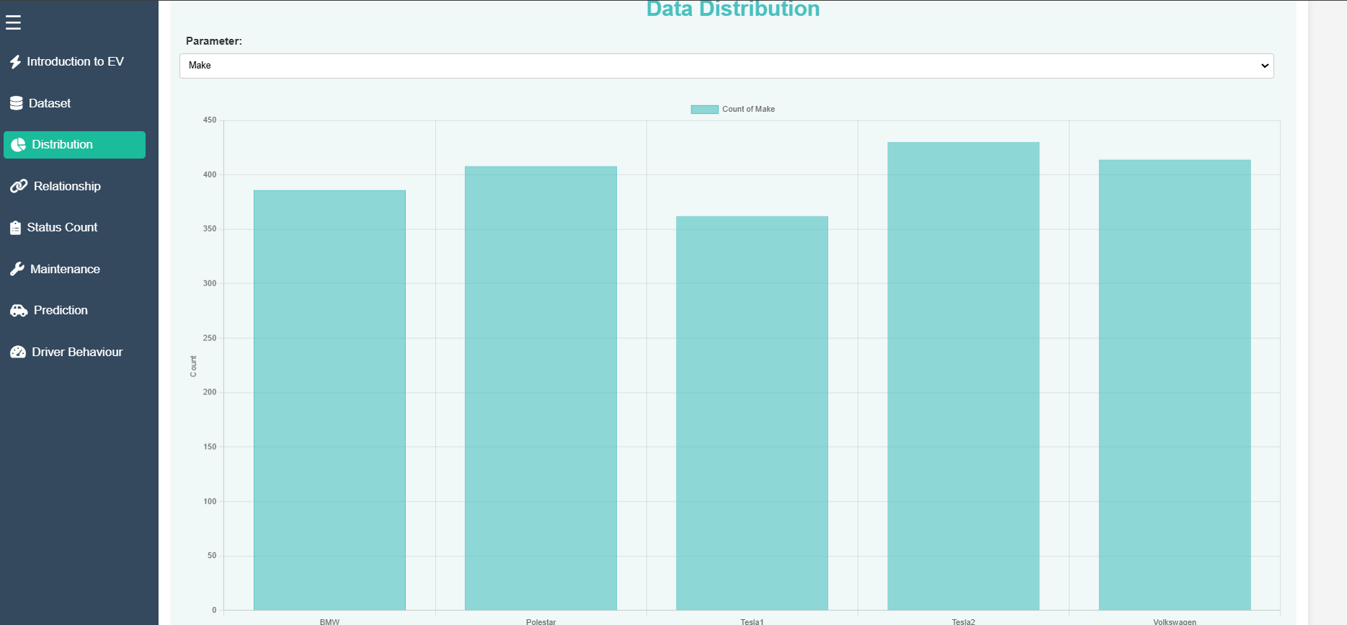
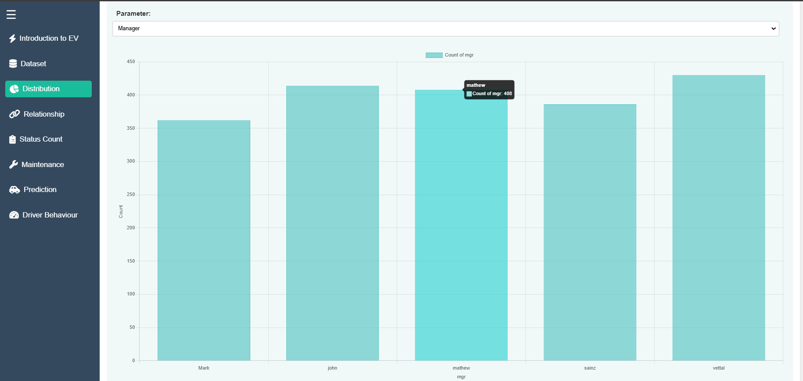
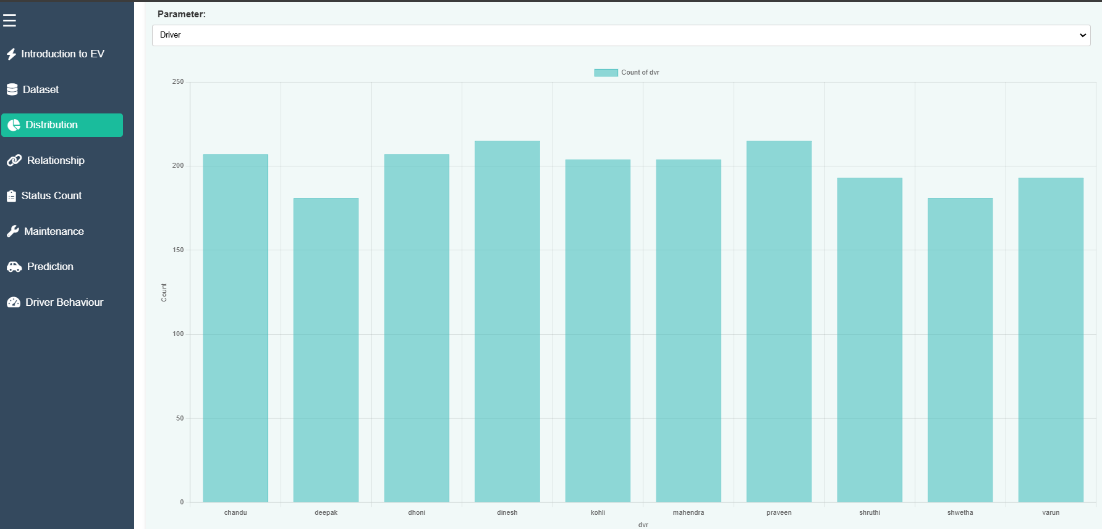
Dash Board - Distribution

Slide 13
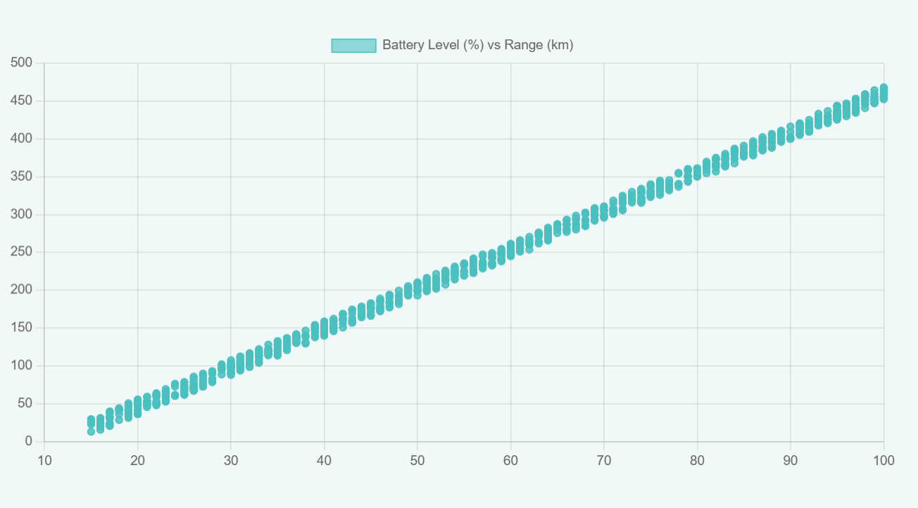
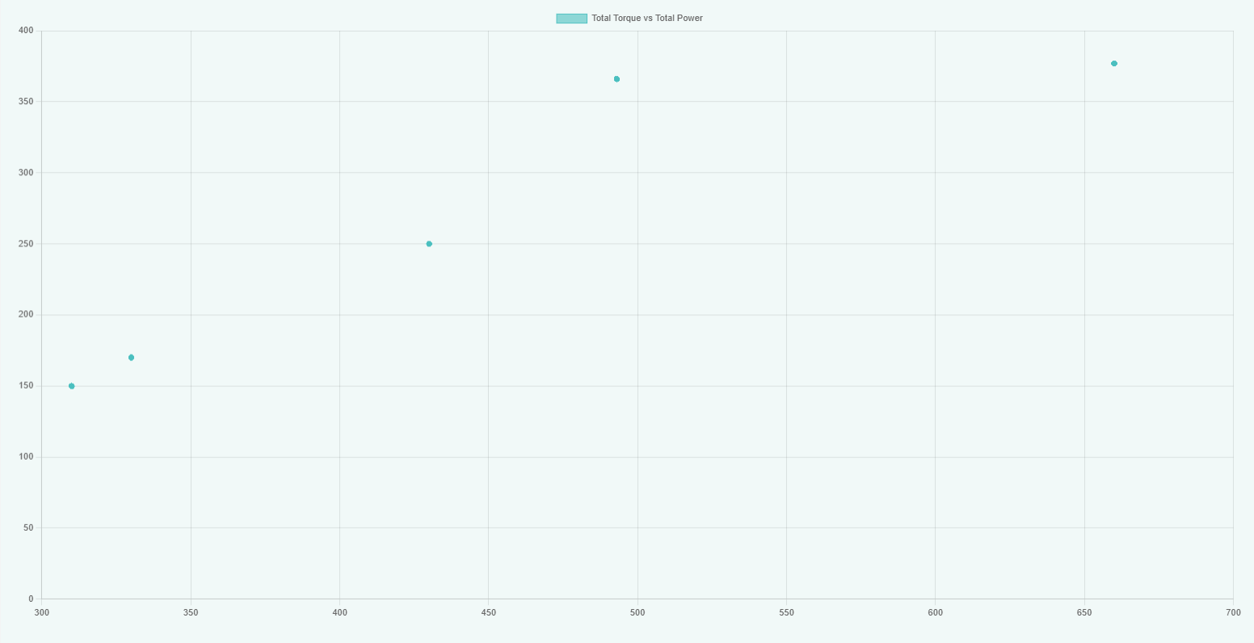
Dash Board - Relationship

Slide 14
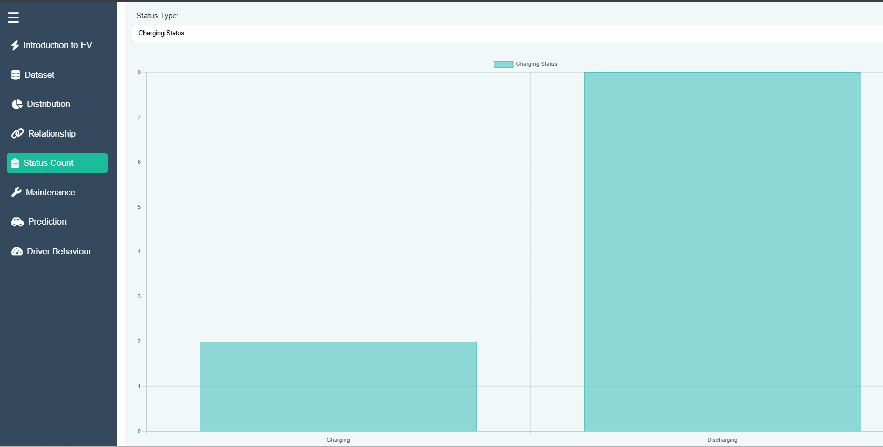
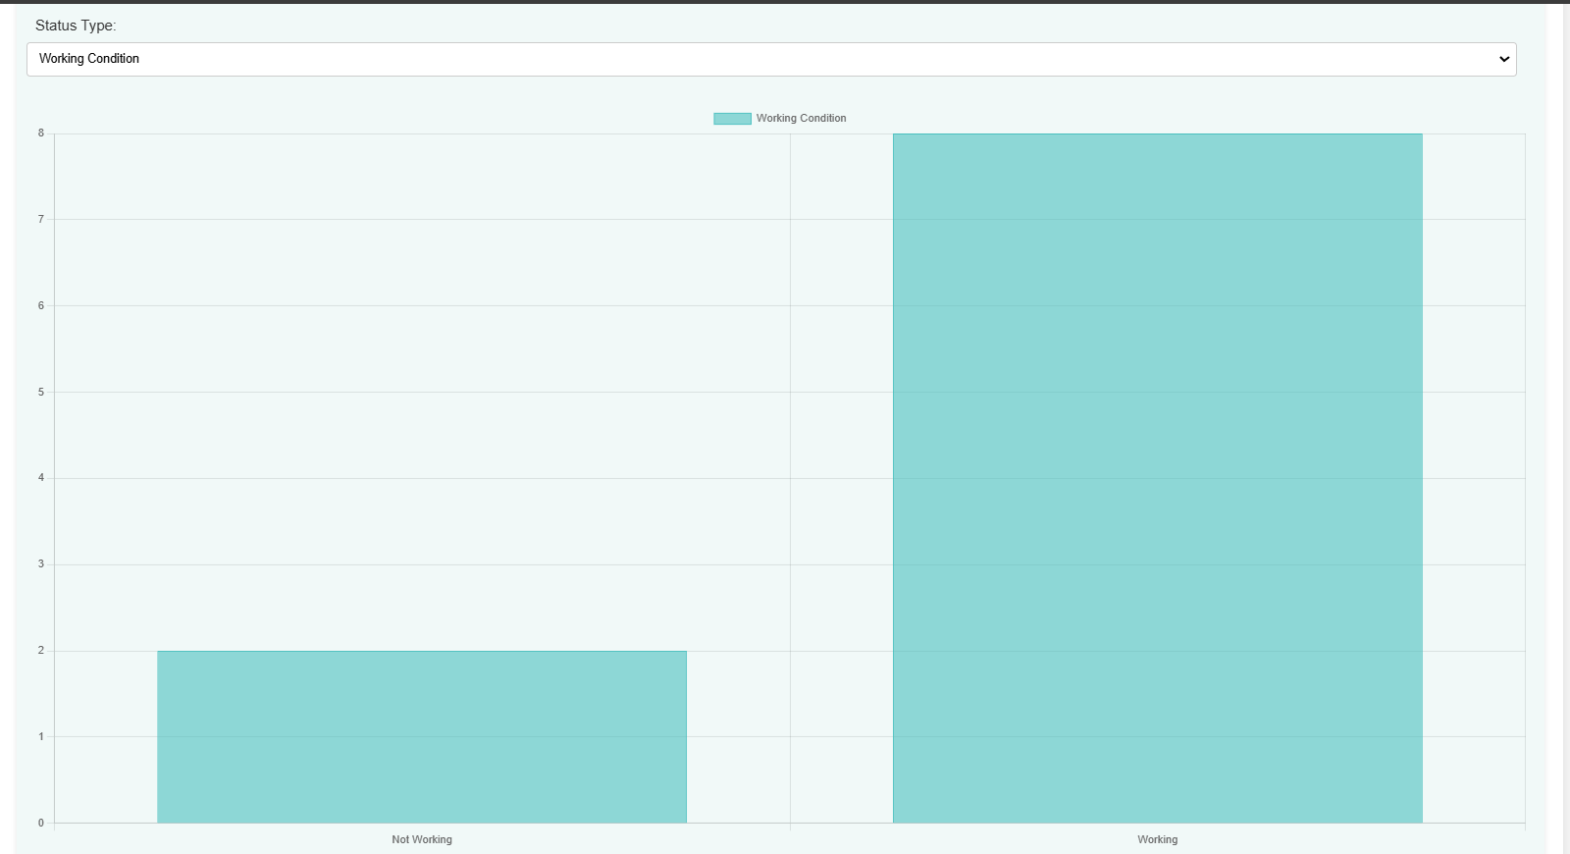
Dash Board – Status Count

Slide 15
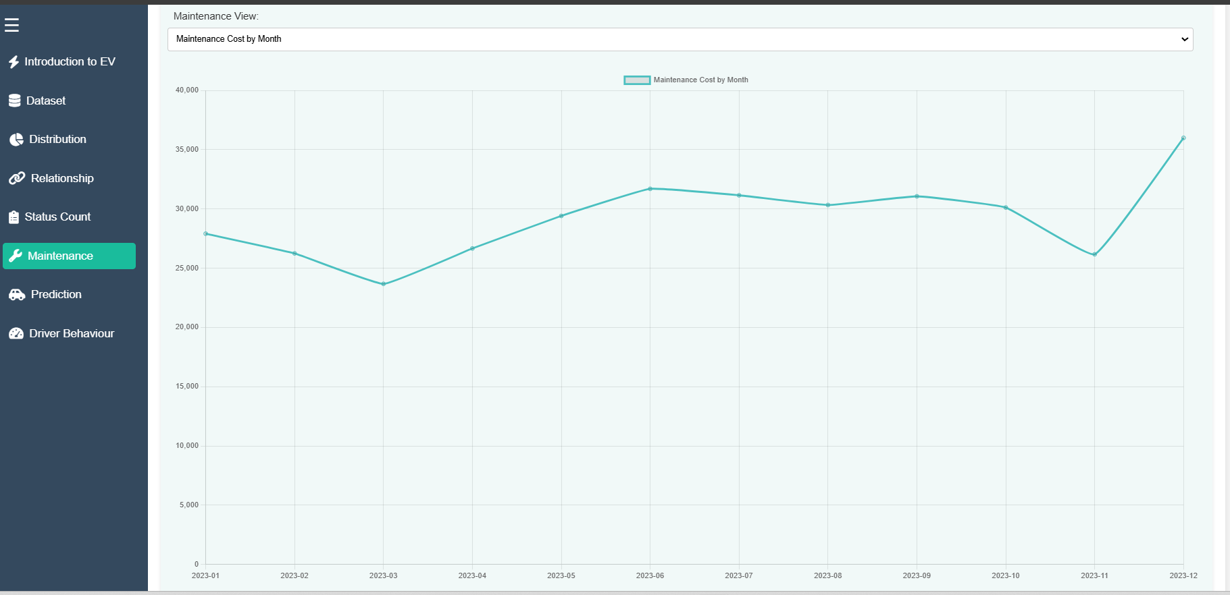
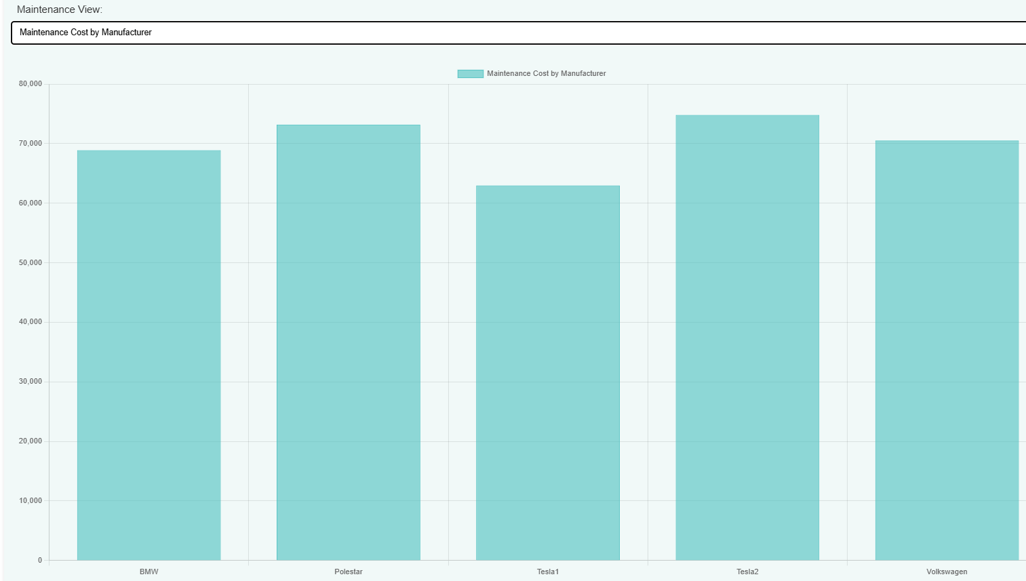
Dash Board – Maintenance Cost

Slide 16
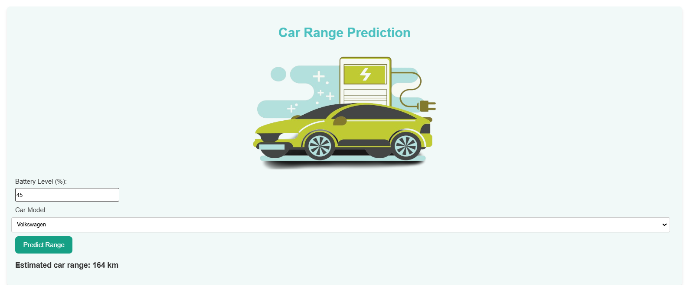
Dash Board - Prediction

Slide 17
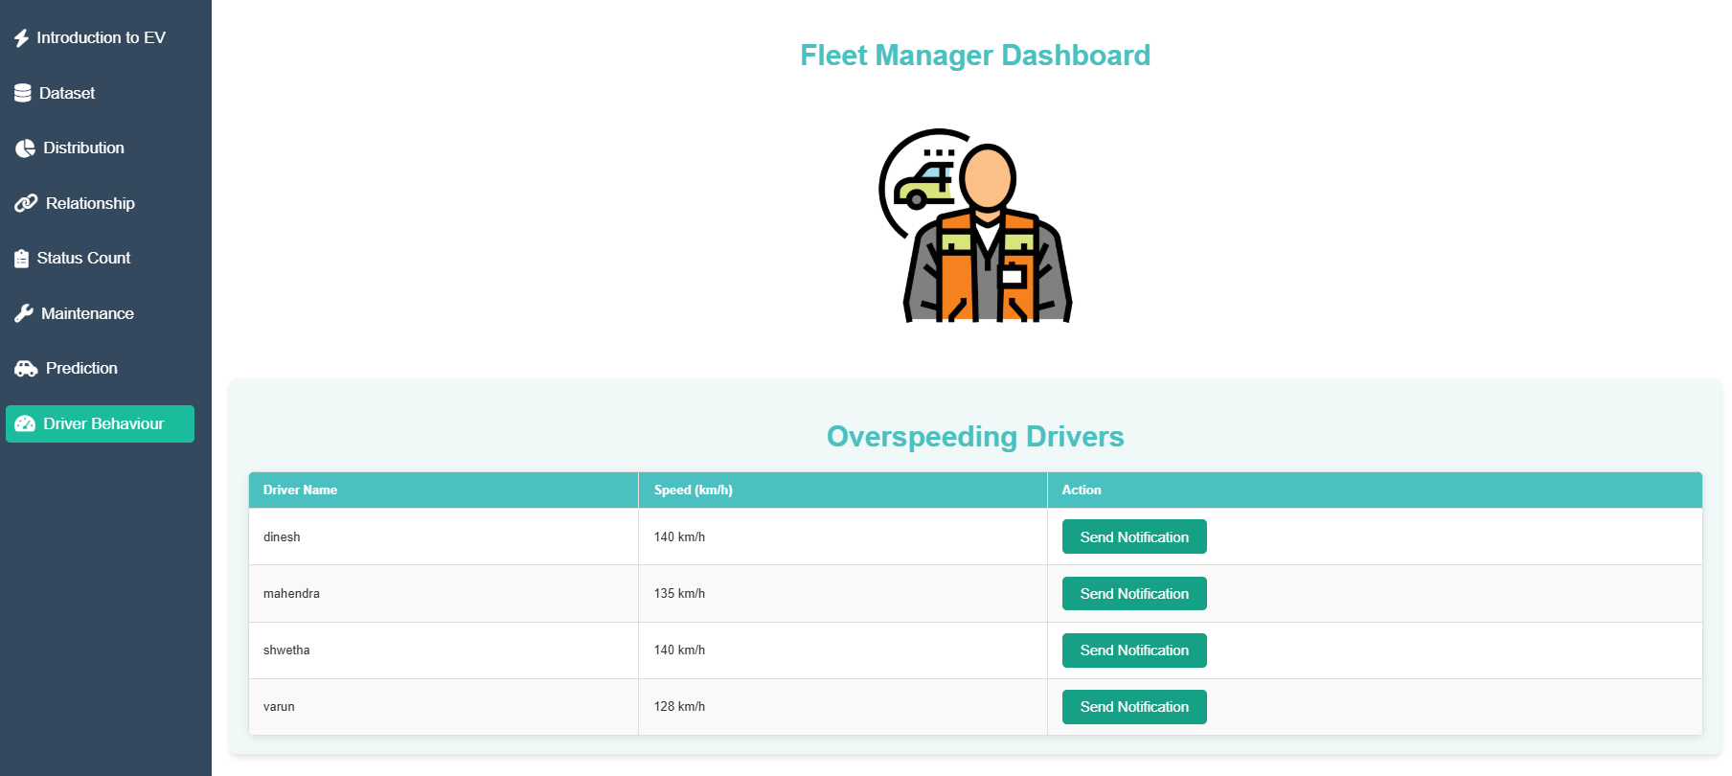
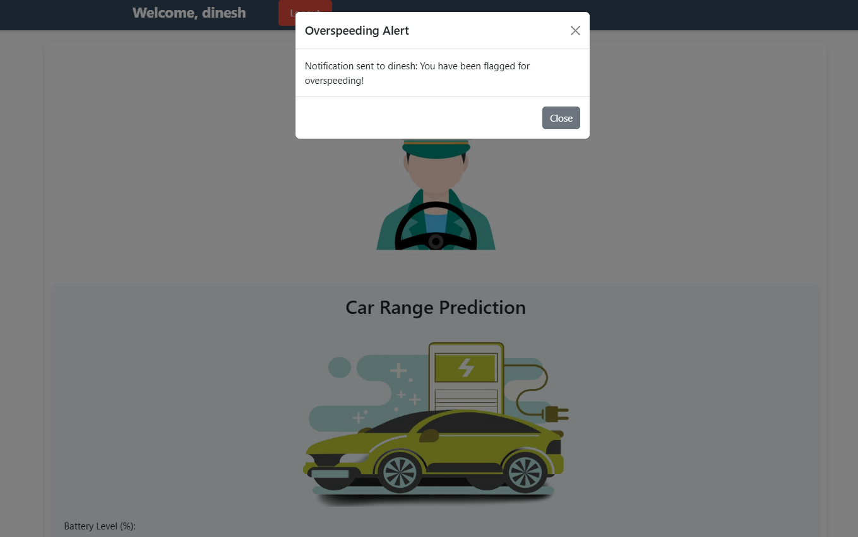
Dash Board – Over speeding

Slide 18
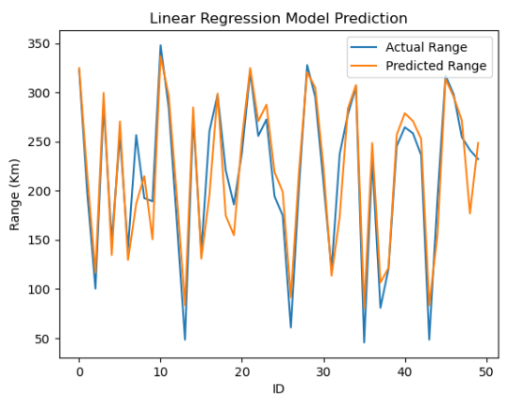
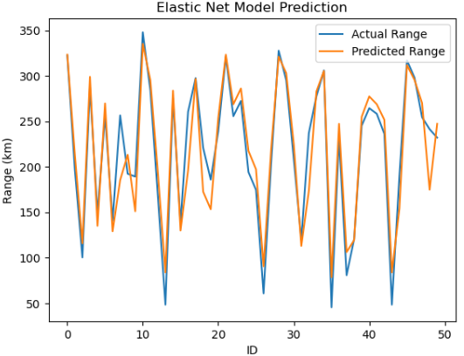
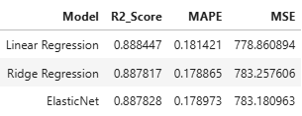
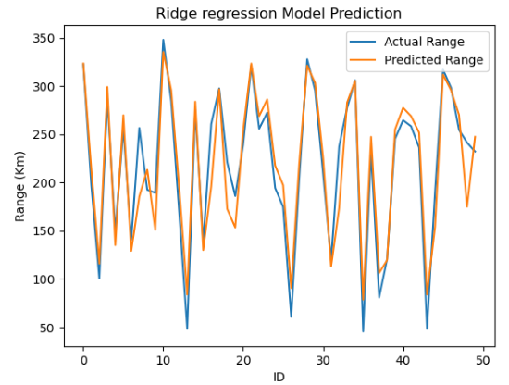
Model predictions (Actual Vs Predicted)

Slide 19
Results
Vehicle Range Prediction:
The predictive model estimates the vehicle range based on features like battery level, car model, and specifications.
For a specific input, the model predicted an estimated car range of X km (value from
Fleet Condition Analysis:
The last recorded statuses of fleet vehicles reveal:
Working Condition: Majority are operational.
Charging Status: Significant percentage of vehicles in an idle or charging state.
Maintenance Insights:
Total maintenance cost distribution:
By Manufacturer: Specific brands incurred higher maintenance costs based on fleet performance.
By Month: Maintenance expenses peaked during certain months, indicating periodic trends.
Model Performance:
The pre-trained model achieved high accuracy for predicting EV ranges.
The model performs consistently across multiple car brands (Tesla, BMW, Volkswagen, Polestar), confirming its versatility.
Example prediction:
test results).

Slide 20
Our Team Members
Vishwa Jothi
Sahana
Dinesh
Anshika
Leela Chaitanya

