Slide 1
Client-Side Personal Finance Management (PFM) Web Application
MTECH CSE
25CS5102- Frontend Development Project
Academic Year 2024–2025
Vishwa Teja (2501050050)| SivaGanesh EDE(2501050079)
Tutor: Chaitanya Krishna B
Notes:
Introduce the project and team.

Slide 2
Abstract
Client-side personal finance management web application
Designed for students and young adults
Offline-capable using browser localStorage
No backend or cloud dependency
Charts for expense analysis

Slide 3
Introduction
Managing finances is challenging for students
Existing tools are complex and internet dependent
Privacy concerns with cloud-based apps
Need for a simple and secure solution

Slide 4
Objectives
Develop an intuitive finance tracker
Track expenses and budgets in real time
Visualize spending patterns
Ensure offline access and privacy

Slide 5
System Architecture
Client-side web architecture
HTML, CSS, JavaScript
localStorage for data persistence
Chart.js for visualization

Slide 6
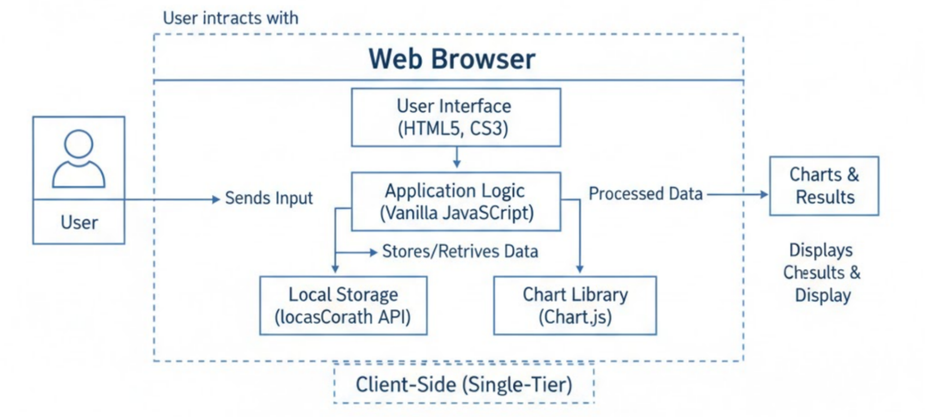
Architecture Diagram

Slide 7
Existing System & Disadvantages
Manual or cloud-based tracking
Internet dependency
Privacy risks
Complex user interfaces

Slide 8
Proposed System
Fully client-side application
Offline and privacy focused
Real-time calculations
Simple UI

Slide 9
User Interface
Dashboard
Analytics Page
Charts Page
Summary Page

Slide 10
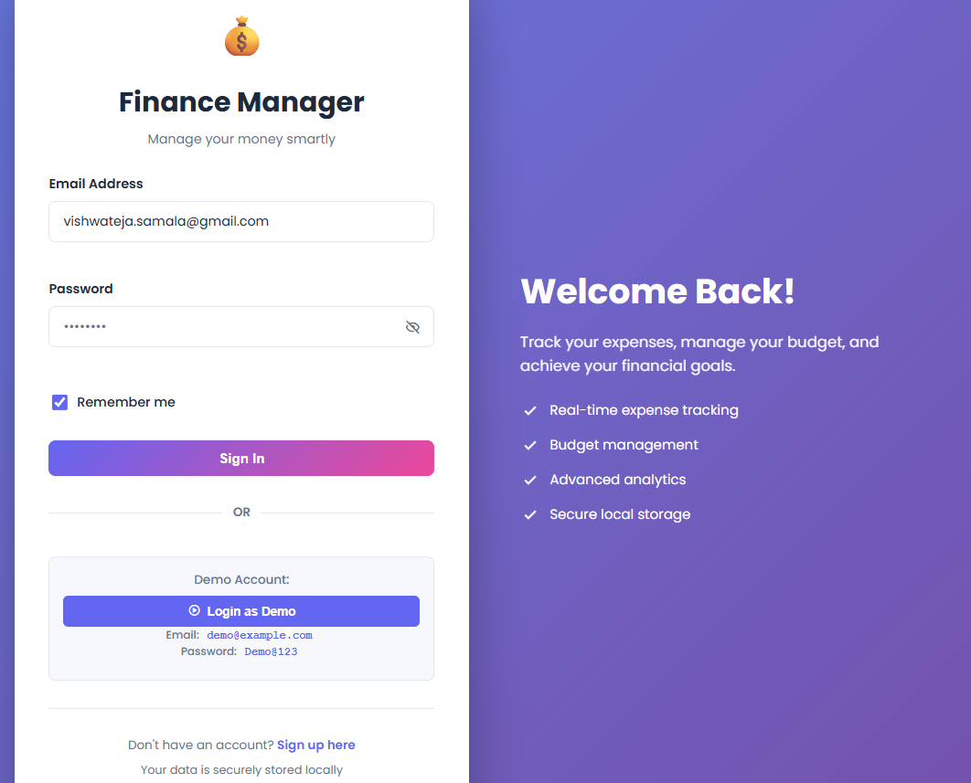
Application Screenshots
1. LOGIN PAGE
The Login Page allows users to securely access the application using email and password, with validation and a demo login option for quick access.

Slide 11
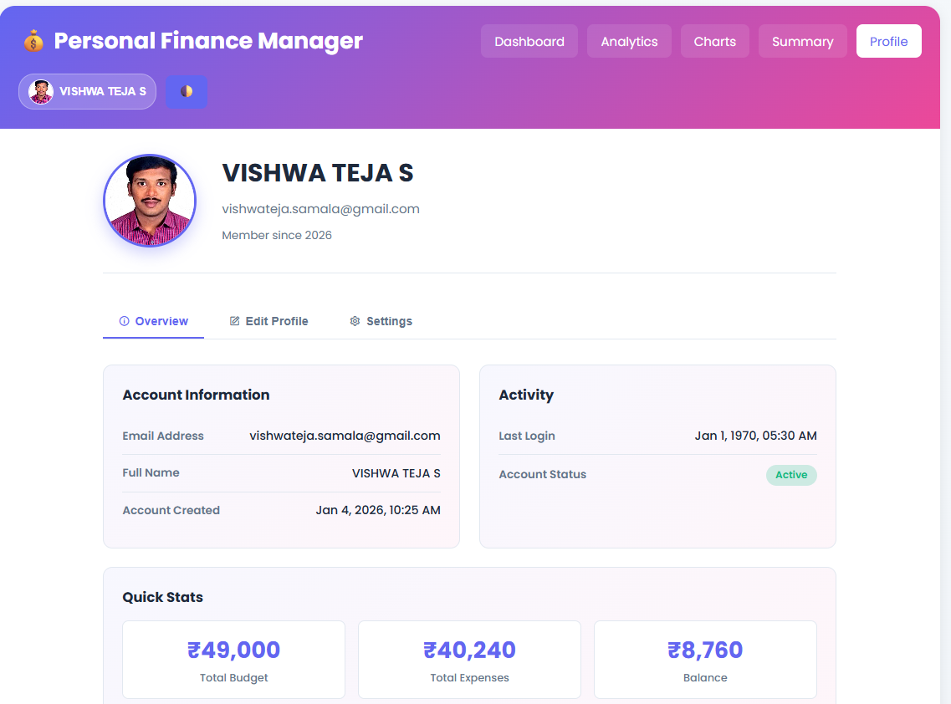
Application Screenshots
2. PROFILE PAGE
The Profile Page displays user details such as name, email, account status, and quick financial statistics, allowing users to view and manage their profile information.

Slide 12
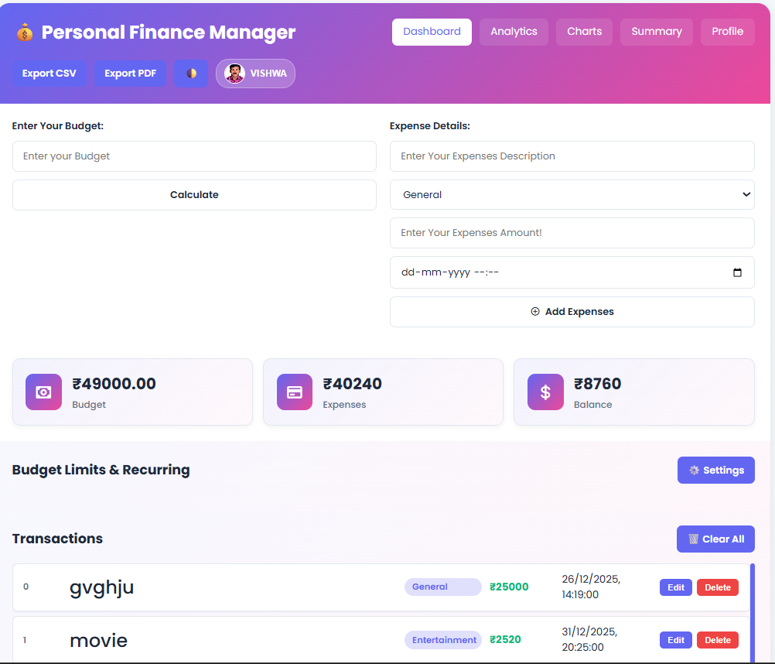
Application Screenshots
3 DASHBOARD PAGE
The Dashboard provides an overview of budget, total expenses, and remaining balance, along with options to add, edit, and delete expense transactions in real time.

Slide 13
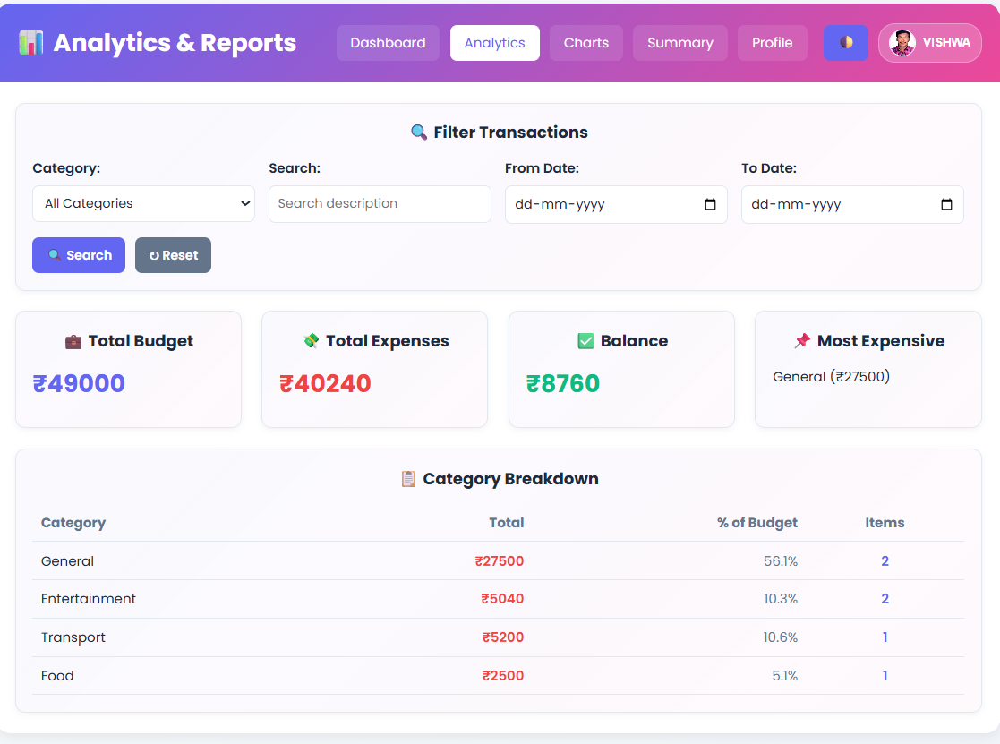
Application Screenshots
4. ANALYTICS PAGE
The Analytics Page offers detailed financial insights through filters, category-wise breakdowns, and key metrics such as most expensive category and balance status.

Slide 14
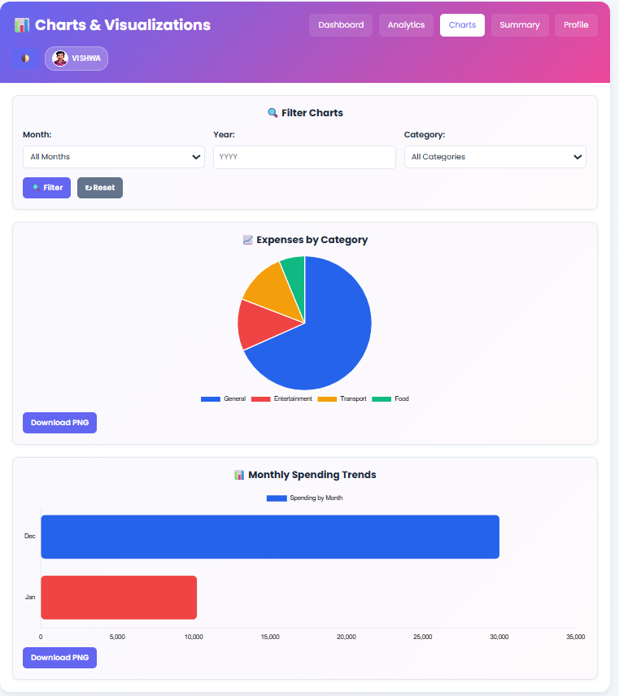
Application Screenshots
5. CHARTS PAGE
The Charts Page visually represents spending patterns using pie and bar charts, helping users analyse expenses by category and month effectively.

Slide 15
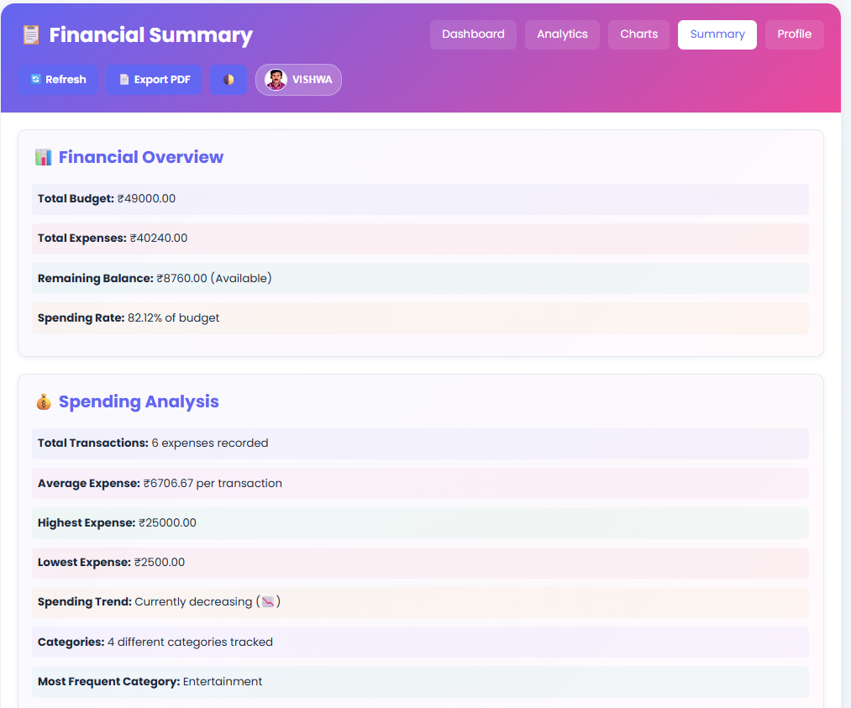
Application Screenshots
6 SUMMARY PAGE
The Summary Page presents a consolidated financial overview including total budget, expenses, balance, spending rate, and transaction analysis for quick decision-making.

Slide 16
Database Connectivity
Uses browser localStorage instead of traditional database
Data stored in JSON format
Supports Create, Read, Update, Delete operations
Data persists even after page reload
Ensures privacy and offline functionality

Slide 17
Results
Accurate expense tracking and budget updates
Real-time dashboard and analytics
Charts update dynamically based on data
Data retained after refresh
High usability and stable performance

Slide 18
Conclusion
Successfully developed a lightweight PFM application
Meets all projects objectives
Suitable for students and first-time budgeters

Slide 19
Future Enhancements
Cloud synchronization
User authentication
Bank Integration
AI- based spending predictions
Mobile app support

Slide 20
THANK YOU

