Slide 1
Template Design Final
8th July

Slide 2

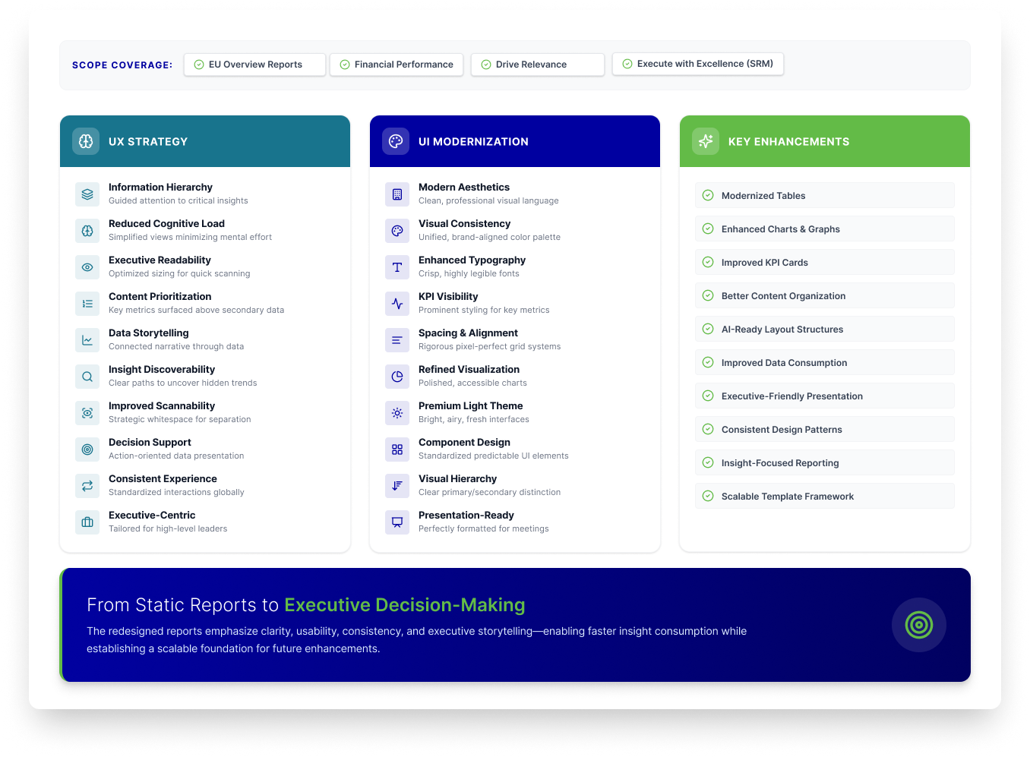
Overview Summary

Slide 3


EU Overview
Financial Performance
Drive Relevance
Execute with Excellence (SRM)
A consolidated view of key metrics and insights, enabling quick assessment of overall business performance.
Improved visibility into key financial metrics, enabling faster and more informed business decisions.
Delivered actionable insights tailored to stakeholder priorities, ensuring focus on what matters most.
Streamlined reporting experiences through intuitive design, enhanced usability, and operational efficiency.

Slide 4
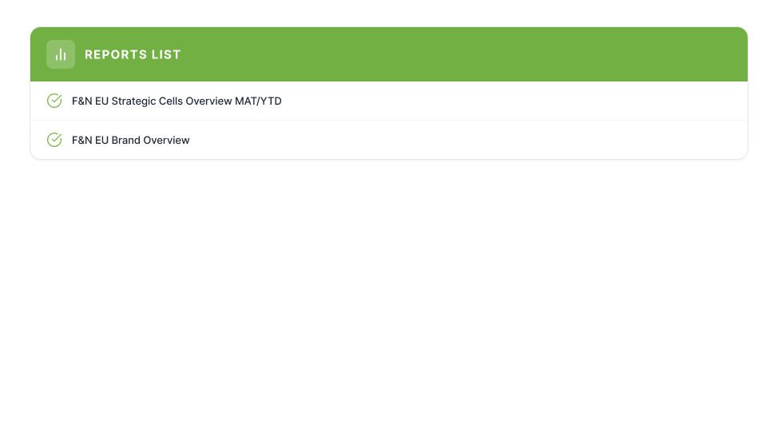
EU Overview Reports Coverage

Slide 5
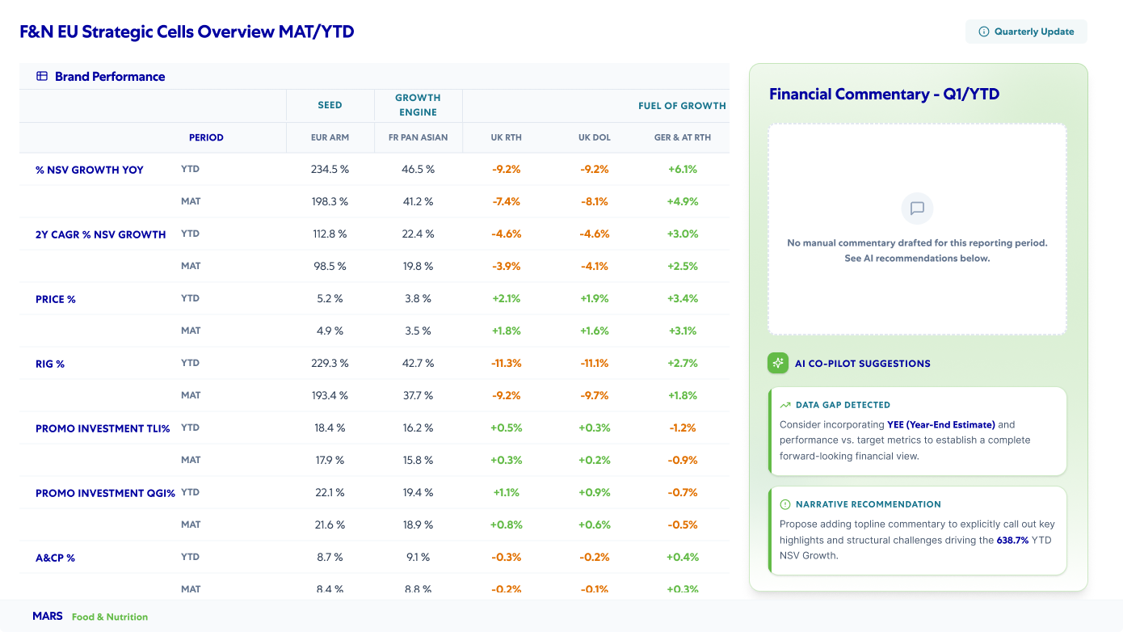
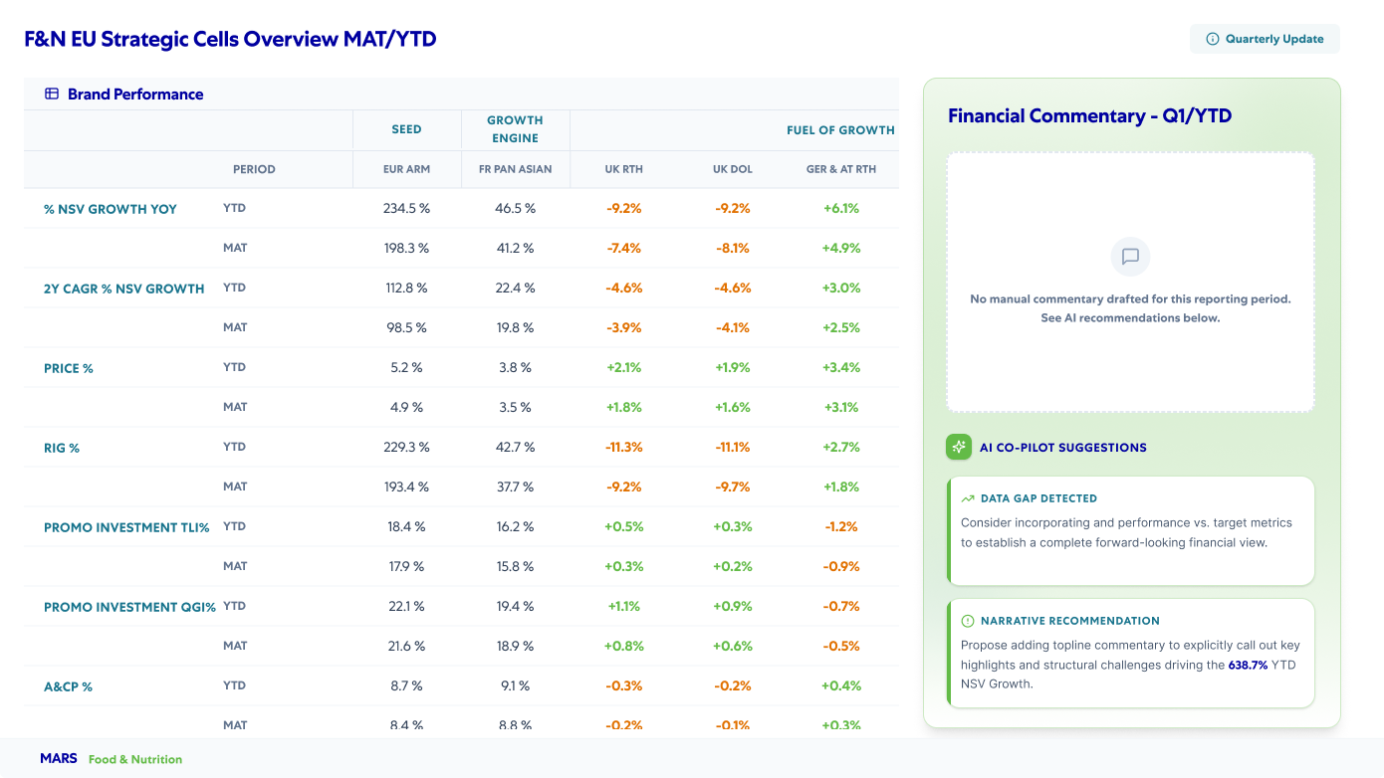
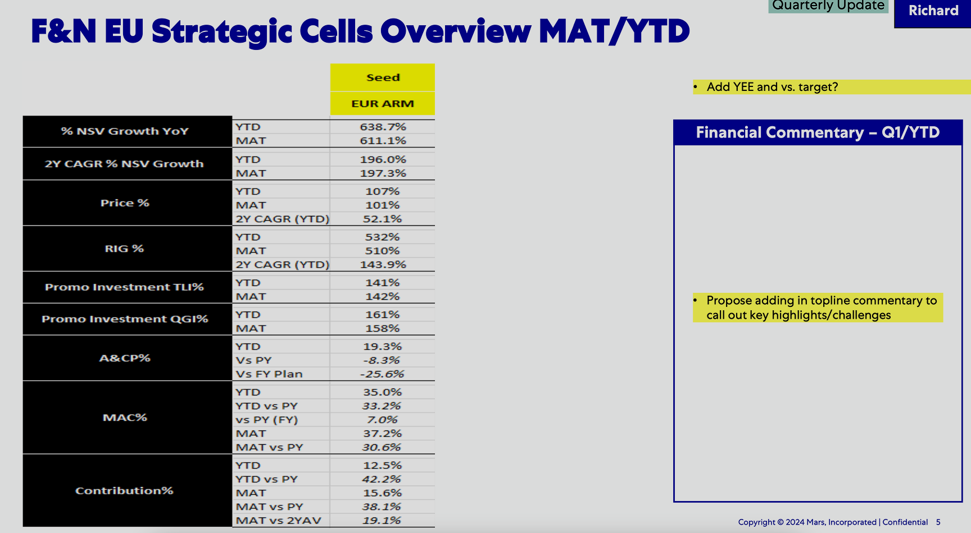





F&N EU Strategic Cells Overview MAT/YTD
Dashboard Redesign. Before & After Comparison
Updated Version
Redesigned for clarity and performance
Previous Version
02
DESIGN PRINCIPLES & VALUE ADDITIONS
Maximized Whitespace
Structured Layout
AI Integration
Professional Palette
Modern Components
Replaces heavy black blocks with crisp text and subtle dividers. This creates an airy layout that makes the data significantly easier to scan.
Eliminates messy, floating sticky notes in favor of a dedicated side panel. This clearly separates the financial commentary from the quantitative data table.
Introduces an "AI Co-Pilot" to provide proactive, structured insights. This adds major functional value by automatically highlighting data gaps and narrative recommendations.
Swaps jarring black and bright yellow for soft greens and deep blues. This refined color scheme reduces visual fatigue and modernizes the corporate aesthetic.
Upgrades rigid spreadsheet cells into clean, modular UI cards. Elements like pill-shaped status tags and intuitive icons greatly improve overall usability.

Slide 6
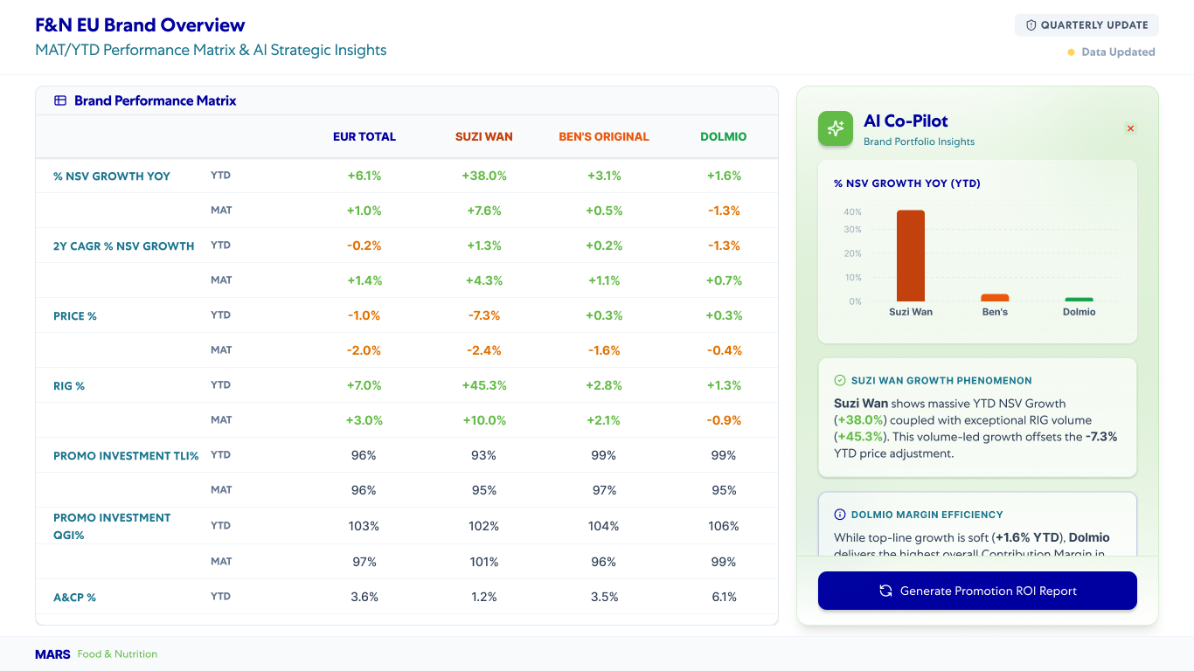
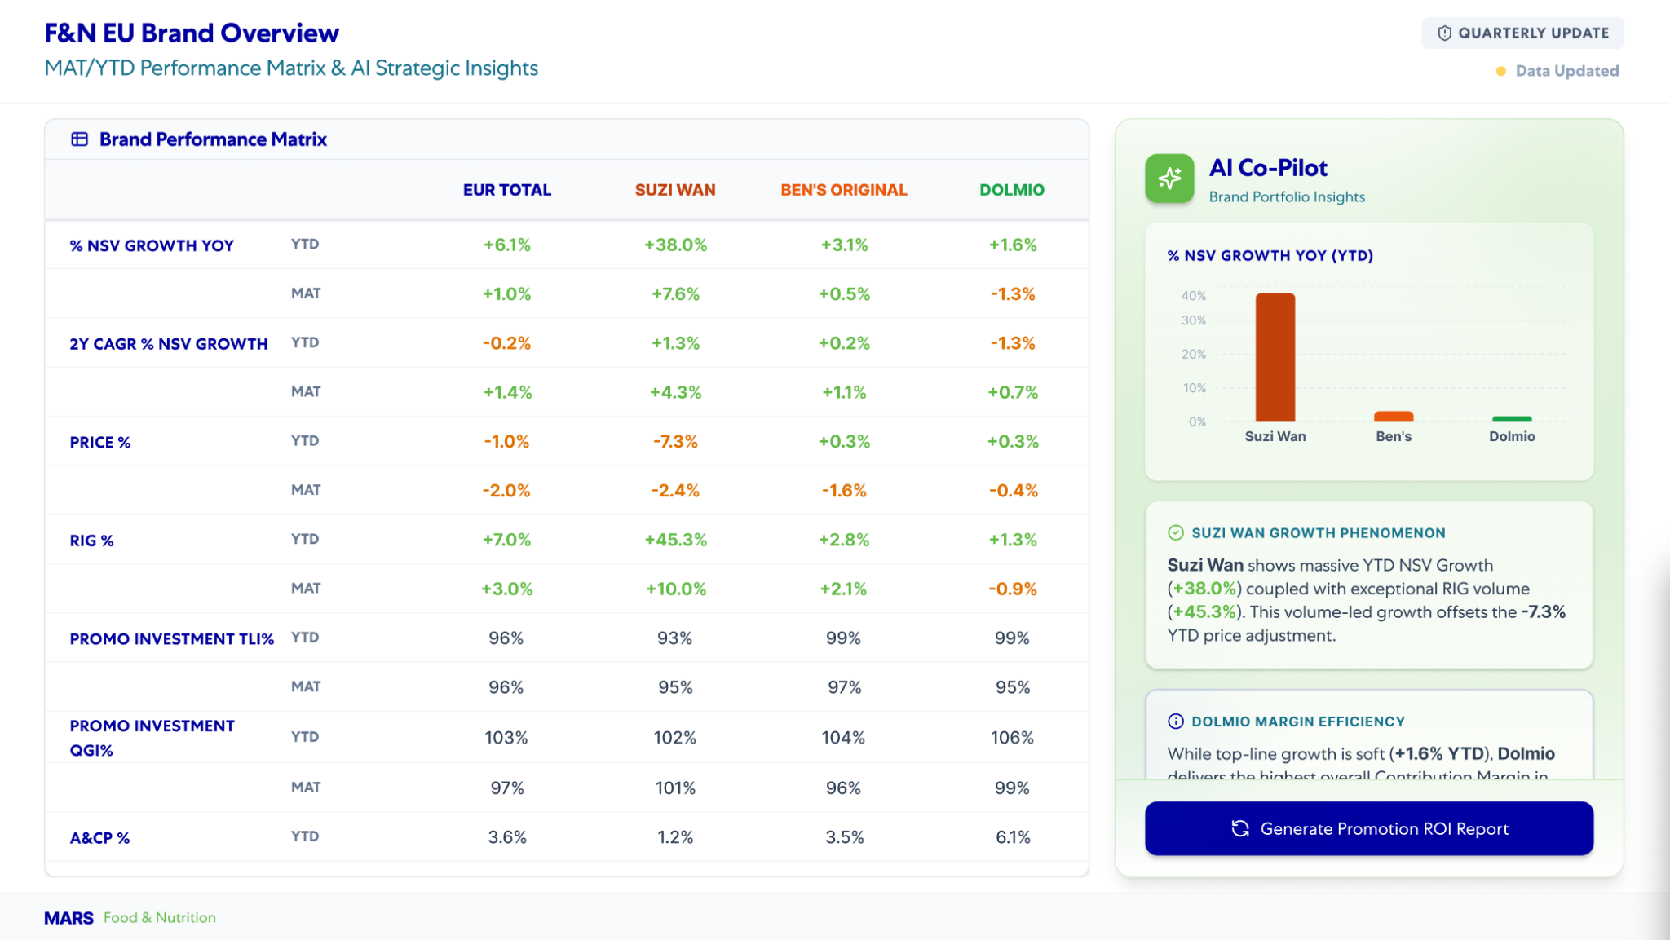
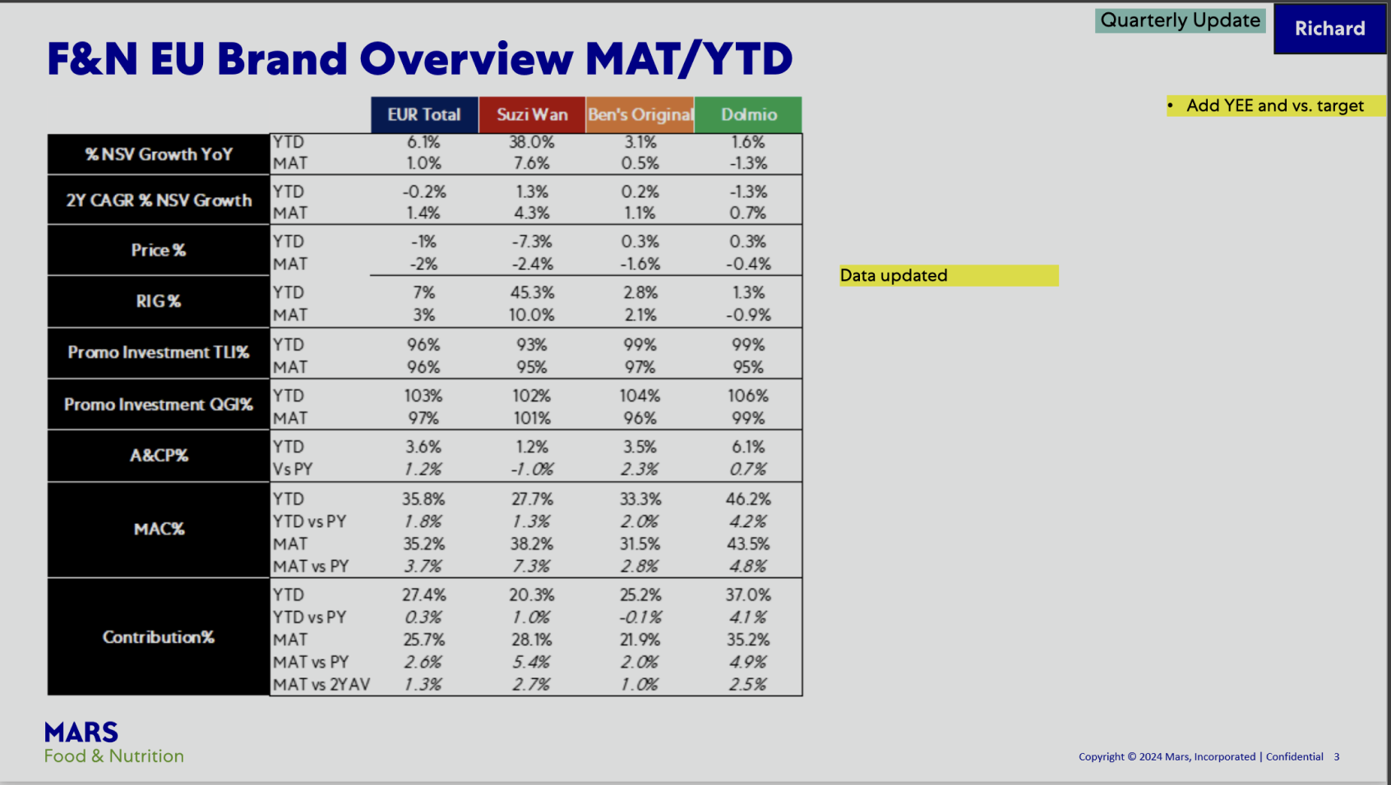
F&N EU Brand Overview
Dashboard Redesign. Before & After Comparison
Updated Version
Redesigned for clarity and performance
Previous Version
02
DESIGN PRINCIPLES & VALUE ADDITIONS
Maximized Whitespace
Structured Layout
AI Integration
Professional Palette
Modern Components
Replaces heavy black blocks with crisp text and subtle dividers. This creates an airy layout that makes the data significantly easier to scan.
Eliminates messy, floating sticky notes in favor of a dedicated side panel. This clearly separates the financial commentary from the quantitative data table.
Introduces an "AI Co-Pilot" to provide proactive, structured insights. This adds major functional value by automatically highlighting data gaps and narrative recommendations.
Swaps jarring black and bright yellow for soft greens and deep blues. This refined color scheme reduces visual fatigue and modernizes the corporate aesthetic.
Upgrades rigid spreadsheet cells into clean, modular UI cards. Elements like pill-shaped status tags and intuitive icons greatly improve overall usability.

Slide 7
EU Overview
Financial Performance
Drive Relevance
Execute with Excellence (SRM)
A consolidated view of key metrics and insights, enabling quick assessment of overall business performance.
Improved visibility into key financial metrics, enabling faster and more informed business decisions.
Delivered actionable insights tailored to stakeholder priorities, ensuring focus on what matters most.
Streamlined reporting experiences through intuitive design, enhanced usability, and operational efficiency.

Slide 8
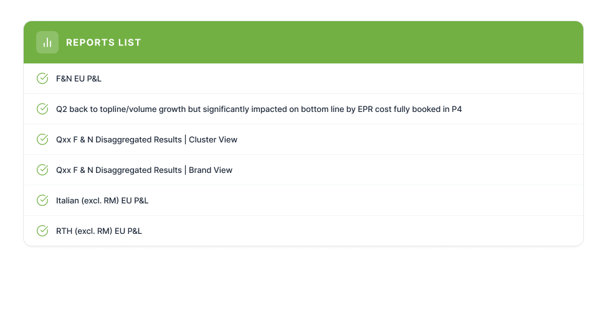
Financial Performance Reports Coverage

Slide 9
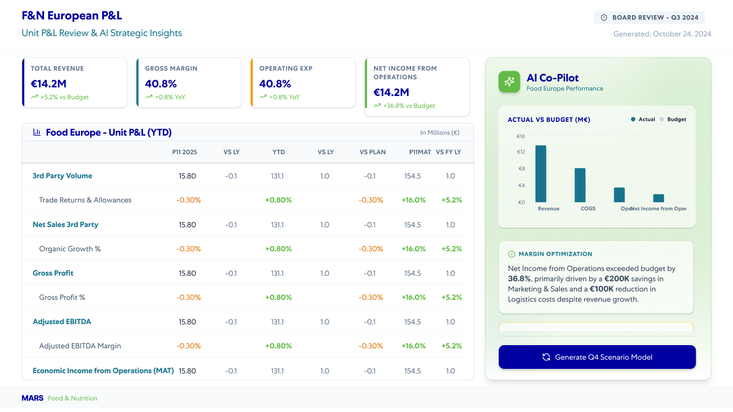
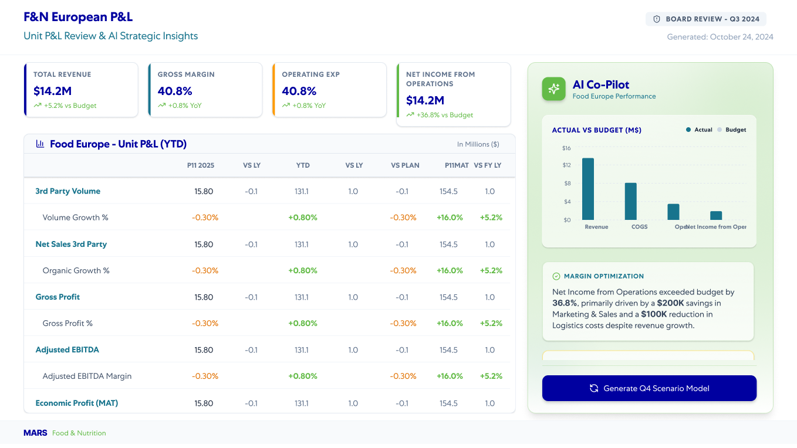
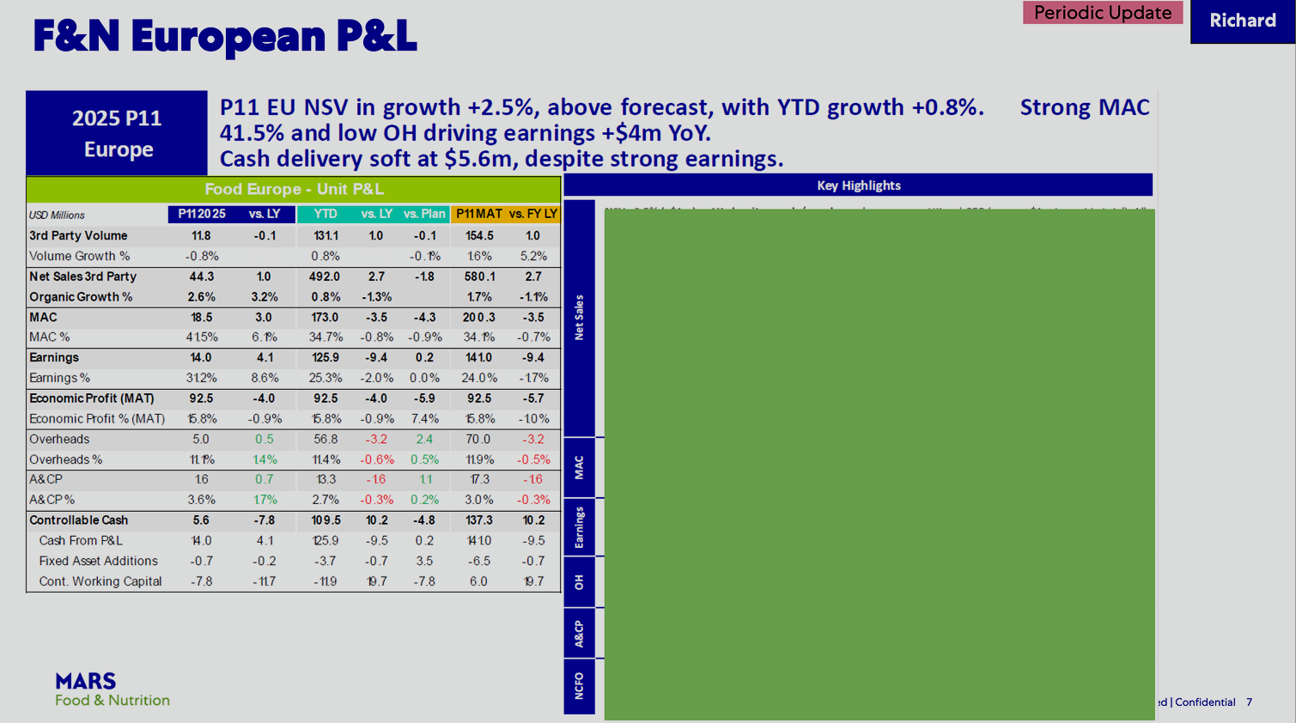



F&N EU P&L
Dashboard Redesign. Before & After Comparison
Updated Version
Redesigned for clarity and performance
Previous Version
02
DESIGN PRINCIPLES & VALUE ADDITIONS
Elevated KPIs
Optimized Readability
Visual Storytelling
Actionable AI
Structured Hierarchy
Introduces prominent, top-level metric cards to highlight crucial figures instantly. This prevents users from hunting through dense spreadsheet rows for bottom-line results.
Replaces cramped grids with generous whitespace, subtle alignment, and clear typography. This visual breathing room drastically reduces cognitive load during detailed data review.
Transforms a stark, empty visual block into a dynamic, easy-to-read bar chart. This allows executives to grasp complex budget-versus-actual comparisons at a single glance.
Integrates a Co-Pilot sidebar with automated narrative insights and a scenario modeling button. This shifts the dashboard from a static historical report to a proactive decision-making tool.
Organizes data into distinct modular zones rather than a single overwhelming block. This guides the viewer's eye naturally from high-level summaries down to granular financial details.

Slide 10
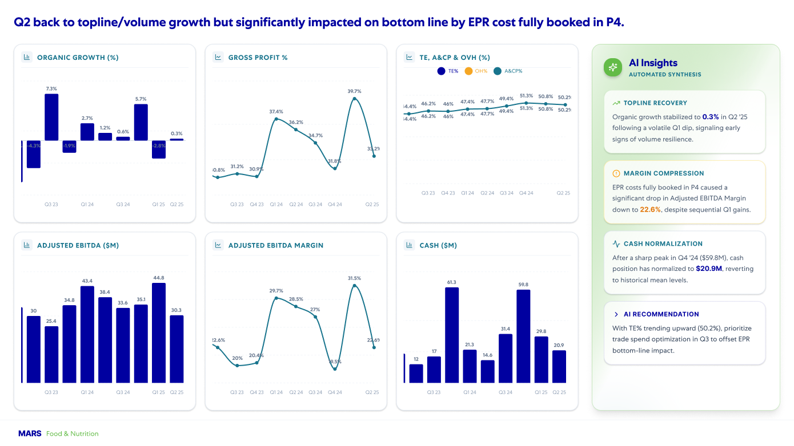
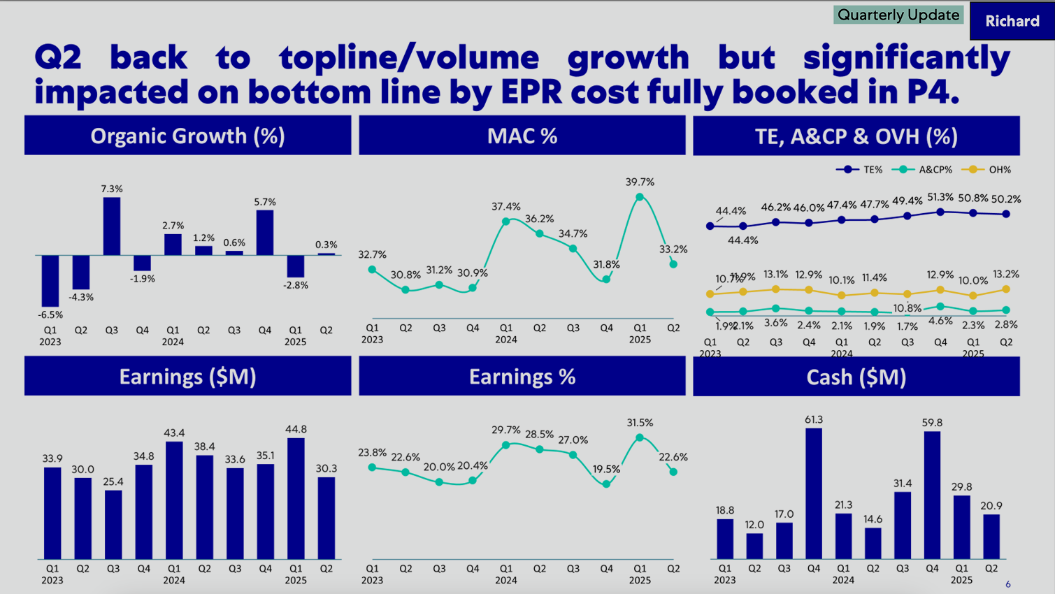


Q2 back to topline/volume growth but significantly impacted on bottom line by EPR cost fully booked in P4
Updated Version
Redesigned for clarity and performance
Previous Version
02
DESIGN PRINCIPLES & VALUE ADDITIONS
Modular Containers
Contextual AI Insights
Strategic Negative Space
Harmonized Visual Identity
Encloses each chart within clean, soft-edged individual cards to segment distinct performance metrics. This cleanly eliminates the oppressive, heavy blue header bars from the original layout.
Adds a side panel pairing complex chart data with automated text synthesis. Instantly extracts vital business takeaways like margin compression and topline recovery.
Removes cramped borders and dense text alignments to provide charts with optimal visual breathing room. This drastically reduces cognitive fatigue and allows complex data trends to stand out clearly.
Standardizes icons, color coding, and graph lines into a cohesive corporate design system. This updates the chaotic, utilitarian aesthetic of the old format into a highly professional executive dashboard.

Slide 11
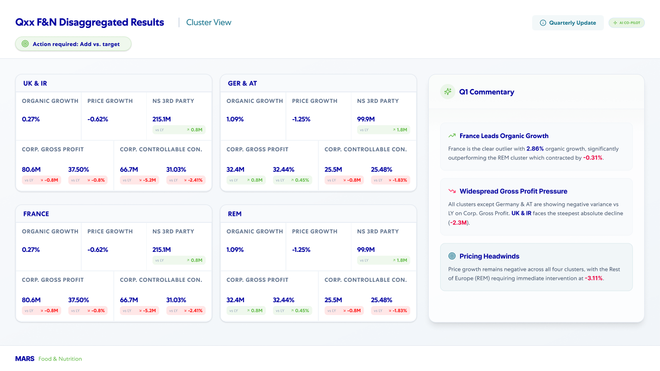
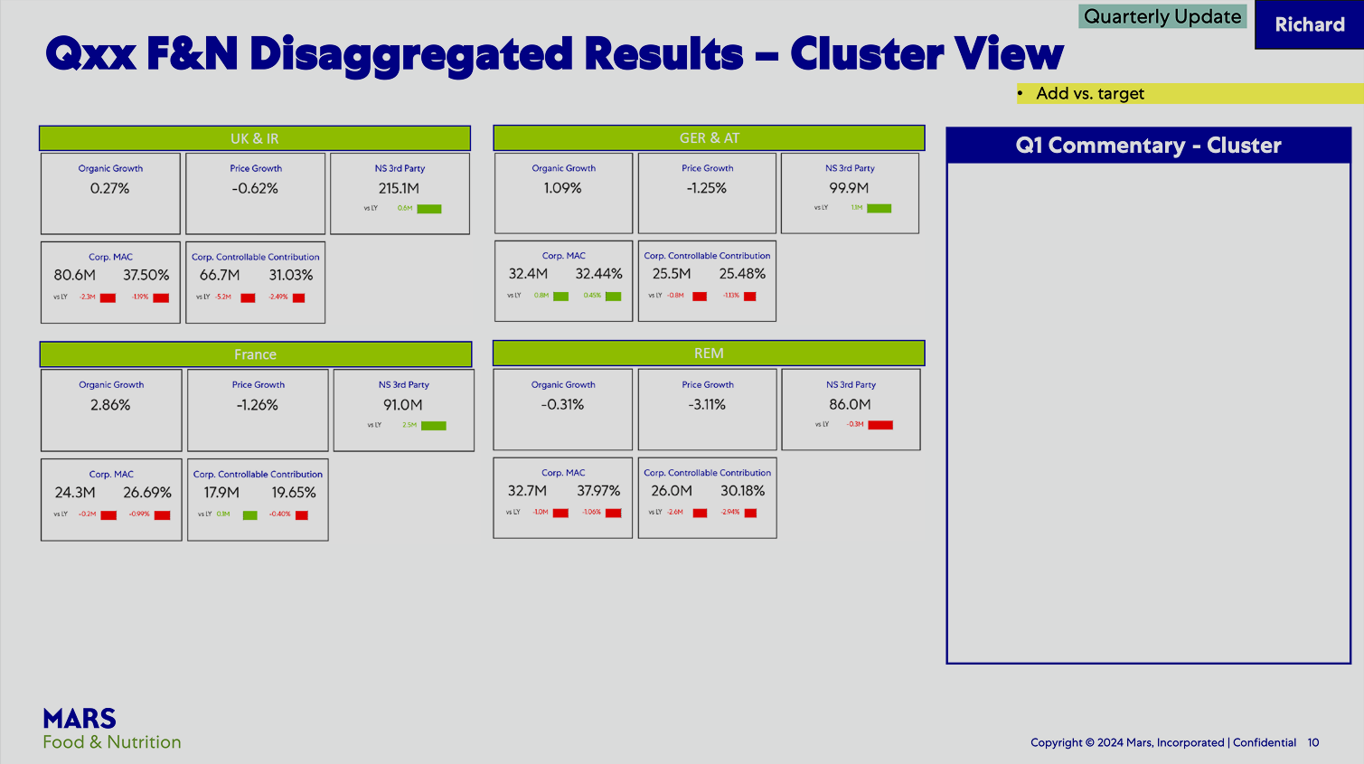



Qxx F & N Disaggregated Results | Cluster View
Dashboard Redesign. Before & After Comparison
Updated Version
Redesigned for clarity and performance
Previous Version
02
DESIGN PRINCIPLES & VALUE ADDITIONS
Clearer Navigation Structure
Better Insight Visibility
Improved Information Hierarchy
Refined Layout Structure
Enhanced Table Presentation
Streamlines the main header into a crisp, modern breadcrumb hierarchy. Adds a distinct, color-coded action banner to highlight pending operational tasks.
Converts a blank, rigid placeholder box into a feature-rich commentary column. Surfaces automated, bold callouts that immediately explain localized performance deviations.
Groups messy metrics into clean regional sections with distinct typographic scaling. Ensures primary financial metrics are visually prioritized over granular sub-data.
Replaces cramped, scattered elements with a balanced four-quadrant modular grid. Leverages spacious, soft-shadow card containers to neatly isolate independent datasets.
Upgrades chaotic table lines to streamlined rows with elegant, faint border dividers. Positions comparison metrics cleanly under core numbers to simplify variance tracking.

Slide 12
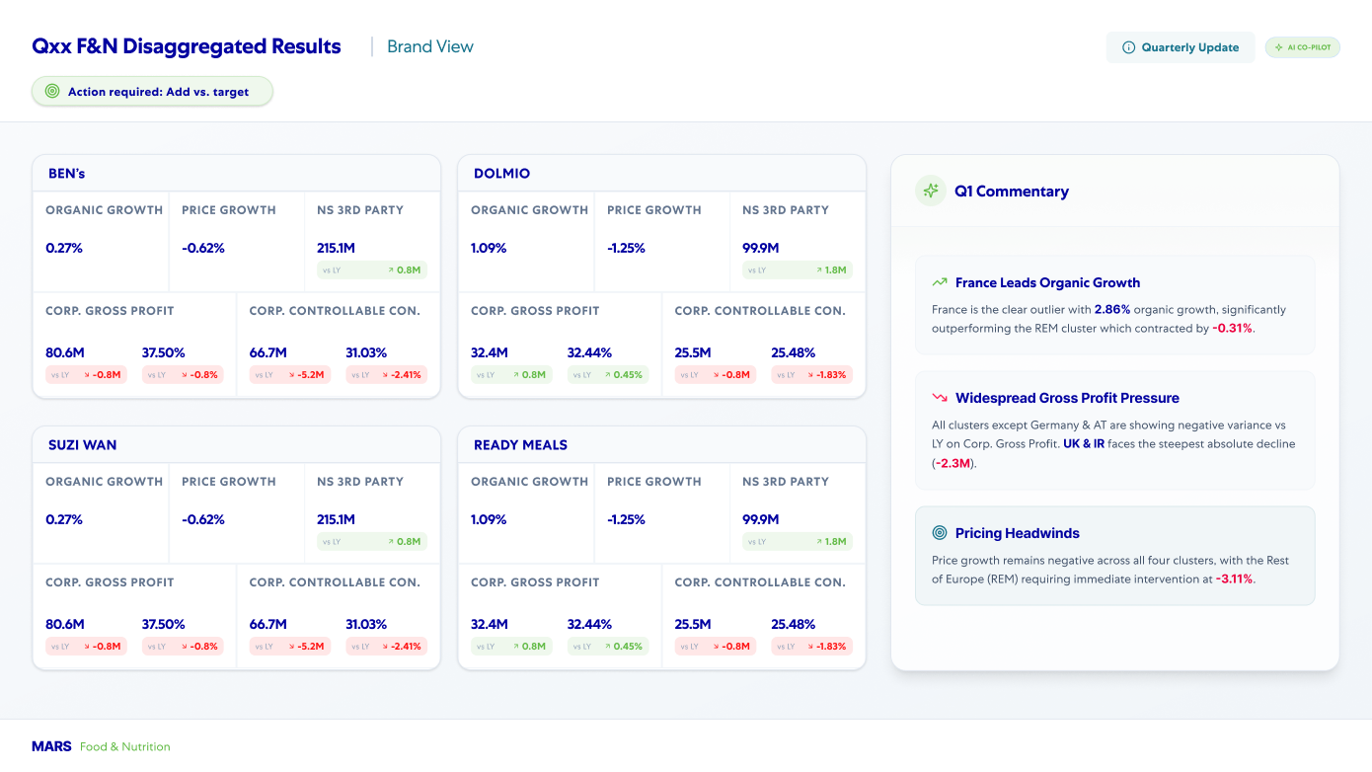

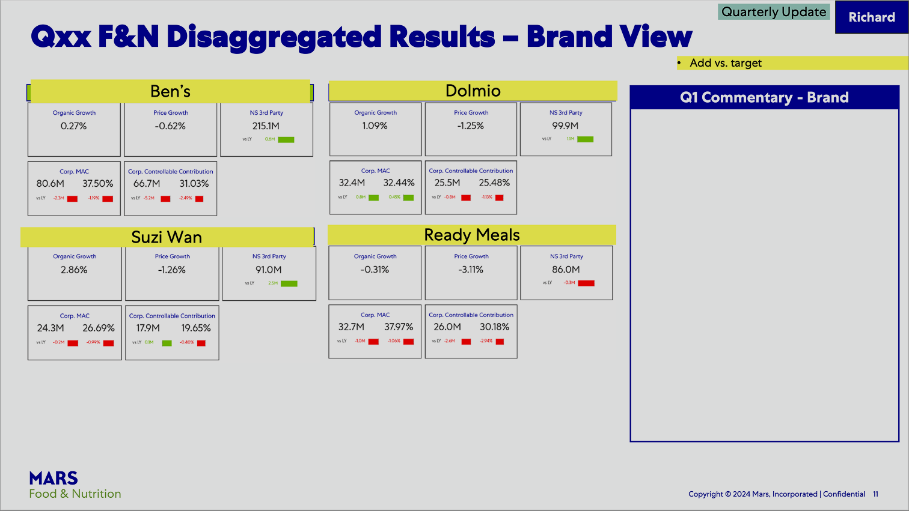
Qxx F & N Disaggregated Results | Brand View
Dashboard Redesign. Before & After Comparison
Updated Version
Redesigned for clarity and performance
Previous Version
02
DESIGN PRINCIPLES & VALUE ADDITIONS
Clearer Navigation Structure
Better Insight Visibility
Improved Information Hierarchy
Refined Layout Structure
Enhanced Table Presentation
Streamlines the main header into a crisp, modern breadcrumb hierarchy. Adds a distinct, color-coded action banner to highlight pending operational tasks.
Converts a blank, rigid placeholder box into a feature-rich commentary column. Surfaces automated, bold callouts that immediately explain localized performance deviations.
Groups messy metrics into clean regional sections with distinct typographic scaling. Ensures primary financial metrics are visually prioritized over granular sub-data.
Replaces cramped, scattered elements with a balanced four-quadrant modular grid. Leverages spacious, soft-shadow card containers to neatly isolate independent datasets.
Upgrades chaotic table lines to streamlined rows with elegant, faint border dividers. Positions comparison metrics cleanly under core numbers to simplify variance tracking.

Slide 13
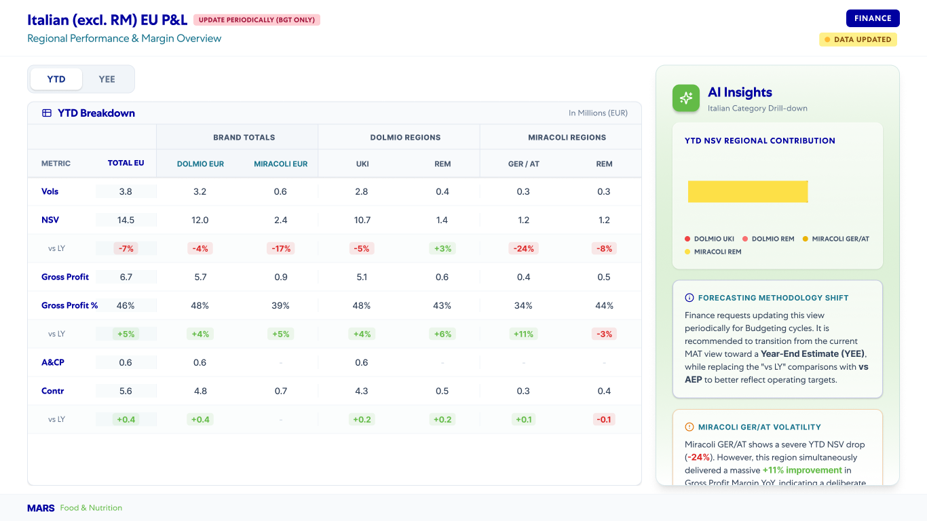

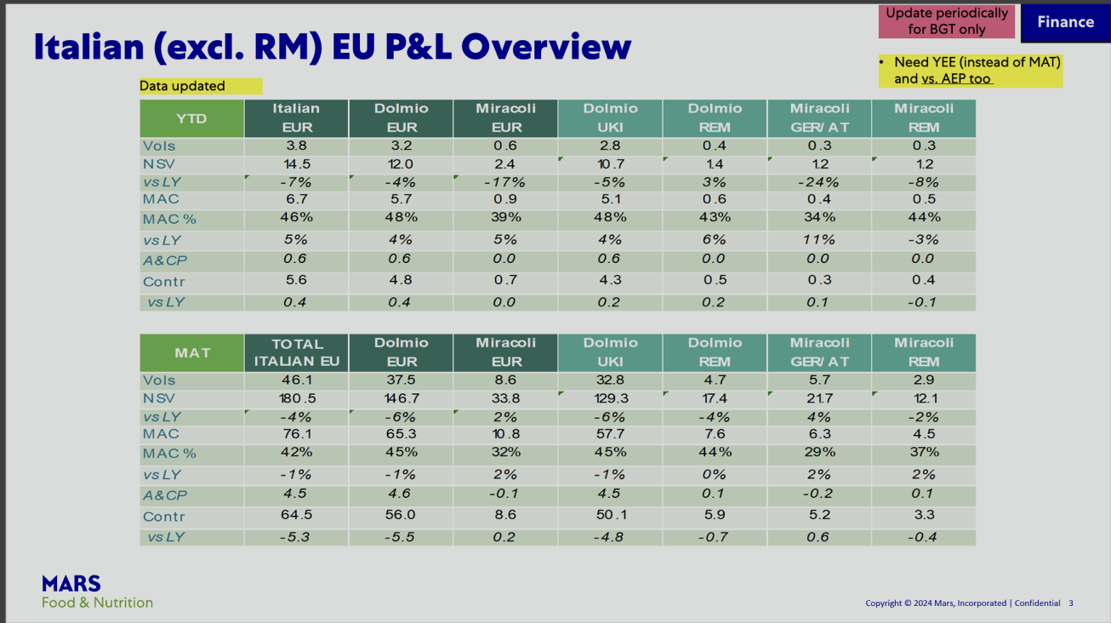
Italian (excl. RM) EU P&L
Dashboard Redesign. Before & After Comparison
Updated Version
Redesigned for clarity and performance
Previous Version
02
DESIGN PRINCIPLES & VALUE ADDITIONS
Simplified User Experience
Actionable Insight Delivery
Clear Hierarchy
Context-Driven Information
Refined Tables
Reducing visual clutter and streamlining workflows to make the interface more intuitive and effortless to navigate.
Moving from rigid data dumps to dynamic, synthesized takeaways that empower users to make fast, informed decisions.
Organizing content logically to improve readability and information flow.
Aligning the UI elements (typography, iconography, and color palettes) to create a cohesive, modern corporate identity.
Decluttering tables with whitespace and clear highlights for effortless scanning.

Slide 14

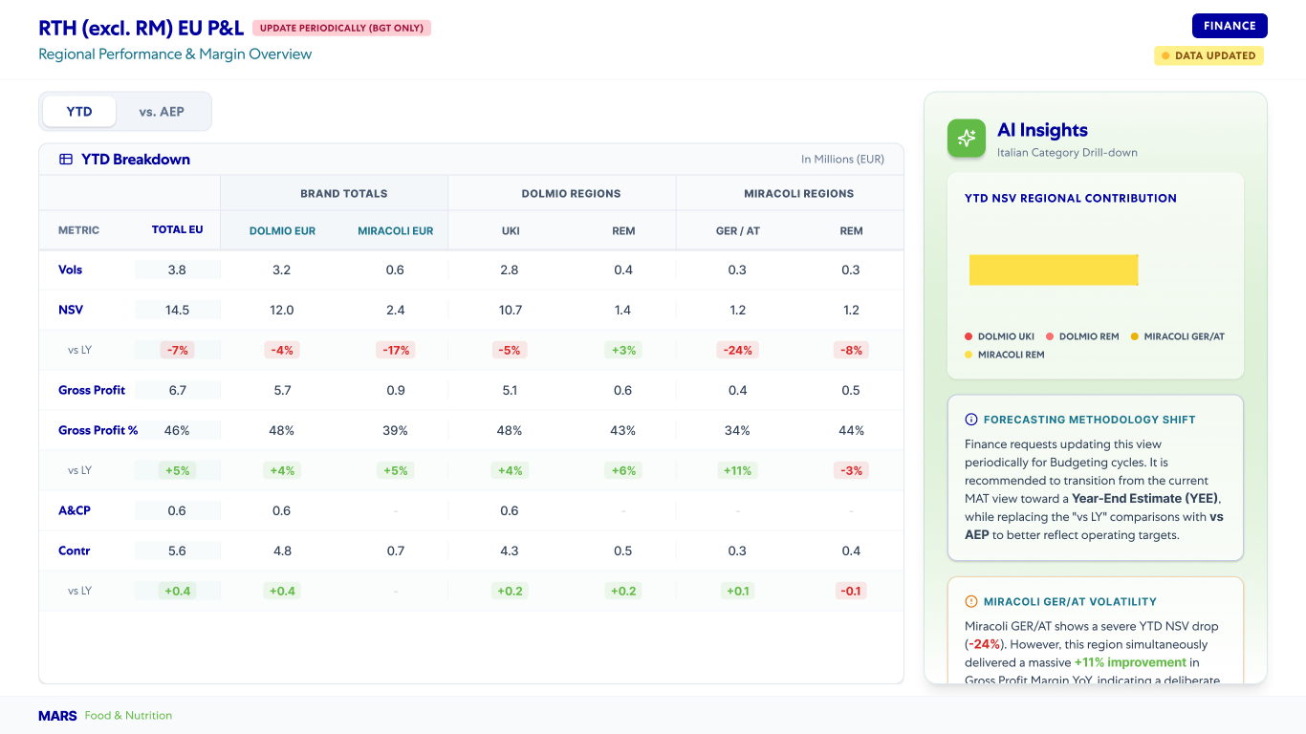
RTH (excl. RM) EU P&L
Dashboard Redesign. Before & After Comparison
Updated Version
Redesigned for clarity and performance
Previous Version
02
DESIGN PRINCIPLES & VALUE ADDITIONS
Simplified User Experience
Actionable Insight Delivery
Clear Hierarchy
Context-Driven Information
Refined Tables
Reducing visual clutter and streamlining workflows to make the interface more intuitive and effortless to navigate.
Moving from rigid data dumps to dynamic, synthesized takeaways that empower users to make fast, informed decisions.
Organizing content logically to improve readability and information flow.
Aligning the UI elements (typography, iconography, and color palettes) to create a cohesive, modern corporate identity.
Decluttering tables with whitespace and clear highlights for effortless scanning.

Slide 15
EU Overview
Financial Performance
Drive Relevance
Execute with Excellence (SRM)
A consolidated view of key metrics and insights, enabling quick assessment of overall business performance.
Improved visibility into key financial metrics, enabling faster and more informed business decisions.
Delivered actionable insights tailored to stakeholder priorities, ensuring focus on what matters most.
Streamlined reporting experiences through intuitive design, enhanced usability, and operational efficiency.

Slide 16
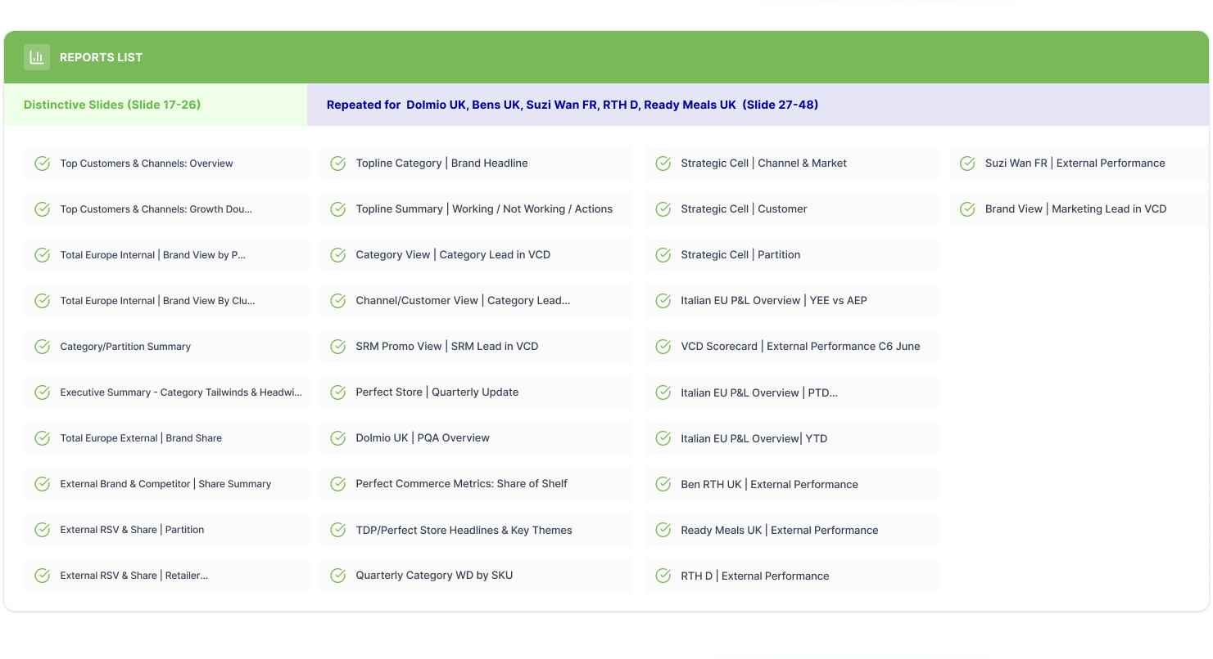
Drive Relevance Reports Coverage

Slide 17
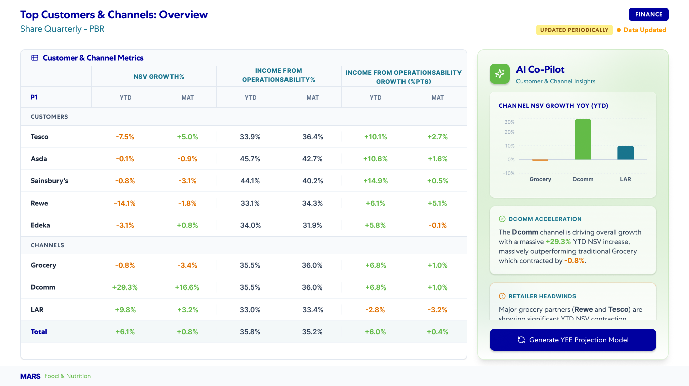
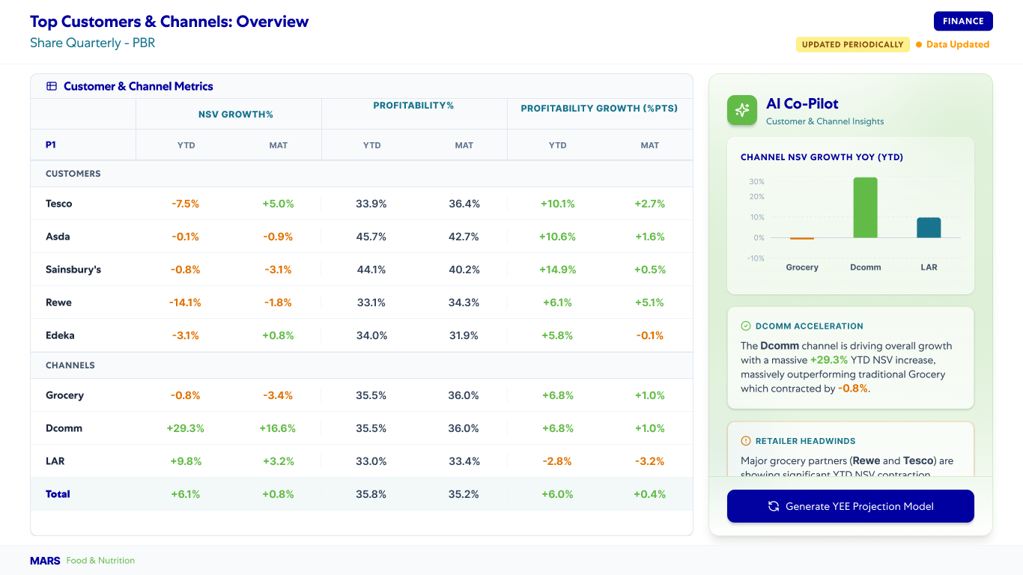
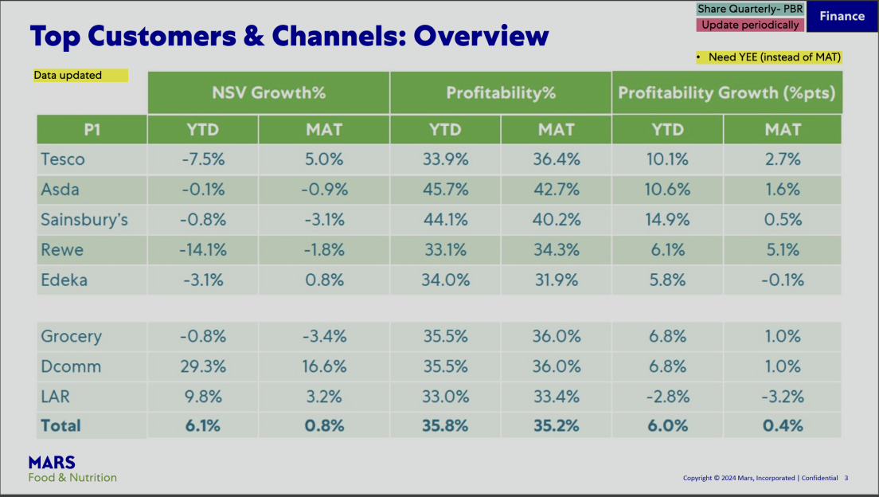
Top Customers & Channels: Overview
Dashboard Redesign. Before & After Comparison
Updated Version
Redesigned for clarity and performance
Previous Version
02
DESIGN PRINCIPLES & VALUE ADDITIONS
Improved Information Hierarchy
Improved Readability
Decision-Making Support
Consistent Design Language
Enhanced Table Presentation
Uses distinct bolding and header breadcrumbs to logically separate main brands from sub-regions. Establishes a clear visual path that instantly distinguishes parent summary rows from granular rows.
Eliminates heavy, solid green row fills in favor of a clean white palette with crisp typography. Maximizes spacing around text data to significantly lower visual fatigue while reviewing large grids.
Introduces a smart "AI Data Assistant" alert banner to surface critical, pending reporting issues. Converts messy, chaotic yellow notes into neat, cell-specific comment boxes tied directly to relevant metrics.
Standardizes top-level utility buttons and font stylings into a cohesive, modern enterprise dashboard theme. Replaces raw spreadsheet structures with a uniform corporate identity and refined layout system.
Upgrades chaotic table lines to streamlined rows with elegant, faint border dividers. Positions comparison metrics cleanly under core numbers to simplify variance tracking.

Slide 18
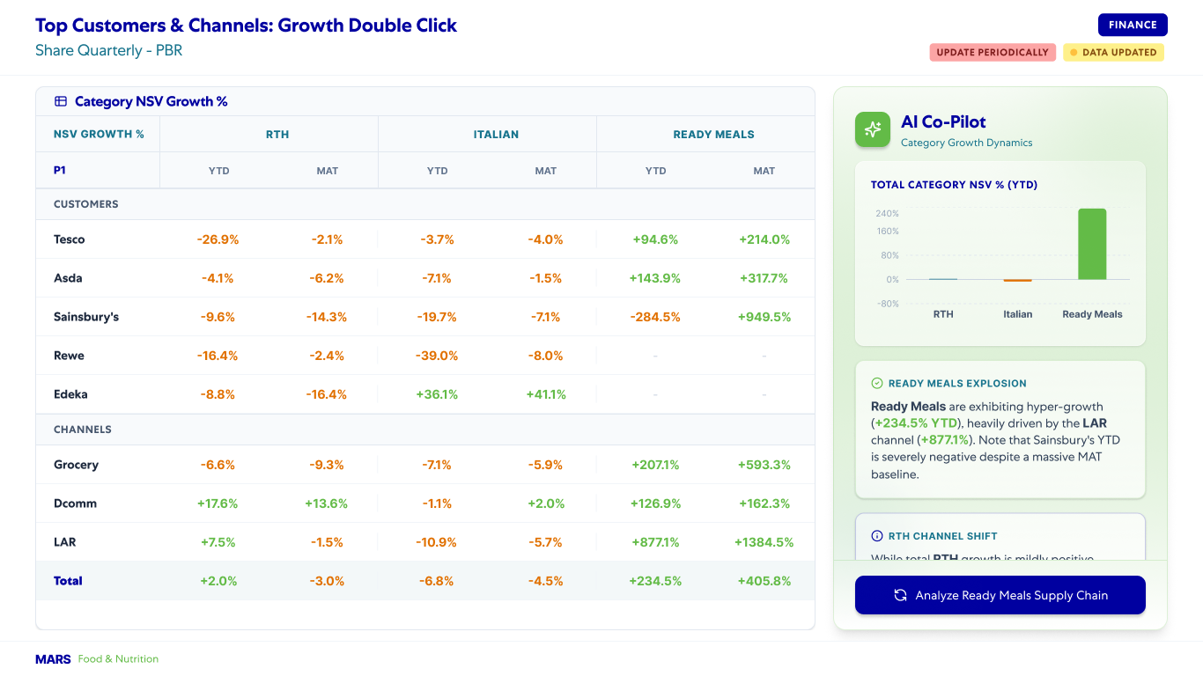
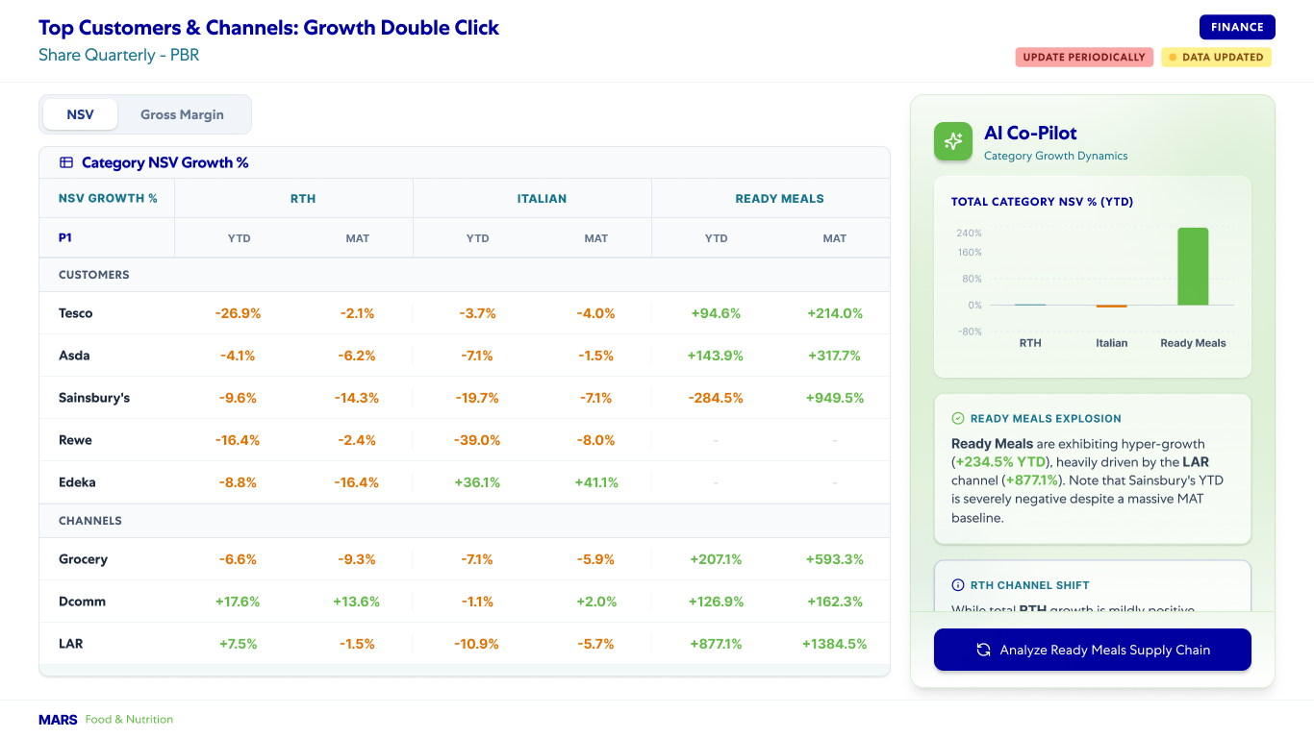
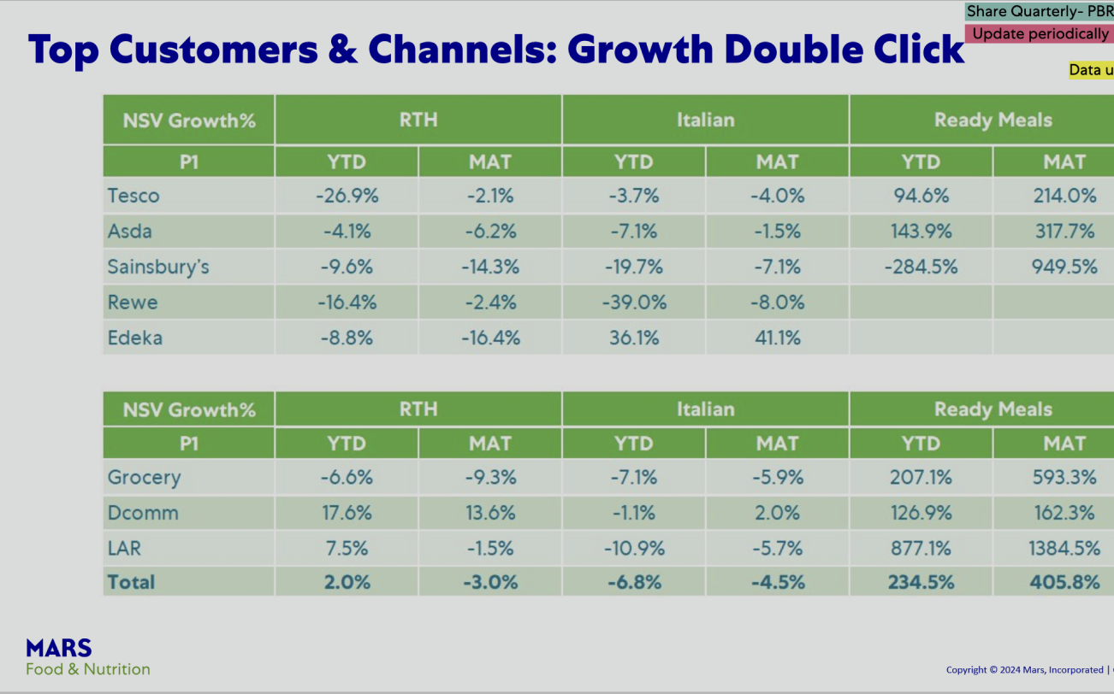
Top Customers & Channels: Growth Double Click
Dashboard Redesign. Before & After Comparison
Updated Version
Redesigned for clarity and performance
Previous Version
02
DESIGN PRINCIPLES & VALUE ADDITIONS
Improved Information Hierarchy
Improved Readability
Decision-Making Support
Consistent Design Language
Enhanced Table Presentation
Uses distinct bolding and header breadcrumbs to logically separate main brands from sub-regions. Establishes a clear visual path that instantly distinguishes parent summary rows from granular rows.
Eliminates heavy, solid green row fills in favor of a clean white palette with crisp typography. Maximizes spacing around text data to significantly lower visual fatigue while reviewing large grids.
Introduces a smart "AI Data Assistant" alert banner to surface critical, pending reporting issues. Converts messy, chaotic yellow notes into neat, cell-specific comment boxes tied directly to relevant metrics.
Standardizes top-level utility buttons and font stylings into a cohesive, modern enterprise dashboard theme. Replaces raw spreadsheet structures with a uniform corporate identity and refined layout system.
Upgrades chaotic table lines to streamlined rows with elegant, faint border dividers. Positions comparison metrics cleanly under core numbers to simplify variance tracking.

Slide 19
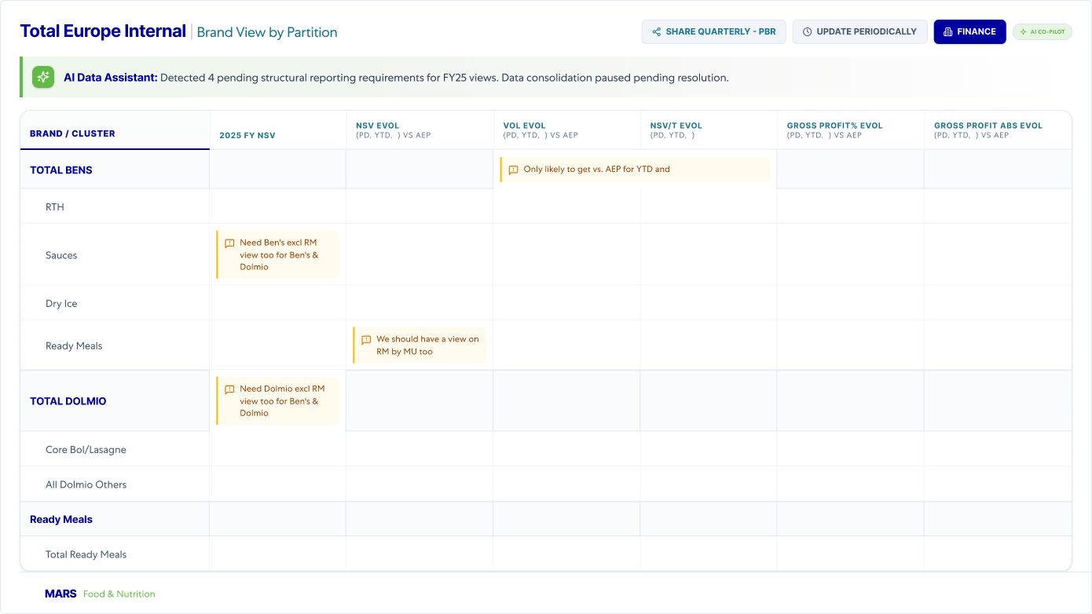
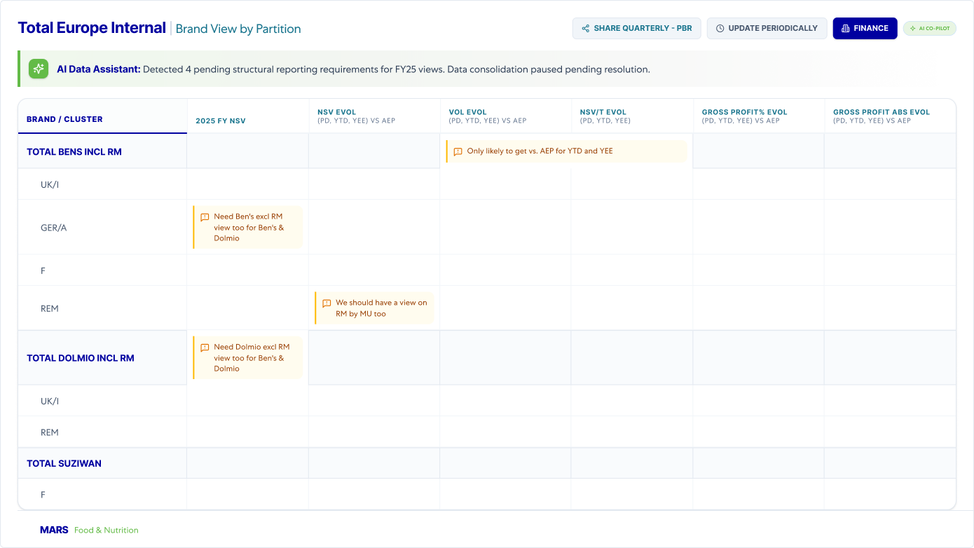
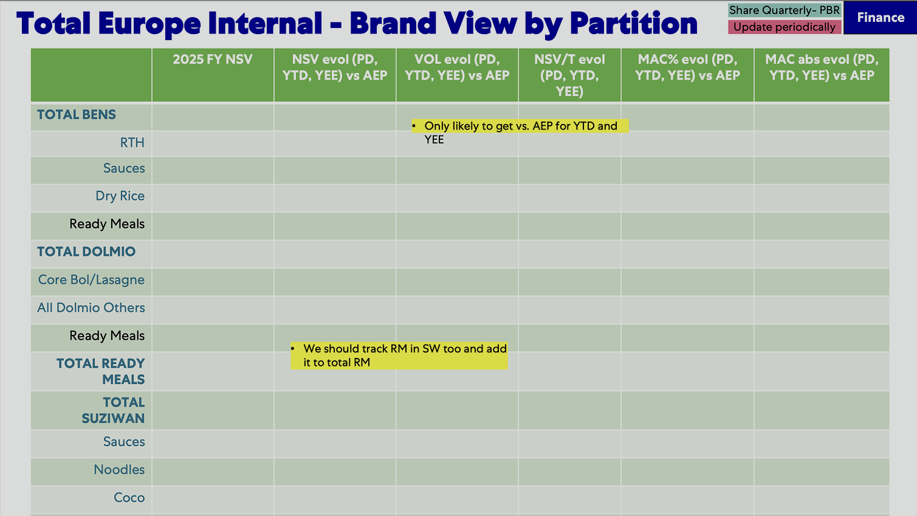
Total Europe Internal | Brand View by Partition
Dashboard Redesign. Before & After Comparison
Updated Version
Redesigned for clarity and performance
Previous Version
02
DESIGN PRINCIPLES & VALUE ADDITIONS
Improved Information Hierarchy
Improved Readability
Decision-Making Support
Consistent Design Language
Enhanced Table Presentation
Uses distinct bolding and header breadcrumbs to logically separate main brands from sub-regions. Establishes a clear visual path that instantly distinguishes parent summary rows from granular rows.
Eliminates heavy, solid green row fills in favor of a clean white palette with crisp typography. Maximizes spacing around text data to significantly lower visual fatigue while reviewing large grids.
Introduces a smart "AI Data Assistant" alert banner to surface critical, pending reporting issues. Converts messy, chaotic yellow notes into neat, cell-specific comment boxes tied directly to relevant metrics.
Standardizes top-level utility buttons and font stylings into a cohesive, modern enterprise dashboard theme. Replaces raw spreadsheet structures with a uniform corporate identity and refined layout system.
Upgrades chaotic table lines to streamlined rows with elegant, faint border dividers. Positions comparison metrics cleanly under core numbers to simplify variance tracking.

Slide 20


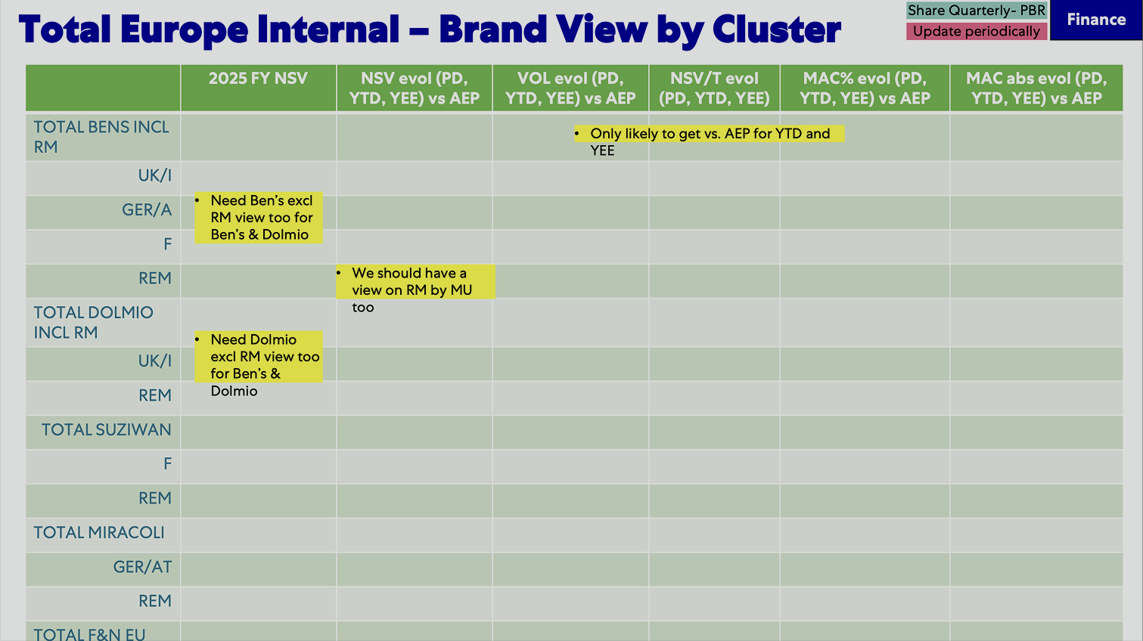
Total Europe Internal | Brand View by Cluster
Dashboard Redesign. Before & After Comparison
Updated Version
Redesigned for clarity and performance
Previous Version
02
DESIGN PRINCIPLES & VALUE ADDITIONS
Improved Information Hierarchy
Improved Readability
Decision-Making Support
Consistent Design Language
Enhanced Table Presentation
Uses distinct bolding and header breadcrumbs to logically separate main brands from sub-regions. Establishes a clear visual path that instantly distinguishes parent summary rows from granular rows.
Eliminates heavy, solid green row fills in favor of a clean white palette with crisp typography. Maximizes spacing around text data to significantly lower visual fatigue while reviewing large grids.
Introduces a smart "AI Data Assistant" alert banner to surface critical, pending reporting issues. Converts messy, chaotic yellow notes into neat, cell-specific comment boxes tied directly to relevant metrics.
Standardizes top-level utility buttons and font stylings into a cohesive, modern enterprise dashboard theme. Replaces raw spreadsheet structures with a uniform corporate identity and refined layout system.
Upgrades chaotic table lines to streamlined rows with elegant, faint border dividers. Positions comparison metrics cleanly under core numbers to simplify variance tracking.

Slide 21
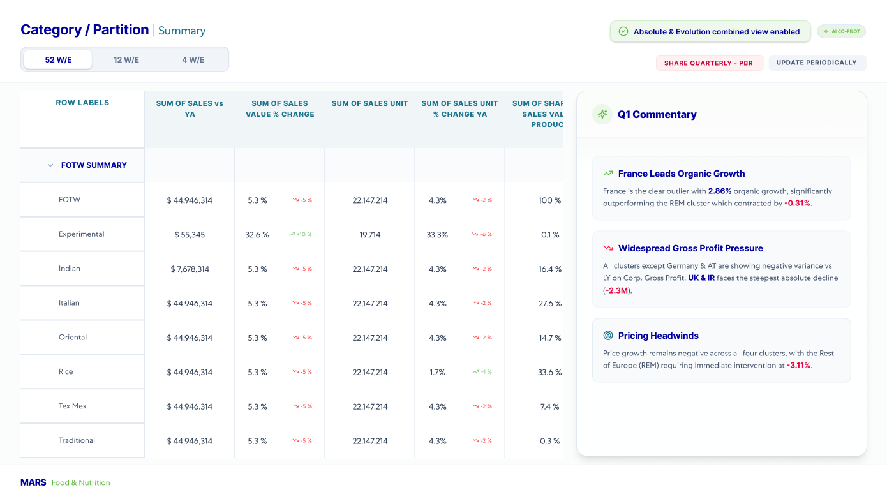
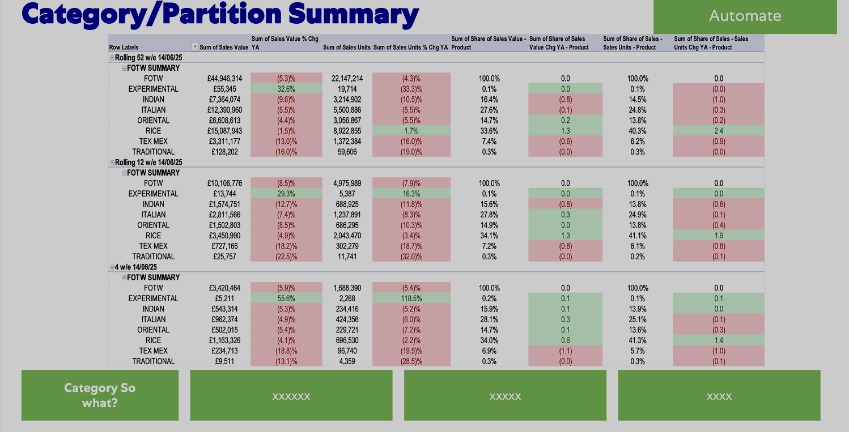
Category/Partition | Summary
Remove
Dashboard Redesign. Before & After Comparison
Updated Version
Redesigned for clarity and performance
Previous Version
02
DESIGN PRINCIPLES & VALUE ADDITIONS
Simplified User Experience
Actionable Insight Delivery
Clear Hierarchy
Context-Driven Information
Refined Tables
Reducing visual clutter and streamlining workflows to make the interface more intuitive and effortless to navigate.
Moving from rigid data dumps to dynamic, synthesized takeaways that empower users to make fast, informed decisions.
Organizing content logically to improve readability and information flow.
Aligning the UI elements (typography, iconography, and color palettes) to create a cohesive, modern corporate identity.
Decluttering tables with whitespace and clear highlights for effortless scanning.

Slide 22
Topline Category/Brand headlines in one page
Quarterly
ADD – Slide #2 in Esther Deck
 |  | 12 weeks | vs YA | MAT | Vs YA
Category | RSV
 | Units
 | Penetration
Brand Value Share | Dolmio
 | Brand 1
 | Brand 2
 | Brand 3
 | Private Label
Dolmio UK | RSV Share
 | Units Share
 | Val ROS
 | Unit ROS
 | TDP Share
Shopper Metrics Dolmio | Penetration %
 | Penetration % U35s
 | Buyers/Repeat
Elevator Pitch: Maximum 3 sentences summarising what’s going on in the Category & for Mars remember the WHY!
Headlines | SO WHAT | NOW WHAT (ACTION)
Category
Mars Cell/Brand
Shopper Metrics

Slide 23
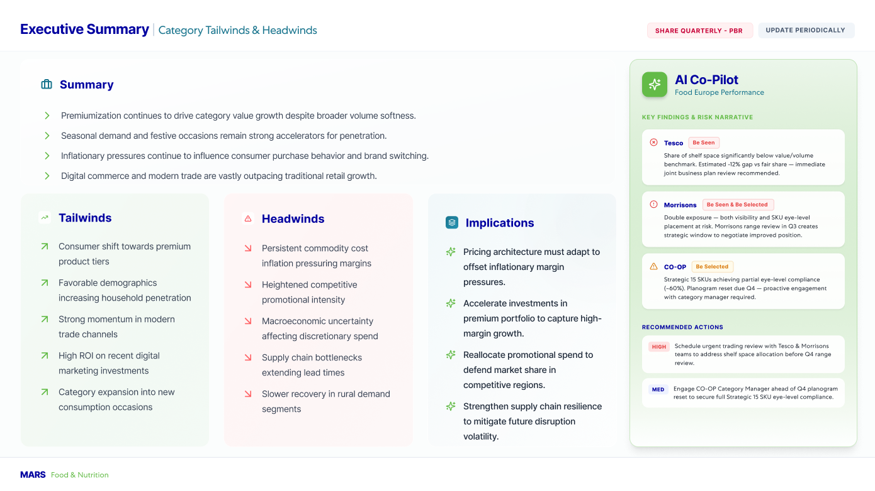
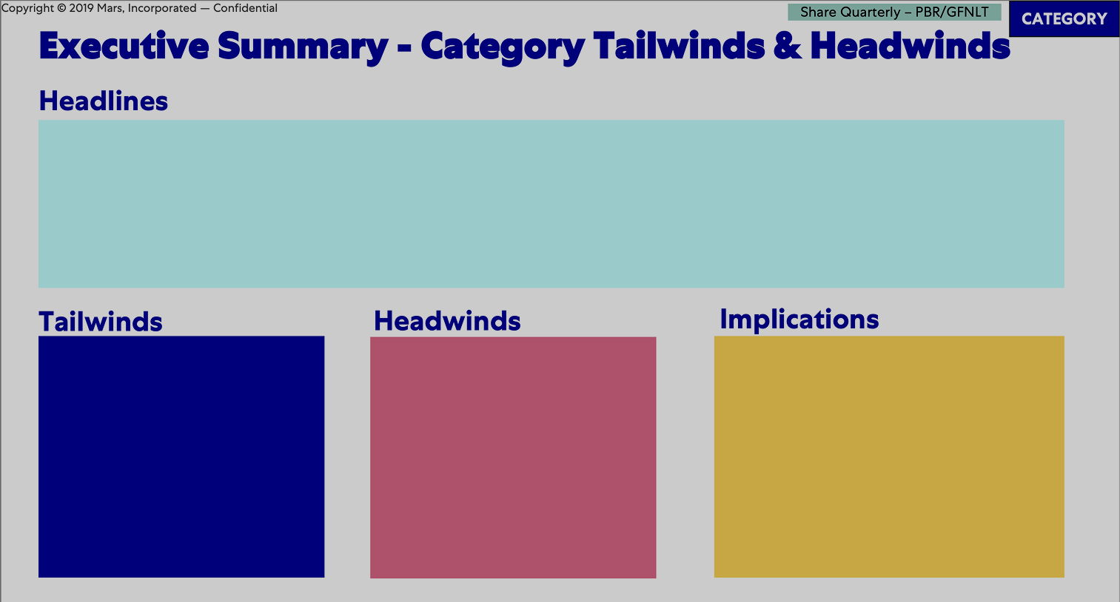
Executive Summary - Category Tailwinds & Headwinds
Replace with Working/Not Working (Slide 29 this deck)
Dashboard Redesign. Before & After Comparison
Updated Version
Redesigned for clarity and performance
Previous Version
02
DESIGN PRINCIPLES & VALUE ADDITIONS
Improved Information Hierarchy
Improved Readability
Decision-Making Support
Consistent Design Language
Enhanced Table Presentation
Uses distinct bolding and header breadcrumbs to logically separate main brands from sub-regions. Establishes a clear visual path that instantly distinguishes parent summary rows from granular rows.
Eliminates heavy, solid green row fills in favor of a clean white palette with crisp typography. Maximizes spacing around text data to significantly lower visual fatigue while reviewing large grids.
Introduces a smart "AI Data Assistant" alert banner to surface critical, pending reporting issues. Converts messy, chaotic yellow notes into neat, cell-specific comment boxes tied directly to relevant metrics.
Standardizes top-level utility buttons and font stylings into a cohesive, modern enterprise dashboard theme. Replaces raw spreadsheet structures with a uniform corporate identity and refined layout system.
Upgrades chaotic table lines to streamlined rows with elegant, faint border dividers. Positions comparison metrics cleanly under core numbers to simplify variance tracking.

Slide 24
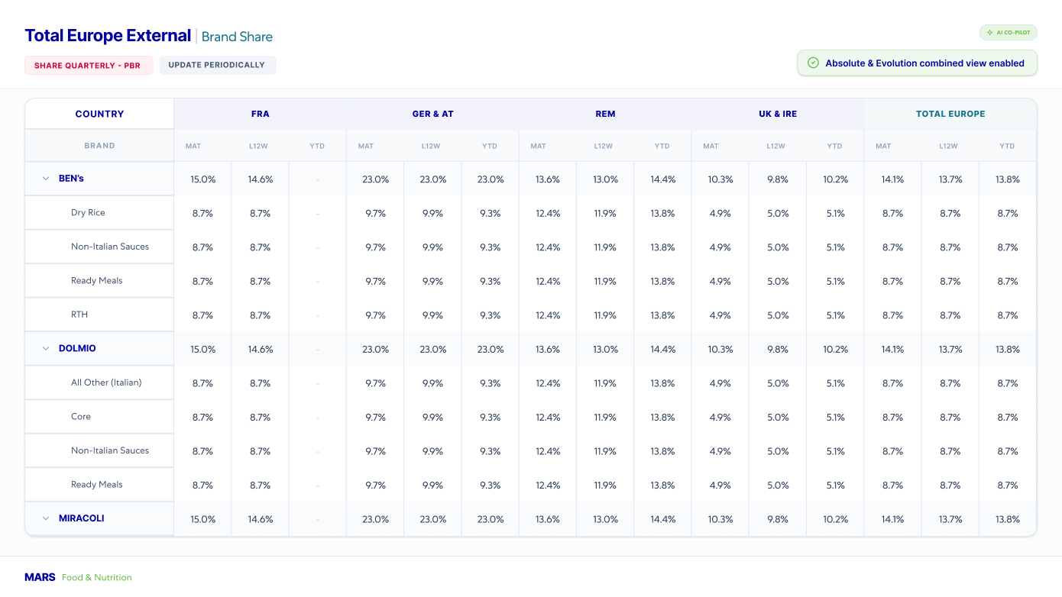
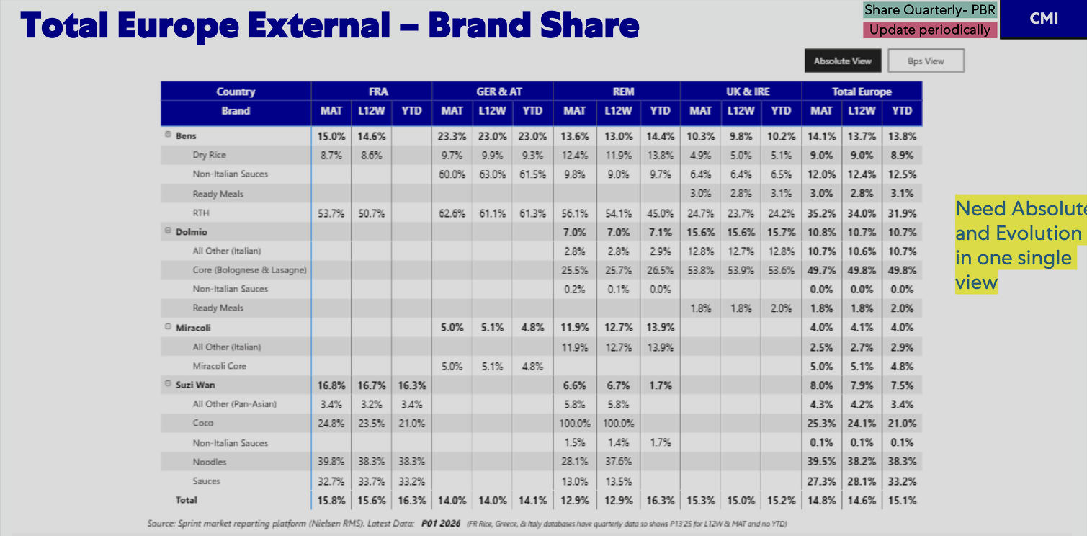
Total Europe External | Brand Share
Dashboard Redesign. Before & After Comparison
Updated Version
Redesigned for clarity and performance
Previous Version
02
DESIGN PRINCIPLES & VALUE ADDITIONS
Improved Information Hierarchy
Improved Readability
Decision-Making Support
Consistent Design Language
Enhanced Table Presentation
Uses distinct bolding and header breadcrumbs to logically separate main brands from sub-regions. Establishes a clear visual path that instantly distinguishes parent summary rows from granular rows.
Eliminates heavy, solid green row fills in favor of a clean white palette with crisp typography. Maximizes spacing around text data to significantly lower visual fatigue while reviewing large grids.
Introduces a smart "AI Data Assistant" alert banner to surface critical, pending reporting issues. Converts messy, chaotic yellow notes into neat, cell-specific comment boxes tied directly to relevant metrics.
Standardizes top-level utility buttons and font stylings into a cohesive, modern enterprise dashboard theme. Replaces raw spreadsheet structures with a uniform corporate identity and refined layout system.
Upgrades chaotic table lines to streamlined rows with elegant, faint border dividers. Positions comparison metrics cleanly under core numbers to simplify variance tracking.

Slide 25
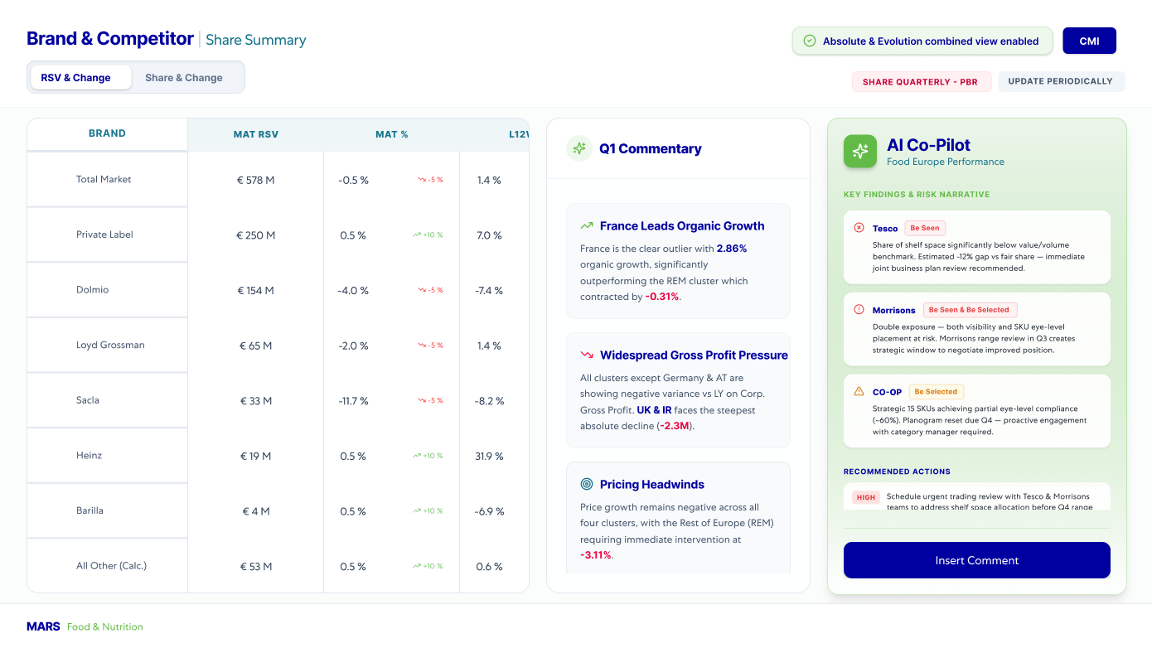
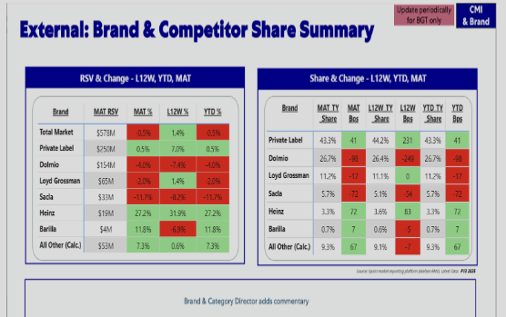
External Brand & Competitor | Share Summary
Dashboard Redesign. Before & After Comparison
Updated Version
Redesigned for clarity and performance
Previous Version
02
DESIGN PRINCIPLES & VALUE ADDITIONS
Content Hierarchy
Consistent Layout
Smart Insights
Optimized Tables
Modern Charts
Organized information logically to guide users effortlessly through the interface.
Standardized visual elements to create a cohesive and predictable user experience.
Delivering proactive, data-driven recommendations tailored to the user's current context.
Decluttering data grids with intentional whitespace for effortless scanning and comprehension.
Upgrading data visualizations with clean aesthetics and accessible, semantic color palettes.

Slide 26

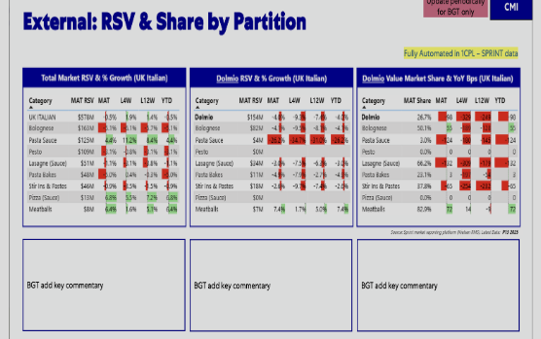
External RSV & Share | Partition
Dashboard Redesign. Before & After Comparison
Updated Version
Redesigned for clarity and performance
Previous Version
02
DESIGN PRINCIPLES & VALUE ADDITIONS
Content Hierarchy
Consistent Layout
Smart Insights
Optimized Tables
Modern Charts
Organized information logically to guide users effortlessly through the interface.
Standardized visual elements to create a cohesive and predictable user experience.
Delivering proactive, data-driven recommendations tailored to the user's current context.
Decluttering data grids with intentional whitespace for effortless scanning and comprehension.
Upgrading data visualizations with clean aesthetics and accessible, semantic color palettes.

Slide 27

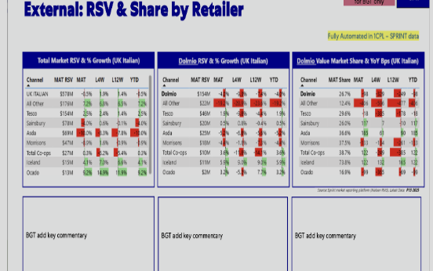
External RSV & Share | Retailer
Dashboard Redesign. Before & After Comparison
Updated Version
Redesigned for clarity and performance
Previous Version
02
DESIGN PRINCIPLES & VALUE ADDITIONS
Content Hierarchy
Consistent Layout
Smart Insights
Optimized Tables
Modern Charts
Organized information logically to guide users effortlessly through the interface.
Standardized visual elements to create a cohesive and predictable user experience.
Delivering proactive, data-driven recommendations tailored to the user's current context.
Decluttering data grids with intentional whitespace for effortless scanning and comprehension.
Upgrading data visualizations with clean aesthetics and accessible, semantic color palettes.

Slide 28
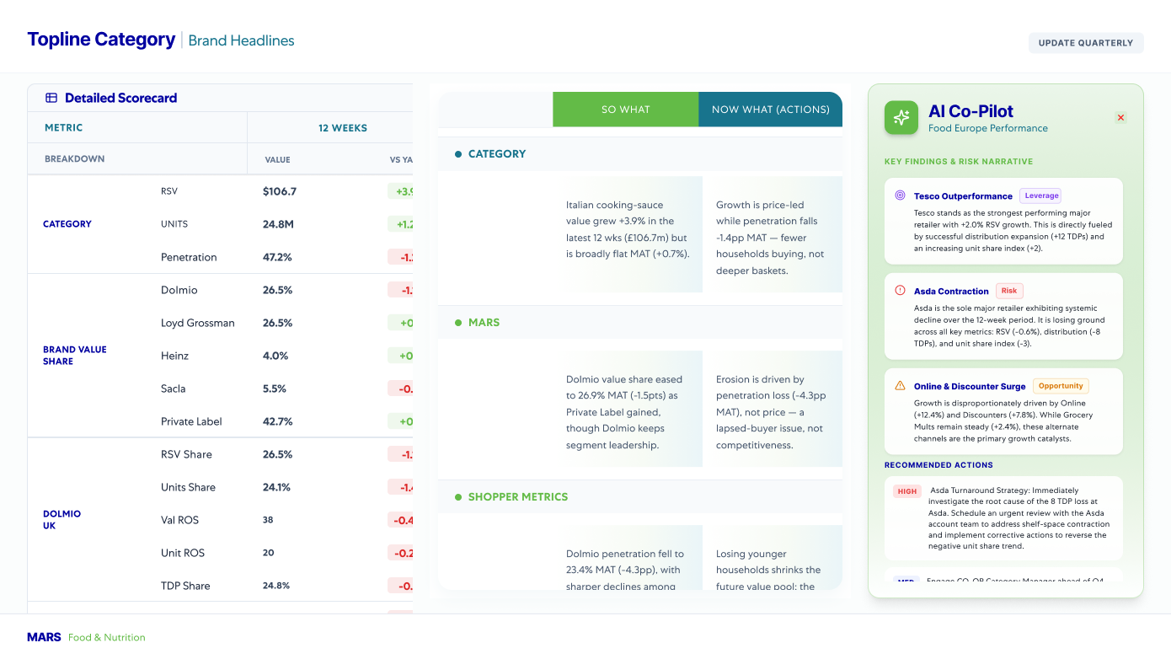
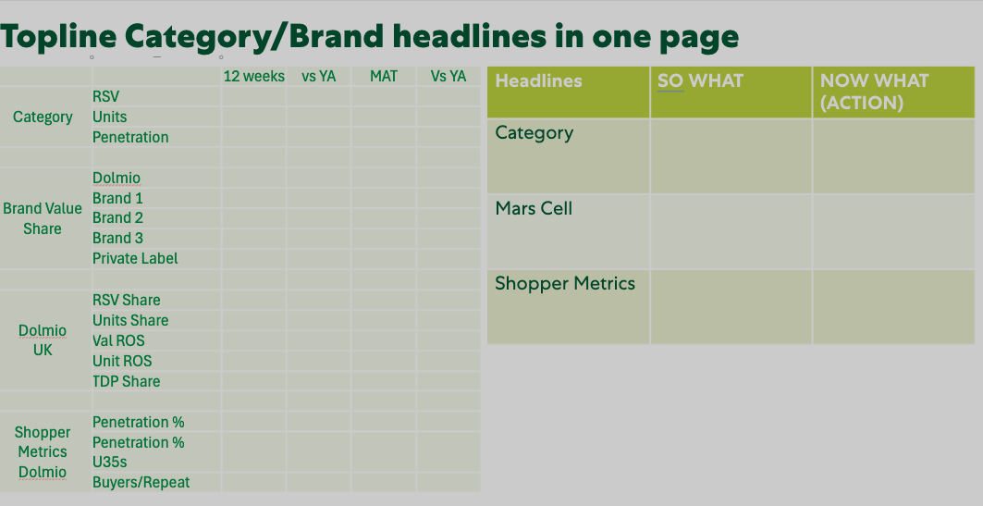
Topline Category | Brand Headlines
Replace with slide 22
Dashboard Redesign. Before & After Comparison
Updated Version
Redesigned for clarity and performance
Previous Version
02
DESIGN PRINCIPLES & VALUE ADDITIONS
Content Hierarchy
Consistent Layout
Decision Support
Contextual Data
Optimized Tables
Organized information logically to guide users effortlessly through the interface.
Standardized visual elements to create a cohesive and predictable user experience.
Delivering proactive, data-driven insights that empower users to act quickly and confidently.
Aligning UI elements and data points to directly match the specific needs and roles of the user.
Decluttering data grids with intentional whitespace for effortless scanning and comprehension.

Slide 29
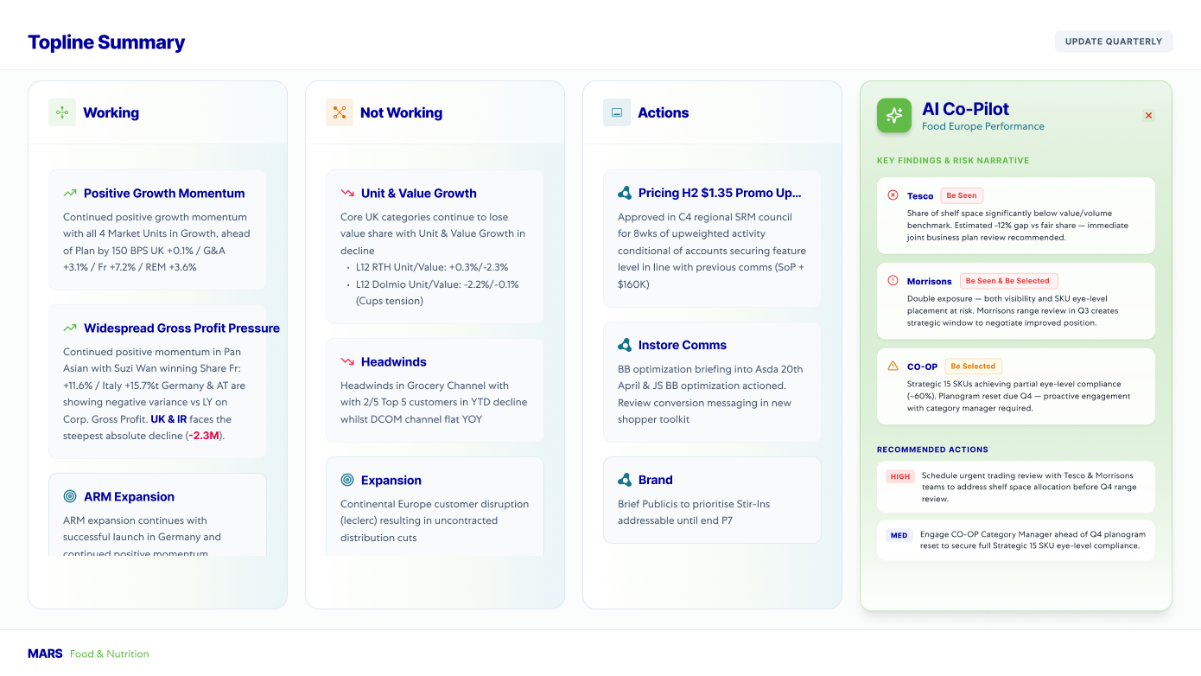
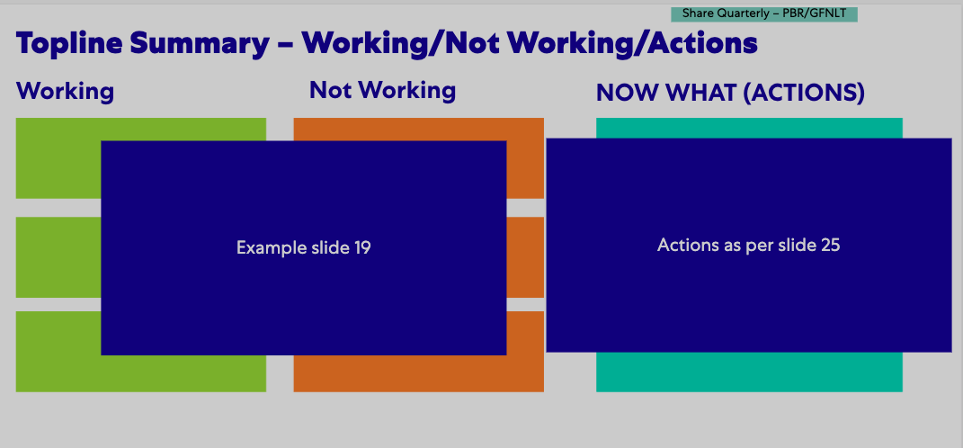
Topline Summary | Working / Not Working / Actions
Add in place of slide 23
Dashboard Redesign. Before & After Comparison
Updated Version
Redesigned for clarity and performance
Previous Version
02
DESIGN PRINCIPLES & VALUE ADDITIONS
Content Hierarchy
Consistent Layout
Decision Support
Contextual Data
Optimized Tables
Organized information logically to guide users effortlessly through the interface.
Standardized visual elements to create a cohesive and predictable user experience.
Delivering proactive, data-driven insights that empower users to act quickly and confidently.
Aligning UI elements and data points to directly match the specific needs and roles of the user.
Decluttering data grids with intentional whitespace for effortless scanning and comprehension.

Slide 30
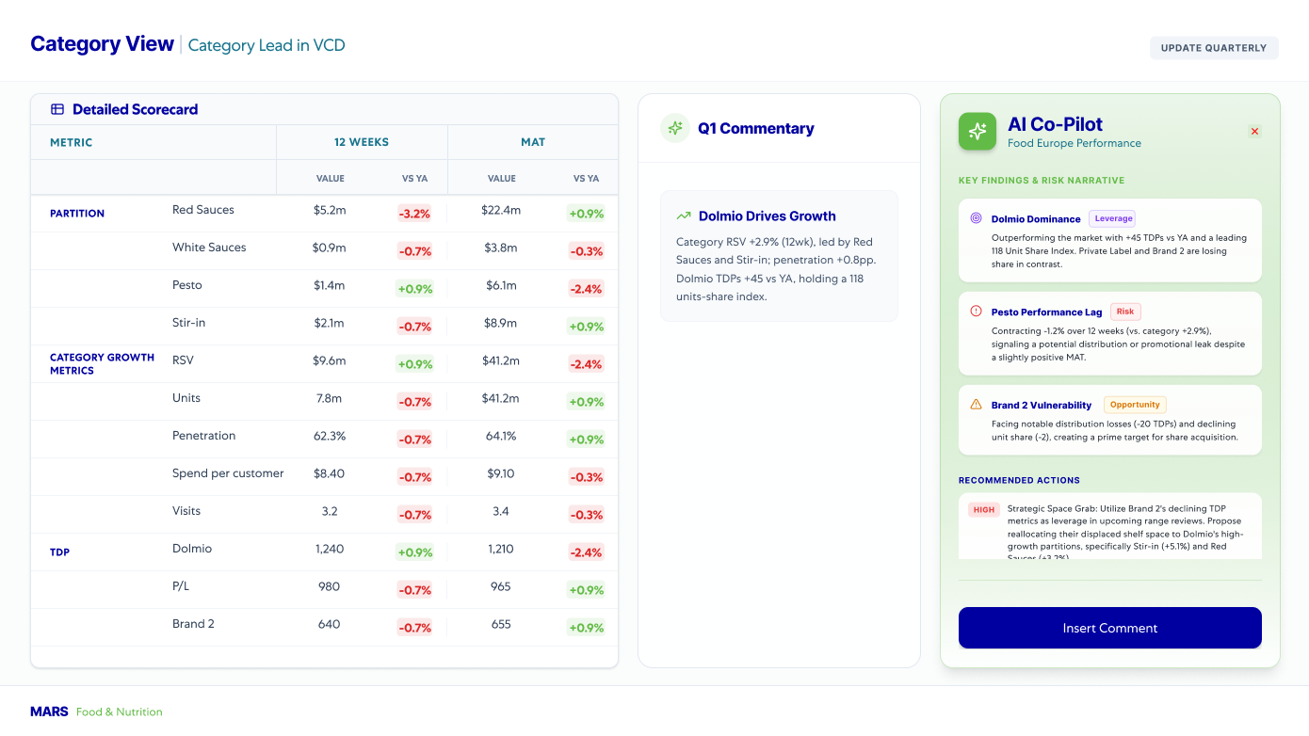
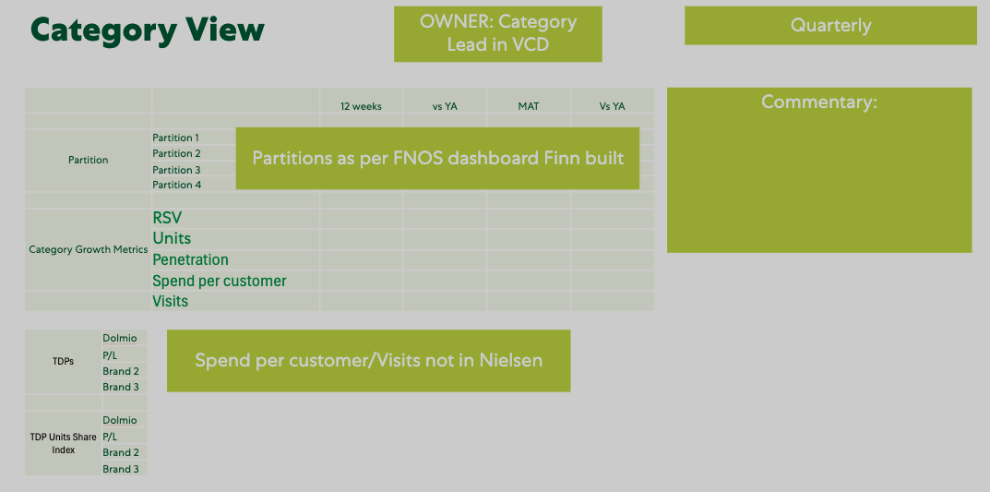
Category View | Category Lead in VCD
Dashboard Redesign. Before & After Comparison
Updated Version
Redesigned for clarity and performance
Previous Version
02
DESIGN PRINCIPLES & VALUE ADDITIONS
Content Hierarchy
Consistent Layout
Decision Support
Contextual Data
Optimized Tables
Organized information logically to guide users effortlessly through the interface.
Standardized visual elements to create a cohesive and predictable user experience.
Delivering proactive, data-driven insights that empower users to act quickly and confidently.
Aligning UI elements and data points to directly match the specific needs and roles of the user.
Decluttering data grids with intentional whitespace for effortless scanning and comprehension.

Slide 31

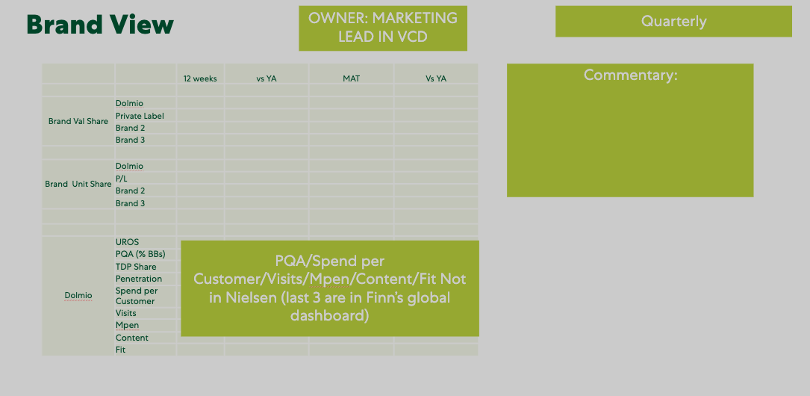
Brand View | Marketing Lead in VCD
Dashboard Redesign. Before & After Comparison
Updated Version
Redesigned for clarity and performance
Previous Version
02
DESIGN PRINCIPLES & VALUE ADDITIONS
Content Hierarchy
Consistent Layout
Decision Support
Contextual Data
Optimized Tables
Organized information logically to guide users effortlessly through the interface.
Standardized visual elements to create a cohesive and predictable user experience.
Delivering proactive, data-driven insights that empower users to act quickly and confidently.
Aligning UI elements and data points to directly match the specific needs and roles of the user.
Decluttering data grids with intentional whitespace for effortless scanning and comprehension.

Slide 32
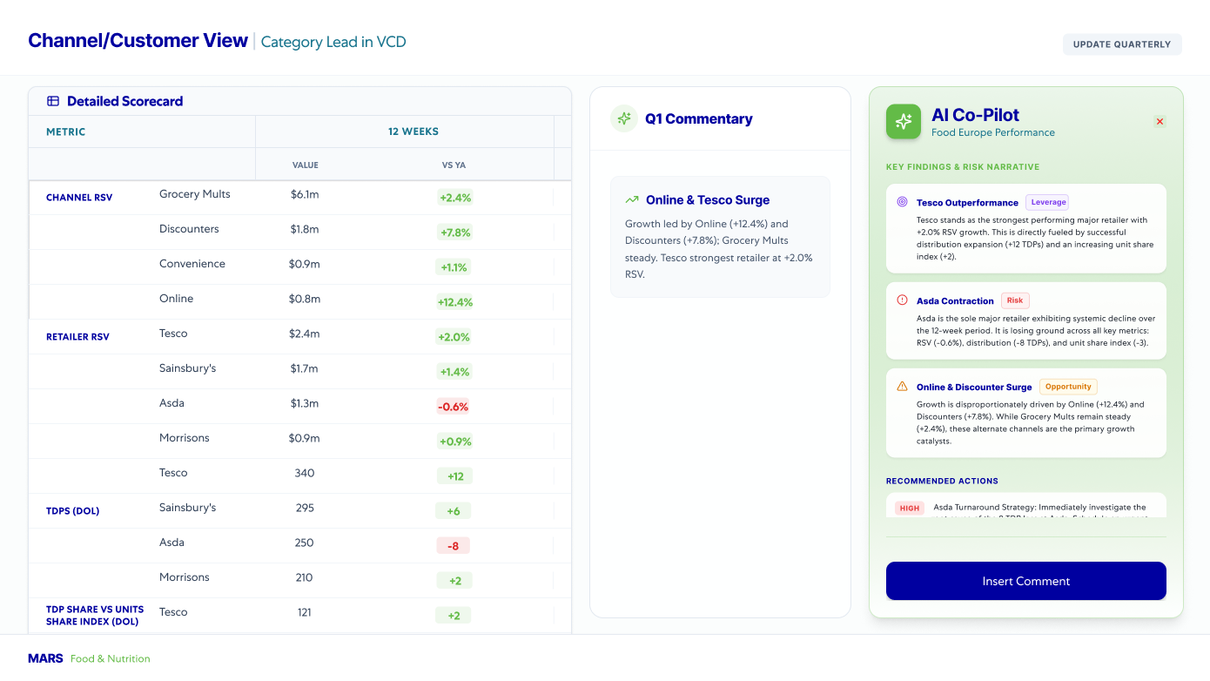

Channel/Customer View | Category Lead in VCD
Dashboard Redesign. Before & After Comparison
Updated Version
Redesigned for clarity and performance
Previous Version
02
DESIGN PRINCIPLES & VALUE ADDITIONS
Content Hierarchy
Consistent Layout
Decision Support
Contextual Data
Optimized Tables
Organized information logically to guide users effortlessly through the interface.
Standardized visual elements to create a cohesive and predictable user experience.
Delivering proactive, data-driven insights that empower users to act quickly and confidently.
Aligning UI elements and data points to directly match the specific needs and roles of the user.
Decluttering data grids with intentional whitespace for effortless scanning and comprehension.

Slide 33


SRM Promo View | SRM Lead in VCD
Dashboard Redesign. Before & After Comparison
Updated Version
Redesigned for clarity and performance
Previous Version
02
DESIGN PRINCIPLES & VALUE ADDITIONS
Content Hierarchy
Consistent Layout
Decision Support
Contextual Data
Optimized Tables
Organized information logically to guide users effortlessly through the interface.
Standardized visual elements to create a cohesive and predictable user experience.
Delivering proactive, data-driven insights that empower users to act quickly and confidently.
Aligning UI elements and data points to directly match the specific needs and roles of the user.
Decluttering data grids with intentional whitespace for effortless scanning and comprehension.

Slide 34


TDP/Perfect Store Headlines & Key Themes
Dashboard Redesign. Before & After Comparison
Updated Version
Redesigned for clarity and performance
Previous Version
02
DESIGN PRINCIPLES & VALUE ADDITIONS
Simplified User Experience
Actionable Insight Delivery
Clear Hierarchy
Context-Driven Information
Refined Tables
Reducing visual clutter and streamlining workflows to make the interface more intuitive and effortless to navigate.
Moving from rigid data dumps to dynamic, synthesized takeaways that empower users to make fast, informed decisions.
Organizing content logically to improve readability and information flow.
Aligning the UI elements (typography, iconography, and color palettes) to create a cohesive, modern corporate identity.
Decluttering tables with whitespace and clear highlights for effortless scanning.

Slide 35


Perfect Store | Quarterly Update
Dashboard Redesign. Before & After Comparison
Updated Version
Redesigned for clarity and performance
Previous Version
02
DESIGN PRINCIPLES & VALUE ADDITIONS
Visual Consistency
Data Discoverability
Insight Visibility
Contextual AI
Refined Layout
Standardizing design elements and typography to create a cohesive, predictable, and polished user experience.
Ensuring key metrics and trends are instantly accessible and easy to locate without deep navigation.
Elevating critical takeaways and performance variances so they stand out immediately upon scanning.
Delivering proactive, data-driven recommendations tailored to the current reporting context
Aligning UI elements and data points to directly match the specific needs and roles of the user.

Slide 36


Dolmio UK | PQA Overview
Dashboard Redesign. Before & After Comparison
Updated Version
Redesigned for clarity and performance
Previous Version
02
DESIGN PRINCIPLES & VALUE ADDITIONS
Data Discoverability
Insight Visibility
Contextual AI
Refined Layout
Visual Consistency
Ensuring key metrics and trends are instantly accessible and easy to locate without deep navigation.
Elevating critical takeaways and performance variances so they stand out immediately upon scanning.
Delivering proactive, data-driven recommendations tailored to the current reporting context.
Aligning UI elements and data points to directly match the specific needs and roles of the user.
Standardizing design elements, colors, and typography to create a cohesive, predictable, and polished user experience.

Slide 37



Ben RTH UK | External Performance
Dashboard Redesign. Before & After Comparison
Updated Version
Redesigned for clarity and performance
Previous Version
02
DESIGN PRINCIPLES & VALUE ADDITIONS
Information Hierarchy
Enhanced Readability
Data Discoverability
Visual Hierarchy
Contextual Insights
Organized information logically to guide users effortlessly through the interface and highlight key metrics.
Standardized visual elements to create a cohesive, predictable, and highly scannable user experience.
Delivering proactive, data-driven recommendations that minimize the need for manual analysis and mental effort.
Decluttering data grids with intentional whitespace and accessible color usage to make complex information easily digestible.
Surfacing the most relevant metrics and insights exactly when and where the user needs them based on their specific role.

Slide 38
Ready Meals UK | External Performance
Dashboard Redesign. Before & After Comparison
Updated Version
Redesigned for clarity and performance
Previous Version
02
DESIGN PRINCIPLES & VALUE ADDITIONS
Information Hierarchy
Enhanced Readability
Data Discoverability
Visual Hierarchy
Contextual Insights
Organized information logically to guide users effortlessly through the interface and highlight key metrics.
Standardized visual elements to create a cohesive, predictable, and highly scannable user experience.
Delivering proactive, data-driven recommendations that minimize the need for manual analysis and mental effort.
Decluttering data grids with intentional whitespace and accessible color usage to make complex information easily digestible.
Surfacing the most relevant metrics and insights exactly when and where the user needs them based on their specific role.

Slide 39
RTH D | External Performance
Dashboard Redesign. Before & After Comparison
Updated Version
Redesigned for clarity and performance
Previous Version
02
DESIGN PRINCIPLES & VALUE ADDITIONS
Information Hierarchy
Enhanced Readability
Data Discoverability
Visual Hierarchy
Contextual Insights
Organized information logically to guide users effortlessly through the interface and highlight key metrics.
Standardized visual elements to create a cohesive, predictable, and highly scannable user experience.
Delivering proactive, data-driven recommendations that minimize the need for manual analysis and mental effort.
Decluttering data grids with intentional whitespace and accessible color usage to make complex information easily digestible.
Surfacing the most relevant metrics and insights exactly when and where the user needs them based on their specific role.

Slide 40
Suzi Wan FR | External Performance
Dashboard Redesign. Before & After Comparison
Updated Version
Redesigned for clarity and performance
Previous Version
02
DESIGN PRINCIPLES & VALUE ADDITIONS
Information Hierarchy
Enhanced Readability
Data Discoverability
Visual Hierarchy
Contextual Insights
Organized information logically to guide users effortlessly through the interface and highlight key metrics.
Standardized visual elements to create a cohesive, predictable, and highly scannable user experience.
Delivering proactive, data-driven recommendations that minimize the need for manual analysis and mental effort.
Decluttering data grids with intentional whitespace and accessible color usage to make complex information easily digestible.
Surfacing the most relevant metrics and insights exactly when and where the user needs them based on their specific role.

Slide 41


Strategic Cell | Channel & Market
Dashboard Redesign. Before & After Comparison
Updated Version
Redesigned for clarity and performance
Previous Version
02
DESIGN PRINCIPLES & VALUE ADDITIONS
Content Hierarchy
Consistent Layout
Decision Support
Contextual Data
Optimized Tables
Organized information logically to guide users effortlessly through the interface.
Standardized visual elements to create a cohesive and predictable user experience.
Delivering proactive, data-driven insights that empower users to act quickly and confidently.
Aligning UI elements and data points to directly match the specific needs and roles of the user.
Decluttering data grids with intentional whitespace for effortless scanning and comprehension.

Slide 42
Strategic Cell | Customer
Dashboard Redesign. Before & After Comparison
Updated Version
Redesigned for clarity and performance
Previous Version
02
DESIGN PRINCIPLES & VALUE ADDITIONS
Content Hierarchy
Consistent Layout
Decision Support
Contextual Data
Optimized Tables
Organized information logically to guide users effortlessly through the interface.
Standardized visual elements to create a cohesive and predictable user experience.
Delivering proactive, data-driven insights that empower users to act quickly and confidently.
Aligning UI elements and data points to directly match the specific needs and roles of the user.
Decluttering data grids with intentional whitespace for effortless scanning and comprehension.

Slide 43
Strategic Cell | Partition
Dashboard Redesign. Before & After Comparison
Updated Version
Redesigned for clarity and performance
Previous Version
02
DESIGN PRINCIPLES & VALUE ADDITIONS
Content Hierarchy
Consistent Layout
Decision Support
Contextual Data
Optimized Tables
Organized information logically to guide users effortlessly through the interface.
Standardized visual elements to create a cohesive and predictable user experience.
Delivering proactive, data-driven insights that empower users to act quickly and confidently.
Aligning UI elements and data points to directly match the specific needs and roles of the user.
Decluttering data grids with intentional whitespace for effortless scanning and comprehension.

Slide 44


Italian EU P&L Overview | PTD
Dashboard Redesign. Before & After Comparison
Updated Version
Redesigned for clarity and performance
Previous Version
02
DESIGN PRINCIPLES & VALUE ADDITIONS
Simplified User Experience
Actionable Insight Delivery
Clear Hierarchy
Context-Driven Information
Refined Tables
Reducing visual clutter and streamlining workflows to make the interface more intuitive and effortless to navigate.
Moving from rigid data dumps to dynamic, synthesized takeaways that empower users to make fast, informed decisions.
Organizing content logically to improve readability and information flow.
Aligning the UI elements (typography, iconography, and color palettes) to create a cohesive, modern corporate identity.
Decluttering tables with whitespace and clear highlights for effortless scanning.

Slide 45


Italian EU P&L Overview| YTD
Dashboard Redesign. Before & After Comparison
Updated Version
Redesigned for clarity and performance
Previous Version
02
DESIGN PRINCIPLES & VALUE ADDITIONS
Simplified User Experience
Actionable Insight Delivery
Clear Hierarchy
Context-Driven Information
Refined Tables
Reducing visual clutter and streamlining workflows to make the interface more intuitive and effortless to navigate.
Moving from rigid data dumps to dynamic, synthesized takeaways that empower users to make fast, informed decisions.
Organizing content logically to improve readability and information flow.
Aligning UI elements and data points to directly match the specific needs, roles, and current tasks of the user.
Decluttering tables with whitespace and clear highlights for effortless scanning.

Slide 46


Italian EU P&L Overview | YEE vs AEP
Dashboard Redesign. Before & After Comparison
Updated Version
Redesigned for clarity and performance
Previous Version
02
DESIGN PRINCIPLES & VALUE ADDITIONS
Simplified User Experience
Actionable Insight Delivery
Clear Hierarchy
Context-Driven Information
Refined Tables
Reducing visual clutter and streamlining workflows to make the interface more intuitive and effortless to navigate.
Moving from rigid data dumps to dynamic, synthesized takeaways that empower users to make fast, informed decisions.
Organizing content logically to improve readability and information flow.
Aligning UI elements and data points to directly match the specific needs, roles, and current tasks of the user.
Decluttering tables with whitespace and clear highlights for effortless scanning.

Slide 47


Quarterly Category WD by SKU
Dashboard Redesign. Before & After Comparison
Updated Version
Redesigned for clarity and performance
Previous Version
02
DESIGN PRINCIPLES & VALUE ADDITIONS
Content Hierarchy
Consistent Layout
Decision Support
Contextual Data
Optimized Tables
Organized information logically to guide users effortlessly through the interface.
Standardized visual elements to create a cohesive and predictable user experience.
Delivering proactive, data-driven insights that empower users to act quickly and confidently.
Aligning UI elements and data points to directly match the specific needs and roles of the user.
Decluttering data grids with intentional whitespace for effortless scanning and comprehension.

Slide 48


Perfect Commerce Metrics: Share of Shelf
Dashboard Redesign. Before & After Comparison
Updated Version
Redesigned for clarity and performance
Previous Version
02
DESIGN PRINCIPLES & VALUE ADDITIONS
Content Hierarchy
Consistent Layout
Decision Support
Contextual Data
Optimized Tables
Organized information logically to guide users effortlessly through the interface.
Standardized visual elements to create a cohesive and predictable user experience.
Delivering proactive, data-driven insights that empower users to act quickly and confidently.
Aligning UI elements and data points to directly match the specific needs and roles of the user.
Decluttering data grids with intentional whitespace for effortless scanning and comprehension.

Slide 49


VCD Scorecard | External Performance C6 June
Dashboard Redesign. Before & After Comparison
Updated Version
Redesigned for clarity and performance
Previous Version
02
DESIGN PRINCIPLES & VALUE ADDITIONS
Content Hierarchy
Consistent Layout
Decision Support
Contextual Data
Optimized Tables
Organized information logically to guide users effortlessly through the interface.
Standardized visual elements to create a cohesive and predictable user experience.
Delivering proactive, data-driven insights that empower users to act quickly and confidently.
Aligning UI elements and data points to directly match the specific needs and roles of the user.
Decluttering data grids with intentional whitespace for effortless scanning and comprehension.

Slide 50
EU Overview
Financial Performance
Drive Relevance
Execute with Excellence (SRM)
A consolidated view of key metrics and insights, enabling quick assessment of overall business performance.
Improved visibility into key financial metrics, enabling faster and more informed business decisions.
Delivered actionable insights tailored to stakeholder priorities, ensuring focus on what matters most.
Streamlined reporting experiences through intuitive design, enhanced usability, and operational efficiency.

Slide 51

Execute With Excellence Reports Coverage

Slide 52


SRM Cluster Scorecard P5 2026 YTD
Dashboard Redesign. Before & After Comparison
Updated Version
Redesigned for clarity and performance
Previous Version
02
DESIGN PRINCIPLES & VALUE ADDITIONS
Simplified User Experience
Actionable Insight Delivery
Clear Hierarchy
Context-Driven Information
Refined Tables
Reducing visual clutter and streamlining workflows to make the interface more intuitive and effortless to navigate.
Moving from rigid data dumps to dynamic, synthesized takeaways that empower users to make fast, informed decisions.
Organizing content logically to improve readability and information flow.
Aligning UI elements and data points to directly match the specific needs, roles, and current tasks of the user.
Decluttering tables with whitespace and clear highlights for effortless scanning.

Slide 53


Growth & Leverage Matrix
Dashboard Redesign. Before & After Comparison
Updated Version
Redesigned for clarity and performance
Previous Version
02
DESIGN PRINCIPLES & VALUE ADDITIONS
Data Discoverability
Content Organization
Contextual AI
Refined Layout
Visual Consistency
Ensuring key metrics and trends are instantly accessible and easy to locate without deep navigation.
Organizing information logically to guide users effortlessly through the interface and highlight key metrics.
Delivering proactive, data-driven recommendations that minimize the need for manual analysis and mental effort.
Decluttering data grids with intentional whitespace to make complex financial information easily digestible.
Standardizing design elements, colors, and typography to create a cohesive, predictable, and polished user experience.

Slide 54


Growth & Leverage Matrix
Dashboard Redesign. Before & After Comparison
Updated Version
Redesigned for clarity and performance
Previous Version
02
DESIGN PRINCIPLES & VALUE ADDITIONS
Data Discoverability
Content Organization
Contextual AI
Refined Layout
Visual Consistency
Ensuring key metrics and trends are instantly accessible and easy to locate without deep navigation.
Organizing information logically to guide users effortlessly through the interface and highlight key metrics.
Delivering proactive, data-driven recommendations that minimize the need for manual analysis and mental effort.
Decluttering data grids with intentional whitespace to make complex financial information easily digestible.
Standardizing design elements, colors, and typography to create a cohesive, predictable, and polished user experience.

Slide 55


Growth & Leverage Matrix
Dashboard Redesign. Before & After Comparison
Updated Version
Redesigned for clarity and performance
Previous Version
02
DESIGN PRINCIPLES & VALUE ADDITIONS
Data Discoverability
Content Organization
Contextual AI
Refined Layout
Visual Consistency
Ensuring key metrics and trends are instantly accessible and easy to locate without deep navigation.
Organizing information logically to guide users effortlessly through the interface and highlight key metrics.
Delivering proactive, data-driven recommendations that minimize the need for manual analysis and mental effort.
Decluttering data grids with intentional whitespace to make complex financial information easily digestible.
Standardizing design elements, colors, and typography to create a cohesive, predictable, and polished user experience.

Slide 56


Slide 57


Product Quadrant Analysis
Dashboard Redesign. Before & After Comparison
Updated Version
Redesigned for clarity and performance
Previous Version
02
DESIGN PRINCIPLES & VALUE ADDITIONS
Data Discoverability
Content Organization
Contextual AI
Refined Layout
Visual Consistency
Ensuring key metrics and trends are instantly accessible and easy to locate without deep navigation.
Organizing information logically to guide users effortlessly through the interface and highlight key metrics.
Delivering proactive, data-driven recommendations that minimize the need for manual analysis and mental effort.
Decluttering data grids with intentional whitespace to make complex financial information easily digestible.
Standardizing design elements, colors, and typography to create a cohesive, predictable, and polished user experience.

Slide 58
Thank You

