Slide 1

MASC Client.Api Modernization
Demo
Prepared for MASC • Executive discussion • October 2026

Slide 2
Agenda
01
Approach & Agent Skills
A specialized agent for each job, not one black box
02
Humans in the Loop
TechioSoft's Tech Lead makes the risky calls
TODAY'S OBJECTIVE
Stage Gates & Risks
Status Updates & Demo
03
Nothing risky merges without passing a gate
04
Prompts → Outputs → Refinement
How a request becomes a reviewed change
05
Reviews, Quality & Security
Real-data testing found what compilers couldn't
06
Progress, Timeline & What's Next
Ahead of plan; deployment and sign-off remain
Techiosoft Systems Inc.

Slide 3
The Approach: Modernization Agents
A specialized agent for each job — not one black box
Agent / Skills | Role
Modernization Lead | Orchestrates the plan, one unit at a time
State Tracker | Single source of truth — live progress dashboard
Branch & PR Orchestrator | One branch/PR per unit + self-healing build loop
Vertical-Slice / Parity Validator | Generates & checks each feature slice
Security Review | Vulnerability + dependency scanning
Each agent has a narrow, auditable responsibility. The TechioSoft Tech Lead prompts, agents execute, and the Tech Lead reviews and approves.
Techiosoft Systems Inc.

Slide 4
Agent Skills
Five skills, each with a narrow job and a built-in guardrail. TechioSoft reviews what each one produces.
Skill
What it does
Guardrail built in
What TechioSoft reviews
Modernization Lead
Orchestrates the plan: decides what, when, who and on which branch.
Never writes production source code.
A reviewable PR for every stage, with auto generated docs
State Tracker
Single source of truth for all 14 slices. Powers the live progress dashboard.
Live progress dashboard
A validate gate enforces slicing rules R1–R10 before any phase or slice moves.
Branch & PR Orchestrator
Opens one branch and one PR per stage. Runs the self-healing build loop.
No silent commits to main. Up to 5 fix retries, then a draft PR with the failure log.
PR summary, test and parity reports, self-healing log, state diff
Vertical Slice / Parity Validator
Generates and checks each feature slice end to end, from domain to web and tests.
Slices come from analysis of the legacy app. One owner per slice, with parity sign-off.
Parity report for each slice
Security Review
Scans code and dependencies for vulnerabilities.
Runs as a gate in the workflow. Security changes need a human to merge.
Scan findings, e.g. a vulnerable Graph dependency pinned away from a known CVE
Techiosoft Systems Inc.

Slide 5
Humans in the Loop
People make the risky calls. Agents do the repeatable work.
1
Tech Lead prompts
2
Agents build
3
Tech Lead approves
4
MASC reviews
TechioSoft Tech Lead sets the intent for each stage
Branch, code, tests and the self-healing loop
TechioSoft Tech Lead reviews the PR and parity reports
MASC reviews the PR and demo; confirms parity before Phase 4
Human gates: Tech Lead approves
Good practices we follow
TechioSoft team doing the work
Data-parity sign-off against Azure SQL
Authentication and live token validation
Live-Azure deployment steps
Any database or security change: agents cannot merge these alone
One branch and one PR per stage. Nothing merges to main until UAT passes.
Golden master captured on .NET 4.8 before any code changes
We work inside MASC's environment: your VM, Azure DevOps repos and Dev database
MASC confirms data and auth parity before Phase 4 starts
Sparsh Dutta, Tech Lead. Full-stack development, testing and QA
Dinakara Kaushik Dhulipala, DevOps
Vishwa Isola, PMO and delivery oversight
Cadence with MASC: 1-hour demo as Phases proceed, weekly 30-minute technical sync, weekly status report. Escalation: Vishwa Isola → Munish Saldhi → Project Sponsors
Techiosoft Systems Inc.

Slide 6



Stage Gates & Governance
Nothing risky merges without passing a gate
HOW IT IS STRUCTURED
Phase gates (L0–L5)
foundation must be green before any feature work
The agent can't merge a database or security change on its own — those are gated to the TechioSoft Tech Lead. Governance is built into the workflow.
Slicing rules (R1–R10)
anchor-first, size caps, frozen data models — prevents "big-bang" risk with small, reviewable changes — full audit trail
Human gates (L3)
data parity, authentication, and live-Azure steps are agent-scaffolded but validated by the TechioSoft Tech Lead
Techiosoft Systems Inc.

Slide 7
Phase Gates & Risks
14 slices pass through five gates. Each known risk has a control and a gate that catches it.
L0 Foundation
L2 Host
L3 Data & identity
L4 Observability
L5 CI/CD
9 slices: shared libraries, settings, auth and MVC base
1 slice: API host, 20 controllers, DI
3 slices: EF Core data access, MSAL token validation
1 slice: observability and Linux container
Pipeline must be done before reporting slices start
Every slice clears eight checks: Domain · App · Infra · Web · Unit · Integration · E2E · Parity. L3 is a human gate.
Risk
Severity
How we control it
Gate that catches it
EF6 → EF Core query and behavior drift
High
Validate data parity against Azure SQL before any tuning
L3 human gate
OWIN → ASP.NET Core port, the biggest single rewrite
High
Golden-master tests on auth flows
L0 foundation
B2C token validation regression (ADAL → MSAL)
Medium
Explicit authorization tests, reviewed by the TechioSoft Tech Lead
L3 human gate
Contract drift across 20 controllers
Medium
Capture the golden master on .NET 4.8 before code changes
L2 host
Plan accuracy: a reference labeled "dead" was still registered
Resolved
The build caught it on self-heal iteration 2. Lesson: check "dead" code with a real build, not grep alone.
Build + closure trace
Techiosoft Systems Inc.

Slide 8
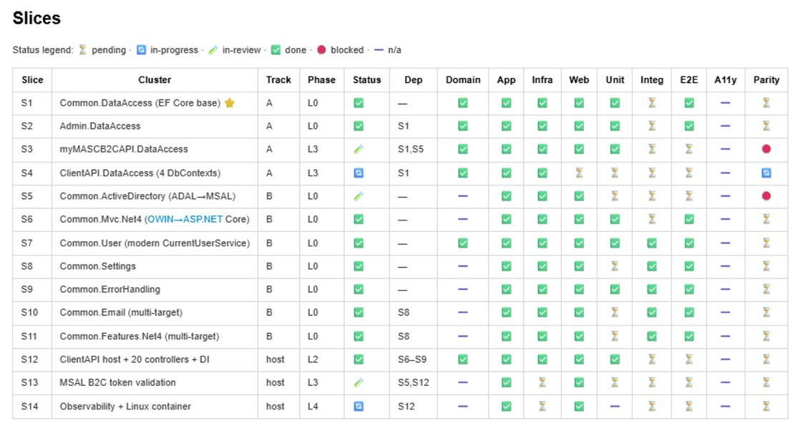
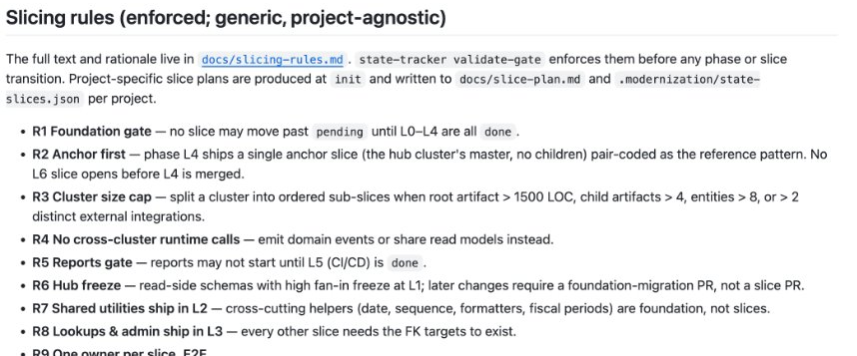
Live progress dashboard (status) and Slicing rules

Slide 9
Prompts → Outputs → Refinement (the loop)
Human intent in, reviewed change out — iteratively
Prompt: "Port the 20 controllers to ASP.NET Core"
Output: 20 controllers migrated, 59 endpoints reconciled 1:1 with legacy
Refinement: review caught runtime parity bugs a green build missed → fixed (model binding, ambiguous routes)
Artifacts produced along the way: endpoint inventory - contract-parity test harness - live progress dashboard - access checklist - local-run guide
It's a conversation. Our Tech Lead asks, the agent produces a reviewable PR, we refine. Every step leaves a documented artifact
Techiosoft Systems Inc.

Slide 10

Reviews & Quality: Real Bugs Caught
AI review + real data testing found what compilers couldn't
8
6
2
22
EF6→EF Core parity bugs
self-healing fix cycles
runtime-only defects
Endpoints
surfaced by running the modern app against the real database — all fixed
100% converged (avg 2 iterations)
Independent code-review agent caught defects a passing build hid
modern API now returns real client data from the Dev database
Real Time Parity Checks
These are subtle behavioural bugs that would've hit production. We caught them early by actually running it — not just compiling it
Techiosoft Systems Inc.

Slide 11
Security by Design
Modernization hardened the security posture
Vulnerable dependency avoided
Legacy auth retired
No secrets in code
Security review as a gate
pinned Microsoft Graph to dodge a known CVE (vulnerable Kiota 1.x)
ADAL → MSAL; B2C bearer-token validation rebuilt on ASP.NET Core
Azure Key Vault + Managed Identity (DefaultAzureCredential)
dependency & vulnerability scanning in the workflow
We didn't just port the code — we removed deprecated auth libraries, eliminated in-code secrets, and closed a dependency vulnerability
Techiosoft Systems Inc.

Slide 12
Progress & What's Next
Application code is feature-complete; deployment & sign-off remain
Done & merged
Parity Testing
Human-gated next
modern host + 20 controllers + DI, EF Core data layer, auth (S13), observability
Modernized app runs today against the real Dev database, returns real data
data-parity sign-off · live-token auth validation · Azure deploy + CI/CD · Security scan
TARGET: 2nd week OCT'26
Techiosoft Systems Inc.

Slide 13
Project Timeline
AHEAD OF PLAN
AI agents cut our timeline by 34%
Ahead of plan. Phases 0–3 complete; Phases 4–6 now targeted for Oct 10.
34 planned business days down to 23
Workstream
Planned dates
Sep 7
Sep 14
Sep 21
Sep 28
Oct 5
Oct 12
Oct 19
Oct 26
Nov 2
Nov 9
Kick-off & finalized plan
Sep 4 – 9
Phase 0 — Prune & migrate dependencies
Sep 10 – 22
Phase 1 — Foundation & configuration
Sep 10 – 22
Phase 2 — Host & framework
Sep 23 – 29
Demo — Phases 0, 1, 2
Oct 1
Phase 3 — Data & identity
Oct 2 – 7
Demo — Phase 3
Oct 8
Phase 4 — Observability & optimization
Oct 8 – 15
Phase 5 — Cloud deployment (CI/CD)
Oct 8 – 15
Phase 6 — Integration & internal QA
Oct 16 – 29
Demo — Phase 4 (final technical demo)
Oct 30
UAT handover (SOW completion)
Nov 2
Hypercare (outside SOW scope)
Nov 2 – 16
Target: all work done Oct 12
Complete
Remaining
Outside SOW scope
Demo / handover milestone
Bars show baselined plan dates; dashed line is the revised target
Techiosoft Systems Inc.
Notes:
How the 38% is calculated: the plan's build work (Phase 0 start Sep 10 to Phase 6 end Oct 29) is 34 business days (BC statutory holidays excluded). Completing all work by Oct 10 is 21 business days. 1 - 21/34 = 38%. Calendar days give the same result: 31 days vs 50 days. If demo and UAT handover (Nov 2) were counted in the baseline it would be 42%.

Slide 14



Thank you
Questions and discussion

