Slide 1
ANOMALY DETECTION USING COMPUTER VISION

Slide 2
Team Details
Guide Name : Prof. Shivani Sompura
Student Names :
Institute Name : Aditya Silver Oak Institute Of Technology
Name | Enrollment No.
1. MUTHE VISHWAJEET SANTOSH | 2102030400186
2. MEHTA VANSH SIDDHARTHBHAI | 2102030400167
3. MODI KRISHAL RAJENBHAI | 2102030400171
4. MUKTAWAT AYUSH SUNIL | 2102030400181
5. MODI ROMIL MAHESHBHAI | 2102030400172

Slide 3
Problem Statement
Design and develop a technological solution based on live CCTV feeds, that can automatically detect incidents related to street crime, violence, burglary, theft, infiltration, unauthorized access etc. and generate alerts to the nearest Police Station. The solution should also be able to generate a report and maintain a database that includes the nature of incident/crime, location, time, level of alert (i.e., low, medium, high risk alert) etc.

Slide 4
Outline
Objectives :-
This project is aimed at improving the surveillance capabilities of our police forces.
This project uses advanced AI-ML techniques to identify the anomalies.
Project Requirements:-
High Quality cameras.
To capture clear and detailed images and videos.
Sufficient Data Storage.
Diverse And Annoted Dataset.
Machine Learning Models.
Alerting and Notification.
False Positive Reduction.
Scalibility.
User-Friendly Interface.

Slide 5
Project scope:-
The software provides convenience to access it’s services from any where and on any device as it is completely web based.
The purpose of this project is to improve the surveillance capabilities of the various law enforcement bodies by automating the monitoring of surveillance feed.
This project targets only the law enforcement agencies and not will not be available publically.
Deliverables:-
In this project, the model will take Input from the cctv installed by the concerned agencies.
After processing the input it will alert (If anomaly detected) the concerned agencies.

Slide 6

Project Under “VIKSIT BHARAT ”

Slide 7
Project Under “VIKSIT BHARAT ”
Applications:
Public Safety:
Computer vision can be used to monitor public spaces for unusual activity, potentially identifying threats or dangerous situations before they escalate.
Traffic Management:
Anomaly detection in traffic can help identify unusual patterns or incidents, such as traffic congestion or accidents, enabling authorities to manage traffic more effectively.
And much more….

Slide 8
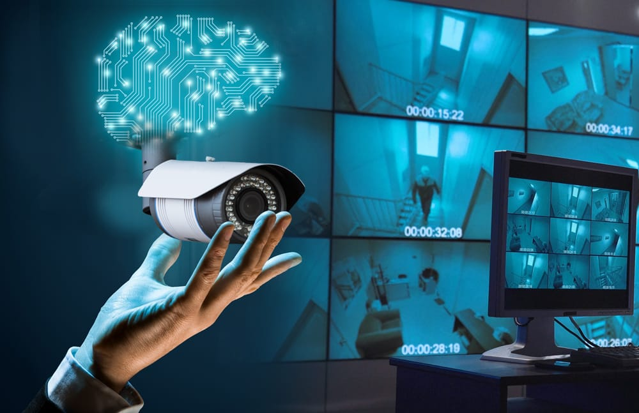
Introduction
Presently, there has been an increase in the number of offensive or disruptive activities that have been taking place these days. Due to this, security has been given uttermost importance lately.

Slide 9
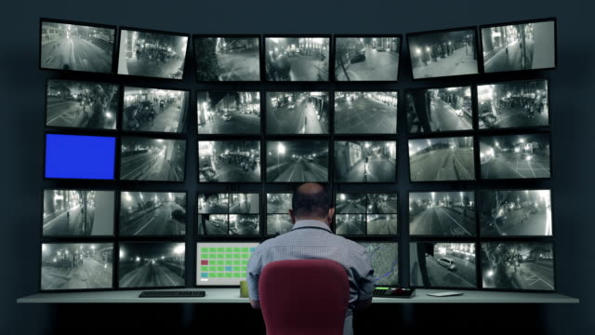
Installation of CCTVs for constant monitoring of people and their interactions is a very common practice in most of the organizations and fields.
For a developed country with a population of millions, every person is captured by a camera many times a day. A lot of videos are generated and stored for a certain time duration. Since constant monitoring of these surveillance videos by the authorities to judge if the events are suspicious or not is nearly an impossible task as it requires a workforce and their constant attention.

Slide 10
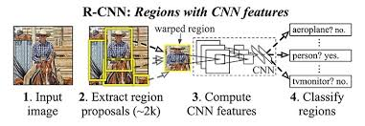
To solve the above-mentioned problem, deep learning techniques are used which would create phenomenal results in the detection of the activities and their categorization.
Here, two Different Neural Networks: CNN and RNN have been used. CNN is the basic neural network that is being used primarily for extracting advanced feature maps from the available recordings.
The output of this system is used to perform real-time surveillance on the CCTV cameras of different organisations to avoid and detect any suspicious activity.
Hence, the time complexity is reduced to a great extent.

Slide 11
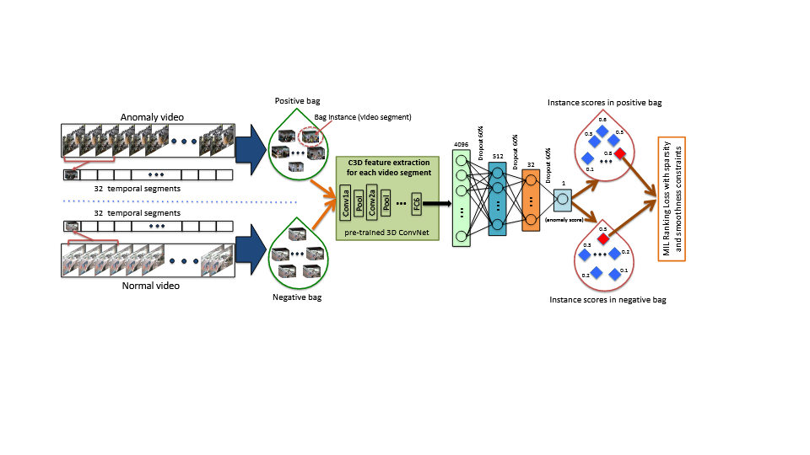
Existing Solution
The existing approach (summarized in the following Figure) begins with dividing surveillance videos into a fixed number of segments during training. These segments make instances in a bag. Using both positive (anomalous) and negative (normal) bags, we train the anomaly detection model using the proposed deep MIL ranking loss.
Reference :-https://paperswithcode.com/paper/real-world-anomaly-detection-in-surveillance/

Slide 12
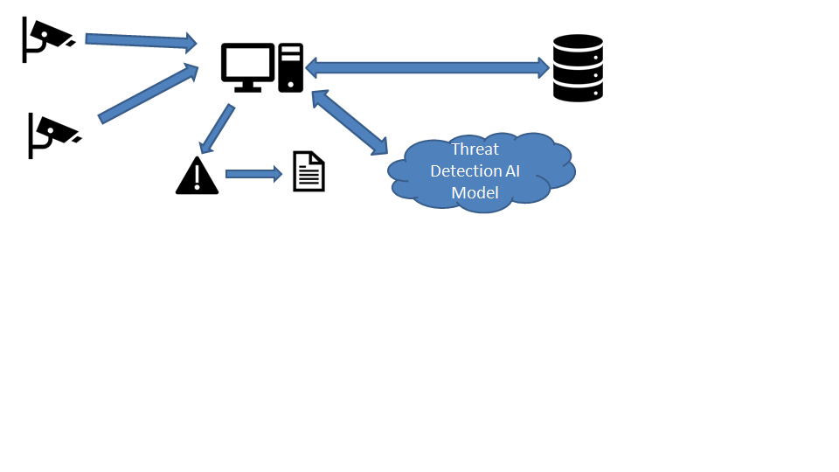
Proposed Work
A web application which can be accessed from anywhere and on any device.
No need to install any heavy ML model or utilities on the system as the entire AI/ML utilities will be cloud based on a remote location.
It will use an API of the Machine Learning model to detect any anomaly.

Slide 13
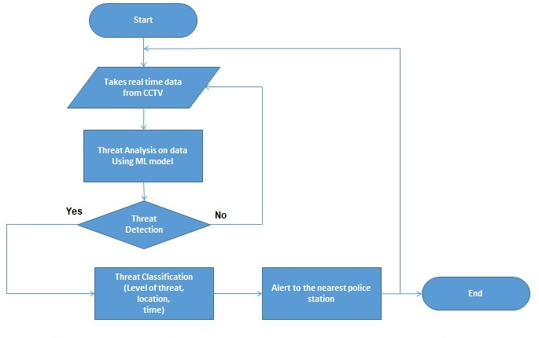
System Workflow:-

Slide 14
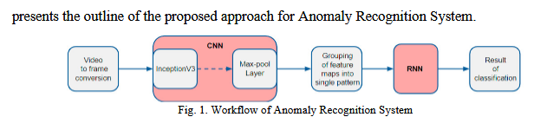
Workflow of AI Model:-
We are utilizing a Convolution (C3D)and LSTM to replace the traditional two stream-model. This model applies transfer learning as a widely used object identification models.
Video to Frame Conversion: Extracting frames from the captured CCTV/webcam/video recordings is the first step of this approach. The work extracts the frame after a fixed and small interval of time (say 1 sec). This extracted frame is then resized to the dimension 299x299 pixels which are the standard input dimensions.

Slide 15
Convolution Neural Network:
We employ the feature extraction part to the new model and re- train the classification part with our original dataset.
3. Grouping of feature maps into a single pattern:
To give the framework a sense of the sequence, multiple prepossessed frames are considered. Low-level features have been considered to generate a high-level feature map. These features are used for finding shapes and objects in computer images.

Slide 16
Recurrent Neural Network:
The actual probabilistic classification (Threat or No-Threat) of the framework is produced using this neural network.
Dataset:
UCF-Crime Dataset: Recordings that are manually altered, hoax recordings, news collected, the non-CCTV camera captured, or captured by a portable recording camera and containing aggregation are expelled from the dataset. Unnecessary footage like advertisements, inactivities and looped frames have been manually trimmed off from each video to reduce the size of the dataset and hence increasing the processing speed. It contains 12 real world anomalies viz. Abuse, Burglar, Explosion, Shooting, Fighting, Shoplifting, Road Accidents, Arson, Robbery, Stealing, Assault, Vandalism, Normal

Slide 17
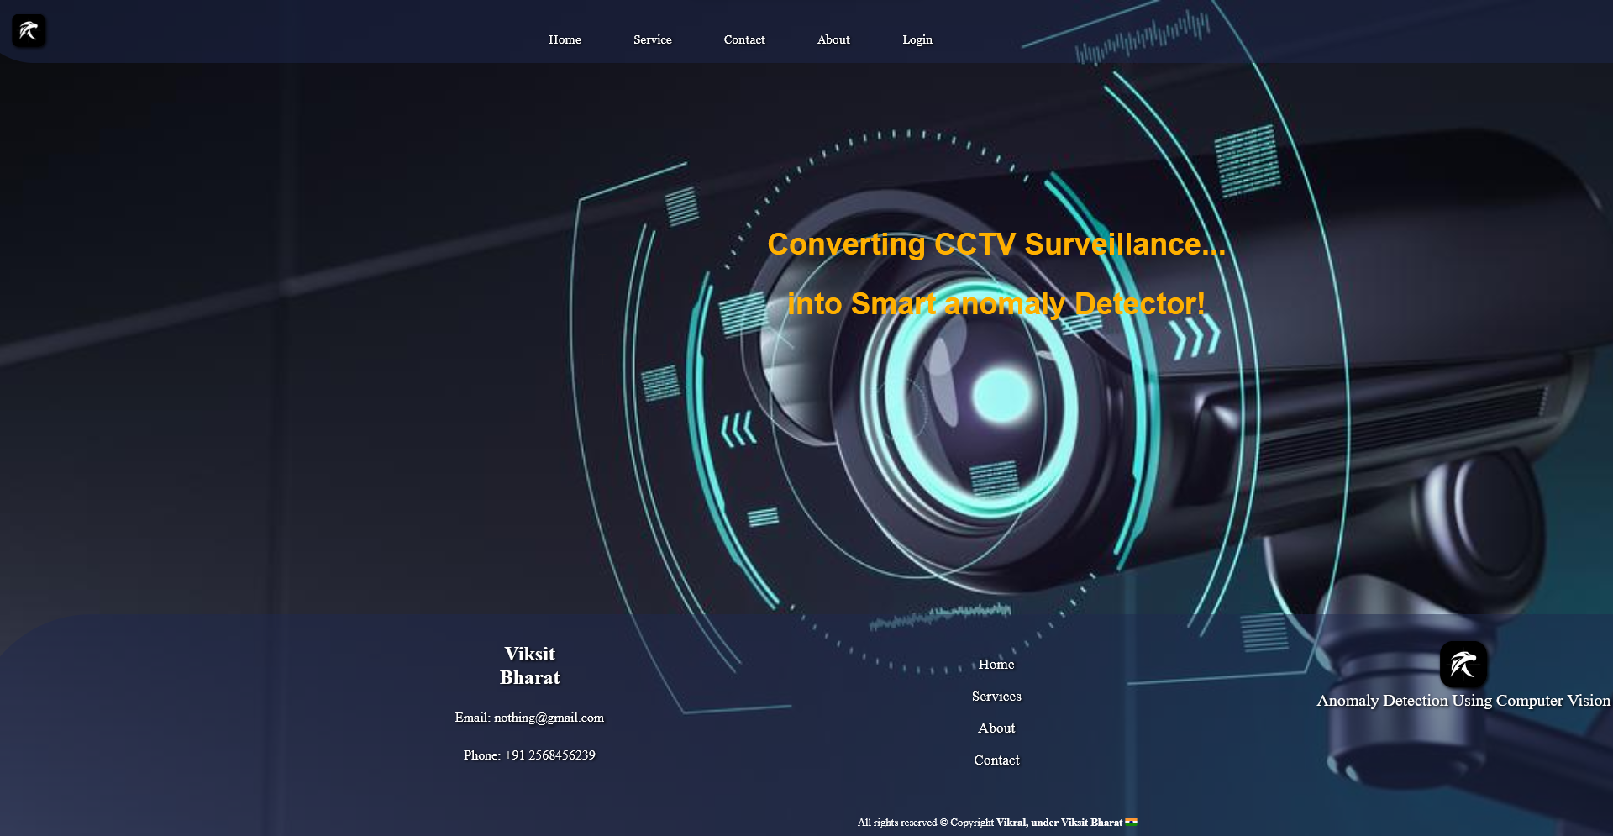
Project Glimpse
Website-Index:

Slide 18

Project Glimpse
Website-Services:

Slide 19
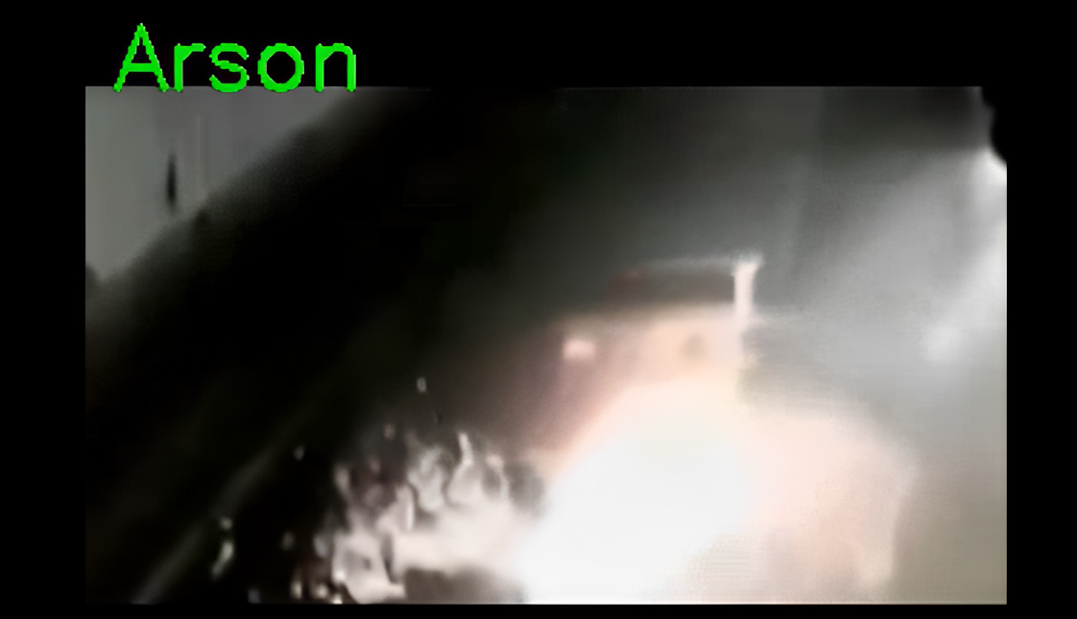
Project Glimpse
Event-Detection:

Slide 20
Conclusion
This work suggests an approach to spot variation from the norm in real-world CCTV recordings. The normal data alone may not be effective to distinguish abnormalities in these recordings.
Therefore, to handle the complexity of these realistic anomalies, both normal and anomalous videos have been considered and hence, maximized the accuracy of the model.
Furthermore, to prevent the efforts-requiring temporal annotations of abnormal sections in training recordings, a general model of anomaly detection has been learned utilizing two distinct neural networks with a poorly labelled dataset.

Slide 21
Thank You

