Slide 1
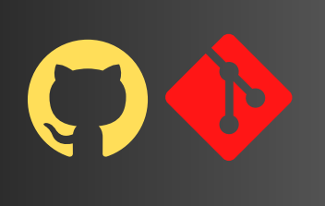
Git and
GITHUB
Version control System
(VCS)

Slide 2
The Problem

Slide 3
You want to write some <code/>
With a group of people

Slide 4
Solution: Version Control

Slide 5
What is Version Control ?
A system that keeps records of your changes
Allow for collaborative development
Allow you to know who made what changes and when
Allows you to revert the changes

Slide 6
Version Control System types
Local
Centralized
Distributed

Slide 7
Why VCS?
Backup and Restore: Files are safe against accidental losses or mistakes.
Collaboration: Multiple people can work on the same project
simultaneously.
Branching and Merging: Users can diverge from the main base of code, experiment, and then bring changes back in line without losing work.
Tracking Changes: You can see specific changes made and by whom.

Slide 8
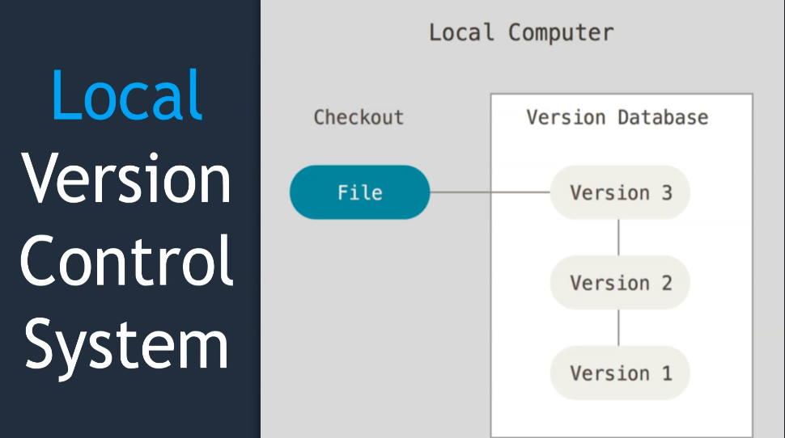
The Problem

Slide 9
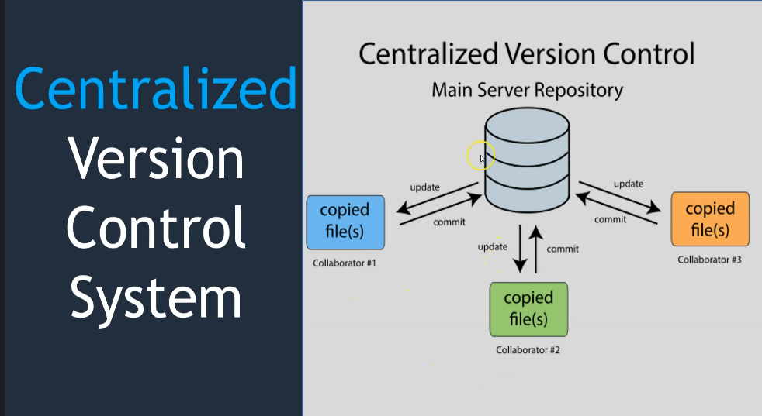

Slide 10
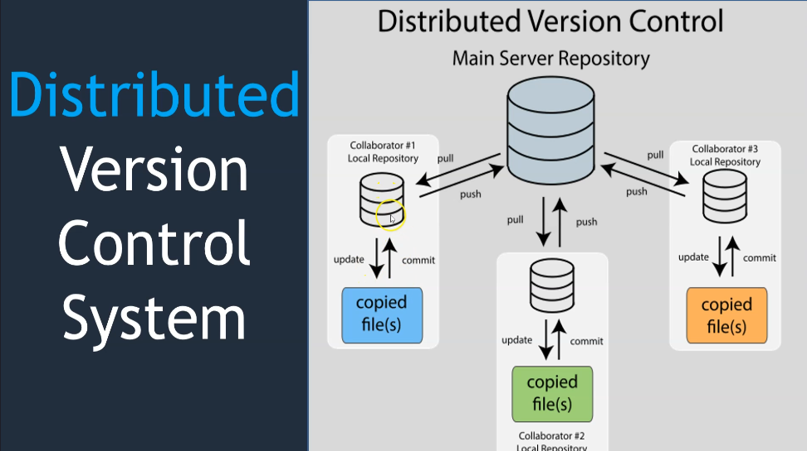

Slide 11
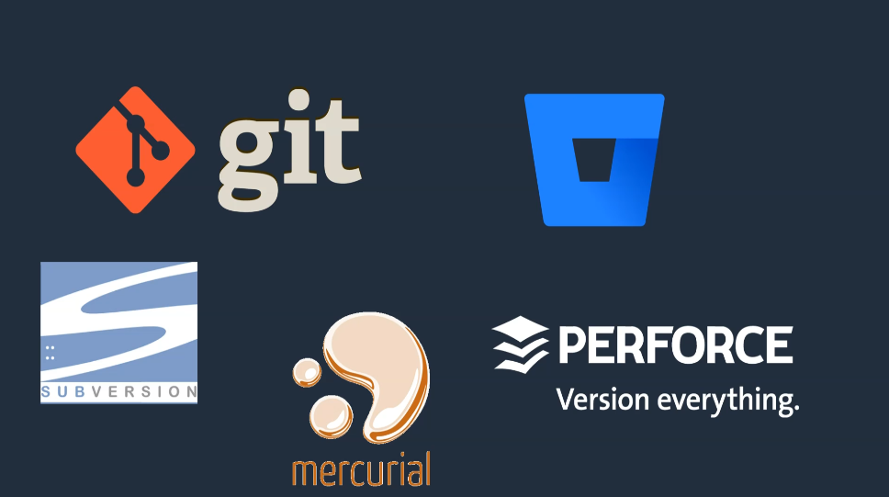

Slide 12
What is Git?
Git is a distributed version control system (VCS).
Git is a tool that helps multiple people work on the same code project or documents by tracking and managing changes to the files.

Slide 13
Installing Git

Slide 14
Git Environment
Developer 1 : on Windows system
Developer 2: on AWS Linux EC2 instance

Slide 15
Step-by-step installation of Git.
Configuring Git with your username and email.

Slide 16
Introduce yourself to Git
Start with below command
git config –global user.name “vicky”
git config –global user.email “vickykumawat.tp@gmail.com”
This is one time activity
To display user details
git config –global user.name
git config –global user.email

Slide 17
Before working with Git
All git command start with “git”
You should introduce yourself to git
Git works with repositories
Most of the git commands should run inside a git repository.

Slide 18
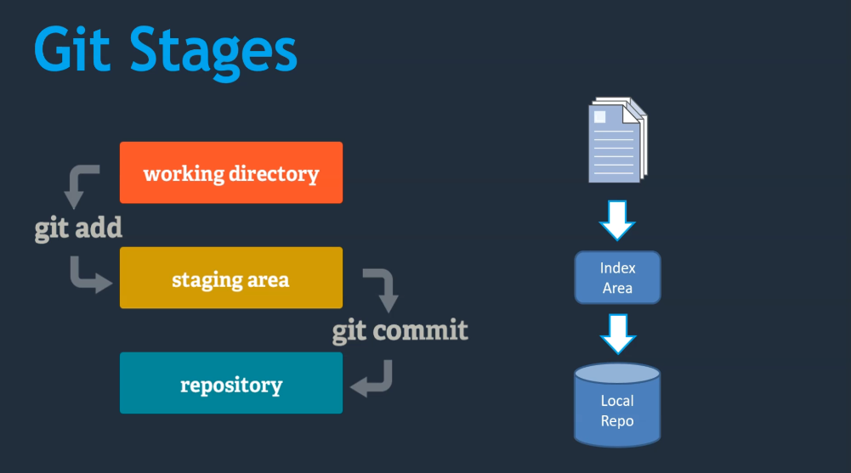

Slide 19
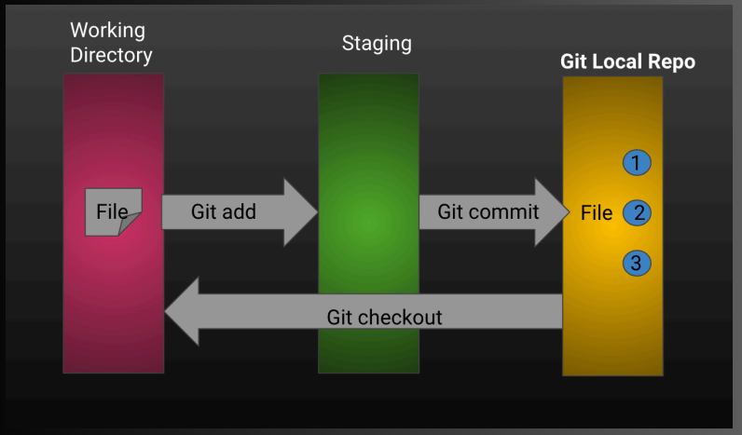

Slide 20
Git stages
git add - add files into staging area
git commit - add changes to local vcs
git status – shows current stage of repository
git log – shows commit history
git log -p -2 (last two commit with diff)
git log --stat (summary of changes)
git log --pretty=oneline

Slide 21
Git diff commands
git diff – compare changes of working directory with staging area
git diff –cached – compare changes of staging area with local repository
git diff HEAD – compare changes of working directory with local repository

Slide 23
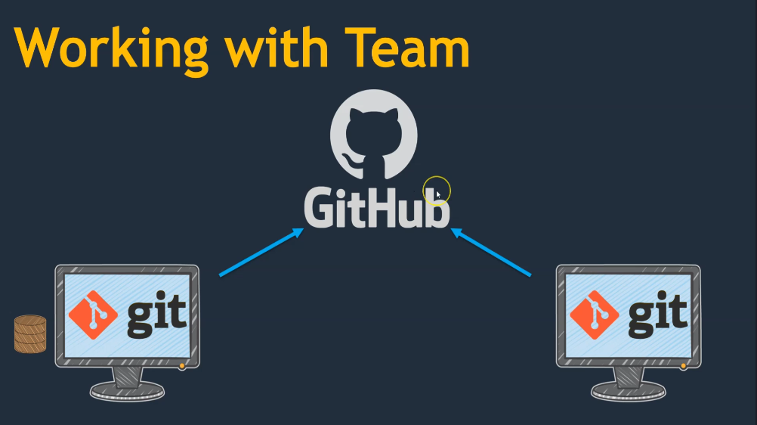
The Problem

Slide 24


Slide 25


Slide 26
Remote Repo
A remote repository refers to a version of your project that resides on a network server or a hosted repository on the internet.

Slide 27


Slide 28
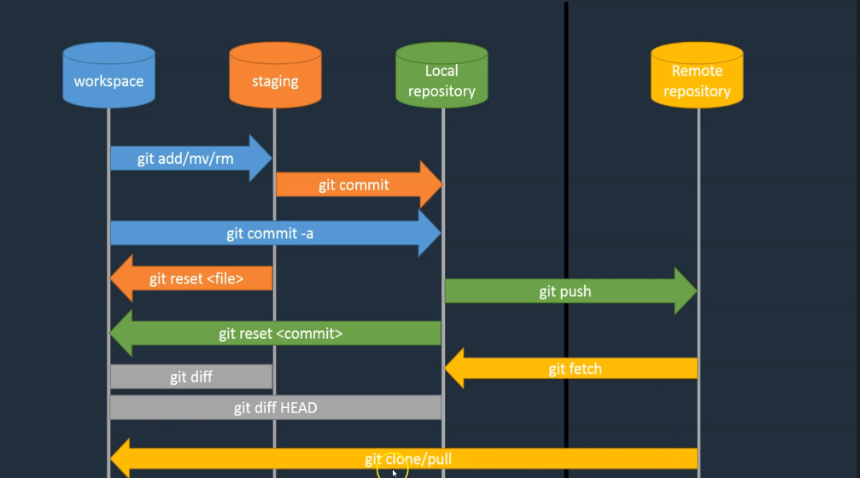

Slide 29
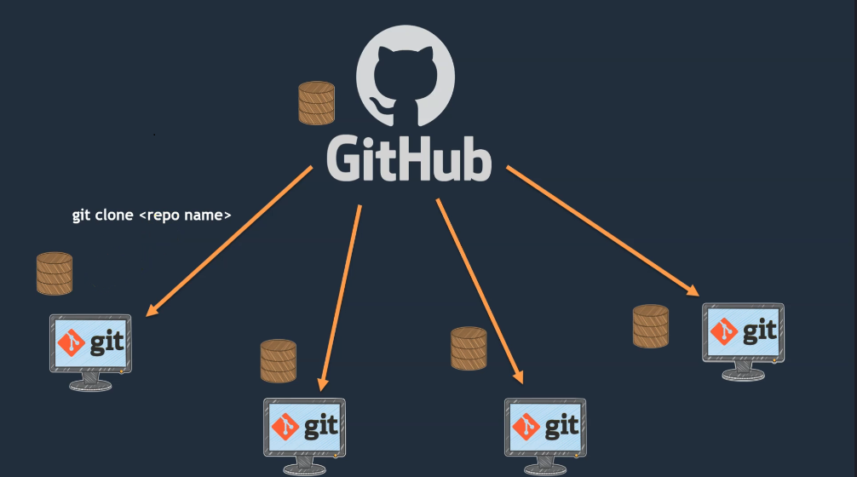
The Problem

Slide 30
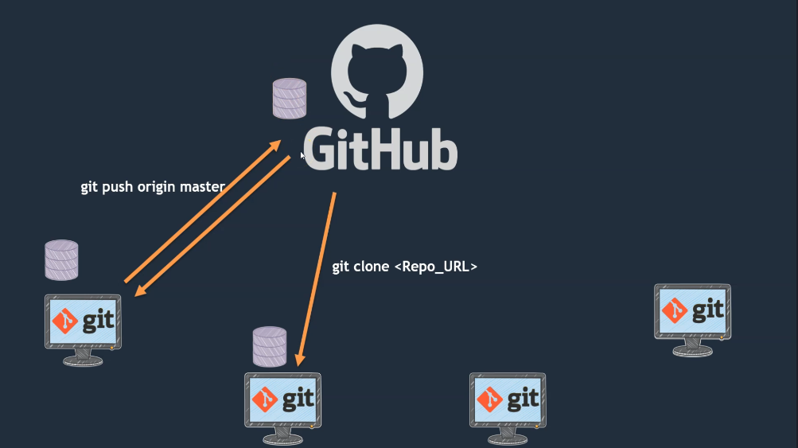

Slide 31
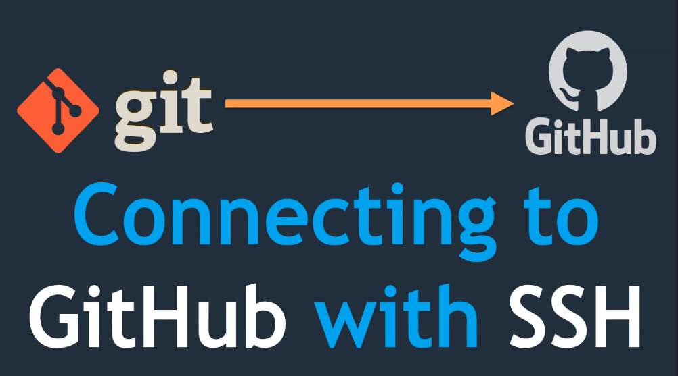

Slide 32
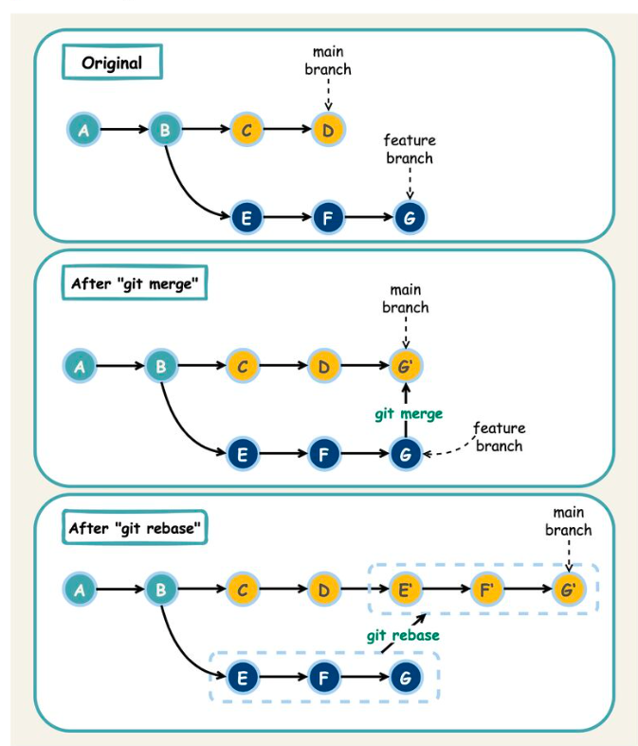
Github commit

Slide 33
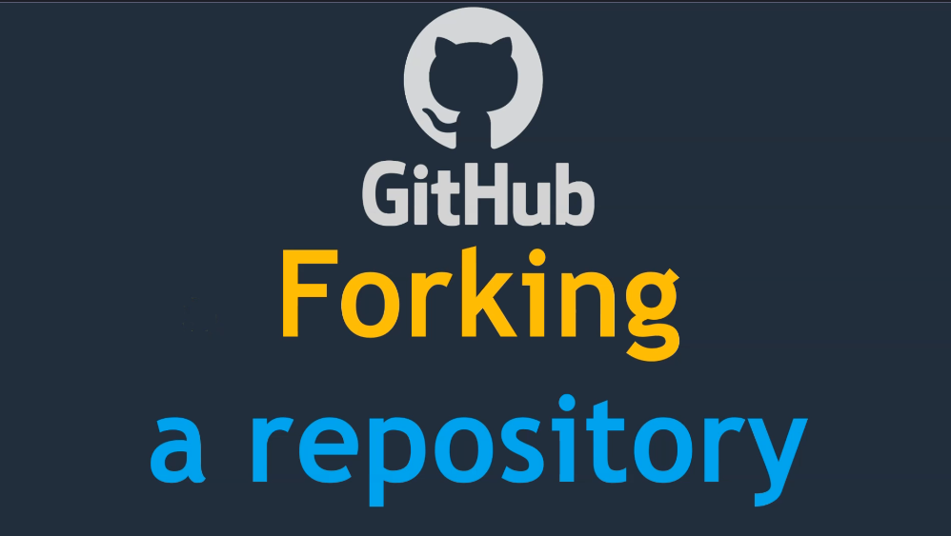

Slide 34
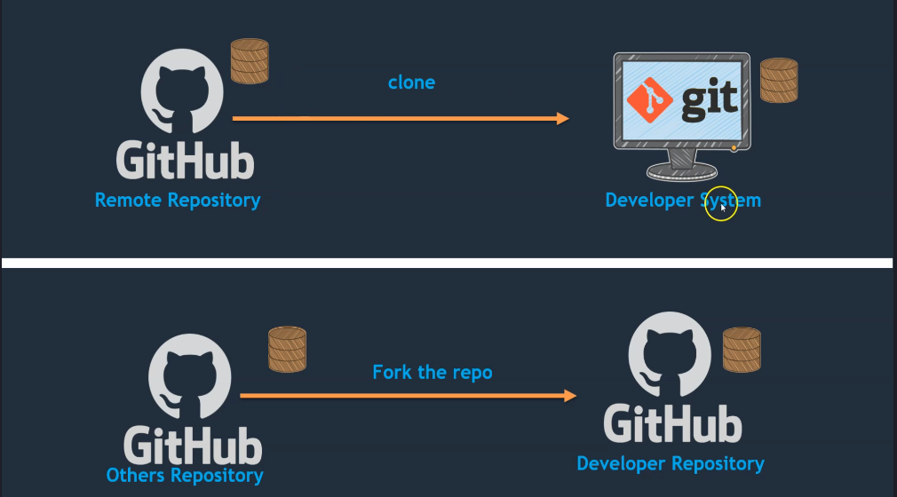

Slide 35

The Problem

Slide 36
