Slide 1




Slide 2
Business Information
Name
ClubAppPro
Owner
Deogiri Institute of Engineering and Management Studies
Address
Near Vits Hotel, Railway Station Road, Aurangabad.
Focused in
To Manage and Notify about all the Deogiri Clubs Activities and Events.

Slide 3

Business Requirements
User Requirements
Owner Requirements
Functional Requirements (Business Process)
Non-Functional Requirements (Validation for Module)

Slide 4
User Requirements
Admin Login
Interactive User Interface.
Ease of Accessing Contents.
Providing Security to Confidential Information.
Creating Post related to Events and Activities.
Total Clubs Display.
Designing a connective portal for successful feedback review.

Slide 5

Owner Requirements
Easy UI for Students for reading the information and giving feedback on the events and activities which are being conducted.
Ease of Registration Process with Security.
Focused on encouraging students to join Clubs and participated in all the Clubs Activities.

Slide 6
Functional Requirements
Keeping the Record of Students Login Details.
Keeping Record of Events and Activities which are being conducted by particular Deogiri Club.
Storing Students Feedback with suitable and optimised User-Interface with facilities like (Post Like and Comments)
Keeping the Details about Organized events.

Slide 7

Non-Functional Requirements
Require Valid Email Address and Contact for Identification of Students.
Required Password of at least 8 Characters in Length for Admin.
All the fields required for filling application form.

Slide 8
Proposed Solution
Module For Admin Login.
Module for Student Login.
Module For Arranging, Managing different events by Creating Events posts.
Module For taking feedback and response from the students.
Providing Notifications for upcoming events.

Slide 9
Activity Diagrams

Slide 10
Use Case Diagram
Login
User
Comments/
Feedback
Admin
Registration
Clubs Display
Post Creation
Post Display

Slide 11

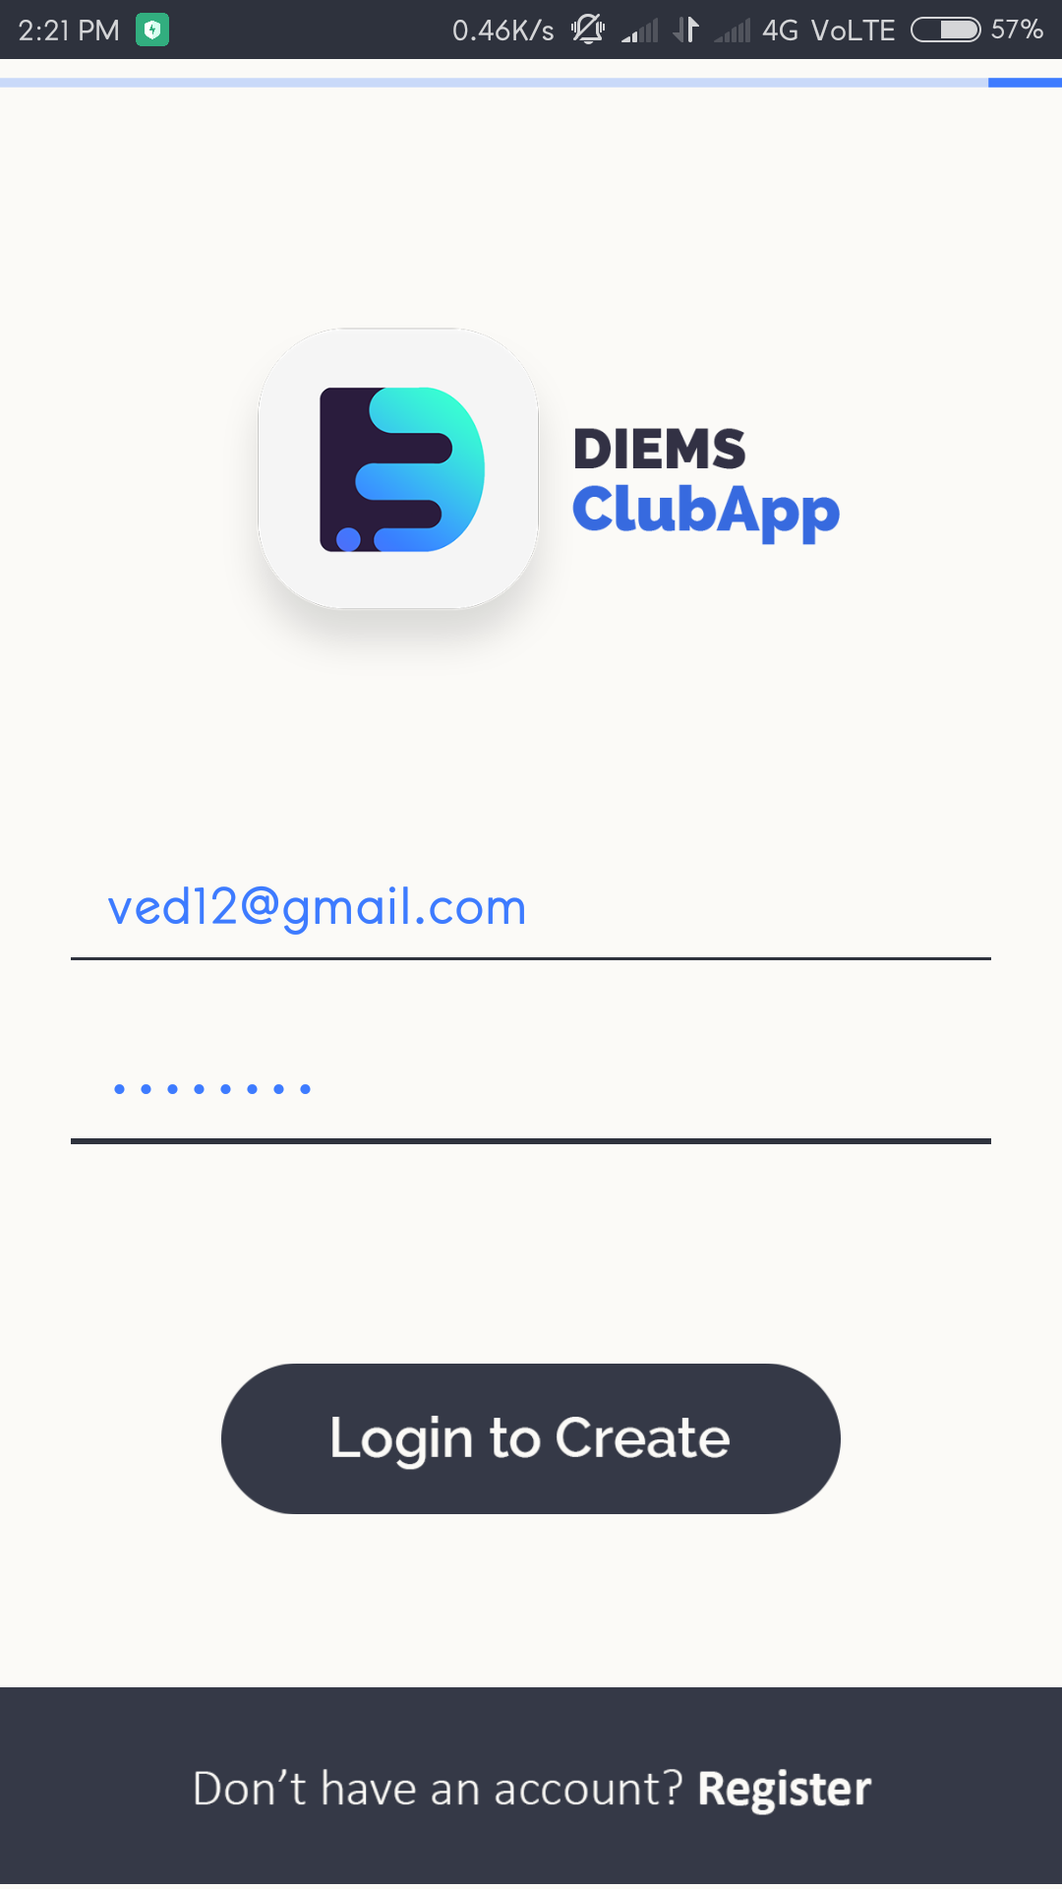
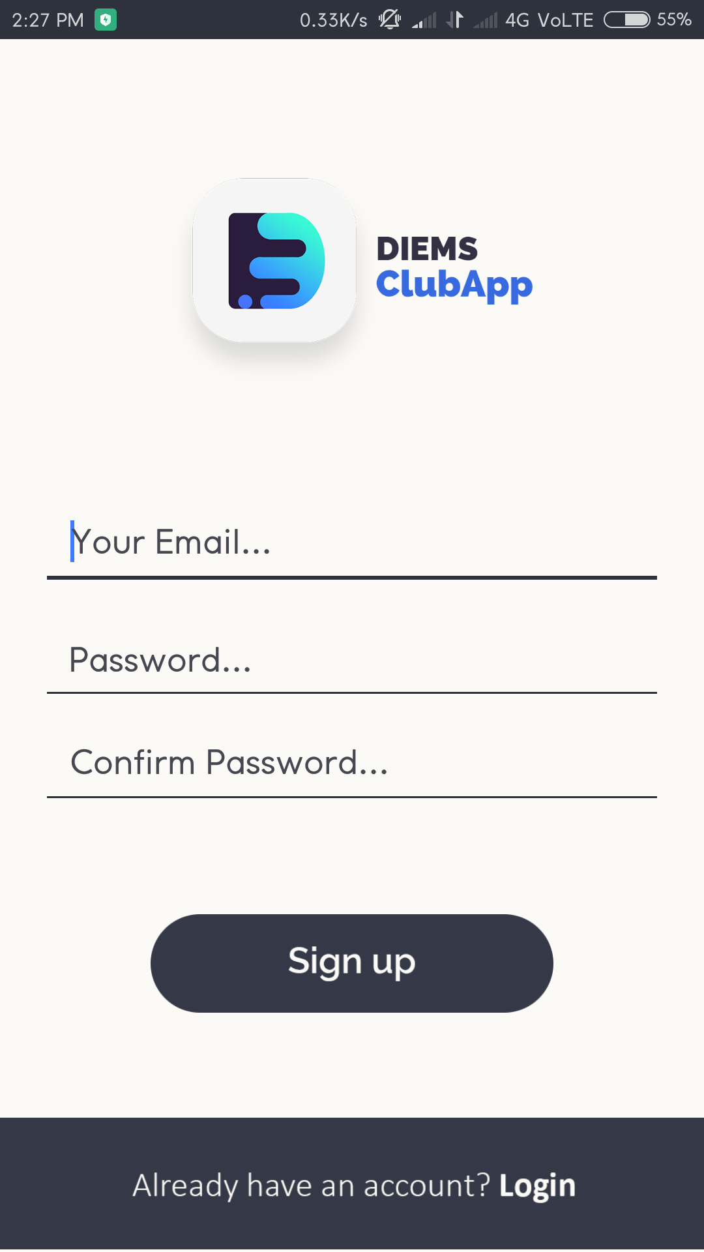

Slide 12
