Slide 1
0.8348
F1 score
Tuned Random Forest
87.60% accuracy · ROC-AUC 0.9497 · verified by re-scoring
Understanding Guest Cancellation Behavior
A Data-Driven Case Study on Hotel Booking Cancellation Prediction and Analysis
Activity 2 — Machine Learning · Natural Language Processing · Time-Series Analysis
Data Science — Case Study Activity 2 | Group 12
Vishwajeet Singh · Harsh Vishwakarma · Khatri Bhavya · Assudani Siddhi Satyankumar · Sadanand S
MCA Program, JAIN (Deemed-to-be University), Bengaluru | Submitted to: Kavya Bijith P
Notes:
Same title as Activity 1, because this is one project in two parts. Activity 1 profiled the data and stopped at the boundary of modelling. Activity 2 crosses it and adds two further techniques — NLP on guest reviews and time-series forecasting of daily cancellation volume.

Slide 2
Where Activity 1 stopped, and what Activity 2 adds
119,390
37.04%
31 → 297
3
Bookings — unchanged from Activity 1
Ended in cancellation
Predictors after encoding
Components: ML, NLP, Time-Series
Activity 1 ended with an explicit boundary
What this report delivers
“The scope of this case study is limited to dataset profiling, exploratory analysis, and visualization; the construction and evaluation of a trained cancellation classifier is identified as future work.”
1
Machine Learning
Four classifiers, cross-validated and tuned — Steps 71–105
2
NLP
33-step VADER study of 19,994 guest reviews
— Activity 1, Section II
3
Time-Series
31-step study of daily cancellation volume across 2024
The booking dataset, the target variable and the business question are unchanged. What changes is the method — from describing the average to predicting the individual booking.
Notes:
The quote is verbatim from Activity 1. It is the cleanest way to show the examiner that these two reports are one piece of work.

Slide 3
Leakage control: the decisive step before any model
reservation_status maps onto the target with no error at all across all 119,390 records.
reservation_status | is_canceled = 0 | is_canceled = 1
Check-Out | 75,166 | 0
Canceled | 0 | 43,017
No-Show | 0 | 1,207
One pipeline, fitted on training data only
1
Split
Stratified 80/20 — 95,512 train, 23,878 test, seed 42; 37.04% positive in both
2
Numeric
Median imputation → standard scaling
Every off-diagonal cell is zero. Kept in the feature set, this one column would have produced a near-perfect classifier that had learned nothing. Six columns were removed in total.
3
Categorical
Most-frequent imputation → one-hot, unknowns ignored
4
Imbalance
class_weight = balanced — no synthetic resampling
Because every transformation is fitted inside the pipeline, no test-set statistic ever reaches the training stage.
5
Result
31 predictors expand to 297 model inputs
Notes:
This slide is the integrity slide. If an examiner asks one methodological question, it will be about leakage, and the cross-tab answers it in three rows.

Slide 4
Random Forest leads on every metric computed
Model | Acc. | Prec. | Rec. | F1 | ROC | PR
Random Forest | 0.8590 | 0.8087 | 0.8112 | 0.8100 | 0.9356 | 0.9081
Decision Tree | 0.8437 | 0.7798 | 0.8058 | 0.7925 | 0.9259 | 0.8825
Logistic Regression | 0.8087 | 0.7263 | 0.7759 | 0.7503 | 0.8943 | 0.8522
Dummy Baseline | 0.6296 | 0.0000 | 0.0000 | 0.0000 | 0.5000 | 0.3704
The baseline is an instrument, not a candidate
62.96% accuracy, zero cancellations found.
ROC-AUC exactly 0.5000 — no discriminative power.
PR-AUC exactly 0.3704 — the positive-class rate, 8,845 / 23,878.
Both match theory to four decimal places, which validates the evaluation code before any claim is made about the real models.
F1 score by model on the 23,878-row held-out test set
Against that floor: +22.94 accuracy points and F1 from 0.0000 to 0.8100. Over Logistic Regression, +5.97 F1 points; over a single Decision Tree, only +1.75.
Notes:
Accuracy alone would have ranked the Dummy model respectable at 62.96%. That is Finding 2 and the reason every metric in this table is reported.

Slide 5
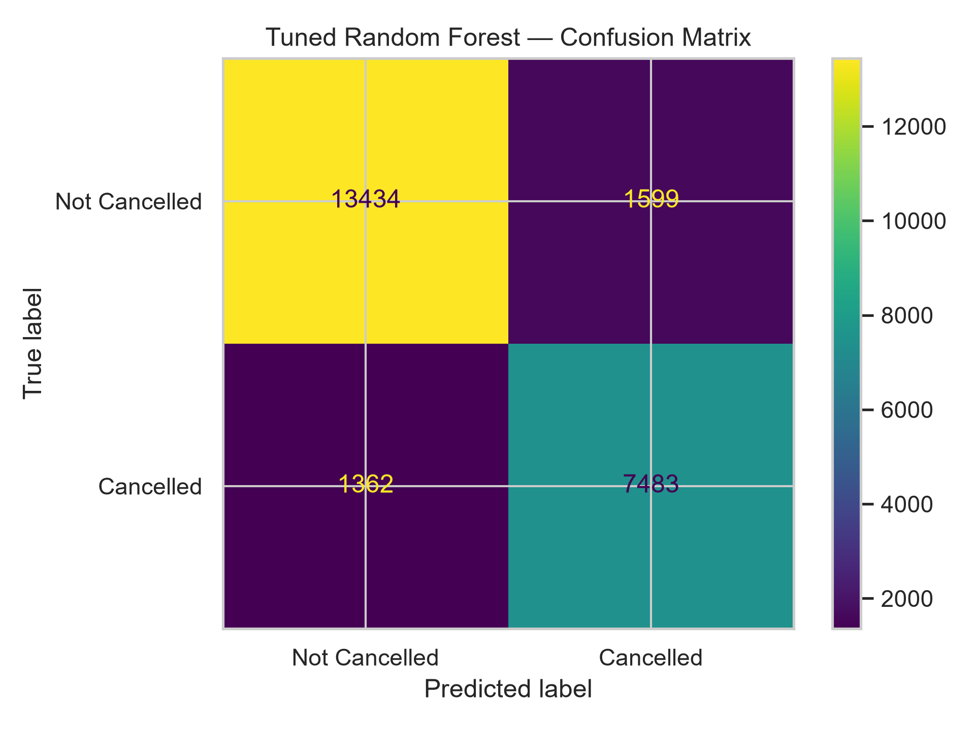
Cross-validation and tuning: 0.8100 → 0.8348
0.8106
0.8348
Cross-validated F1
± 0.0012 over 3 folds
Tuned test F1
+0.0248 over untuned
Metric | Untuned | Tuned | Change
Accuracy | 0.8590 | 0.8760 | +0.0170
Precision | 0.8087 | 0.8239 | +0.0152
Recall | 0.8112 | 0.8460 | +0.0348
F1 score | 0.8100 | 0.8348 | +0.0248
ROC-AUC | 0.9356 | 0.9497 | +0.0141
Matthews corr. | 0.6979 | 0.7358 | +0.0379
Tuned model on the random test split — TN 13,434 · FP 1,599 · FN 1,362 · TP 7,483
Randomised search: 8 configurations × 3 folds = 24 fits, scored on F1. Winner: 200 trees, unlimited depth, min_samples_leaf 1, max_features 0.5.
Both error cells fall: false alarms 1,697 → 1,599, missed cancellations 1,670 → 1,362. Every tuned metric was reproduced to nine decimal places by reloading the saved model.
Notes:
The tuning gain is real but modest. The honest framing is that it improved recall most, which is the metric that matters when the cost is an empty room.

Slide 6
Feature importance confirms Activity 1 by a different method
Lead time ranks first
Activity 1 ranked it first by linear correlation (+0.293). The model ranks it first among undivided columns — two methods, one answer.
Commitment signals protect
Special requests and parking carry 10.92% of total importance, and both are recorded free at booking time.
Who, not where
Segment and customer type carry 13.53% against 3.49% for hotel, city and month combined.
Six of eight confirmed
Six of Activity 1's eight findings are confirmed or acted on. None is contradicted.
Gini importance aggregated back to the source variable (%)
Gini importance is biased towards high-cardinality features, so country's 13.93% across 173 indicator columns is read with caution.
Notes:
The strongest thing to say here is that Activity 1 and Activity 2 used different mathematics and reached the same ranking. That is convergent evidence, not repetition.

Slide 7
What the headline number actually rests on
The dominant feature is a data artefact
Generalisation gap 0.141
Non Refund bookings cancel at 99.36% — 14,494 of 14,587 — and alone account for 32.77% of every cancellation in the dataset. deposit_type is the model's largest importance block at 19.05%.
A near-deterministic rate of this kind is not how guests behave; it is how a recording convention looks. Activity 1's Finding 3 withheld judgement here, and it was right to.
Train F1 0.9761 against test 0.8348. With no depth limit the 100 trees reach depths of 45–65 and hold 616,175 leaves — close to memorising.
No forward-time estimate
The chronological test splits by arrival date, not booking date: 99.0% of training bookings were made after the earliest test booking.
The verdict stated in the report
A verified analytical result and a strong final candidate — not a production-ready system. The single most informative experiment not yet run: re-train with Non Refund excluded and measure how much of the 0.8348 F1 survives.
Duplicate leakage negligible
On the 31-column matrix only 126 rows (0.11%) are non-unique and 20 test rows have a twin — an earlier concern, withdrawn.
Notes:
Presenting the limitations as part of the result, rather than as an apology at the end, is the difference between a student report and an audit.

Slide 8
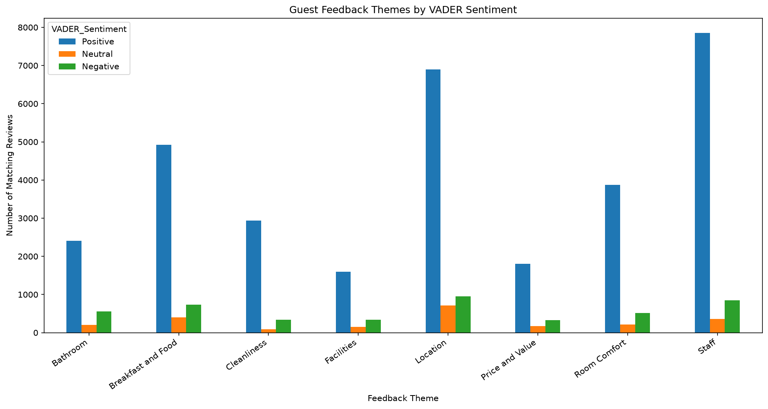
Natural Language Processing: what guests write about
19,994
75.51%
72.21%
56.7%
Reviews analysed
from a 515,738 corpus
Positive under VADER
13.00% negative
Agreement with
rating-derived labels
Of reviews rated < 5
caught as negative
Staff and Location dominate; Bathroom is the disproportionate complaint
Staff appears in 9,058 reviews and Location in 8,568. Bathroom ranks only sixth by total mentions but accounts for 21.47% of the negative class — the highest share of any theme.
Two honest qualifications
72.21% is an agreement rate, not an accuracy. No supervised classifier was trained and neither labelling is ground truth.
The lexicon under-detects complaints — praise and complaint were concatenated before scoring; the complaint field alone returns 28.24% negative.
Guest feedback themes by VADER sentiment
Notes:
If asked whether sentiment predicts cancellation: it cannot be tested here. The review corpus covers European hotels with no booking identifier; the two datasets are unlinked.

Slide 9
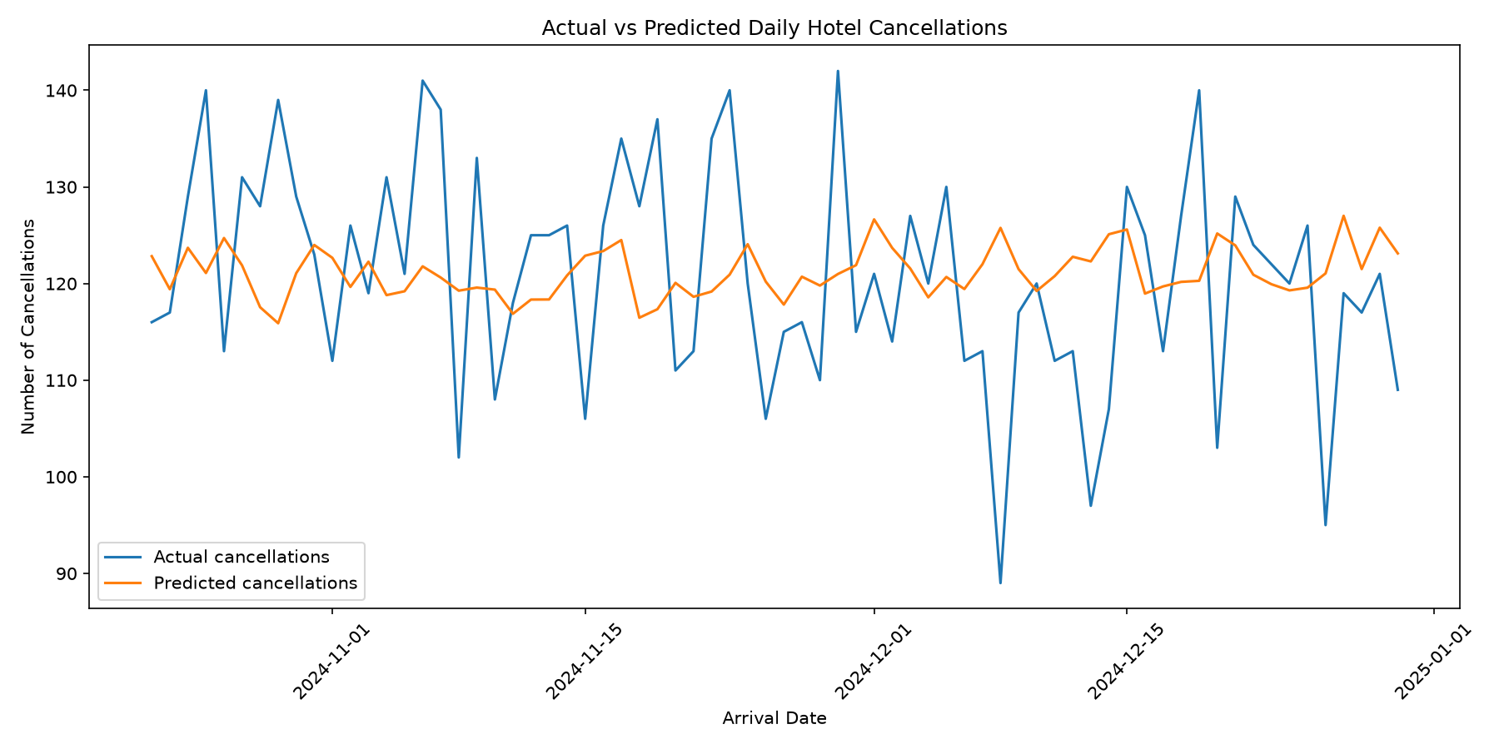
Time-Series: an honest negative result
Predictor | MAE | RMSE | R²
Previous 7-day rolling mean | 10.700 | 18.000 | +0.023
Random Forest regressor | 11.464 | 18.541 | −0.036
Predicting the test-period mean | 10.834 | 18.211 | 0.000
The baseline beat the model
A seven-day rolling mean outperformed the Random Forest on both error metrics — MAE 7.14% lower, RMSE 3.01% lower.
Neither predictor has real skill
Predicting a flat test-period average gives MAE 10.834. The baseline beats that by 0.134; the model loses to it by 0.630.
Evaluated over the same 71-day chronological window (281 training days, 22 Oct – 31 Dec 2024 test)
A negative R² is not an error
R² = −0.036 states that the model is 3.6% worse than a flat average — the expected outcome for a short, stationary, weakly autocorrelated series.
There is little structure to learn
ADF p = 4.61 × 10⁻²⁹ confirms stationarity, and monthly cancellation rates vary by only 1.42 percentage points across 2024.
Notes:
This is the slide to deliver confidently rather than apologetically. Establishing that a problem is not solvable with the available data is a finding, and the project files already said the baseline won.

Slide 10
What the three components tell the business
Signal | Honoured | Cancelled
Lead time, mean days | 79.98 | 144.85
Lead time, median days | 45.0 | 113.0
Special requests | 0.714 | 0.329
Car parking reserved | 0.099 | 0.000
Booking changes | 0.293 | 0.098
Previous cancellations | 0.016 | 0.208
The operational reading
Lead time is the clearest behavioural separator — cancellations are booked 145 days ahead against 80, and the gap survives at the median.
Commitment signals are free — a booking that reserved parking essentially never cancelled, and all three signals are captured at reservation at no cost.
Cancellation rate by segment — the 37.04% overall rate shown for reference
Notes:
Direct bookings cancel at 17.46% against 41.03% through travel agents and tour operators — a gap of more than twenty-three percentage points, and the clearest commercial lever in the dataset.

Slide 11
Recommendations across four fronts
Operational
Data & pipeline
Score every booking at reservation and route the high-risk tail into follow-up — supported at 84.60% recall, 82.39% precision
Re-confirm bookings made more than ~113 days ahead
Tighter terms for the Groups segment (61.06%); promote the direct channel (17.46% vs 41.03%)
Use the 7-day rolling mean, not a model, for volume planning
Audit the Non Refund recording convention, and report performance with and without that category
Complete Activity 1's Findings 7 and 8 — cap the adr outliers, transform the skewed counts
Group the 173 country indicators into top-N plus Other
Re-aggregate the series by cancellation date, not arrival date
Modelling
NLP & forecasting
Re-run the tuned pipeline with Non Refund excluded — the single most informative missing experiment
Build a true forward-time split on arrival date minus lead time
Constrain depth or use boosting with early stopping; compare generalisation gaps
Replace Gini with permutation importance or SHAP; calibrate the probabilities
Train a supervised sentiment classifier on a TF-IDF or embedding representation — the largest outstanding requirement
Score the positive and negative fields separately, not concatenated
Apply stop-word removal and lemmatisation before n-gram analysis
Obtain a review corpus for the same properties before linking sentiment to cancellation
Notes:
Completed work and proposed future work are kept strictly separate throughout the report. Nothing on this slide is claimed as done.

Slide 12
Conclusion
MACHINE LEARNING
NLP
TIME-SERIES
A verified classifier
A credible description
An honest negative
Tuned Random Forest at F1 0.8348, accuracy 87.60%, ROC-AUC 0.9497 — reproduced to nine decimal places by re-scoring the saved model.
19,994 reviews: 75.51% positive, Staff and Location dominant, Bathroom most disproportionately negative. An agreement rate, not an accuracy.
The seven-day rolling mean beat the model, and barely beat a flat average. Daily volume is close to unforecastable from one year of history.
Two reports, one project — and an honest account of what the result rests on.
Activity 1 profiled the data and stopped at the boundary of modelling; Activity 2 crossed it and arrived at the same conclusions by a different method — six of its eight findings confirmed, none contradicted. The project's principal contribution is not any single metric but the discipline of checking each one: leakage removed before training, a baseline that exposed accuracy as misleading, a saved model reloaded to confirm its own numbers, and a reference predictor that revealed a forecasting model to be no better than an average.
Thank you | Questions
Notes:
Close on the number the project still owes: how much of the 0.8348 F1 survives once the Non Refund category is excluded.

