Slide 1
CASE STUDY
Predictive Hardware Failure Analytics
Transforming Raw Data into Actionable Insights through Data Preprocessing, Analysis & Visualization
Dataset: Backblaze Hard Drive SMART Telemetry (Q1 2026) | 30.9M records | 351,095 drives | 80 models
Group Project Team • MCA, JAIN (Deemed-to-be University) • Faculty: Dr. I Brem Navas

Slide 2
Agenda
01
Problem Statement & Dataset
02
Data Preprocessing Pipeline
03
Exploratory Data Analysis
04
Key Visualizations
05
Key Insights & Findings
06
Recommendations & Conclusion
1

Slide 3
Problem Statement
Unplanned hard-drive failure causes data loss, downtime, and costly emergency replacement in data centres.
30.9M
351,095
Every drive continuously logs SMART health telemetry — but the raw feed has missing values, duplicates, and extreme outliers.
Drive failure is a rare event, creating a severe class-imbalance analytical challenge.
Goal: clean, analyse & visualise real telemetry to identify which signals are associated with failure, as the foundation for predictive maintenance.
Raw daily records
Unique drives
80
90
Drive models
Days observed
2

Slide 4
Dataset Description
Backblaze Hard Drive "Drive Stats" SMART telemetry — Q1 2026 extract
Attribute | Description
date, serial_number, model | Record date, unique drive ID, drive model (3 categorical fields)
capacity_bytes | Drive storage capacity
failure | Target label — 1 if drive failed on that date, else 0
SMART 5 / 9 / 90 / 187 / 188 / 197 / 198 | 7 paired SMART health attributes (normalized + raw), 14 numeric columns
Top 5 Drive Models by Volume
WDC WUH722222ALE6L4
4,038,443
TOSHIBA MG08ACA16TA
3,587,969
TOSHIBA MG07ACA14TA
3,380,872
ST16000NM001G
3,132,694
WDC WUH721816ALE6L4
2,392,299
Why this dataset fits the case study:
Top 5 models ≈ 53% of all daily records
30.9M records, 351K devices, 19 attributes — far exceeds the 500-record minimum, and its multi-gigabyte scale required memory-aware engineering (float32/int8 downcasting, sparse encoding).
3

Slide 5
Data Preprocessing Pipeline
1
2
3
4
5
Missing Values
Duplicates
Outliers
Encoding
Standardization
→
→
→
→
Median (numeric) / mode (categorical) imputation
345,662 exact duplicate rows removed
1.5×IQR detection + capping on 15 features
High-cardinality check; no 1-hot encoding required
StandardScaler on 15 continuous features
Metric | Before | After
Rows | 30,943,146 | 30,597,484
Duplicate rows | 345,662 | 0
Missing values | 122,124,538 cells | 0
Memory footprint | 9,190.94 MB | 7,337.45 MB
4

Slide 6
EDA: Extreme Class Imbalance
99.9966%
of daily records are healthy drives
0.0034%
of records are failures — 1,054 events
(≈ 1 in every 29,357 records)
Implication: any model must use class-imbalance-aware techniques — plain accuracy is meaningless here.
5

Slide 7
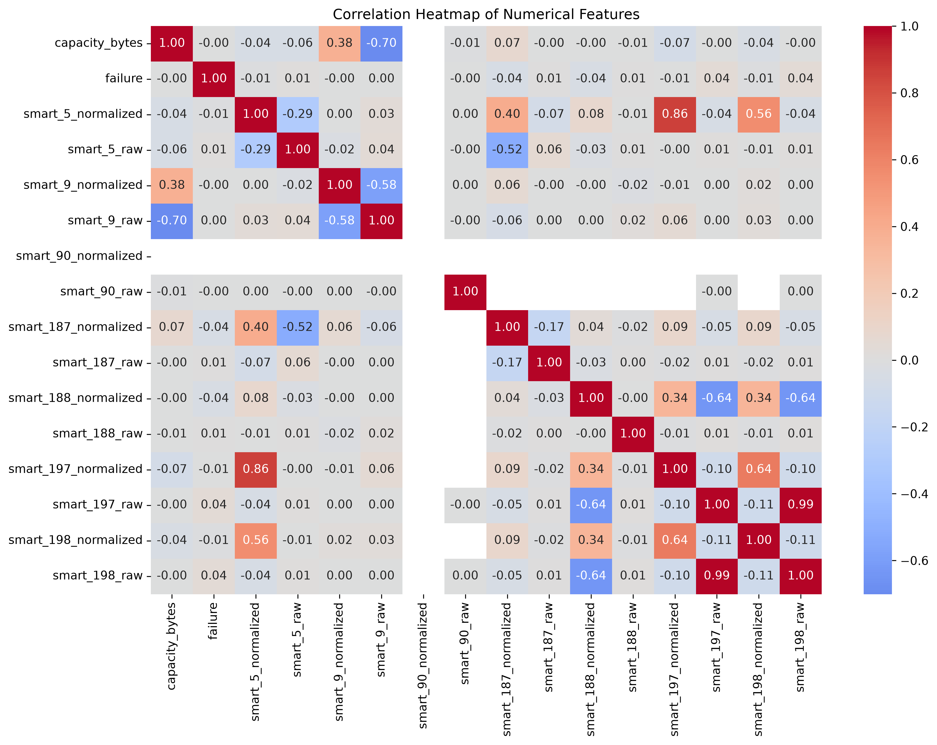
EDA: Correlation Structure
Strongest relationships
Feature pair | r
smart_197_raw ↔ smart_198_raw | +0.99
capacity_bytes ↔ smart_9_raw | -0.70
smart_9_normalized ↔ smart_9_raw | -0.58
capacity_bytes ↔ smart_9_normalized | +0.38
failure ↔ smart_198_raw | +0.038
smart_90 is the only attribute that stays constant (reported by just 13.65% of drives); the other paired SMART attributes retain real structure on the raw feed — SMART 197 and 198 (raw) move almost in lockstep (r = 0.99).
6

Slide 8
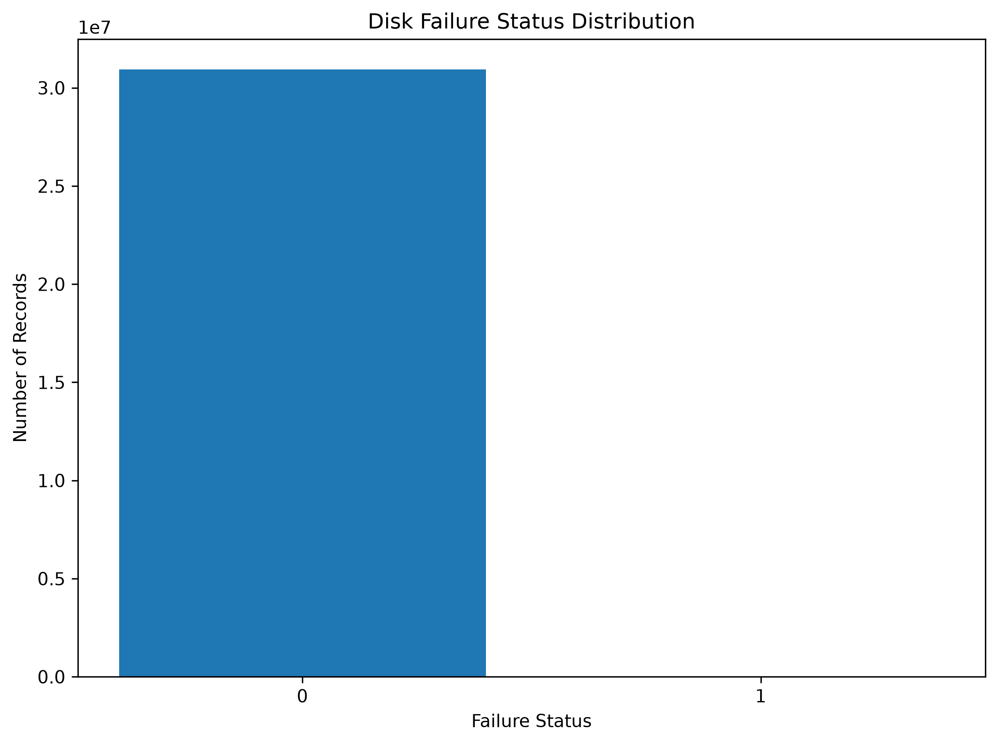
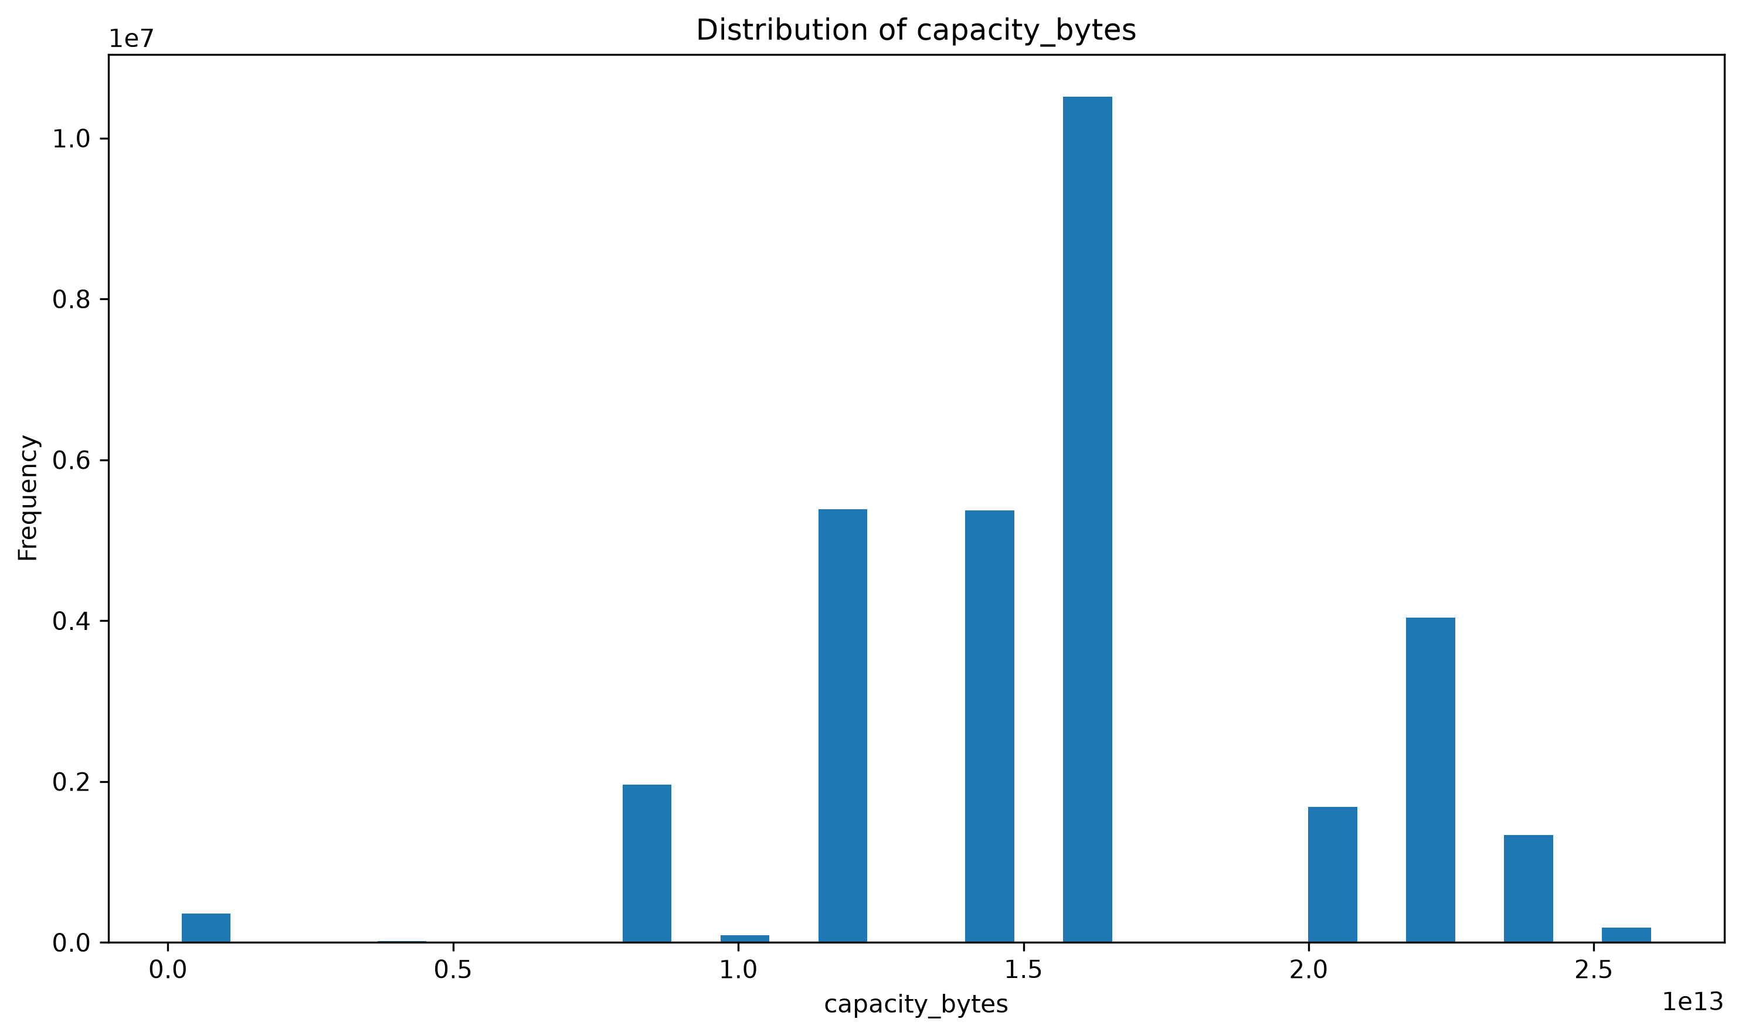
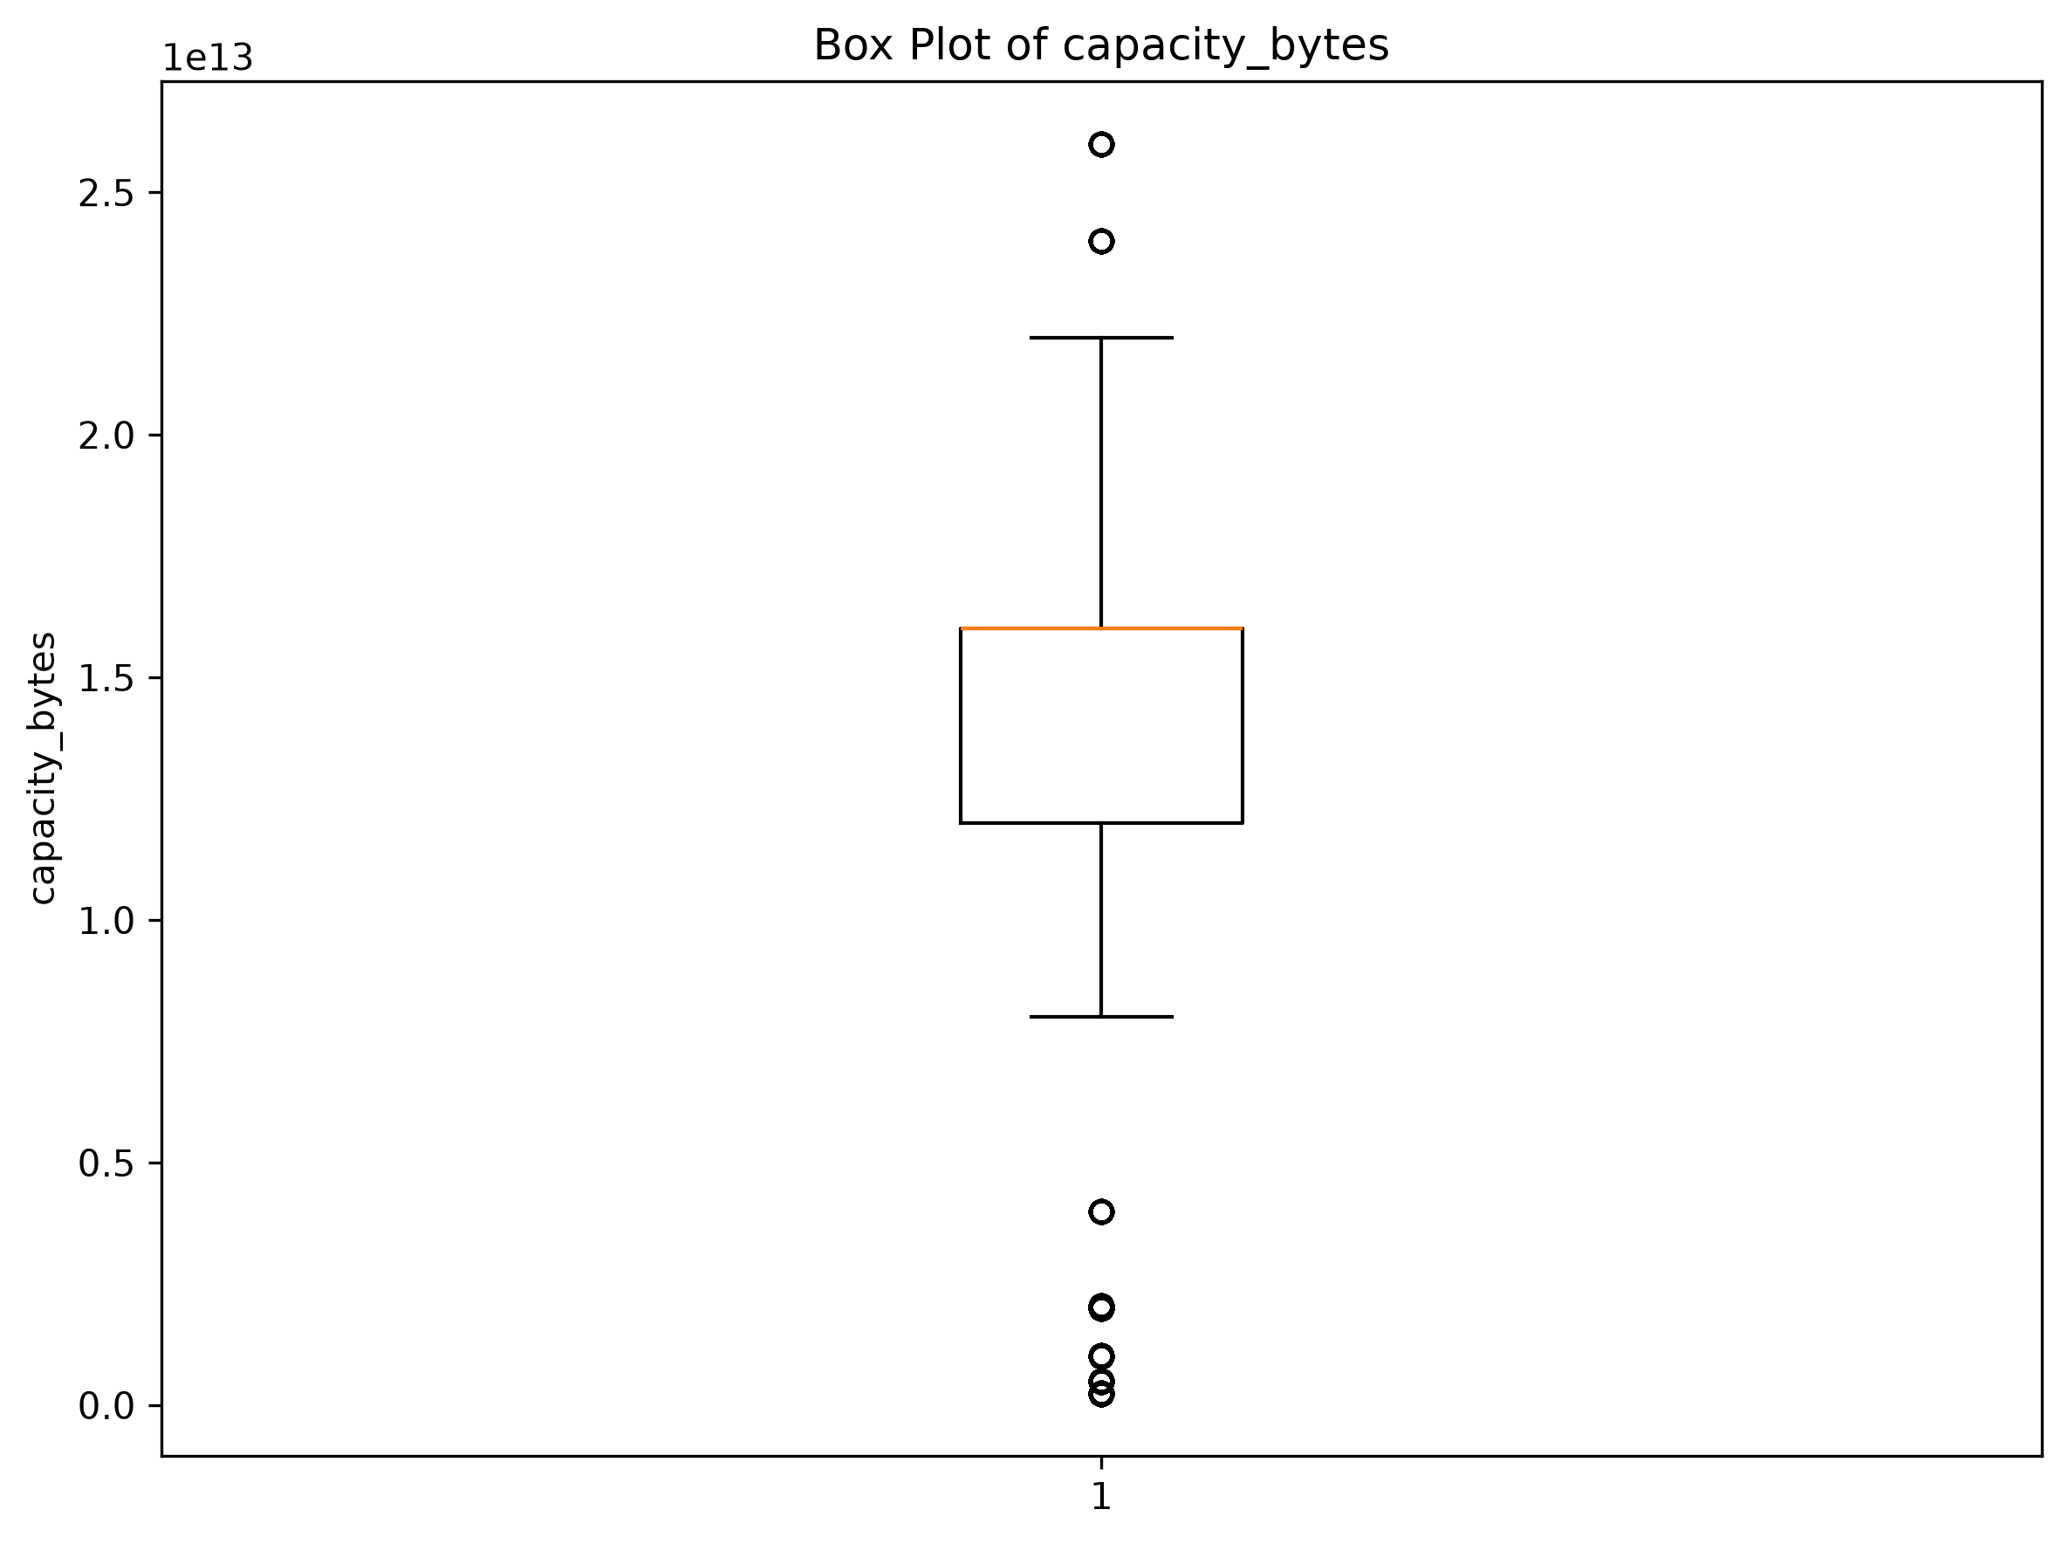
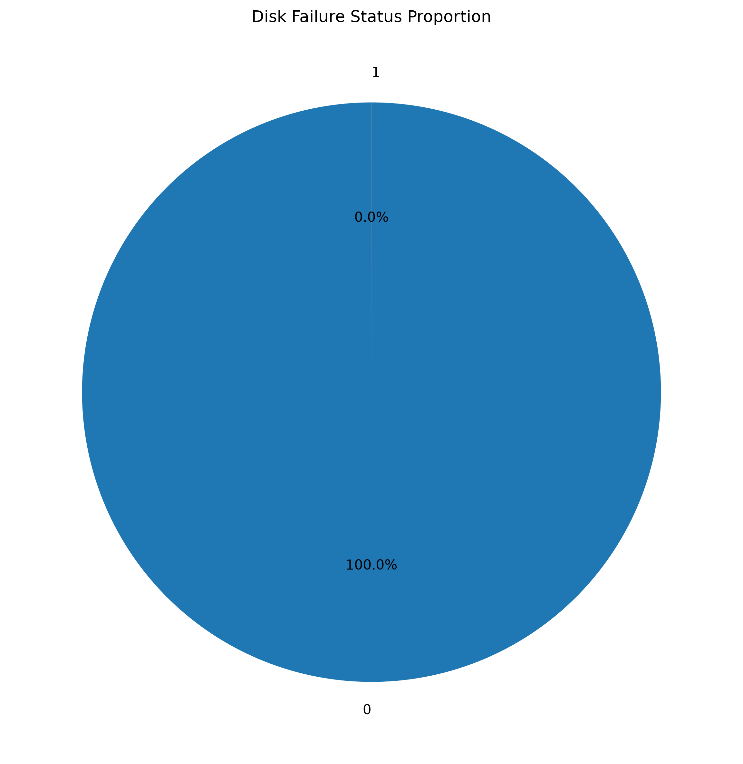
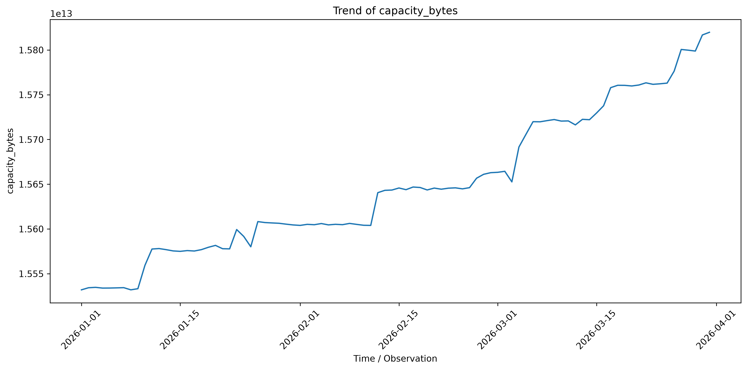
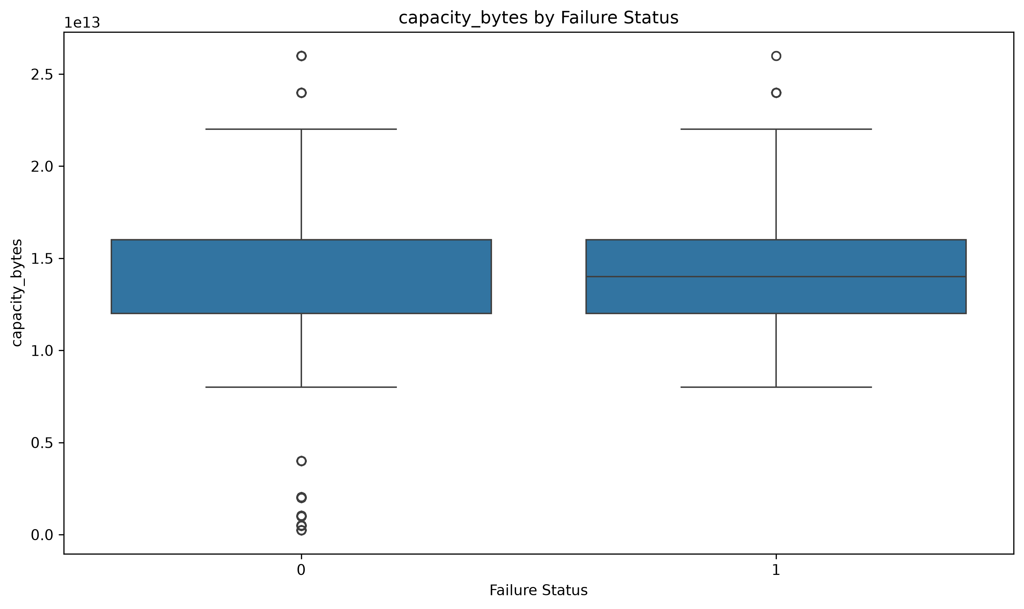
Visualization Gallery
Bar Chart — Failure Status
Histogram — Capacity Distribution
Box Plot — Capacity Spread
Pie Chart — Failure Proportion
Takeaway
Failed drives average 1.48×10¹³ bytes of capacity vs. 1.57×10¹³ bytes for healthy drives — visually confirmed by the failure-status box plot above.
Line Chart — Capacity Trend Over Time
Box Plot — Capacity by Failure Status
7

Slide 9
Key Insights (1 of 2)
01
Failure is an extreme rare event
Only 0.0034% of records are failures (1,054 of 30,943,146) — imbalance-aware modelling is essential.
02
SMART 197 and 198 (raw) move almost in lockstep
r = 0.99 between smart_197_raw and smart_198_raw — the two uncorrectable/pending-sector counters likely capture the same wear mechanism.
03
Capacity and power-on hours remain entangled
capacity_bytes and smart_9_raw (power-on hours) are strongly negatively correlated (r ≈ -0.70) — larger-capacity drives have, on average, fewer duty hours.
8

Slide 10
Key Insights (2 of 2)
04
Failed drives run smaller-capacity on average
Mean capacity is 1.48×10¹³ bytes for failed drives vs. 1.57×10¹³ bytes for healthy drives, across the full 30.9M-row population.
05
Fleet volume is concentrated in 5 models
Just 5 of 80 drive models generate ≈53% of all daily records — fleet-wide stats mask model-specific risk.
06
Cleaning materially changed the dataset
345,662 duplicates + up to 3.9M outlier values in a single feature were resolved before analysis began.
9

Slide 11
Recommendations
Operational
Analytical / Modelling
Prioritise power-on hours in maintenance scheduling
Track failure rate per drive model, not only fleet-wide
Report incidence per 10,000 drive-days, not raw %
Investigate SMART reporting gaps with vendors
Use imbalance-aware modelling (class weights / resampling / anomaly detection)
Re-source or engineer indicators for the constant SMART fields
Model time-to-failure (survival analysis) using power-on hours
Segment models by drive family before pooling results
Extend the observation window beyond 90 days for more failure events
10

Slide 12
Conclusion
A complete pipeline — cleaning, EDA, and visualization — turned 30.9M raw telemetry rows into a validated, decision-ready analytical dataset.
Failure remains extremely rare (0.0034%); capacity and power-on hours remain entangled (r ≈ -0.70), and SMART 197/198 (raw) move almost in lockstep (r = 0.99).
A significant data-completeness gap (66–86% missing on several SMART fields) was surfaced as a genuine limitation, not a modelling failure.
Rigorous preprocessing was decisive: 345,662 duplicates and millions of outlier values separated the raw feed from analysis-ready data.
11

Slide 13
Thank You
Questions & Discussion
Predictive Hardware Failure Analytics | Group Project Team | MCA, JAIN (Deemed-to-be University)

