Slide 1


M.Tech/MCA Program
Advanced Industry Integrated Programs
Jointly offered by University and LTIMindTree
RAG Based Telecom RAN Assistant
Review III
VISHWA M - 25MML0039
VIT-VELLORE

Slide 2
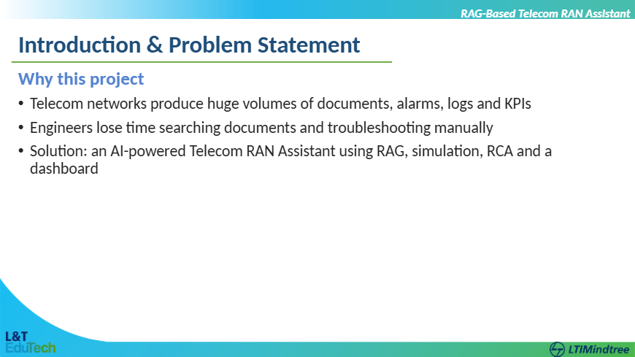

Slide 3
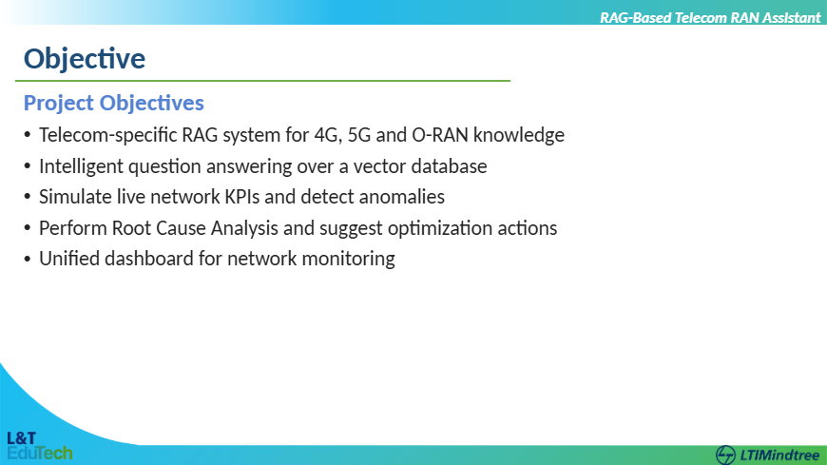

Slide 4
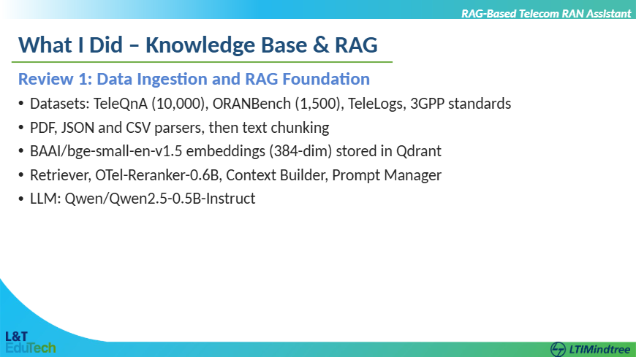

Slide 5
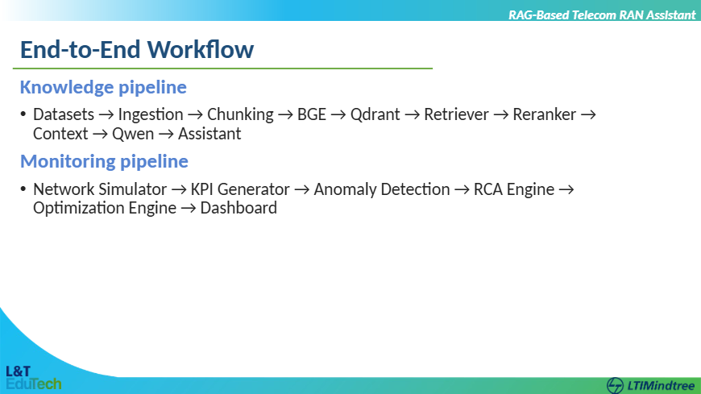

Slide 6
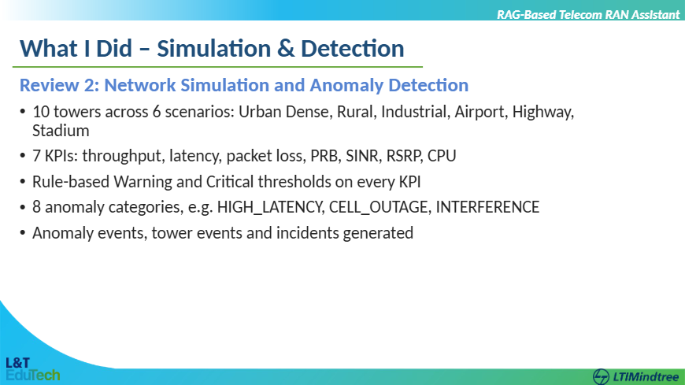

Slide 7
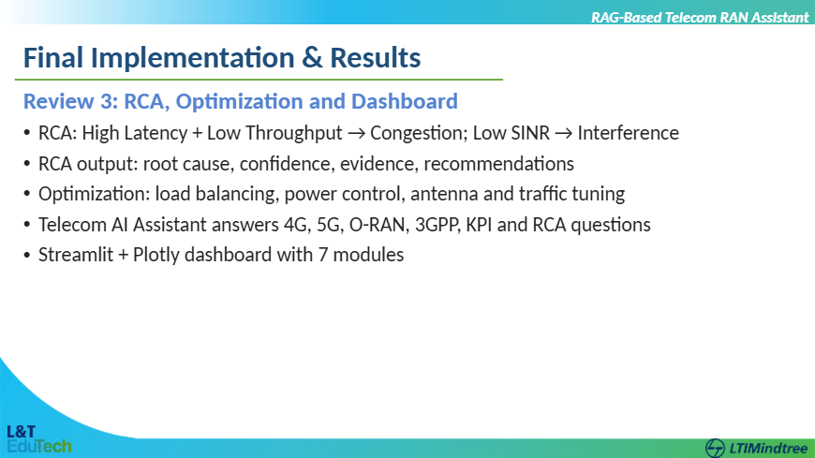

Slide 8
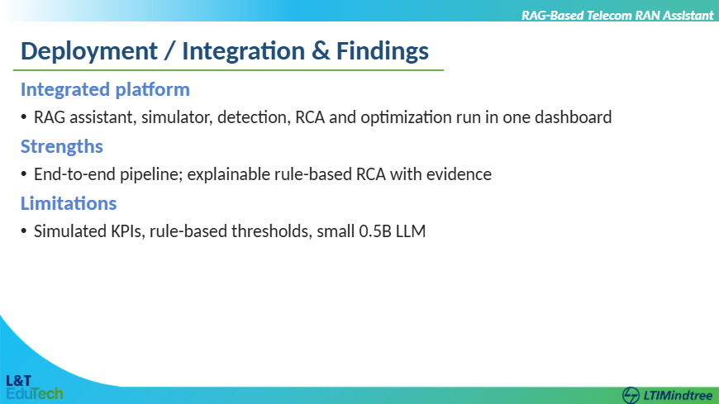

Slide 9
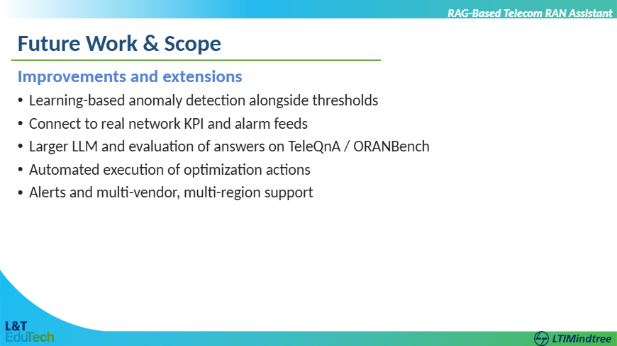

Slide 10
RAG-Based Telecom RAN Assistant
Conclusion
Delivered an end-to-end RAG-based Telecom RAN Assistant
Knowledge retrieval, simulation, anomaly detection, RCA and optimization work together
One interactive dashboard for network monitoring and AI assistance

