Slide 1

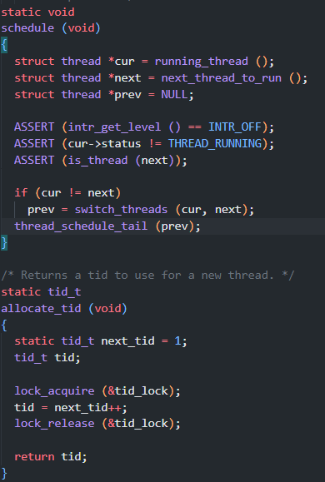
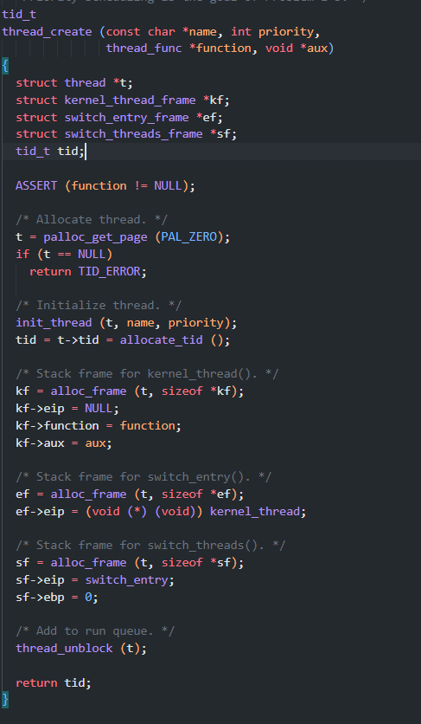
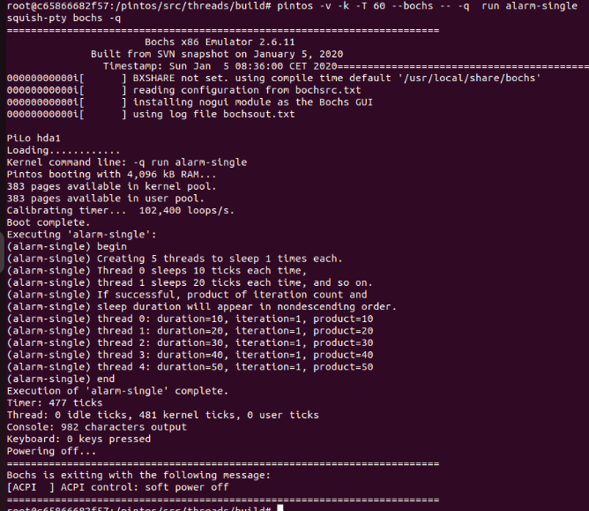
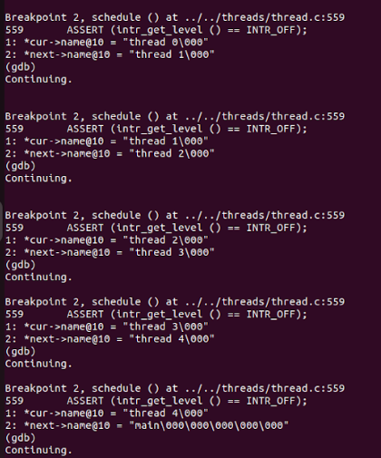
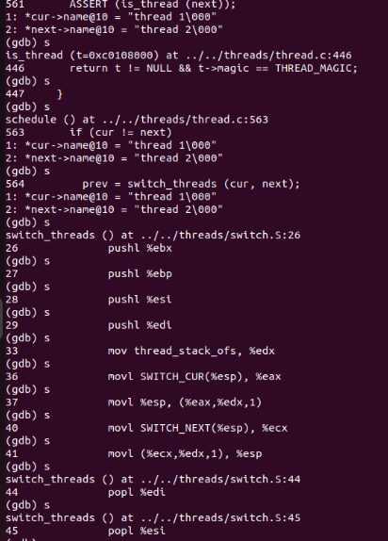
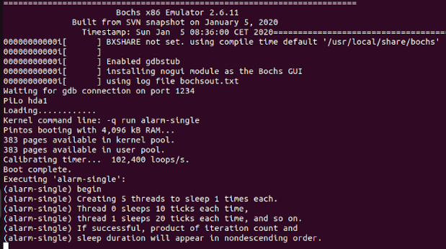
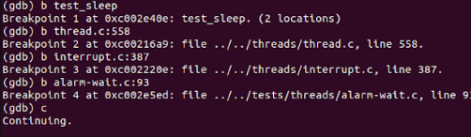
RV College of Engineering
PintOS Thread-Management
Name (USN): Vishwanath Ganesh Bhat(1RV22CS235)
Go, change the world
Department of Computer Science And Engineering
RV College of Engineering, Bangalore – 560059, INDIA
Introduction:
Welcome to Pintos, an operating system framework designed for the 80x86 architecture. Pintos provides foundational support for kernel threads, user program execution, and a file system, albeit in a simplified manner. While Pintos theoretically possesses the capability to operate on standard IBM-compatible PCs, practical considerations necessitate the use of a system simulator. This simulator faithfully emulates an 80x86 CPU and its associated peripheral devices with sufficient accuracy to support unmodified operating systems and software. Within our instructional environment, simulators such as Bochs and QEMU are employed within a Linux Docker container. Additionally, Pintos has been rigorously tested with VMware Player, offering versatility in deployment environments.
Installing PintOS:
Install docker on your machine
Clone the source code onto your directory
git clone https://github.com/Vishwanath-Bhat/PINTOS-Thread-Management
As the next step, build the source code supplied for the first project. First, run the docker container with a mount of your source: (The Docker Image was created by Prof. TheirrySans University of Toloronto)
$ docker run --platform linux/amd64 --rm --name pintos -it -v "$(pwd):/pintos" thierrysans/pintos bash
Once in the Docker container, you should build the utils directory (first time only):
$ cd /pintos/src/utils
$ make
Then, let us build the Pintos kernel inside the docker container:
$ cd /pintos/src/threads
$ make
Methodology:
Run the test case alarm-single which basically creates N threads and puts them to sleep using the GDB tool with bochs/QEMU simulator
pintos -v -k -T 60 --bochs --gdb -- -q run alarm-single
Breakpoint 1: test_sleep
Invokes thread_create function in thread.c file of pintos
Breakpoint 2: schedule();
Shows the current running thread and prev and next thread, and if no thread availabe results in interrupt(trap to os)
Breakpoint 3: intr_handler();
If no thread is ready to yield which results in trap intr_handler() in interrupt.c is invoked which in turn invokes timer.c indicating timer interrupt
Breakpoint 4: thread_create();
It is invoked when there is a creation of thread.
Functions used:
Thread_create();
schedule();
Thread_yield();
Intr_handler();
5. Debugging tools:
dumplist &all_list thread allelem
gives list of all the threads that are
currently running
bt – backtracing the program
c – continuing
display – display contents
b – set breakpoints
Output Code Snippet:
Conclusion and Future Work:
In conclusion, Pintos thread management offers a comprehensive framework for understanding and implementing core operating system concepts related to concurrency, synchronization, and scheduling. Through its support for kernel threads, user program execution, and simplified file system operations, Pintos provides a practical environment for students to explore the intricacies of thread management.
The priority-based scheduling algorithm employed in Pintos ensures that threads with higher priorities are given precedence, promoting fairness and responsiveness in multitasking environments. Additionally, synchronization primitives such as semaphores and locks facilitate coordination among threads, enabling safe access to shared resources.
By integrating a virtual memory system and providing support for system simulation, Pintos enriches the learning experience, allowing students to gain hands-on experience with operating system development in a controlled environment.
Overall, Pintos thread management serves as a foundational component in the educational journey of students studying operating systems, equipping them with essential skills and insights into concurrent programming and scheduling algorithms. Through experimentation and exploration within the Pintos environment, students are empowered to tackle real-world operating system challenges with confidence and proficiency.
Acknowledgements
The authors thanks Principal and HoD, Department of Computer Science Engine,,̣..ering,
RVCE for the kind support received for completion of the project.
Guide Information: Prof. Jyothi Shetty.

