Slide 1
Global AI Adoption &
Market Landscape
2019 – 2025 | End-to-End Data Analytics Project
Python
MySQL
Power BI
pandas
SQLAlchemy
6
14
8
517
5
Datasets
Countries
Industries
Raw Rows
Dashboard Pages
McKinsey · Stanford HAI · OECD · Statista · IDC · Amazon / Alphabet Annual Reports

Slide 2
The Problem
AI adoption data is scattered across 6 independent research organisations — McKinsey, Stanford HAI, OECD, Statista, IDC, and cloud provider annual reports. Each dataset covers a different lens: adoption rates, investment, policy readiness, spending barriers, or infrastructure.
There was no unified view to answer: Who is winning the AI race? Where are the gaps? Which cloud provider is gaining ground?
01
Business Question 01
02
Business Question 02
03
Business Question 03
Which industries & regions lead AI adoption — and which lag?
Where does high readiness meet low revenue (opportunity gap)?
How are AWS, Azure and Google Cloud competing for dominance?
Solution: Single end-to-end pipeline — Python cleaning + MySQL storage + Power BI visualisation — unified across all 6 sources

Slide 3
Pipeline Architecture
1
2
3
4
5
6 Raw CSVs
Python
Cleaning & EDA
3 Clean Tables
MySQL
9 SQL Queries
Power BI
5 Pages
517 rows total
McKinsey · Stanford
OECD · Statista
IDC · Cloud
Type cast · dedup
null fill · normalise
IQR outlier detect
YoY growth calc
ai_industry 238r
ai_geo 84r
ai_cloud 24r
Zero _x/_y cols
Window functions
CAGR · CASE WHEN
JOINs · aggregation
ai_adoption_db
20+ DAX measures
Scatter · Matrix
Forecast · Maps
Interactive slicers
Key Design Decision
Overlapping column names (region, country_code) across sources would create _x/_y duplicate columns on merge. Solution: drop overlapping columns from secondary sources BEFORE merging. Result: zero duplicate suffixes across all 3 final tables.

Slide 4
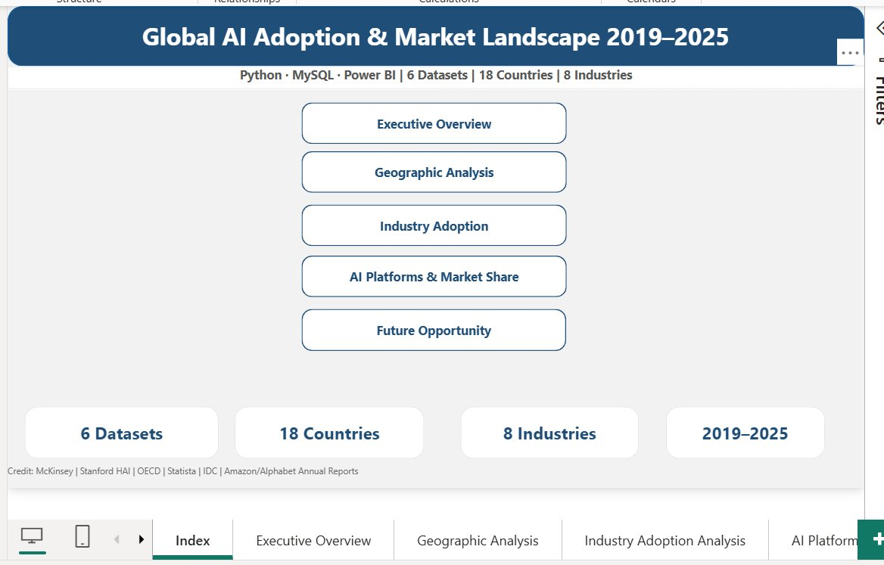
Power BI Dashboard — 5 Pages
01
Executive Overview
4 KPIs · Adoption trend · Spending growth · Revenue donut
02
Geographic Analysis
Bubble map · Top 10 countries · Readiness scores · Scatter
03
Industry Adoption
Heatmap matrix · Rankings · Top 5 trend · Barrier analysis
04
AI Platforms
Revenue race · YoY growth · Market share shift · Table
05
Future Opportunity
Opportunity quadrant · Forecast · Readiness improvement

Slide 5
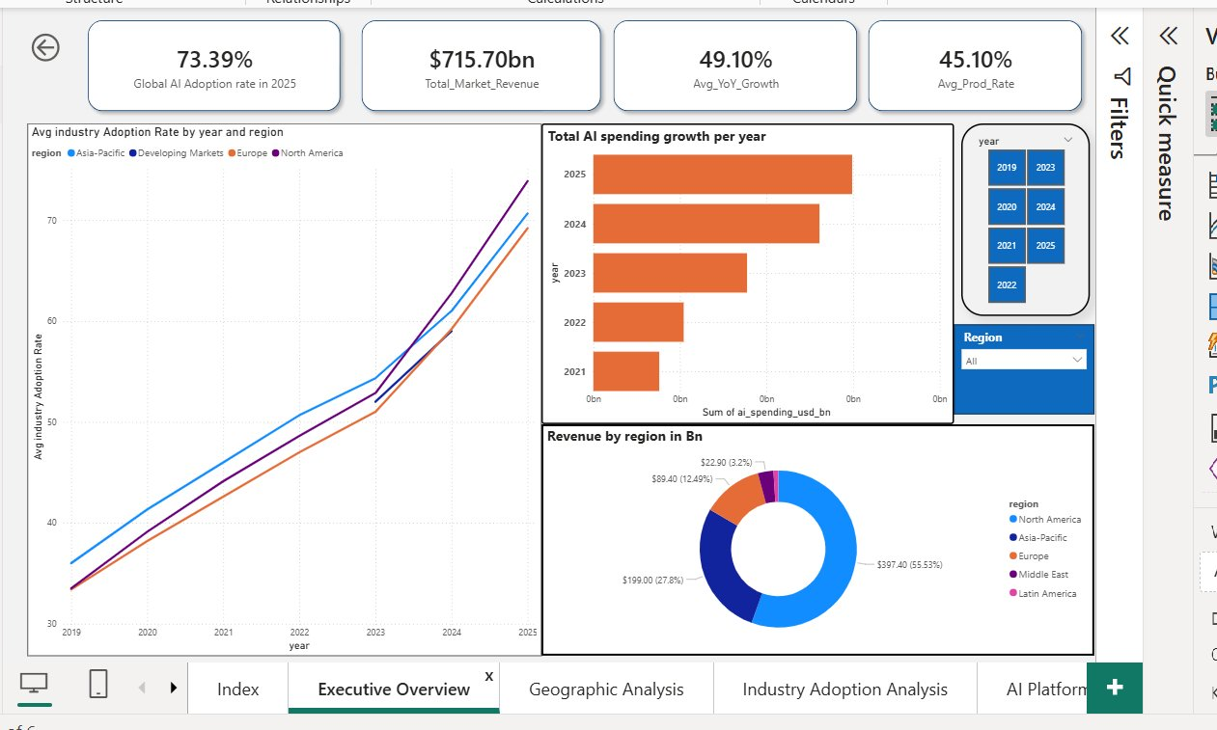
Page 1 — Executive Overview
2019 – 2025
Key Findings
73.4%
Global AI adoption in 2025
Up from 33.9% in 2019 — doubled in 6 years
$715.7B
Total market revenue 2019–24
North America holds 55.5% share
49.1%
Avg YoY growth rate
Geo & cloud data; consistent acceleration
45.1%
Avg pilot-to-production rate
54.9% of AI pilots stuck — scaling gap

Slide 6
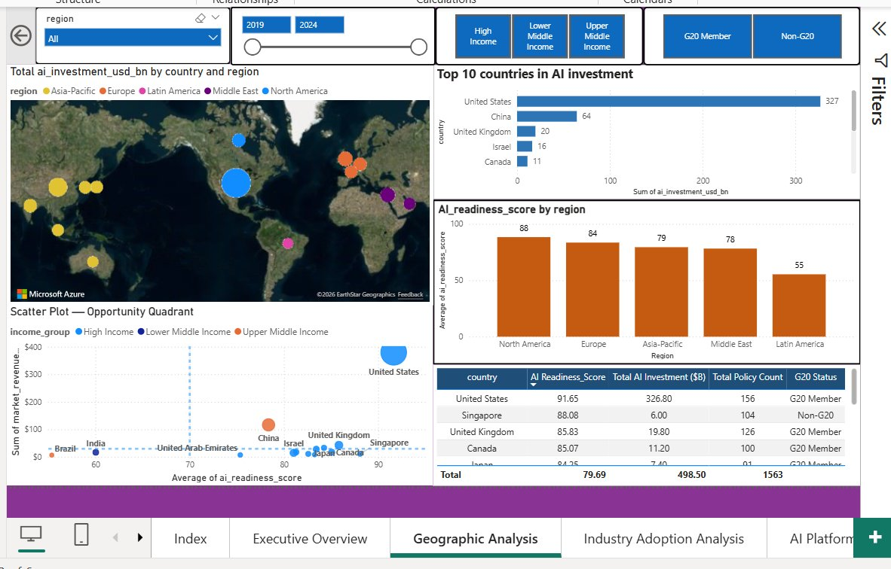
Page 2 — Geographic Analysis
14 Countries · 2019–2024
Geo Insights
USA dominates
$326.8B total investment — 5× China's $64.4B
India fastest-improving
+15.8 readiness pts in 5 yrs — fastest globally
Opportunity quadrant
Singapore, Australia, Japan: high readiness, low revenue
Scatter quadrant logic
X=readiness, Y=revenue, Bubble=investment size
G20 vs Non-G20
G20 nations hold 85%+ of total AI investment

Slide 7
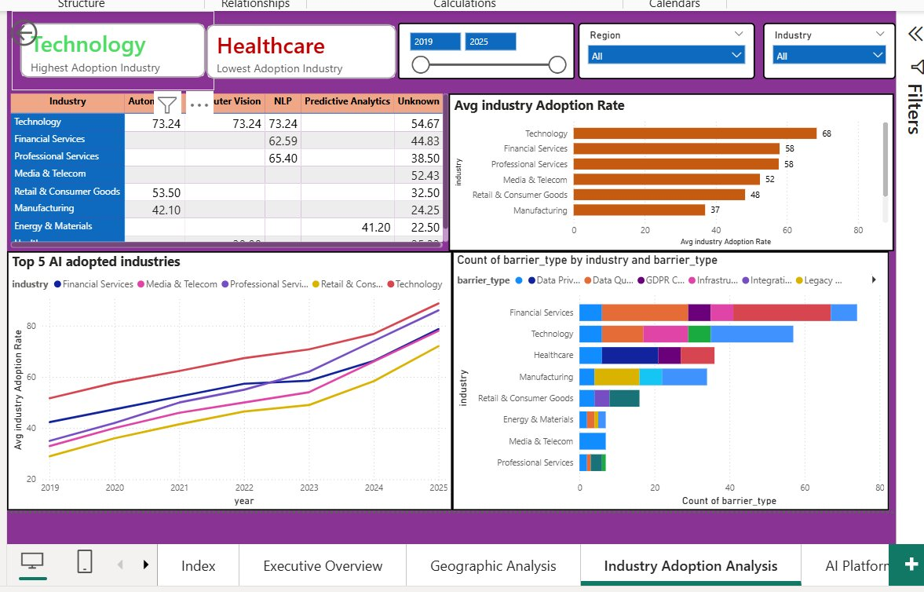
Page 3 — Industry Adoption Analysis
8 Industries · 2019–2025
Industry Rankings
Technology
68%
Fin. Services
58%
Professional Svc
58%
Media & Telecom
52%
Retail
48%
Manufacturing
37%
Energy
36%
Healthcare
35%
DAX: AVERAGEX(SUMMARIZE(...)) deduplication applied

Slide 8
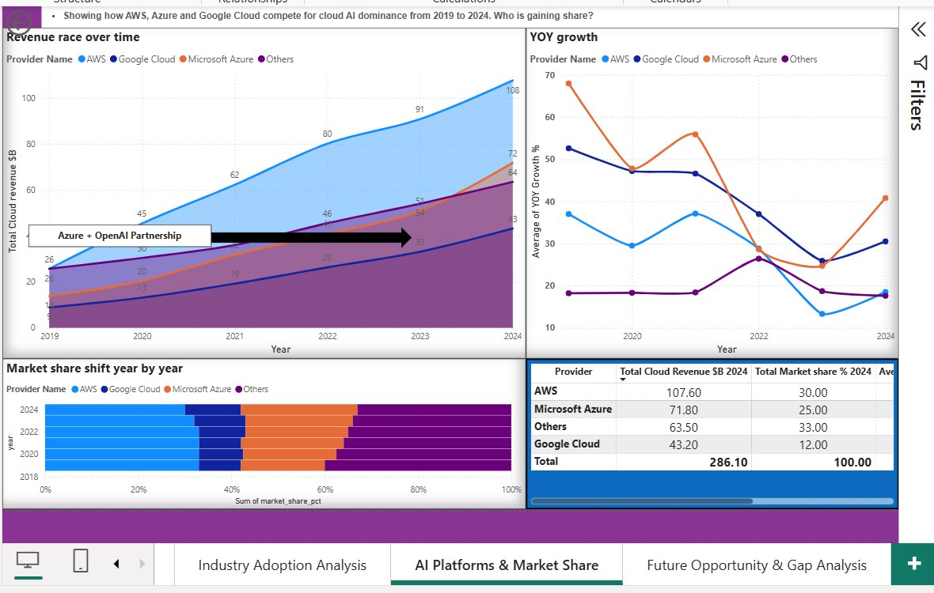
Page 4 — AI Platforms & Market Share
AWS · Azure · GCP · 2019–2024
2024 Snapshot
AWS
Rev: $107.6B Share: 30%
YoY: 18.5% CAGR: 33.1%
Microsoft Azure
Rev: $71.8B Share: 25%
YoY: 40.8% CAGR: 39.1%
Google Cloud
Rev: $43.2B Share: 12%
YoY: 30.5% CAGR: 37.1%
Others
Rev: $63.5B Share: 33%
YoY: 17.6% CAGR: 19.8%
Azure fastest-growing despite being 2nd in revenue — OpenAI investment effect

Slide 9
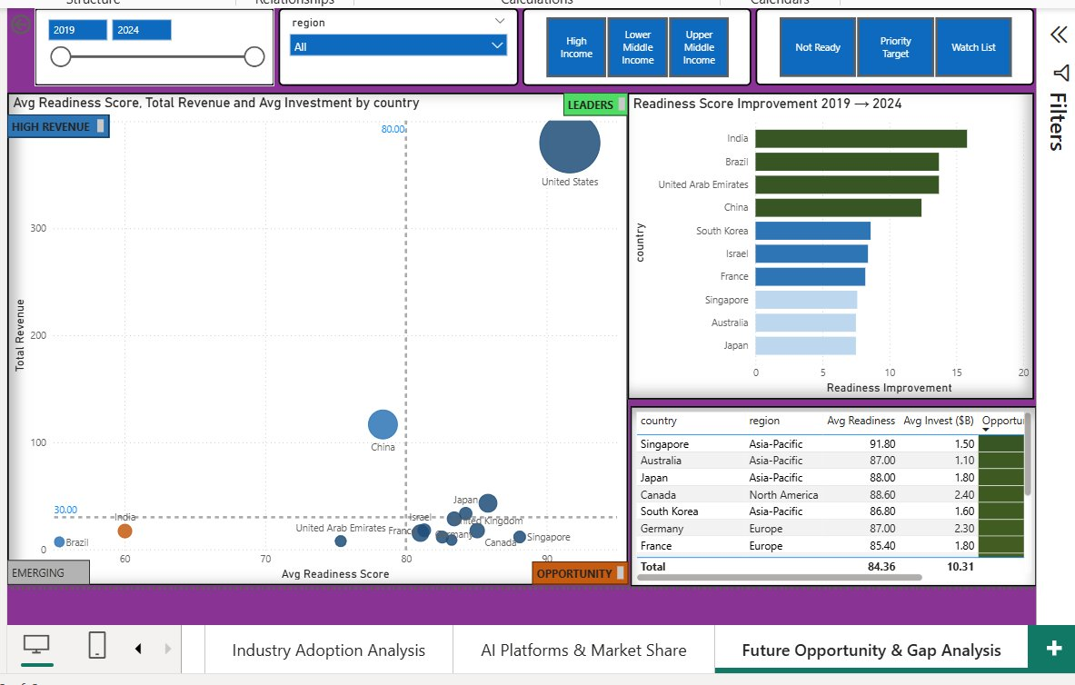
Page 5 — Future Opportunity & Gap Analysis
Forecast to 2026
Opportunity Findings
$401B
Projected 2025 market
Based on 52.2% CAGR · 2024 actual: $263.6B
LEADERS
USA · UK · Japan
High readiness + high revenue — fully positioned
TARGET
Singapore · Australia · S.Korea
High readiness, low revenue — top vendor opportunity
+15.8
India's readiness gain
Fastest improver 2019–2024 despite Lower-Middle Income

Slide 10
Technical Highlights — SQL & DAX
MySQL — 9 Analytical Queries
Power BI — Key DAX Measures
-- Window function: live market share per year
SELECT provider_name,
ROUND(revenue / SUM(revenue)
OVER (PARTITION BY year) * 100, 2)
AS share_pct
FROM ai_cloud
ORDER BY year, share_pct DESC;
-- 5-Year CAGR per country
SELECT country,
ROUND((POWER(rev_2024 /
NULLIF(rev_2019, 0), 1.0/5) - 1)
* 100, 2) AS cagr_pct
FROM country_revs
ORDER BY cagr_pct DESC;
-- Industry scaling tier (CASE WHEN)
SELECT industry,
CASE
WHEN AVG(prod_rate) >= 60
THEN 'Scale Leader'
WHEN AVG(prod_rate) >= 45
THEN 'Moderate Scaler'
ELSE 'Struggling'
END AS scaling_tier
FROM ai_industry
GROUP BY industry;
-- Deduplication fix (IDC join creates
-- duplicate rows per industry-year-region)
Avg industry Adoption Rate =
AVERAGEX(
SUMMARIZE(
ai_industry,
ai_industry[year],
ai_industry[industry],
ai_industry[region],
"d", AVERAGE(
ai_industry[ai_adoption_rate_pct])
), [d]
)
-- Projected 2025 revenue (52.2% CAGR)
Estimated 2025 Revenue =
VAR Rev2024 = CALCULATE(
SUM(ai_geo[market_revenue_usd_bn]),
ALL(ai_geo[year]),
ai_geo[year] = 2024)
RETURN ROUND(Rev2024 * 1.522, 1)

Slide 11
Key Takeaways
01
AI adoption doubled in 6 years
03
Azure is the cloud story of the decade
33.9% → 73.4% globally (2019–2025). Technology leads at 68%; Healthcare lags at 35% due to regulatory barriers — exactly the kind of segmentation that business strategy decisions are built on.
Azure grew at 44.3% avg YoY — fastest of the three major providers. Microsoft's $10B OpenAI investment in 2023 is visible directly in the YoY growth data. Market share climbed 18% → 25%.
02
USA leads but the gap is closing
04
7 countries are under-monetised
USA invested $326.8B — 5× China. But India grew readiness by 15.8 points (fastest globally) and Brazil by 13.7. Emerging markets are closing the gap faster than investment figures suggest.
Singapore, Australia, Japan, Canada, South Korea, Germany, France all score 80+ in AI readiness but show disproportionately low market revenue — the clearest opportunity signal in the dataset.

Slide 12
Thank You
Global AI Adoption & Market Landscape Analysis
▸ Python · pandas · SQLAlchemy
▸ MySQL · Window Functions · CAGR
▸ Power BI · 20+ DAX Measures
▸ 6 Sources · 14 Countries · 8 Industries
Data: McKinsey · Stanford HAI · OECD · Statista · IDC · Amazon/Alphabet Annual Reports · Built: March 2026

