Slide 1

Sprocket Central Pty Ltd
Data analytics approach
[Division Name] - [Engagement Manager], [Senior Consultant], [Junior Consultant]

Slide 2
Agenda
Introduction
Data Exploration
Model Development
Interpretation

Slide 3

Introduction
The projects goal is to identify the most valuable customers of Sprocket Central Pty Ltd
This helps in targeted marketing towards the valuable customers
Optimize resource allocation favoring most profitable customers.
The analysis is conducted in three phases
Data Exploration
Model Development
Interpretation
Place any supporting images, graphs, data or extra text here.

Slide 4
Exploratory Data Analysis
Data Cleaning
Feature Engineering

Slide 5
Data Exploration
The data exploration Phases and project cycle
Merge datasets (transactions, customer)
Conducting an exploratory data analysis for understanding customer demographic and geographic distributions. This can be achieved through distribution plots
Remove cancelled orders, “Default”, “Country” columns.
.Correct values in the columns “gender”, “state”

Slide 6
Feature Engineering
Add new feature profit = ‘list price’ – ‘standard cost’, extract ‘age’ from ‘DOB’.
Obtain ‘Recency’, ‘Frequency’ and ‘Monetary’ attributes from ‘Transaction date’, ‘list price’ and ‘standard cost’.
Feature transformation, categorical encoding

Slide 7
Model Development
Customer segmentation through RFM(Recency, frequency, Monetory) analysis and K-means clustering
Frequent
Segmentation
Demographic
Geographic
Behavioral(RFM)
Recent

Slide 8
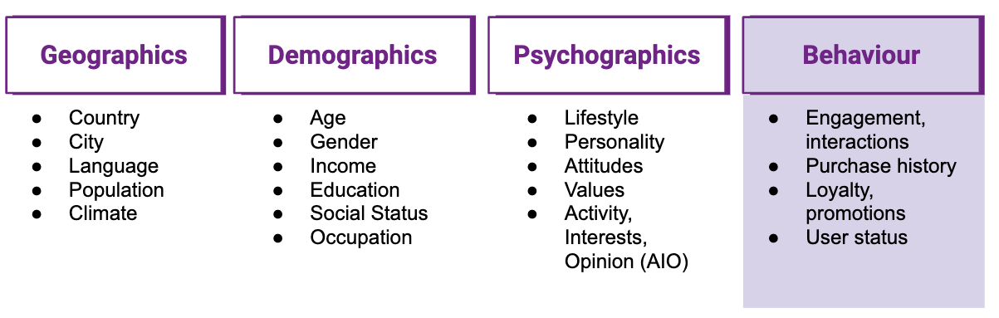
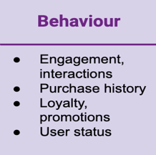

Customer segmentation
Model Development

Slide 9

Interpretation and Reporting
Matplotlib,
Power BI

