Slide 1

Sprocket Central Pty Ltd
Data analytics approach
[Division Name] - [Engagement Manager], [Senior Consultant], [Junior Consultant]

Slide 2
Agenda
Introduction
Data Exploration
Model Development
Interpretation

Slide 3

Introduction
The projects goal is to identify the most valuable customers of Sprocket Central Pty Ltd from the newly available data
This helps in targeted marketing towards the valuable customers
Optimize resource allocation favoring most profitable customers.
The analysis is conducted in three phases
Data Exploration
Model Development
Interpretation
Place any supporting images, graphs, data or extra text here.

Slide 4
Data Exploration
The data exploration Phases
Distributions
Exploratory Data Analysis
Data Cleaning
Deriving new features
Merge datasets
Conducting an exploratory data analysis for understanding customer demographic and geographic distributions.
Feature transformation, encoding. Correct values in the columns “gender”, “state”
Add new feature profit = ‘list_price’ – ‘standard cost’, extract age from DOB
Remove cancelled orders, “Default”, “Country” columns.

Slide 5
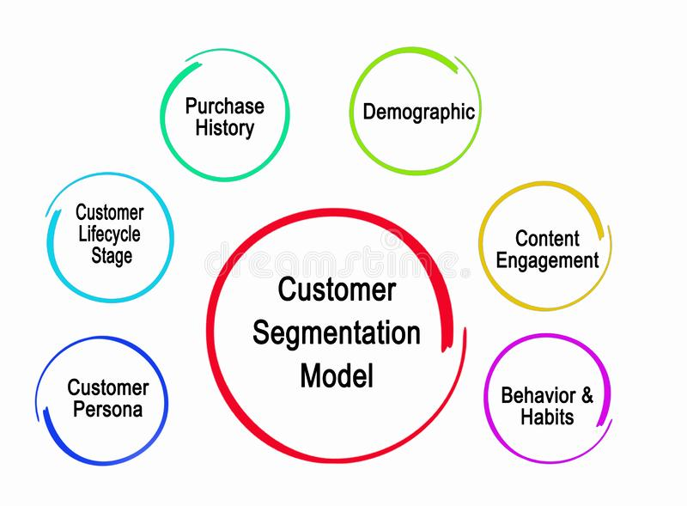
Model Development
Place any information about this point here.
Data
Descreptive and inferential Analysis
Machine learning
Place any supporting images, graphs, data or extra text here.

Slide 6
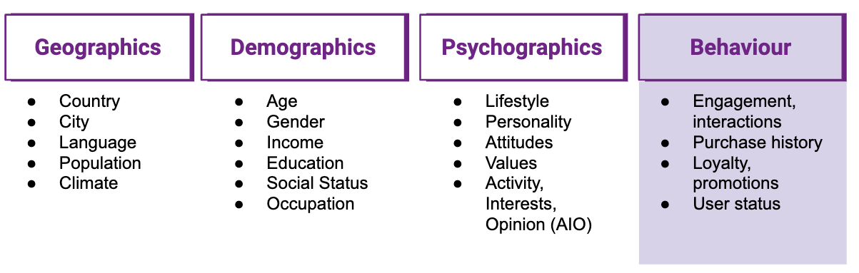
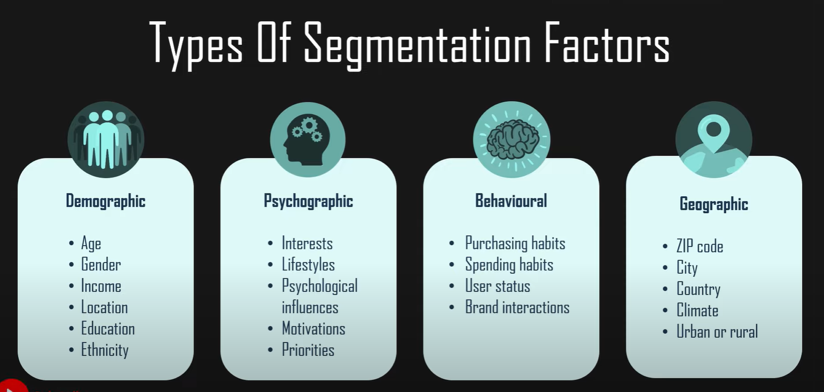
Model Development

Slide 7

Interpretation

