Slide 1
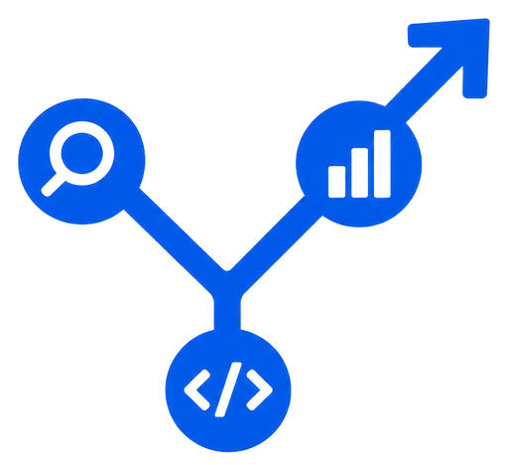

AI Yatra
aiyatra.io
OPEN-SOURCE AI COMMUNITY
Big ideas start
with a hello.
AN OPEN AI COMMUNITY / HYDERABAD & BEYOND
Learn AI.
Build with
your people.
A place for students, builders and curious minds. Come for the meetups. Grow through campus chapters. Turn research into something real, together.
✳ A seat for your curiosity
01
Saturday Meetups
02
Student Ambassadors
03
Research Labs
MEET. BUILD. BELONG.
Notes:
Welcome. AIYatra is an open-source AI community from Hyderabad. The promise is on the slide: learn AI, and build it with your people. Three ways in: Saturday meetups, the Student Ambassador Program, and AIYatra Research Labs. Everything is free, and everything is at aiyatra.io.

Slide 2
Agenda
01
Big picture
Why frameworks matter
02
LangChain
Models, prompts, components, and a RAG example
03
LangGraph
State, nodes, edges, routing, agents, and reliability
04
LangSmith
Trace, debug, and evaluate application runs
05
Takeaway + Q&A
Choose the right tools and questions
AIYATRA
02

Slide 3
ECOSYSTEM
The LangChain Ecosystem
Tools to build, orchestrate, and improve AI applications.
LANGCHAIN
LANGGRAPH
LANGSMITH
BUILD
ORCHESTRATE
OBSERVE + IMPROVE
Models, prompts, retrievers,
and tools
Stateful workflows, routing,
loops, and control
Tracing, debugging, and
evaluation
INTEGRATIONS
Connect model providers, databases, APIs, and external tools.
AIYATRA
03

Slide 4
01 · BIG PICTURE
Why do we need these frameworks?
An LLM call is only one part of a useful AI application.
LLM
Application
Quality loop
Generates a response from the input and context.
Connects data, tools, steps, and decisions.
Tracks behavior, finds issues, and measures quality.
Build the components → control the workflow → understand the results
AIYatra
05

Slide 5
02 · LANGCHAIN
What is LangChain?
A framework for building applications powered by language models.
Models
Prompts + data
Tools
Connect chat models and embedding models.
Format instructions and connect relevant information.
Connect the model to actions and APIs.
LangChain helps connect reusable components around an LLM.
AIYatra
06

Slide 6
02 · LANGCHAIN
Direct API vs LangChain
Both are valid; choose based on application complexity.
Direct API
LangChain
Good for simple, focused model calls.
You control the request and response handling.
Useful for reusable components and integrations.
Connect models, prompts, retrieval, and tools.
LangChain organizes application code; it does not replace the model.
AIYatra
07

Slide 7
03 · COMPONENTS
LangChain building blocks
The pieces used to assemble an AI application.
Models
Prompt templates
Output parsers + tools
Chat models and embedding models provide generation and vector representations.
Reusable instructions with variables; format messages for the model.
Parse model output into a usable format; tools let agents call functions or APIs.
AIYatra
08

Slide 8
04 · USE CASES
Where can we use LangChain?
Common patterns for LLM-powered applications.
RAG
Chatbots
Integrations
Answer using PDFs and knowledge bases.
Conversational applications with context.
Connect APIs, databases, and tools.
Use the components that fit your application's needs.
AIYatra
10

Slide 9
05 · LANGGRAPH
What is LangGraph?
A framework for stateful, controllable multi-step workflows.
Start
LLM
Tool
Check
→
→
→
Input
Reason
Action
Route
Nodes = steps · Edges = transitions · State = shared information
Branch, loop, retry, or continue based on conditions.
AIYatra
11

Slide 10
05 · LANGGRAPH WORKFLOW
LangGraph workflow example
RAG agent: retrieve → generate → evaluate → answer or retry
START
Retrieve
Generate
Evaluate
Relevant?
User question
Find relevant chunks
LLM drafts answer
Check relevance
NO
YES
retry loop
Rewrite query
END / Answer
Improve retrieval query
Return response
State carries the question, retrieved chunks, draft answer, and evaluation result between nodes.
AIYATRA · LANGGRAPH
12

Slide 11
LANGGRAPH • FOUNDATIONS
LangGraph core concepts
A graph describes how an application moves from one step to the next.
State
Nodes
Edges
START / END
Shared data that carries the current query, retrieved context, and answer.
Individual steps: call a model, retrieve documents, run a tool, or validate output.
Connections that define which step runs next.
Entry and exit points that mark the workflow boundary.
Think: State = what we know • Node = what we do • Edge = where we go
AIYATRA • LANGGRAPH
13

Slide 12
LANGGRAPH • EXECUTION
How a LangGraph workflow runs
The graph runs steps in order, updates state, and follows the next edge.
01 START
02 NODE
03 STATE
04 EDGE
05 END
Receive input
→
Run a step
→
Update shared data
→
Choose next step
→
Return result
If a node changes state, the next node can use that updated information.
AIYATRA • LANGGRAPH
14

Slide 13
LANGGRAPH • PRODUCTION PATTERNS
Human approval, retries, and reliability
Graph workflows can make checkpoints and recovery paths part of the design.
Human-in-the-loop
Retry path
Checkpointing
Pause before a sensitive action; let a person approve, edit, or reject.
If a step fails or output is weak, route to retry or another strategy.
Persist workflow state so execution can resume from a saved point.
Use these patterns when workflows are long-running, risky, or need review.
AIYATRA • LANGGRAPH
17

Slide 14
LANGGRAPH • USE CASES
Where LangGraph is useful
Use a graph when an application needs more than a single linear model call.
RAG with fallback
Multi-tool agent
Approval workflow
Retrieve → evaluate context → retry or answer.
Choose tools, execute actions, and loop over results.
Draft an action → human review → continue or stop.
Support assistant
Research workflow
Data processing
Route billing, technical, or account questions to different paths.
Plan → search → summarize → verify.
Validate → transform → handle errors → produce output.
AIYATRA • LANGGRAPH
18

Slide 15
06 · COMPARISON
LangChain vs LangGraph
They complement each other; they are not competing frameworks.
LangChain
LangGraph
Together
Components:
models, prompts, retrieval, tools.
Workflow:
state, nodes, edges, branching, loops.
Use LangChain components inside controlled workflows.
A simple sequence may need neither framework; use what the workflow requires.
AIYatra
19

Slide 16
07 · LANGSMITH
What is LangSmith?
Trace, debug, evaluate, and monitor LLM applications.
Trace
Debug
Evaluate
Inspect inputs, outputs, calls, and latency.
Investigate errors and unexpected behavior.
Measure outputs against examples or criteria.
Understand what happened before deciding how to improve.
AIYatra
20

Slide 17
08 · ECOSYSTEM
How all three work together
One application, three connected responsibilities.
LangChain
LangGraph
LangSmith
Build application components.
Orchestrate workflow execution.
Trace and evaluate application runs.
LangChain connects. LangGraph orchestrates. LangSmith helps us improve.
AIYatra
21

Slide 18
THE TAKEAWAY
Build. Control.
Understand. Improve.
LangChain
LangGraph
LangSmith
Build
Orchestrate
Observe + evaluate
LangChain connects. LangGraph orchestrates. LangSmith helps us improve.
Thank you ·
AIYatra

