Slide 1

ML model to analyse and predict human illness
Vishwanath K R
Amrutha A

Slide 2
Index
Problem Statement
Existing Approaches
Relevance of the Project
Design Methodology

Slide 3
Problem Statement:
While diagnosing a patient for a disease there are chances for true negative report to be enclosed by a medical professional (Final year Med students).
By minimizing the interference of humans in order to shortlist the disease categories to be diagnosed for a patient.
To evade such errors in the field of medicine which may cost the patients their lives.

Slide 4
Existing Approach:
Using an accurate and true positive dataset which is professionally put together.
Using ML models like Support Vector classifier, Gaussian Naïve Bayes Classifier, Random Forest Classifier, Bernoulli Naïve Bayes Classifier.
K-Fold Cross Validation technique to evaluate the model.
Confusion matrix for evaluating the quality of the validated test dataset.

Slide 5
Relevance of the Project
There are 4 models which gives 4 separate predictions of which the mode is considered as the final prediction.
For all the symptoms which have matches with the actual trained dataset we have received an accuracy of 100%.
Based on the small and cleaned data which we have used the accuracy is rated to be a 100% but the catch is by using much larger and realistic medical data from real world we can observe the stability of the models which we are yet to test since access to such datasets are hard to come by.

Slide 6
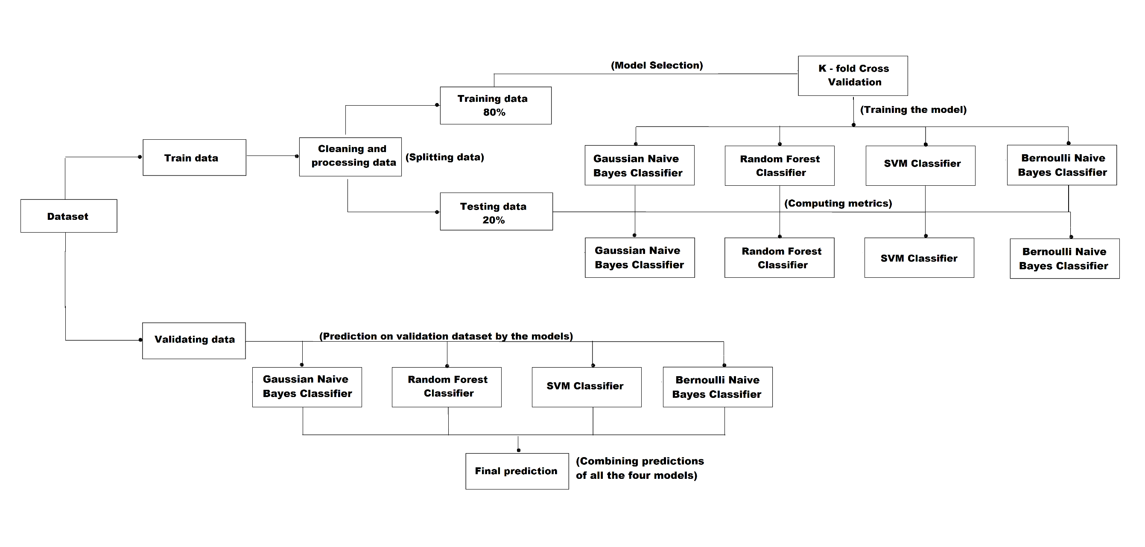
Design Methodology:

Slide 7
THANK YOU

