Slide 1
Cloud Kubernetes vs On-Prem Kubernetes
Cloud
On-Prem
Managed Control Plane
Self Managed
Elastic Infrastructure
Fixed Hardware
Internet Available
Often Private
Easy Scaling
Hardware Dependent
Pay-as-you-go
Capital Investment
Discussion
When should we choose each?

Slide 2
Why Hybrid Wins
Organizations rarely choose only cloud.
Reality
AWS Azure VMware Bare Metal Edge IoT Factories
Need one Kubernetes platform.
Hybrid enables this.

Slide 3

EKS Anywhere Architecture
Architecture Components
Infrastructure
Admin Machine
VMware
Bare Metal
eksctl-anywhere
Nutanix
Bootstrap Cluster
Management Cluster

Slide 4
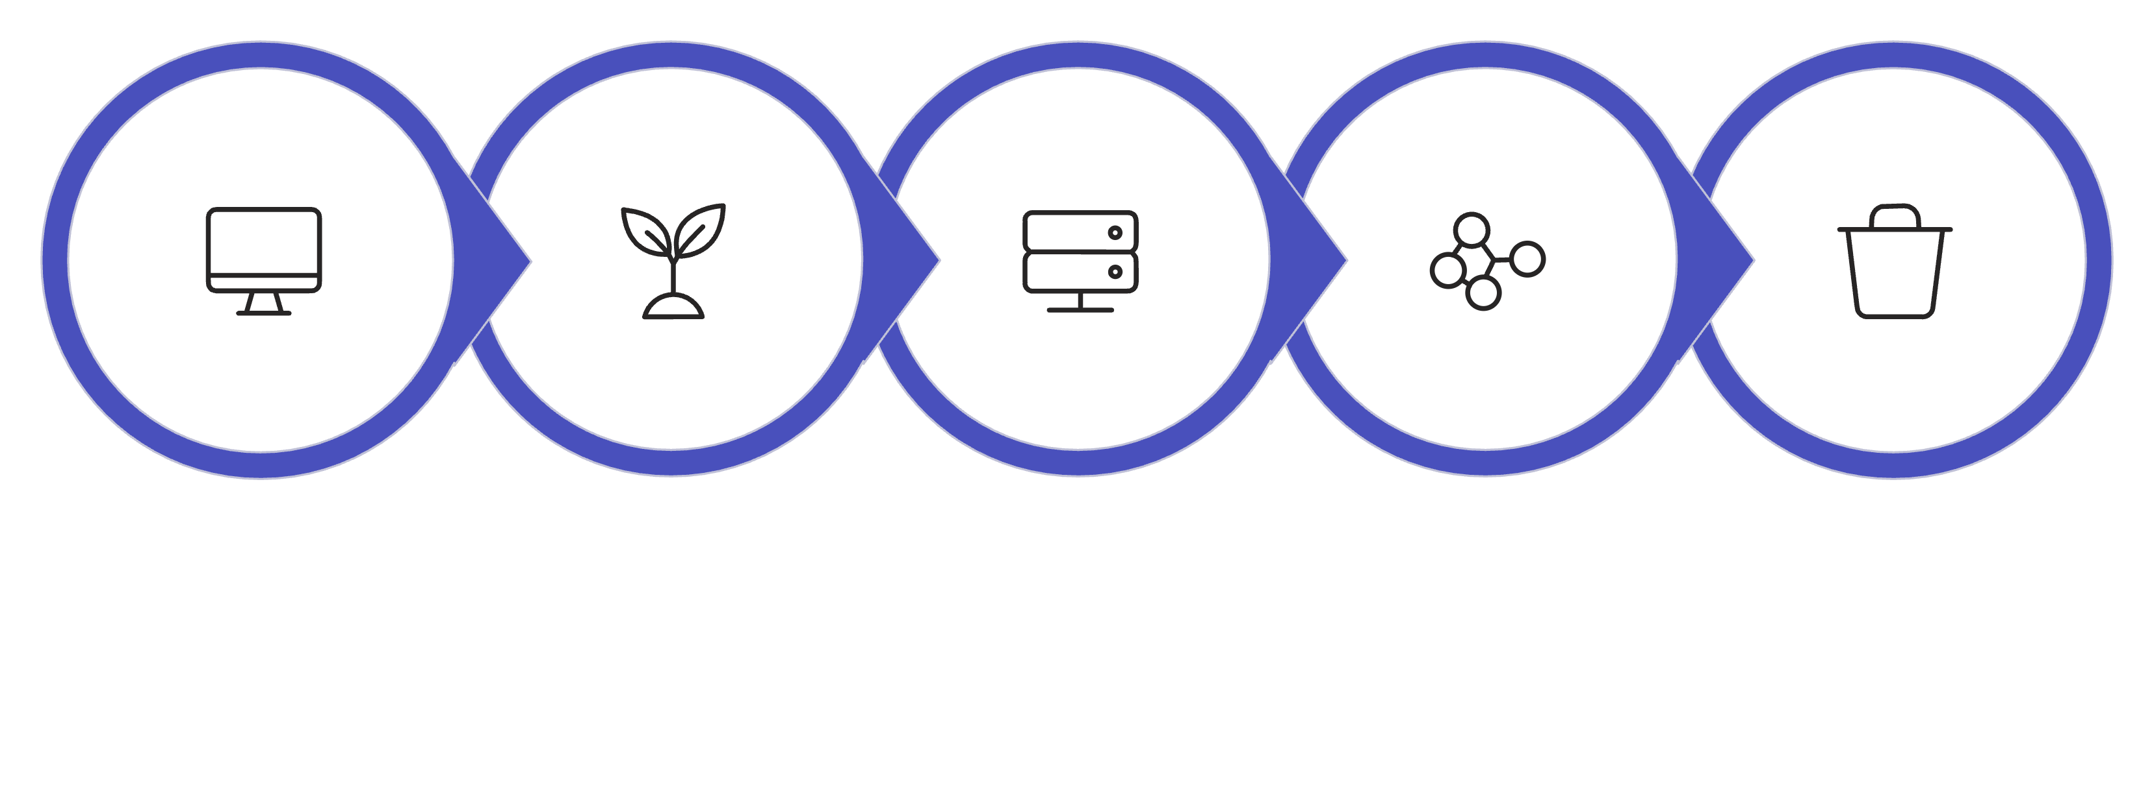
EKS Anywhere Deployment Flow
Admin
Bootstrap
Provision
Management
Delete
Management Cluster remains.

Slide 5
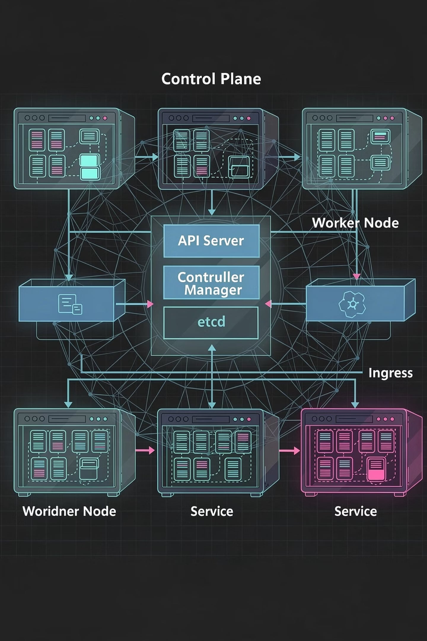
Cluster Components
Control Plane
Applications
API Server
Scheduler
Controller Manager
etcd
Pods
Services
Worker Nodes
kubelet
kube-proxy
Container Runtime
Ingress
Volumes

Slide 6
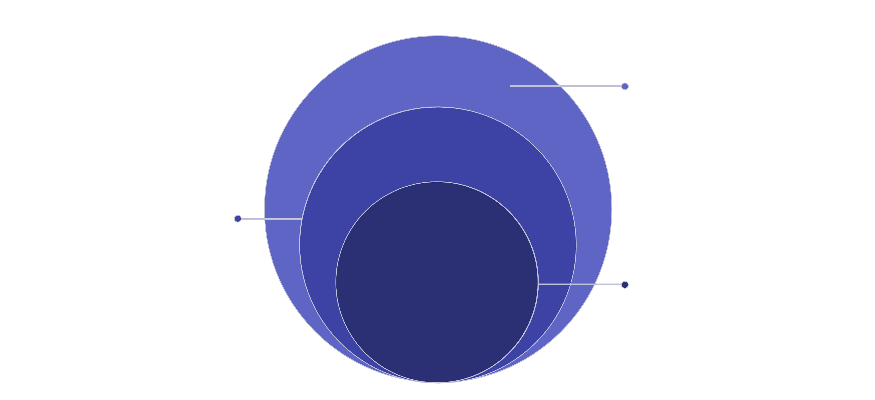
Kubernetes Object Hierarchy
Runtime Units
Nodes and Containers running pods
Workload Layer
Namespaces, Deployments, ReplicaSets, Pods
Core Cluster
Top-level Kubernetes control plane
Understand hierarchy before labs.

Slide 7
Cluster API (CAPI) Overview
Cluster API
An open-source Kubernetes project
Purpose
Manage Kubernetes clusters using Kubernetes.
Everything becomes Kubernetes objects.
Infrastructure becomes declarative.

Slide 8
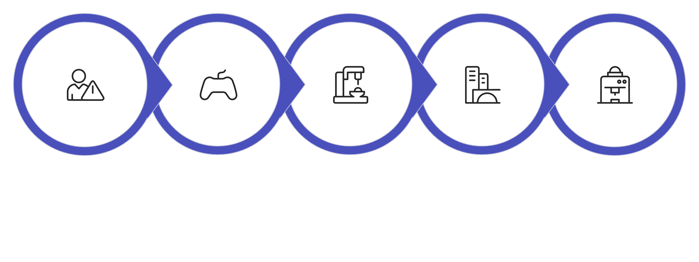
Cluster API Components
Cluster Controller
Machine Controller
Infrastructure
Virtual Machines
Management

Slide 9
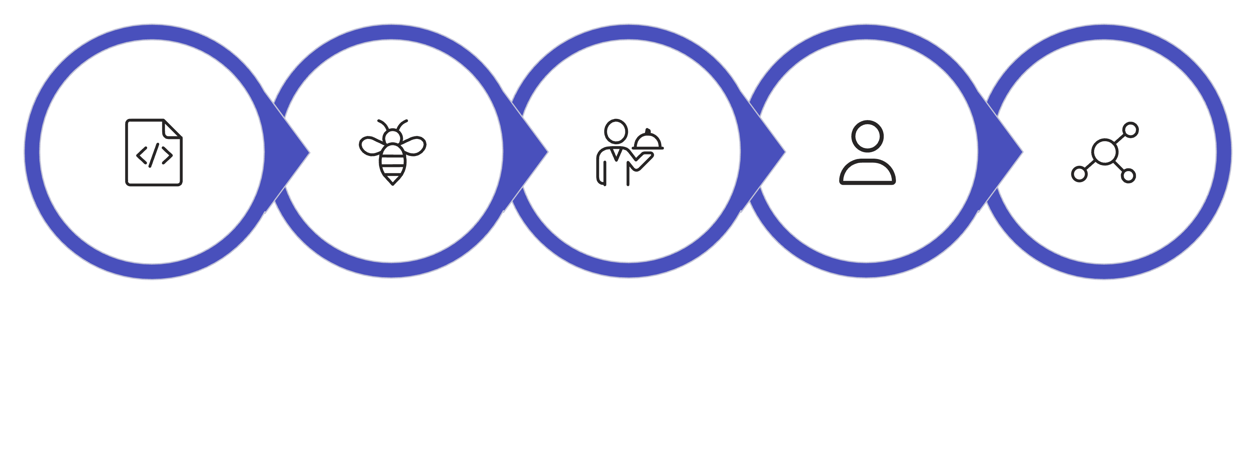
Cluster API Workflow
Cluster YAML
Cluster API
Create VMs
Install K8s
Join Nodes
Infrastructure becomes code.

Slide 10
Summary
Today We Learned
01
02
03
Enterprise Kubernetes
Enterprise Challenges
EKS Anywhere
04
05
06
Platform Engineering
Hybrid Kubernetes
Cloud vs On-Prem
07
08
09
EKS Anywhere Architecture
Cluster Components
Cluster API Basics

