Slide 1
Capstone-project-flow

Slide 2
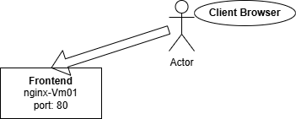
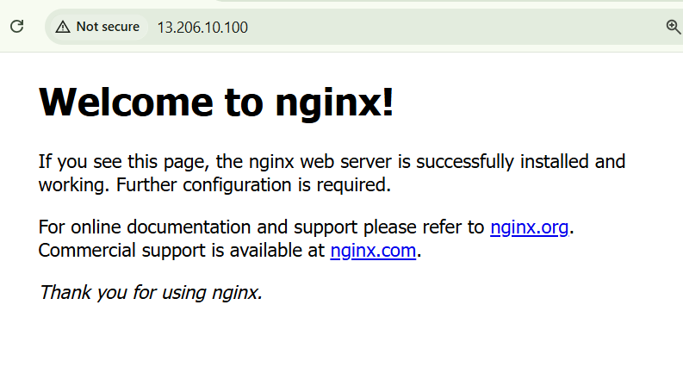
Step-1
The Client Browser is able to access the nginx on port 80
output

Slide 3
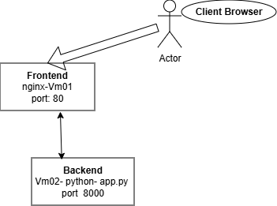
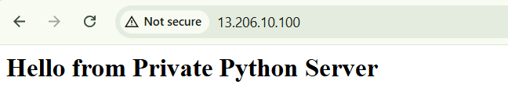
Step-2
The Client Browser is able to access the backend on port 80 via nginx
output

Slide 4
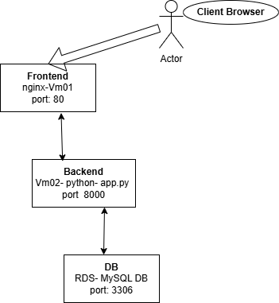
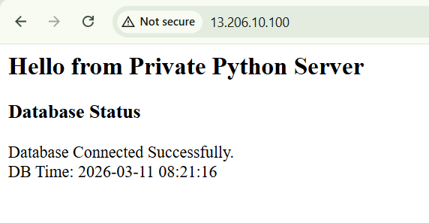
Step-3
The Client Browser is able to access the backend with DB Connection on port 80 via nginx
output

Slide 5
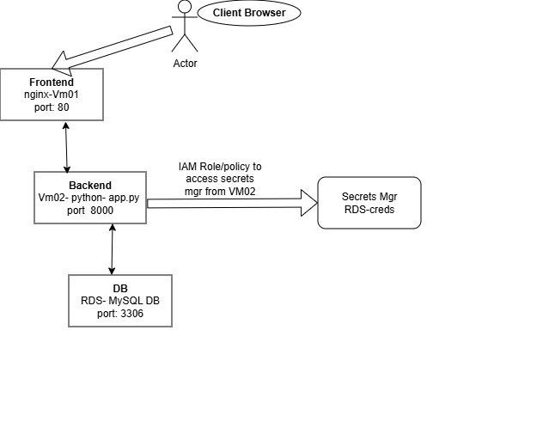
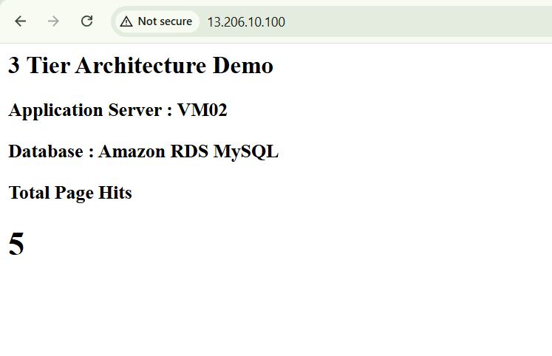
Step-4
Adding Secret's manager to the project with Hit counts
output

Slide 6
Step-4 – Implementation flow
Create Secerts mgmr "RDS-Creds"
IAM Role/policy to access secrets mgr from VM02
Assign on Vm02
update the python code with the boto3 plugin

