Slide 1

ELK Stack - An end to end solution for analytics, logging, search & visualization.
By Vineeth Mohan

Slide 2

About Author
Certified Elasticsearch trainer
Author of Elasticsearch blueprints
Author of Lucene 4 cookbook
Over 5 years of experience in Elasticsearch stack and Lucene
Runs Elasticsearch based consulting - Factweavers

Slide 3
Overview
Business needs
Challenges in understand logs
How ELK helps us

Slide 4
Imagine the following system
We are operating a site having heavy traffic
To catch up with the traffic , we have a load balancer and 1000 apache web servers behind it.
There is also a storage like mysql DB behind these servers which are used to query and insert data.
Every apache web servers logs their activities to their own server.

Slide 5
Challenges

Slide 6
Challenge 01 - Mixed Log Structures
There is no universal log data structure format existing.
The formats of the logs can depend on various factors like the device type, vendor, application etc.
This inconsistency in log structures would make the searching on logs a difficult process

Slide 7

Mixed Log Structures

Slide 8
Mixed Log Structures

Slide 9
Mixed Log Structures

Slide 10
Mixed Log Structures

Slide 11
Challenge 02 - Different formats for time
The most important data in a log file is its time field.
But what happens when the time formats are different across different logs?.
It becomes very difficult for us to do operations based on time.

Slide 12

Different formats for time

Slide 13
Different formats for time

Slide 14
Challenge 03 - Log location and access
Logs of interest maybe a. Spread across different machines b. Depending on the machine logs differ in formats c. On different locations in the same machine

Slide 15
Challenge 04 - Need for expertise
In order to get useful insights from the data a. The data must be accessible. In most cases the data is accessible only to the admins who are working on the servers. b. Need for experienced workforce who are able to understand the log data

Slide 16
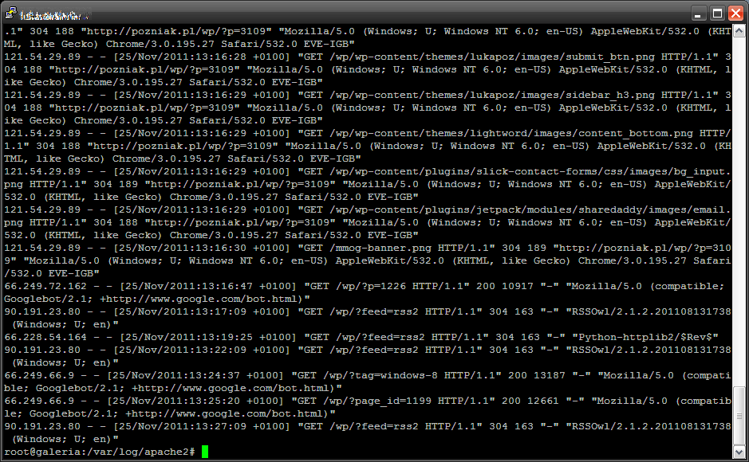
Understanding the logs visually
It is difficult for people to understand and make inferences from the textual data of the logs. Imagine the log below of apache logs, where we have the data of the login information from cities :
From the above logs it is very difficult to deduct the city wise statistics.

Slide 17
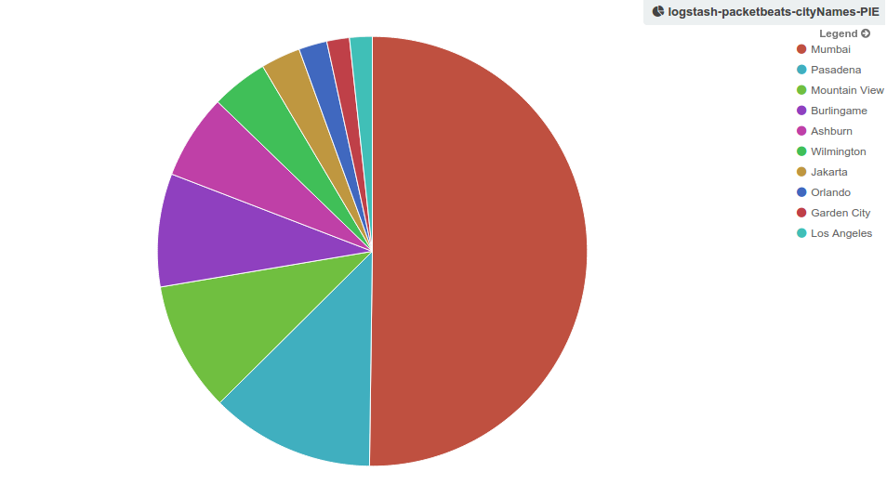
Understanding the logs visually
2. Suppose if we are able to visualize the data from the logs visually. From the previous logs, if we are able to extract the city names information and represent it as a pie chart like below. Now the data looks more eye candy and understandable.

Slide 18
How ELK can help us?

Slide 19
How ELK solves the problem for us?
Would collect all the data, centralize it
Parse the logs to a common format, including time details
Makes the logs quickly searchable and analyzable
Visualize the data in numerous ways with a wide range of analytics
Allows the end user to draw infrences from data with minimal technical overhead

Slide 20
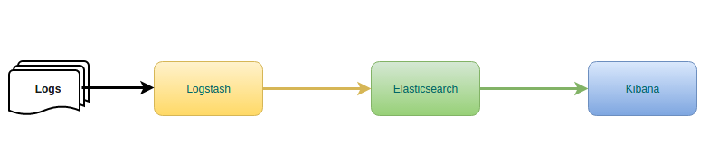
ELK Stack architecture

Slide 21
ELK Stack - Logstash
Transform the log data to the structure of our preference.
Numerous tools and plugins to support the transformation.

Slide 22
ELK Stack - Elasticsearch
Provides the facility for
Near real time search
Extensive analytic capabilities.

Slide 23
ELK Stack - Kibana
Tool for visualizing the data from elasticsearch
Several methods of visualization for easy understanding

Slide 24














Get certified and #BeTheExpert
We have INSTRUCTOR LED - both Online LIVE & Classroom Session
Classroom sessions in Bangalore & Delhi (NCR)
We have delivered more than 5000 trainings and have over 400 courses and a vast pool of over 200 experts to make YOU the EXPERT!
Certified Partners
FOLLOW US ON SOCIAL MEDIA TO STAY UPDATED ON THE UPCOMING WEBINARS

