Slide 1
Log Analytics with ELK Stack
(Architecture for aggressive cost optimization and infinite data scale)
Denis D’Souza | 27th July 2019

Slide 2


About me...
Currently a DevOps engineer at Moonfrog Labs
6 + years working as DevOps Engineer, SRE and Linux administrator Worked on a variety of technologies in both service-based and product-based organisations
How do I spend my free time ?
Learning new technologies and Playing PC Games
www.linkedin.com/in/denis-dsouza

Slide 3






Who we are ?
A Mobile Gaming Company making mass market social games
More than 5M+ Daily Active, 15M+ Weekly Active Users
Real time, Cross platform games optimized for Primary Market(s) - India and subcontinent
Profitable!
Current Scale

Slide 4
Our problem statement
Our business requirements
Choosing the right option
ELK Stack overview
Our ELK architecture
Optimizations we did
Cost savings
Key takeaways

Slide 5

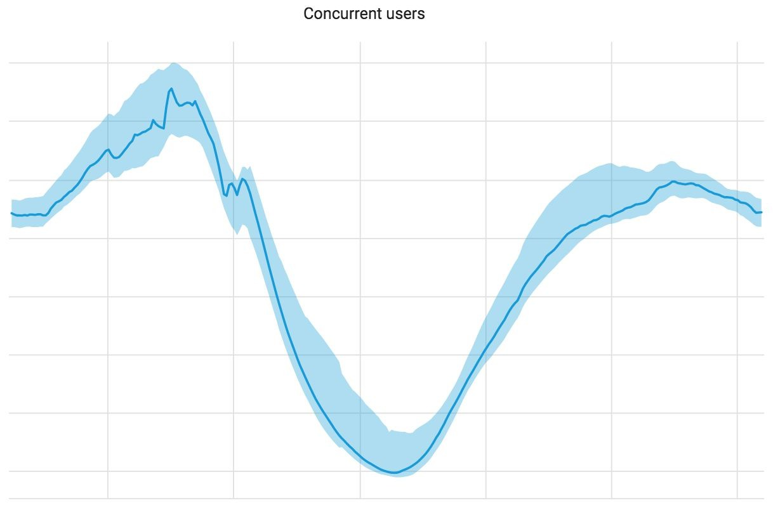


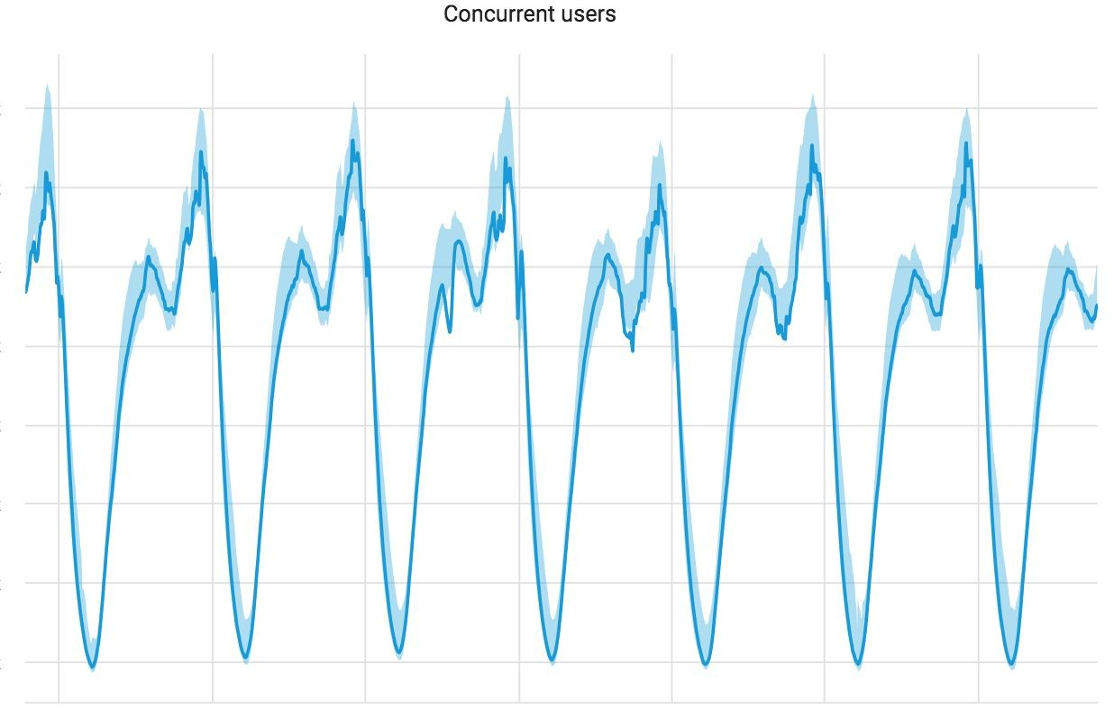
Our business requirements
Log analytics platform (Web-Server, Application, Database logs)
Data Ingestion rate: ~300GB/day
Frequently accessed data: last 8 days
Infrequently accessed
Uptime: 99.90
Hot Retention period: 90 days
Cold Retention period: 90 days (with potential to increase)
Simple and Cost effective solution
Fairly predictable concurrent user-base
Not to be used for storing user/business data

Slide 6
Choosing the right option
 | ELK stack | Splunk | Sumo logic
Product | Self managed | Cloud | Professional
Pricing | ~ $30 per GB / month | ~ $100 per GB / month * | ~ $108 per GB / month *
Data Ingestion | ~ 300 GB / day | ~ 100 GB / day * (post ingestion custom pricing) | ~ 20 GB / day * (post ingestion custom pricing)
Retention | ~ 90 days | ~ 90 days * | ~ 30 days *
Cost/GB/day | ~$ 0.98 per GB / day | ~$ 3.33 per GB / day * | ~$ 3.60 per GB /day *
* values are estimations taken from the ‘product pricing web-page’ of the respective products, they may not represent the actual values and are meant for the purpose of comparison only.
References: https://www.splunk.com/en_us/products/pricing/calculator.html#tabs/tab2 https://www.sumologic.com/pricing/apac/

Slide 7
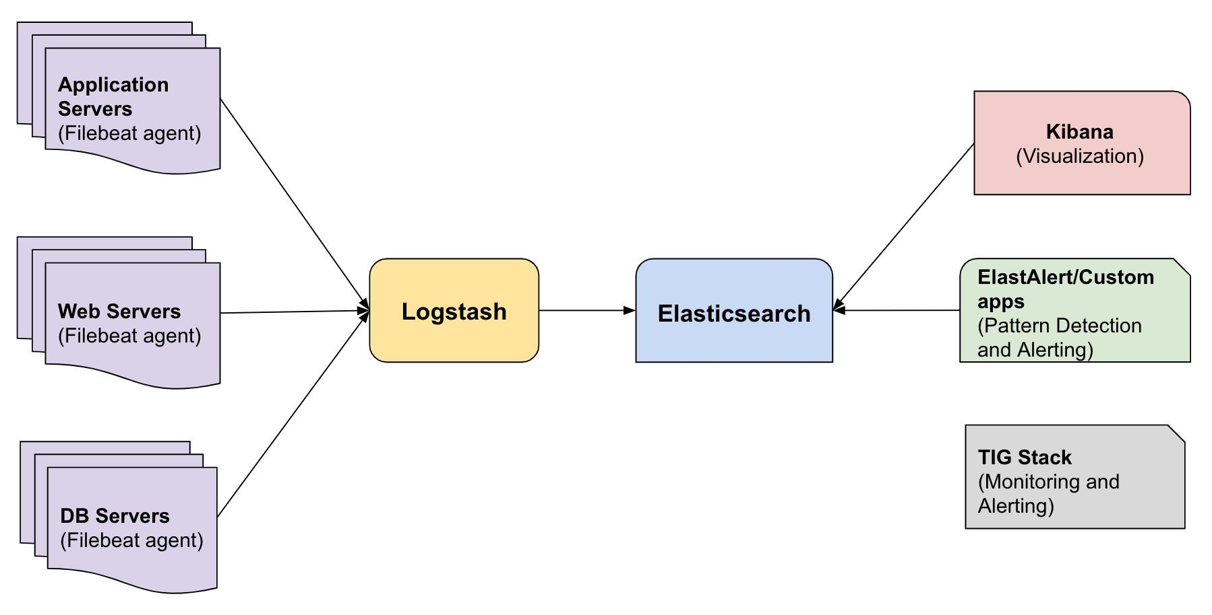
ELK Stack overview

Slide 8
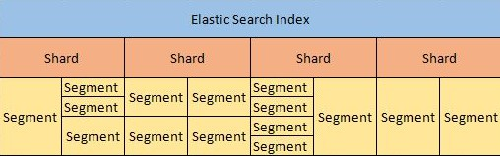
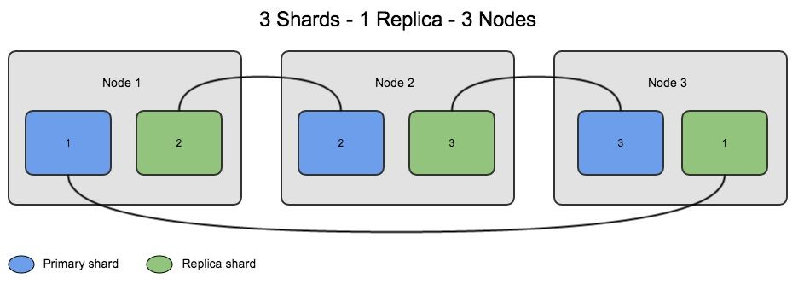
ELK Stack overview: Terminologies
Index
Shard
Primary
Replica
Segment
Node
References: https://www.elastic.co/guide/en/elasticsearch/reference/5.6/_basic_concepts.html

Slide 9
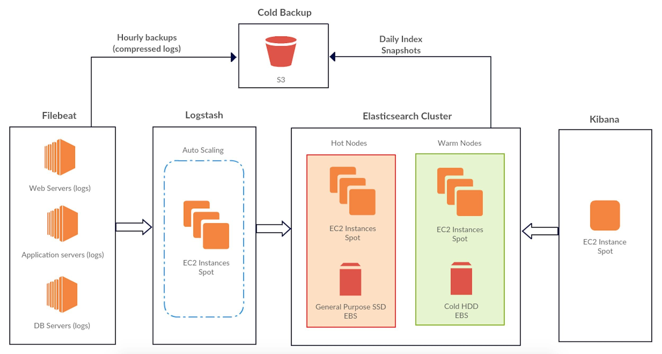
Our ELK architecture

Slide 10
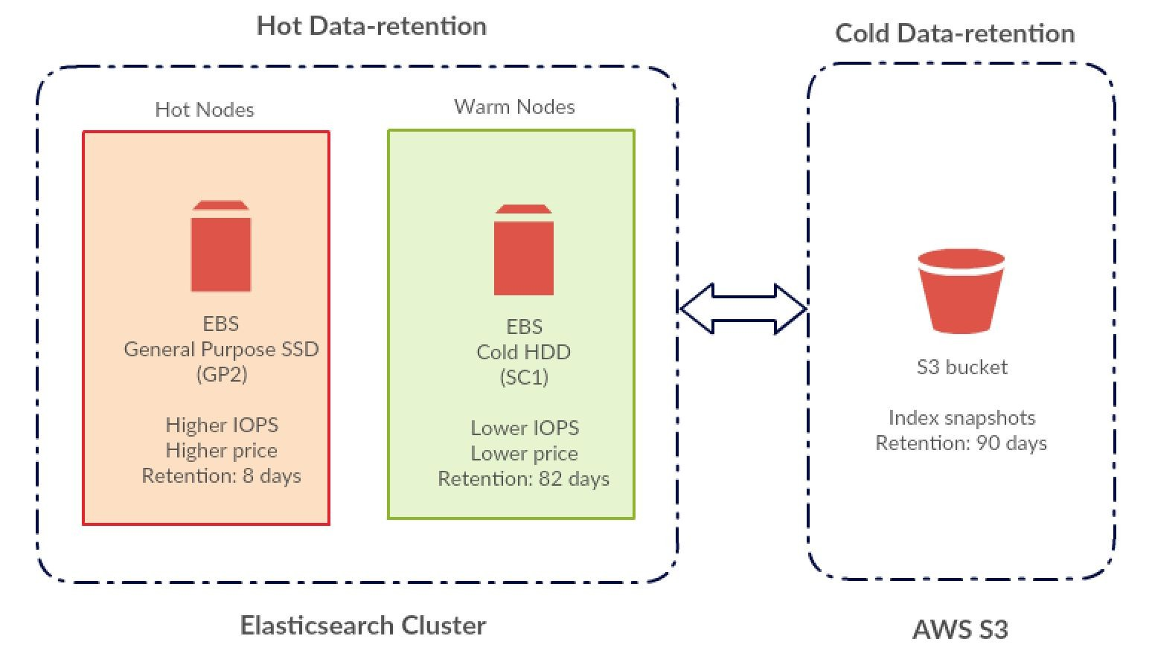
Our ELK architecture: Hot-Warm-Cold data storage (infinite scale)

Slide 11
Our ELK architecture: Size and scale
 | _{Service} Number of Nodes |  | Total CPU Cores | Total RAM | Storage EBS
1 | Elasticsearch | 7 | 28 | 141 GB
2 | Logstash | 3 | 6 | 12 GB
3 | Kibana | 1 | 1 | 4 GB
 | Total | 11 | 35 | 157 GB | ~ 20 TB
Data-ingestion per day | ~ 300 GB
Hot Retention period | 90 days
Docs/sec (at peak load) | ~ 7K

Slide 12


Optimizations we did
Application Side
Logstash
Elasticsearch
Infrastructure Side
EC2
EBS
Data transfer

Slide 13

Optimizations we did: Application side
Logstash

Slide 14


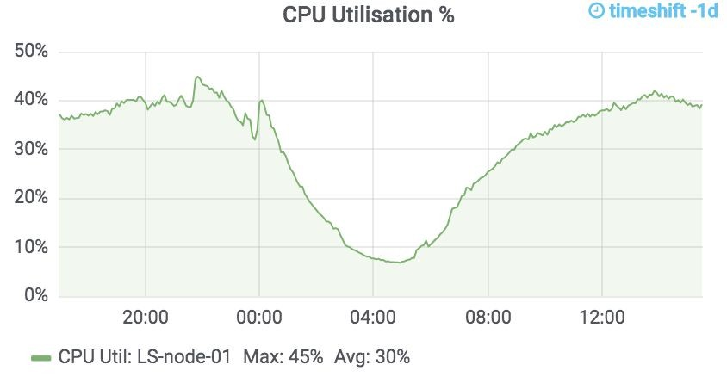
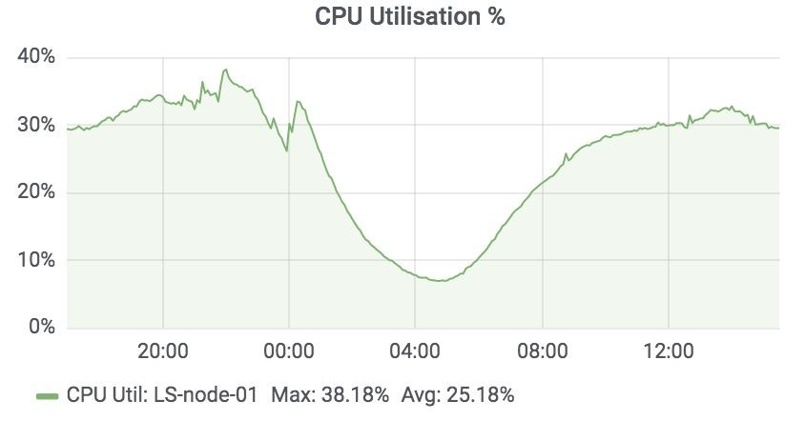
Optimizations we did: Logstash
logstash.yml
Pipeline Workers:
Adjusted "pipeline.workers" to x4 the number of Cores to improve CPU utilisation on Logstash server (as threads may spend significant time in an I/O wait state)
### Core-count: 2 ###
...
pipeline.workers: 8
...
References:
https://www.elastic.co/guide/en/logstash/current/tuning-logstash.html

Slide 15
Optimizations we did: Logstash
Filter config
'info' logs:
if [sourcetype] == "app_logs" and [level] == "info"
{
elasticsearch {
index => "%{sourcetype}-%{level}-%{+YYYY.MM.dd}"
...
Separated application 'info' log to be store in a different index with retention policy of fewer days
'200' response-code logs:
if [sourcetype] == "nginx" and [status] == "200"
{
elasticsearch {
index => "%{sourcetype}-%{status}-%{+YYYY.MM.dd}"
...
Separated Access log with '200' response-code be store in a different index with retention policy of fewer days
References:
https://www.elastic.co/guide/en/logstash/current/event-dependent-configuration.html

Slide 16

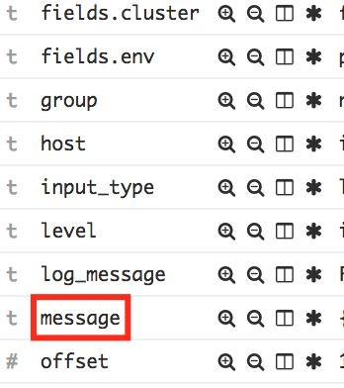
Optimizations we did: Logstash
Filter config
Log ‘message’ field:
if "_grokparsefailure" not in [tags] { mutate {
remove_field => ["message"]
}
}
Removed "message" field if there were no 'grok-failures' in logstash while applying grok patterns
(reduced storage footprint by ~30% per doc)
Eg:
Nginx Log-message: 127.0.0.1 - - [26/Mar/2016:19:09:19 -0400] "GET / HTTP/1.1" 401 194 "" "Mozilla/5.0
Gecko" "-"
Grok Pattern: %{IPORHOST:clientip} (?:-|(%{WORD}.%{WORD})) %{USER:ident}
\[%{HTTPDATE:timestamp}\] "(?:%{WORD:verb} %{NOTSPACE:request}(?: HTTP/%{NUMBER:httpversion})?|%{DATA:rawrequest})" %{NUMBER:response} (?:%{NUMBER:bytes}|-)
%{QS:referrer} %{QS:agent} %{QS:forwarder}

Slide 17

Optimizations we did: Application side
Elasticsearch

Slide 18

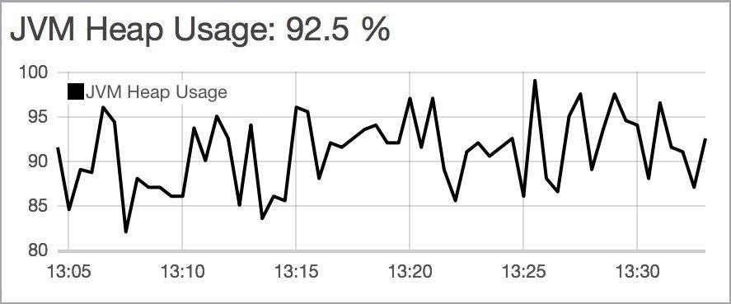

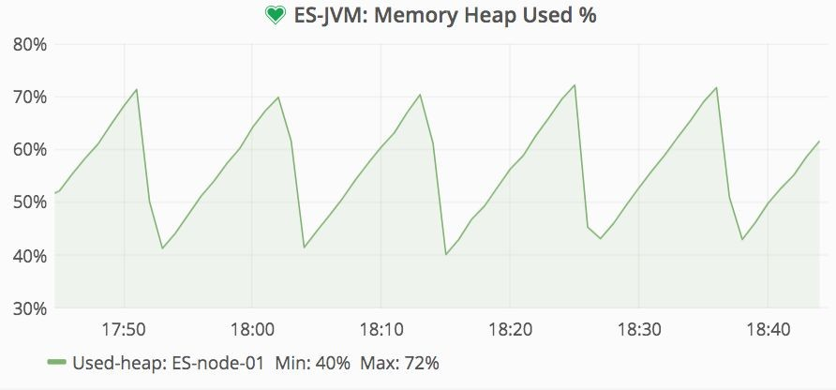

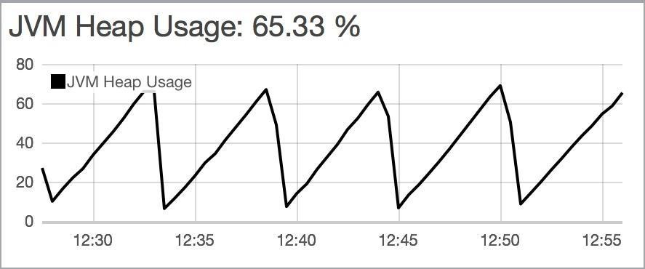
Optimizations we did: Elasticsearch
jvm.options
JVM heap vs non-heap memory:
### Total system Memory 15GB ###
-Xms5g
-Xmx5g
Optimised JVM heap-size by monitoring the GC interval, this helped in efficient utilization of system Memory (33% for JVM, 66% for non-heap) *
Heap too small
Optimised Heap
Heap too large
* Recommended heap-size settings by Elastic: https://www.elastic.co/guide/en/elasticsearch/reference/current/heap-size.html

Slide 19
Optimizations we did: Elasticsearch
Template config
Shards:
### Number of ES nodes: 5 ###
{
"template": "appserver-*",
"settings": {
"number_of_shards": "5",
"number_of_replicas": "0",
...
}
}'
Created templates with number of shards which are multiples of the number of Elasticsearch nodes
(helps fix issues
with
imbalance which resulted in uneven disk,
shards
distribution
compute resource usage)
Replicas:
Trade-offs:
Removed replicas for the required indexes
(50% savings on storage cost, ~30% reduction in compute resource utilization)
Removing replicas will result in search queries running slower as replicas are used while performing search operations
It is not recommended to run production clusters without replicas

Slide 20

Optimizations we did: Infrastructure side
AWS
EC2
EBS
Data transfer (Inter AZ)
Spotinst platform allows users to reliably leverage excess capacity, simplify cloud operations and save 80% on compute costs.

Slide 21

Optimizations we did: Infrastructure side
EC2

Slide 22

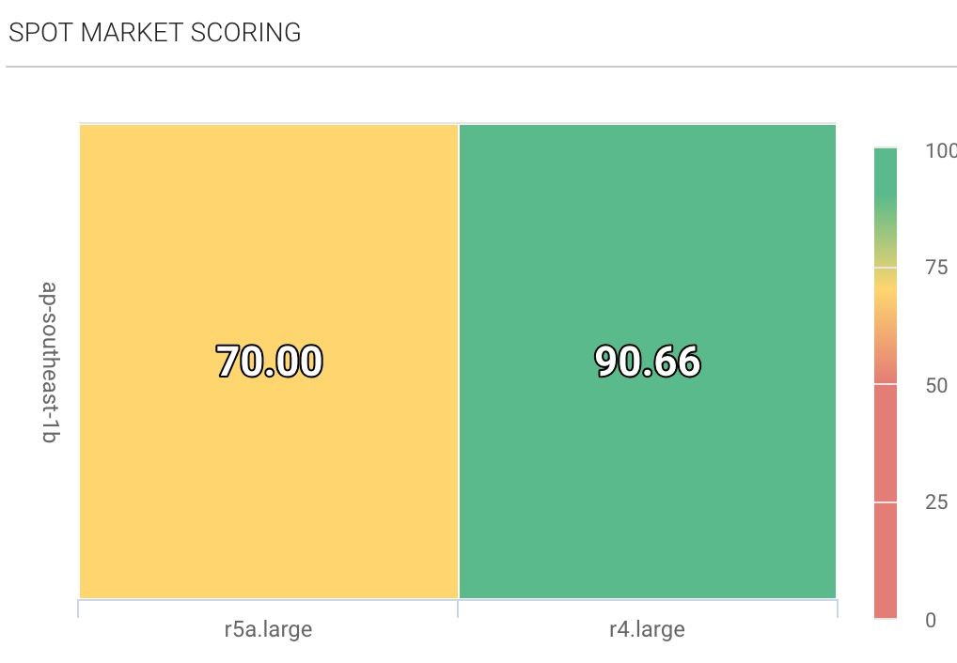

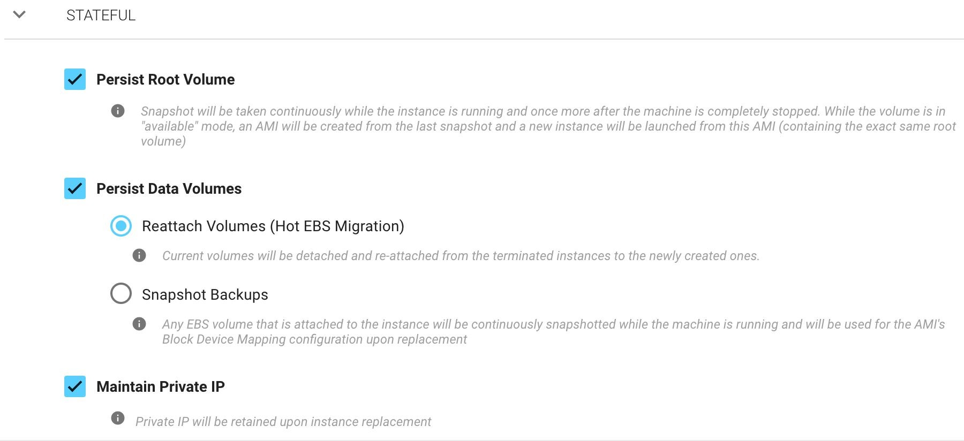
Optimizations we did: EC2 and spot
Stateful EC2 Spot instances:
Moved all ELK nodes to run on spot instances (Instances maintain IP address, EBS volumes) Recovery time: < 10 mins
Trade-offs:
Prefer using previous generation instance types to reduce frequent spot take-backs

Slide 23

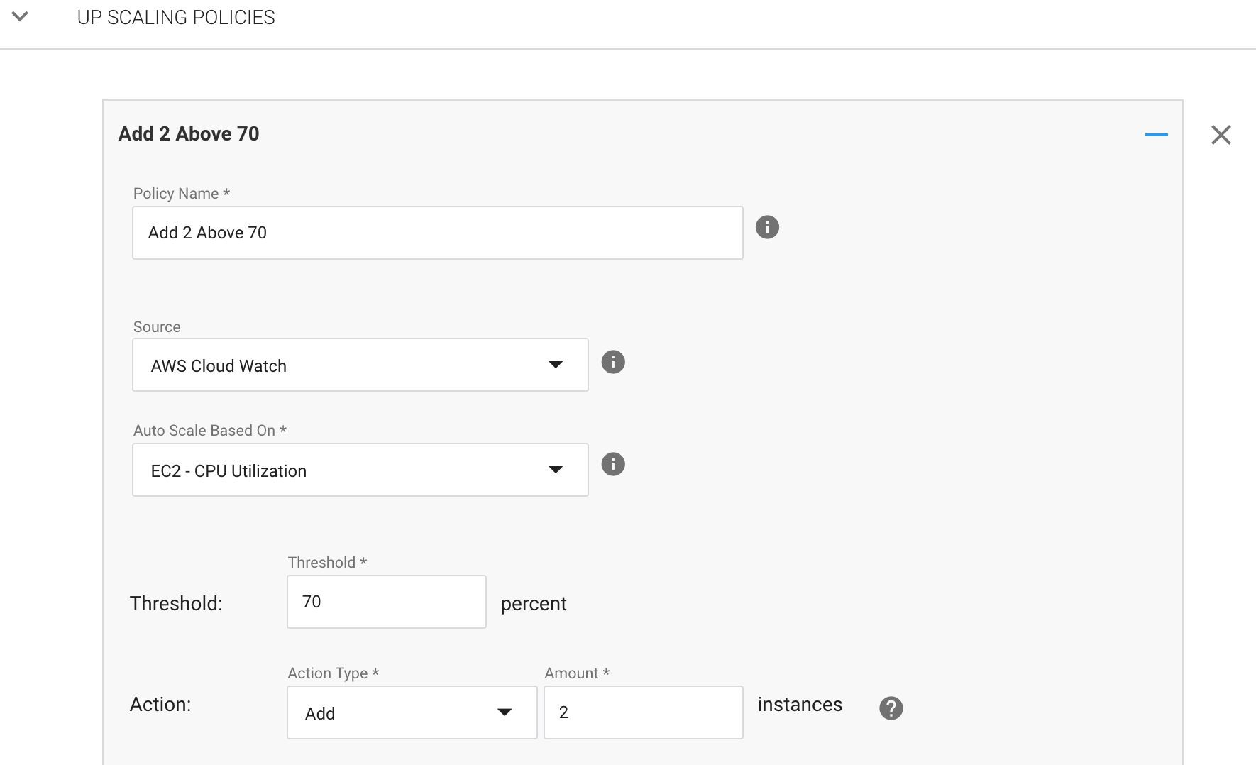

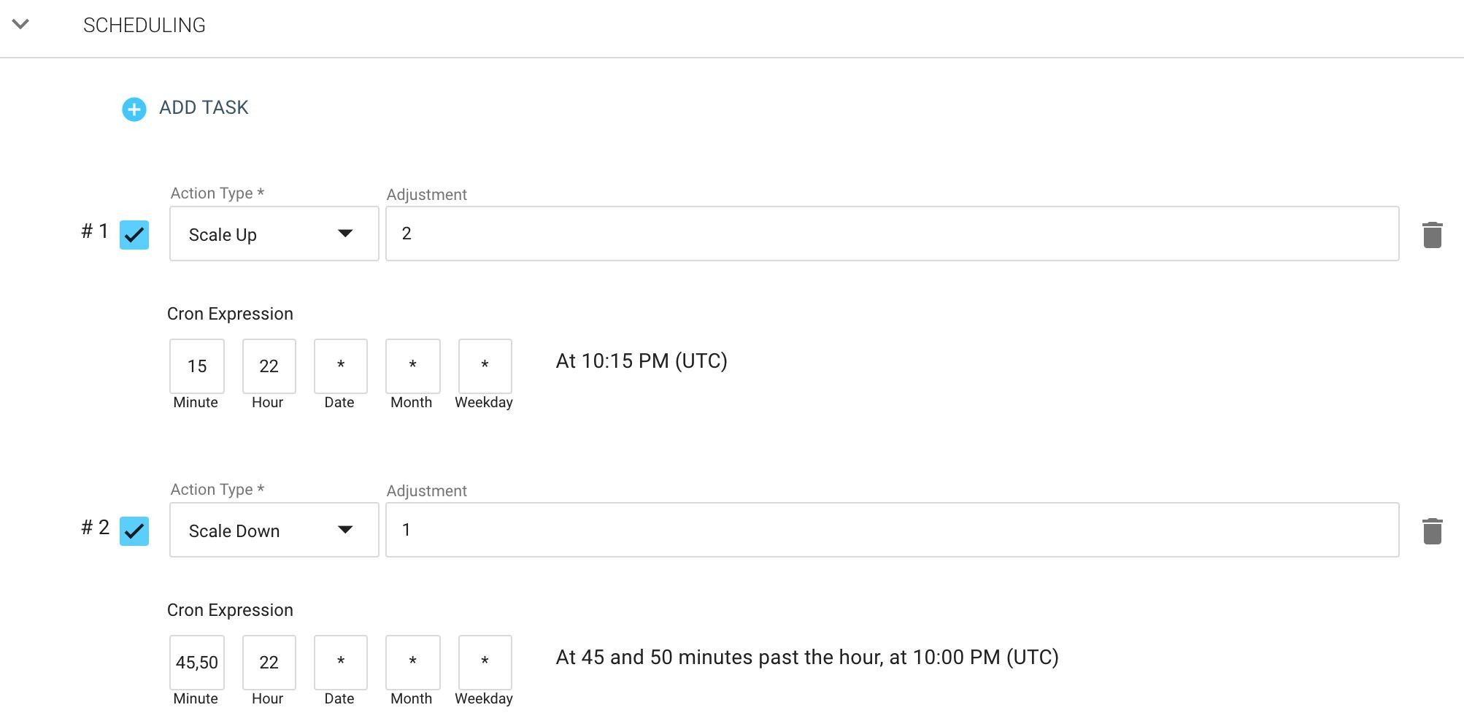
Optimizations we did: EC2 and spot
Auto-Scaling:
Performance/time based auto-scaling for
Logstash Instances

Slide 24

Optimizations we did: Infrastructure side
EBS

Slide 25
Optimizations we did: EBS
"Hot-Warm" Architecture:
elasticsearch.yml
"Hot" nodes: store active indexes, use GP2 EBS-disks (General purpose SSD)
node.attr.box_type: hot
...
"Warm" nodes: store passive indexes, use SC1 EBS-disks (Cold storage)
(~69% savings on storage cost)
Template config
"template": "appserver-*",
"settings": {
"index": {
"routing": {
"allocation": {
"require": {
"box_type": "hot"}
}
}
},
...
Trade-offs:
Since "Warm" nodes are using SC1 EBS-disks, they have lower IOPS, throughput this will result in search operations being comparatively slower
References:
https://cinhtau.net/2017/06/14/hot-warm-architecture/

Slide 26
Optimizations we did: EBS
Curator config
Moving indexes to "Warm" nodes:
Reallocated indexes older than 8 days to "Warm"
nodes
Recommended to perform this operation during off-peak hours as it is I/O intensive
actions: 1:
action: allocation
description: "Move index to Warm-nodes after 8 days"
options:
key: box_type
value: warm allocation_type: require timeout_override: continue_if_exception: false
filters:
- filtertype: age source: name direction: older timestring: '%Y.%m.%d' unit: days unit_count: 8
...
References:
https://www.elastic.co/blog/hot-warm-architecture-in-elasticsearch-5-x

Slide 27
Optimizations we did: Inter-AZ data transfer
Single Availability Zone:
Trade-offs:
Migrated all ELK node to a single availability zone (reduce inter AZ data transfer cost for ELK nodes by 100%)
It is not recommended to run production clusters in a single AZ as it will result in downtime and potential data loss in case of AZ failures
Data transfer/day: ~700GB (Logstash to Elasticsearch: ~300GB,
Elasticsearch inter-communication: ~400GB)

Slide 28
Data backup and restore
Backup:
Using S3 for index Snapshots:
Take snapshots of indexes and store them in S3
curl -XPUT "http://<domain>:9200/_snapshot/s3_repository/ snap1?pretty?wait_for_completion=true" -d'
{
"indices": "index_1,index_2", "ignore_unavailable": true, "include_global_state": false
}
References:
https://www.elastic.co/guide/en/elasticsearch/reference/current/modules-snapshots.html https://medium.com/@federicopanini/elasticsearch-backup-snapshot-and-restore-on-aws-s3-f1fc32fbca7f

Slide 29
Data backup and restore
Restore:
On-demand Elasticsearch cluster:
Launching a on demand ES cluster and importing the snapshots from S3
Existing Cluster:
Restore the required snapshots to existing cluster
curl -s -XPOST --url "http://<domain>:9200/_snapshot/s3_repository/s nap1/_restore" -d'
{
"indices": "index_1,index_2", "ignore_unavailable": true, "include_global_state": false,
}'

Slide 30
Disaster recovery
Data corruption:
Node failure due to AZ going down:
List out indexes with status as ‘Red’
Deleted the corrupted indexes
Restore indexes from S3 snapshots
Recovery time: depends of size of data
Launch a new ELK cluster using AWS cloud formation templates
Do the necessary config changes in Filebeat, Logstash etc.
Restore the required indexes from S3 snapshots
Recovery time: depends on provisioning time and size of data
Node failures due to underlying hardware issue:
Recycle node in Spotinst console
(will take AMI of root volume, launch new instance, attach EBS volumes, maintain private IP)
Recovery time: < 10 mins/node
Snapshot restore time (estimates):
< 4mins for a 20GB snapshot (test-cluster: 3 nodes, multiple indexes with 3 primary shards each, no replicas)

Slide 31
Cost savings: EC2
EC2
Instance type | Service | Daily cost
5 x r5.xlarge (20C, 160GB) | Elasticsearch | 40.80
3 x c5.large (6C, 12GB) | Logstash | 7.17
1 x t3.medium (2C, 4GB) | Kibana | 1.29
 | Total | ~ 49.26$
EC2 (optimized)
Instance type | Service | Daily cost 65% savings + Spotinst charges (20% of savings) | Total Savings
5 x m4.xlarge (20C, 80GB) | Elasticsearch Hot | 14.64
2 x r4.xlarge (8C, 61GB) | Elasticsearch Warm | 7.50
3 x c4.large (6C, 12GB) | Logstash | 3.50
1 x t2.medium (2C, 4GB) | Kibana | 0.69
 | Total | ~ 26.33$ | ~ 47%

Slide 32
Cost savings: Storage
Storage
Storage type | Retention | Daily cost
~54TB (GP2) | 90 days | ~ 237.60$
Ingesting: 300GB/day
Retention: 90 days
Replica count: 1
Storage (optimized)
Storage type | Retention | Daily cost | Total Savings
~ 3TB (GP2) Hot | 8 days | 12.00
~ 24TB (SC1) Warm | 82 days | 24.00
~ 27TB (S3) Backup | 90 days | 22.50
Total |  | ~ 58.50$ | ~ 75%
Ingesting: 300GB/day
Retention: 90 days
Replica count: 0
Backups: Daily S3 snapshots

Slide 33
Total savings
 | ELK stack | ELK stack (optimized) | Savings
EC2 | 49.40 | 26.33 | 47%
Storage | 237.60 | 58.50 | 75%
Data-transfer | 7 | 0 | 100%
Total (daily cost) | ~ 294.00$ | ~ 84.83$ | ~ 71% *
Cost/GB (daily) | ~ 0.98$ | ~ 0.28$
* Total savings are exclusive of some of the application-level optimizations done

Slide 34
Our Costs vs other Platforms
 | ELK Stack (optimized) | ELK Stack | Splunk | Sumo logic
Product | Self managed | Self managed | Cloud | Professional
Data Ingestion | ~ 300GB/day | ~ 300GB/day | ~ 100 GB / day * (post ingestion custom pricing) | ~ 20 GB / day * (post ingestion custom pricing)
Retention | ~ 90 days | ~ 90 days | ~ 90 days * | ~ 30 days *
Cost/GB/day | ~ $ 0.28 per GB /day | ~ $ 0.98 per GB /day | ~ $ 3.33 per GB /day * | ~ $ 3.60 per GB /day *
Savings over traditional ELK stack: 71% *
* Total savings are exclusive of some of the application-level optimizations done

Slide 35
Key Takeaways
ELK Stack Scalability:
Logstash: auto-scaling
Elasticsearch: overprovisioning (nodes run at 60% capacity during peak load), predictive vertical/horizontal scaling
Handling potential data-loss while AZ is down:
DR mechanisms in place, daily/hourly backups stored in S3, Potential chances of data loss of about 1 hour
We do not store user-data or business metrics in ELK, users/business will not be impacted
Handling potential data-corruptions in Elasticsearch:
DR mechanisms in place, recover index from S3 index-snapshots
Managing downtime during spot take-backs:
Logstash: multiple nodes, minimal impact
Elasticsearch/Kibana: < 10min downtime per node
Use previous generation instance types as spot take-back chances are comparatively low

Slide 36
Key Takeaways
Handling back-pressure when a node is down:
Filebeat: will auto-retry to send old logs
Logstash: use ‘date’ filter for document timestamp, auto-scaling
Elasticsearch: overprovisioning
Other log analytics alternatives:
We have only evaluated ELK, Splunk and Sumo Logic
ELK stack upgrade path:
Blue Green deployment for major version upgrade

Slide 37
Reflection
We built a platform tailored to our requirements, yours might be different...
Building a log analytics platform is not rocket science, but it can be painfully iterative if you are not aware of the options
Be aware of the trade-offs you are ‘OK with’ and you can roll out a solution optimised for your specific requirements

Slide 38


Thank you!
Happy to take your questions..
Copyright Disclaimer: All rights to the materials used for this presentation belongs to their respective owners..

