Slide 1
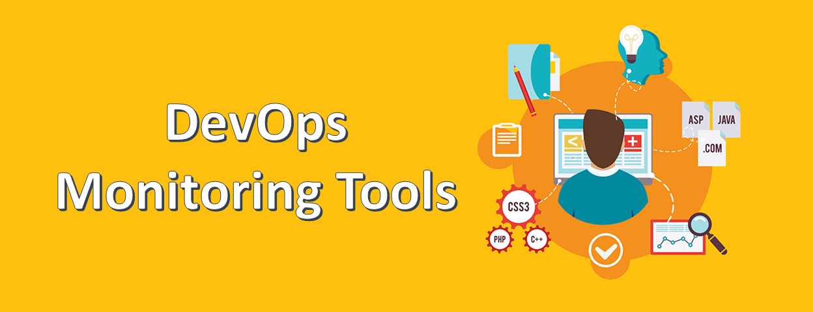


Slide 2
Why monitoring?
Monitoring is one of the fundamental tasks in any system. It can help us to detect problems and take action, or simply to know the current state of our systems.
helps you reduce (or even eliminate) downtime.
You can detect problems, and solve them before they impact users

Slide 3
Monitoring
We can:
Expose Important metrics (data) over time
Provide a way to configure rules, e.g (Cpu usage /80%)
Send alerts (email) when rules are broken
Provide visualization/Graphing
Monitoring tools: Sensu, Prometheus, Nagios
Notes:
Sensu - A flexible and scalable telemetry and service health checking solution for monitoring servers, containers, services, applications, functions, and connected devices.
Prometheus - Relies on the pull method to collect information, with a built-in database.
Nagios - The legacy monitoring tool that introduced monitoring practices to a generation of operators.

Slide 4
Prometheus
Prometheus is an in-memory dimensional time series database with a simple built-in UI, a custom query language. Prometheus is designed to scrape metrics from application instances periodically based on service discovery.
A data scraper that pulls metrics data over HTTP periodically at a configured interval.
A time-series database to store all the metrics data.
A simple user interface where you can visualize, query, and monitor all the metrics.
Written in Go, fully published in 2015.
Second project hosted by SNCF after kubernetes

Slide 5
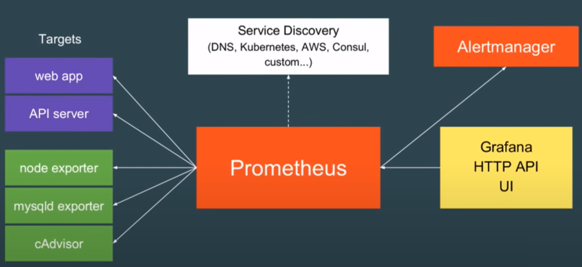
How prometheus works ?

Slide 6
What does prometheus monitor?
Linux / windows servers ( CPU status, memory, Disk space …)
Apache server (On/Off status…)
Single application ( Exceptions, Requests count, client latency…)
Service like database (status, Query Performance…)

Slide 7
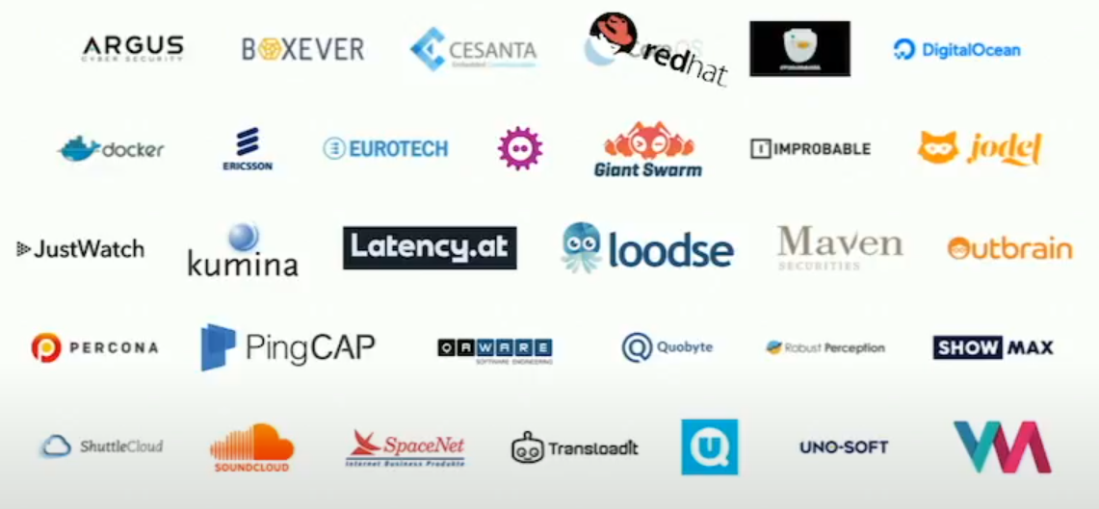
Prometheus

Slide 8
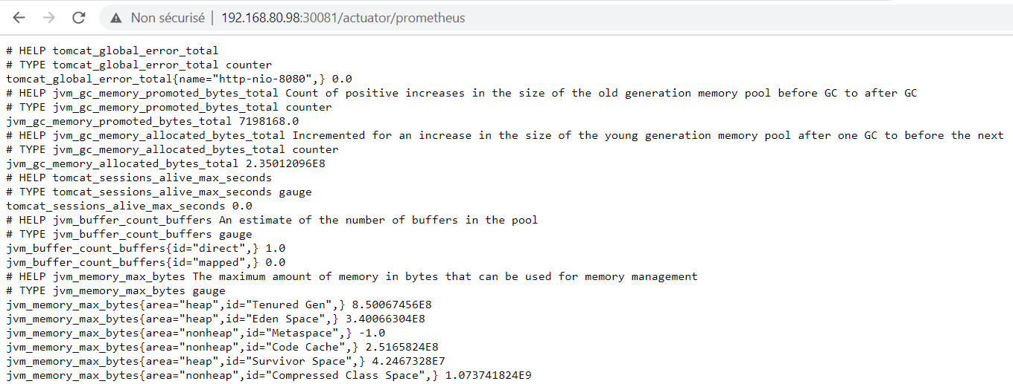
Metrics
Metrics: all data as time series that prometheus can scrape it and stores it in his database.
Metrics has two metadata lines: Help and Type
Help: description of what the metrics is.
Type: we have 3 metrics types:
Count: how many times x happened?
Gauge: what is the current value of x now?
Histogram; How long or how big?
OpenMetrics format

Slide 9
Some examples of metrics
Current memory usage gauge
HTTP request latency gauge
Number of threads in use count
Number of HTTP requests count
CPU usage gauge

Slide 10
PromQL
Prometheus provides a functional query language called PromQL (Prometheus Query Language) that lets the user select and aggregate time series data in real time. The result of an expression can either be shown as a graph, viewed as tabular data in Prometheus's expression browser, or consumed by external systems via the HTTP API.
Example:
Metric name
Metric label

Slide 11
PromQL
Example Queries:
Http_requests_total{status!~”4..”} : Query all HTTP status codes except 4xx ones.
rate(Http_requests_total[5m])[30m:] : Returns the 5-minutes rate of the http_requests_total metric for the past 30 min.

Slide 12
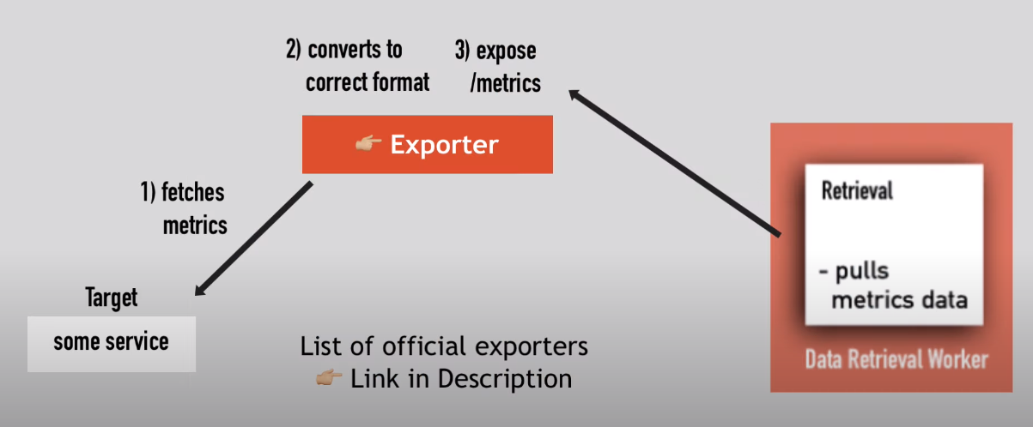
Target Endpoints and Exporters
In order to monitor anything with Prometheus, you need an exporter – a process that exposes metrics for Prometheus to harvest.
The available exporters can be find from here: https://prometheus.io/docs/instrumenting/exporters/

Slide 13
Monitoring your own application
How many requests?
How many exceptions?
How many server resources are used?
Example: micrometer pour spring boot
Also you can use client libraries to expose metrics endpoints

Slide 14
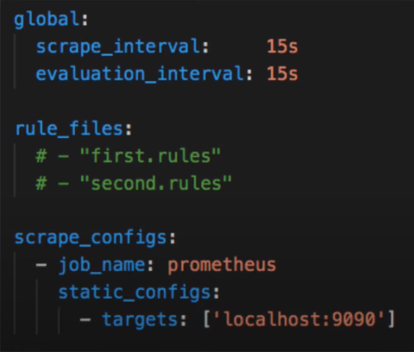
Configuring prometheus
How often Prometheus will scrape its targets
Rules for aggregating metric values or creating alerts when condition met
What resources Prometheus monitors
prometheus.yml

Slide 15
AlertManager
AlertManager is a single binary which handles alerts sent by Prometheus server and notifies end user through E-mail, Slack or other tools.
Example (custom rules):
Is my server not running
Average response time greater than 500Ms
Is my server’s memory usage greater than 95%.
Number of 404 errors greater than 10% of all requests.

Slide 16
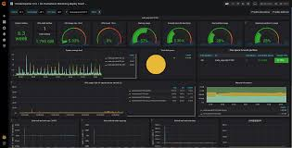
Grafana
Is the open source analytics & monitoring solution for every database.
Grafana allows you to bring data from various data sources like Elasticsearch, Prometheus, Graphite, InfluxDB etc, and visualize them with beautiful graphs.

Slide 17
Grafana features
Create graphs easily
Visualize data in differents ways
Show graphs for different time periods
Create dashboard to be viewed by others
Allows us to easily make changes

Slide 18

Demo

Slide 19

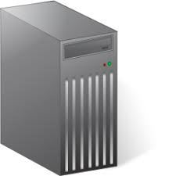




We will monitor all this targets using prometheus and grafana

Slide 20
Node Exporter
Have you ever wondered how you can monitor your entire Linux system performance easily?
If you are looking for all those features, you are in the right place.
Today we are taking a very special look at the Node Exporter, a Prometheus exporter specialized in exposing Linux metrics.

Slide 21
Spring boot Application
Spring Boot uses Micrometer, an application metrics facade to integrate actuator metrics with external monitoring systems.
Micrometer supports several monitoring systems like Netflix Atlas, AWS Cloudwatch, Datadog, InfluxData, SignalFx, Graphite, Wavefront, Prometheus etc.
You should use actuator
To integrate actuator with Prometheus, you need to add the micrometer-registry-prometheus dependency.

Slide 22
Postgres / Sql Server Databases
We want to alert the average response time
Viewing active sessions
Shared buffers
Transactions
Number of active connection
Percentage of memory utilization

Slide 23
Nginx
NGINX Prometheus exporter fetches the metrics from a single NGINX, converts the metrics into appropriate Prometheus metrics types and finally exposes them via an HTTP server to be collected by Prometheus.
For NGINX, the following metrics are exported:
Connections.
HTTP.

Slide 24
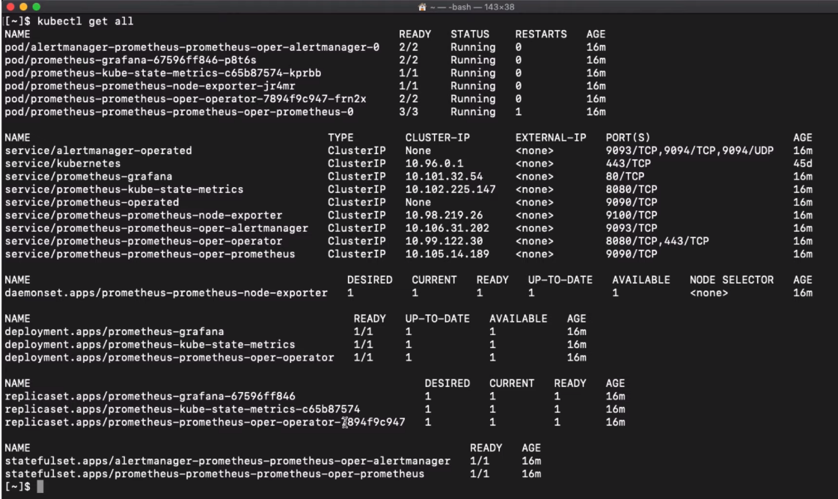
Kubernetes cluster
Helm chart is the best way to deploy prometheus in k8s cluster. It create all configuration yml files in one command.
helm install --name prometheus stable/prometheus-operator
kubectl get all

Slide 25
Conclusion
Prometheus is:
Full Java Client
Simple handling
Supported by grafana ( Graphs )
Full monitoring thanks to numerous exporters and libraries
Service discovery e.g (Consul)
Alerting with AlertManager

Slide 26

Notes:
Metrics: Keys values pairs

