Slide 1

DevOps with Flux – GitOps for Kubernetes
Automating Continuous Delivery the GitOps way
Welcome to this comprehensive guide on implementing GitOps workflows using Flux. Today we'll explore how Flux enables automated, secure, and reliable continuous delivery for your Kubernetes environments.

Slide 2
Today's Agenda
1
2
Introduction to GitOps & Flux
Flux Architecture
Core concepts and principles behind GitOps and why Flux is a leading implementation
Understanding the components and controllers that make up the Flux system
3
4
Installing Flux
Managing Deployments
Step-by-step guide to getting Flux up and running in your environment
Practical examples of GitOps workflows with Flux
5
6
Advanced Features
Wrap-Up & Q&A
Exploring Flux's powerful capabilities beyond basic deployments
Summary and time for questions

Slide 3

What is GitOps?
Git as the single source of truth
All infrastructure and application configurations are stored in Git repositories
Declarative Manifests
Infrastructure defined as code with declarative manifests stored in version control
Continuous Reconciliation
Automated processes ensure the desired state is always enforced
Key Benefits
Complete versioning, auditability, and simplified rollback capabilities

Slide 4
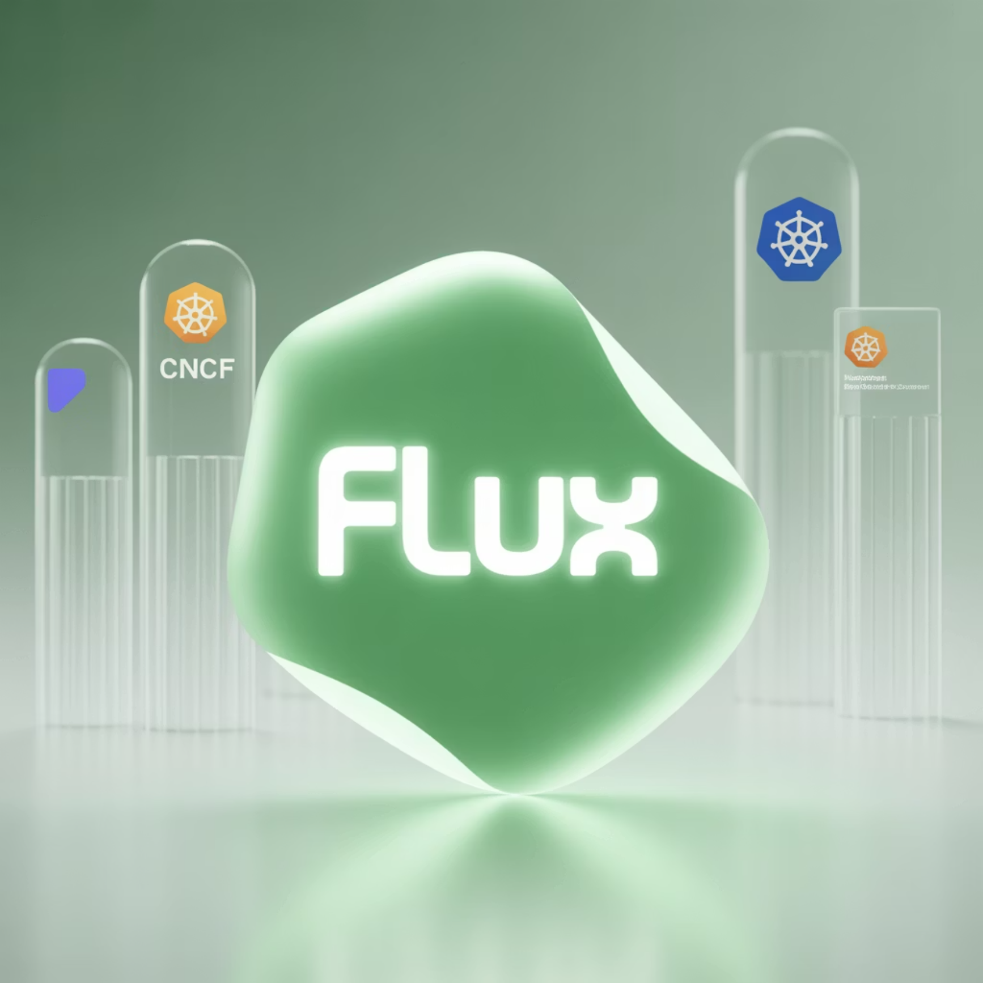
Why Flux?
Flux has emerged as a leading GitOps tool because it's purpose-built for Kubernetes environments and offers a comprehensive feature set that addresses real-world operational challenges.
Key Features
As a CNCF Incubated project, Flux benefits from broad community support and follows cloud-native best practices.
Automated synchronization from Git repositories
Robust multi-tenancy support for team isolation
Native integration with Helm and Kustomize
Image automation for container updates
Drift detection with automatic reconciliation
Kubernetes-native architecture

Slide 5
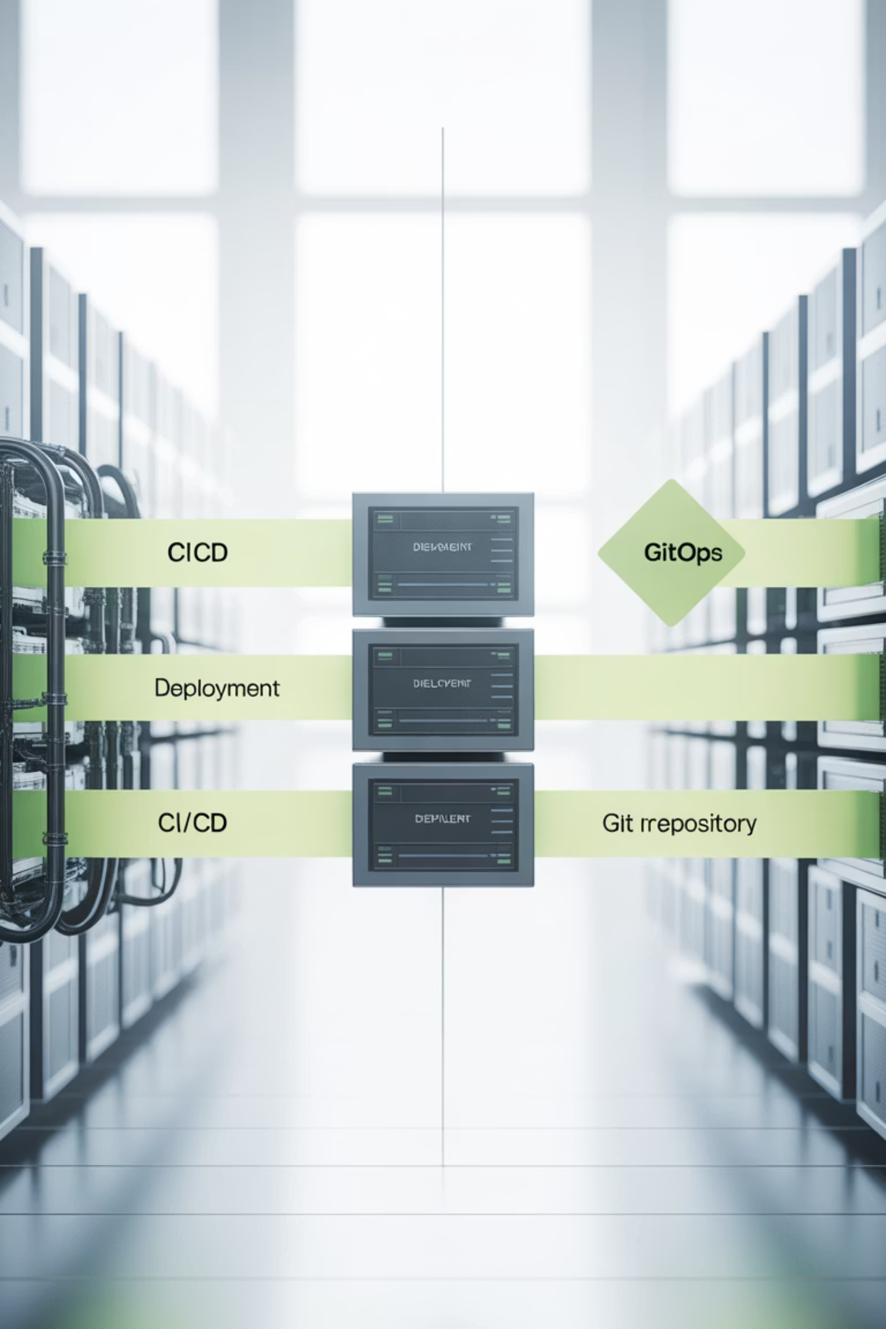
Flux vs Traditional CI/CD
Traditional CI/CD
Flux (GitOps)
CI system pushes changes directly to cluster
Cluster pulls changes from Git repository
Manual approvals often required in pipeline
Immutable, declarative configuration
State drift possible between deployments
Automatic reconciliation prevents drift
Cluster credentials stored in CI system
More secure - no external access to cluster

Slide 6
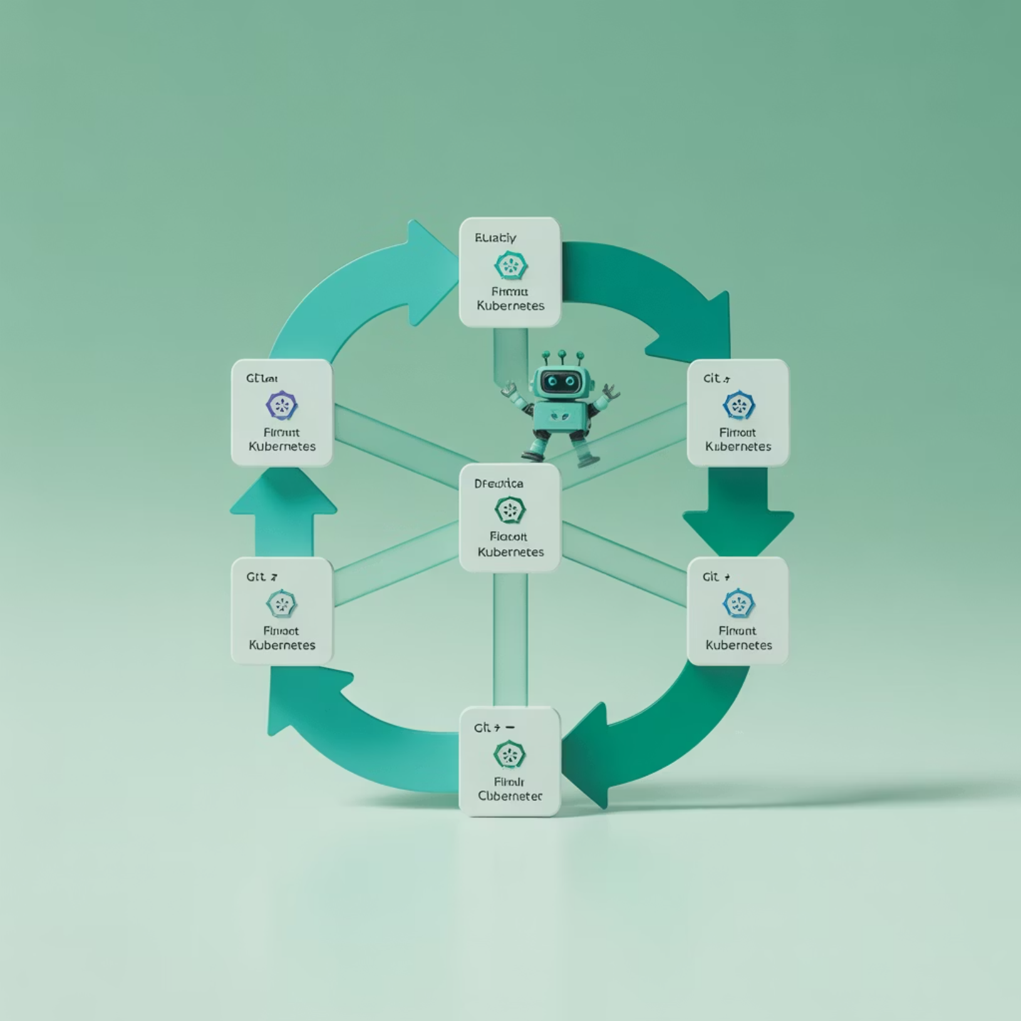
Flux Architecture
Core Controllers
Flux operates on a reconciliation loop, checking for changes at defined intervals and ensuring the cluster state matches Git.
Source Controller
This secure model means your cluster is never exposed to external systems - it only pulls from authorized sources.
Pulls Git repositories, Helm charts, and other artifacts
Kustomize Controller
Applies Kubernetes manifests with Kustomize support
Helm Controller
Manages Helm releases declaratively
Notification Controller
Handles alerts and events to external systems

Slide 7
Flux Workflow
Developer commits code to Git
Changes to application code or configuration are pushed to the Git repository
Flux Source Controller detects change
Source controller polls the Git repository and identifies new commits
Manifests pulled to cluster
Updated Kubernetes manifests are securely pulled into the cluster
Controllers apply desired state
Kustomize or Helm controllers apply the changes to match desired state
Drift automatically corrected
Any manual changes or drift from desired state is automatically fixed

Slide 8
Demo – Installing Flux
Install the Flux CLI
curl -s https://fluxcd.io/install.sh | sudo bash
Bootstrap Flux with GitHub
flux bootstrap github \ --owner= \ --repository=flux-demo \ --branch=main \ --path=clusters/my-cluster
This bootstrap command:
Creates a new repository if it doesn't exist
Generates Flux manifests and commits them to the repository
Deploys Flux components to your cluster in the flux-system namespace
Configures Flux to sync from the specified path in your repository

Slide 9

Demo – GitOps in Action
1. Create sample app repository (podinfo)
3. Commit and watch Flux apply automatically
First, we'll set up a repository with our application manifests.
Once committed to Git, Flux will detect the change and apply the manifests to your cluster.
2. Define GitRepository & Kustomization
4. Verify the deployment
Check that your application is running:
apiVersion: kustomize.toolkit.fluxcd.io/v1beta2kind: Kustomizationmetadata: name: podinfo namespace: flux-systemspec: interval: 1m path: "./deployments/podinfo" prune: true sourceRef: kind: GitRepository name: flux-demo
kubectl get pods -n defaultkubectl get kustomization -n flux-system
Any changes to the Git repository will be automatically synchronized to your cluster within the defined interval (1 minute in this example).

Slide 10




Advanced Features
Image Automation
Helm Releases
Automatically update container image tags in Git when new versions are available in your registry. Flux can scan registries, update manifests, and commit changes back to Git.
Manage Helm charts declaratively through Git. Flux provides custom resources for defining Helm repositories and releases with values overrides.
Multi-cluster Management
Notifications
Control multiple Kubernetes clusters from a single Git repository. Define cluster-specific configurations while sharing common resources.
Send alerts to Slack, Microsoft Teams, Discord, or custom webhooks when reconciliation events occur or when deployments succeed or fail.

Slide 11

Benefits Recap
Immutable Deployments
Changes flow through Git, ensuring consistency and preventing configuration drift
Automated Rollbacks
Leverage Git history to easily revert to previous known-good states
Enhanced Security
Cluster pulls changes rather than being exposed to external systems
Cross-Cluster Consistency
Maintain uniform configurations across development, staging, and production

Slide 12
Demo Recap
Installed Flux CLI and Components
1
We set up the Flux command-line tools and bootstrapped the core controllers in our Kubernetes cluster
2
Configured Git Repository Synchronization
curl -s https://fluxcd.io/install.sh | sudo bashflux bootstrap github ...
We defined sources for our application manifests and configured Flux to monitor them
apiVersion: source.toolkit.fluxcd.io/v1beta2kind: GitRepositorymetadata: name: flux-demo namespace: flux-systemspec: interval: 1m url: https://github.com/user/flux-demo
Demonstrated Reconciliation
3
We observed how Flux automatically detected and applied changes from our Git repository to the cluster

Slide 13

Wrap-Up
GitOps + Flux = Modern DevOps
Next Steps
Explore Image Automation
By combining GitOps principles with Flux's powerful toolkit, you can achieve:
Set up automated updates for container images
Automated deployment workflows
Implement Helm Management
Secure infrastructure management
Manage Helm releases declaratively
Reliable continuous delivery
Flux is particularly well-suited for cloud-native DevOps teams looking to scale their Kubernetes operations efficiently.
Configure Multi-Cluster Setups
Extend GitOps practices across environments

