Slide 1
Docker Concepts
VishwanaTH m s
VISHWACLOUDLAB.com

Slide 2
Agenda
What is Docker?
Docker vs. Virtual Machine
History, Status, Run Platforms
Hello World
Images and Containers
Volume Mounting, Port Publishing, Linking
Around Docker, Docker Use Cases
Hands-On Workshop

Slide 3
What is Docker?
Docker is an open-source project that automates the deployment of applications inside software containers, by providing an additional layer of abstraction and automation of operating system–level virtualization on Linux.

Slide 4
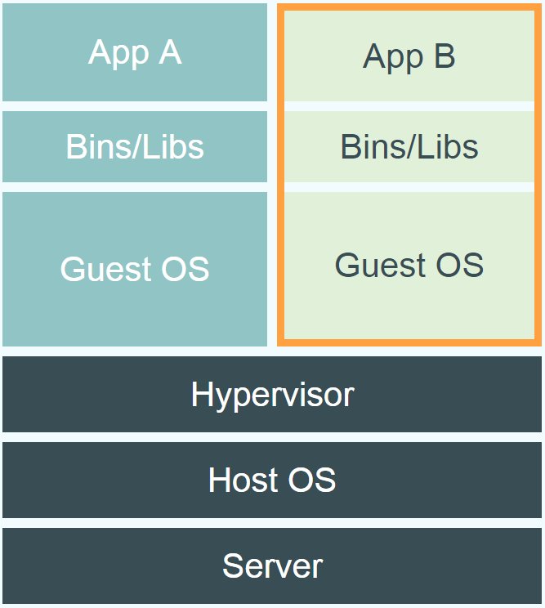
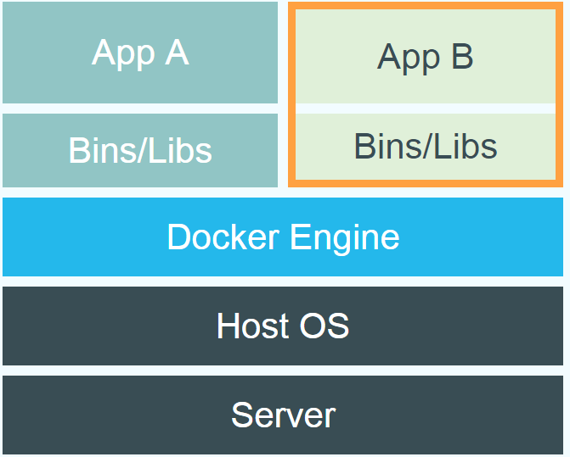
Docker vs. Virtual Machine

Slide 5
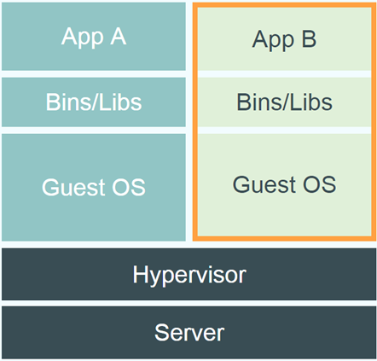
Docker vs. Virtual Machine

Slide 6
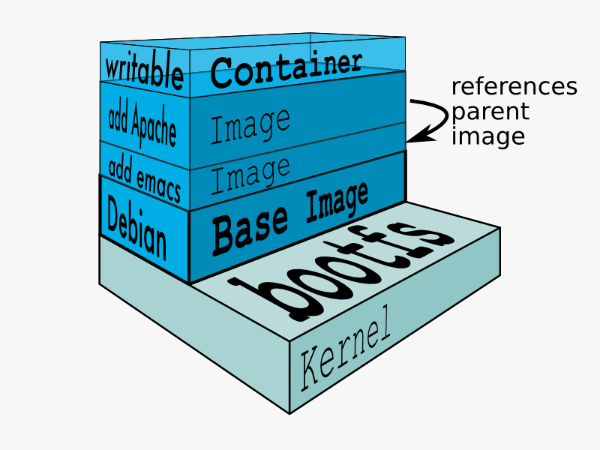
Docker Technology
libvirt: Platform Virtualization
LXC (LinuX Containers): Multiple isolated Linux systems (containers) on a single host
Layered File System
[Source: https://docs.docker.com/terms/layer/]

Slide 7
Docker History
2013-03: Releases as Open Source
2013-09: Red Hat collaboration (Fedora, RHEL, OpenShift)
2014-03: 34th most starred GitHub project
2014-05: JAX Innovation Award (most innovative open technology)

Slide 8
Run Platforms
Various Linux distributions (Ubuntu, Fedora, RHEL, Centos, openSUSE, ...)
Cloud (Amazon EC2, Google Compute Engine, Rackspace)
2014-10: Microsoft announces plans to integrate Docker with next release of Windows Server

Slide 9
Hello World
Simple Command - Ad-Hoc Container
docker run ubuntu echo Hello World
-- docker images [-a]
-- docker ps –a

Slide 10
Image vs. Container
Base Image
ubuntu:latest
run
Container
cid1
base image
cmd → new state
New Image
iid1
commit
Container
cid1
run
Container
cid2
Container
cid3

Slide 11
Terminology - Image
Persisted snapshot that can be run
# docker images ls
images: List all local images
run: Create a container from an image and execute a command in it
tag: Tag an image
pull: Download image from repository
rmi: Delete a local image
This will also remove intermediate images if no longer used

Slide 12
Publish Port
docker run –t –p 8080:80 ubuntu nc –l 80
-- Map container port 80 to host port 8080
-- Check on host: nc localhost 8080
Link with other docker container
- docker run -ti --link containerName:alias ubuntu
-- See link info with set

Slide 13
Terminology - Container
Runnable instance of an image
# docker ps
-- ps: List all running containers
# docker ps -a
-- ps –a: List all containers (incl. stopped)
# docker top ContainerName/ID
-- top: Display processes of a container
# docker start ContainerName/ID
-- start: Start a stopped container
# docker stop ContainerName/ID
-- stop: Stop a running container

Slide 14
Terminology - Container
Runnable instance of an image
# docker pause ContainerName/ID
-- pause: Pause all processes within a container
-- unpause: resumes the container
# docker stats ContainerName/ID
--stats:
# docker rm ContainerName/ID
-- rm: Delete a container
# docker rm ContainerName/ID
-- kill: kills the container abruptly
# docker commit ContainerName/ID
-- commit: Create an image from a container

Slide 15
Difference between stop vs kill
docker kill will stop the main entrypoint process/program abruptly
docker stop will try to stop it gracefully (will ask politely :P)
By running docker events after docker stop shows events
kill (signal 15): where signal 15 = SIGTERM
die
stop
By running docker events after docker kill shows events
kill (signal 9): where signal 9 = SIGKILL
Die (exit Code 137)

Slide 16
Docker Hub
Public repository of Docker images
https://hub.docker.com/
docker search [term]
Automated: Has been automatically built from Dockerfile
Source for build is available on GitHub

Slide 17
Dockerfile
Create images automatically using a build script: «Dockerfile»
Can be versioned in a version control system like Git or SVN, along with all dependencies
Docker Hub can automatically build images based on dockerfiles on Github

Slide 18
Dockerfile Example
Dockerfile:
FROM ubuntu ENV DOCK_MESSAGE Hello My World ADD dir /files CMD ["bash", "someScript"]
docker build [DockerFileDir]
docker inspect [imageId]

Slide 19
Mount Volumes
docker run –ti –v /hostLog:/log ubuntu
Run second container: Volume can be shared
docker run –ti --volumes-from firstContainerName ubuntu

Slide 20
Docker Use Cases
Development Environment
Environments for Integration Tests
Quick evaluation of software
Microservices
Multi-Tenancy
Unified execution environment (dev → test → prod (local, VM, cloud, ...)

Slide 21


