Slide 1
Docker -- Dockerfile
VishwanaTH m s
VISHWACLOUDLAB.COM

Slide 2
DockerFile Basics
Docker images are built from a base image.
Base images are built up using simple instructions such as
Run a command.
Add a file or directory
Create an Env Variable
What process to run when launching a container from this image.

Slide 3
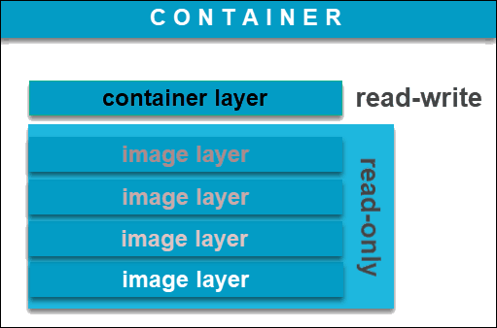
Docker Images
Docker images are read only templates
Each Image consists of a series of layers using the union file system.
When ever an image is changed a new layer is created.

Slide 4
Dockerfile → FROM
FROM →
This sets the Base Image for subsequent instructions.
Every Dockerfile must have FROM, to start from the Base Image.
Eg: -- FROM tomcat:latest
This would check if the image is available in the local machine, if not it would download from the central docker hub either from Private or Public.

Slide 5
Dockerfile → ENV & EXPOSE
ENV →
This is an additional option for providing required environment variables.
Eg: -- ENV TOMCAT_VERSION 8.1.0
Eg: -- ENV var1 testing
EXPOSE →
This informs Docker that the container will listen on the specified network ports at runtime, to interconnect containers using links.
Eg: -- EXPOSE 8080

Slide 6
Dockerfile → RUN
RUN →
This will execute any commands in a new layer on top of the current image and commit the results.
The resulting committed image will be used for the next step in the Dockerfile.
Eg: -- RUN yum update && yum install –y httpd wget
This would update and install “httpd” & “wget” on the Base image on the new layer.

Slide 7
Dockerfile → ADD & COPY
ADD →
Eg: -- ADD http://source.file/url /dst/path
Eg: -- ADD source.file.tar.gz /dst/path
COPY → Eg: -- COPY /source/file/path /dst/path
Notes:
Docker Copy vs ADD
Why was there a need to add a new, similar command?
The fact that ADD had so many functionalities proved to be problematic in practice, as it behaved extremely unpredictable.
The result of such unreliable performance often came down to copying when you wanted to extract and extracting when you wanted to copy.
Docker couldn’t completely replace the command due to its many existing usages.
To avoid backward compatibility, the safest option was to add the COPY command – a less diverse yet more reliable command.

Slide 8
Dockerfile → ADD & COPY
Details | ADD | COPY
Can copy file from URL to the DST container folder | Yes | No
Copies and extract compressed files | Yes | No
Duplicate file/Dir in a specified location in their format | Yes | Yes
Notes:
Docker Copy vs ADD
Why was there a need to add a new, similar command?
The fact that ADD had so many functionalities proved to be problematic in practice, as it behaved extremely unpredictable.
The result of such unreliable performance often came down to copying when you wanted to extract and extracting when you wanted to copy.
Docker couldn’t completely replace the command due to its many existing usages.
To avoid backward compatibility, the safest option was to add the COPY command – a less diverse yet more reliable command.

Slide 9
Dockerfile → WORKDIR
WORKDIR →
This sets the working directory for any RUN, CMD, ENTRYPOINT, & COPY that follow it.
We could use it multiple times in the same Dockerfile.
The relative path provided would be relative to the path of the previous WORKDIR instruction.
Eg: -- WORKDIR $MY_HOME
WORKDIR /app1 → absolute path
WORKDIR fold1 → relative path

Slide 10
Dockerfile → CMD
CMD →
CMD is used to identify what should be executed when the container comes up.
If a Dockerfile has multiple CMDs, it only applies the instructions from the last one.
Eg: --
CMD [“script.sh”, “run”]
CMD [“python”, “app1.py”]

Slide 11
Dockerfile → ENTRYPOINT
ENTRYPOINT →
ENTRYPOINT is used to identify what should be executed when the container comes up.
However, the user DOES NOT has the option to override either of these values at run time.
Eg: --
docker run --entrypoint ping localhost

Slide 12
Dockerfile → ENTRYPOINT vs CMD
CMD →
When we want the user of the image to have the flexibility to run whichever executable they choose when starting the container
ENTRYPOINT →
It Should be used in scenarios where we want the container to behave exclusively as if it were the executable it’s wrapping.
When we don’t want or expect the user to override the executable

Slide 13
Building an Image
docker build . -t vishwacloudlab/tomcat-cust01:v1
Dockerfile contains set of instructions, to inform Docker how to build the image.
Docker daemon does actual build process.
We can reduce build overhead by using .dockerignore files

Slide 14
Custom image on the central repo
As best practice we will need to upload the image to central repo.
Internal docker registry for private images.
Docker hub for Public and private images but stored in the cloud.
Docker push <<docker hub id>>/cust-01:v1

Slide 15
Dockerfile example
FROM httpd:latest
ADD . /code
WORKDIR /code
RUN echo “hello world”
ENV NAME World
EXPOSE 80
CMD [“script1.sh", “run"]

Slide 16
Dockerfile Best Practices
Use .dockerignore to avoid adding unnecessary files to your image
Don’t run “yum update” or “apt-update” on a single line.
This will cause caching issues if the referenced archive gets updated, which will make your subsequent apt-get install fail without comment.
Avoid installing unnecessary packages.

Slide 17
Dockerfile Best Practices -- Continued
Always use version tags in “FROM” statements. Avoid :latest
Avoid run + commit, use a Dockerfile instead
Installing ssh into a container is NOT GOOD.
One Process per container
Leverage and understand the cache

Slide 18
References
Dockerfile Best Practices -- https://docs.docker.com/articles/dockerfile_best-practices/

Slide 19


