Slide 1
Docker Volumes Features
VishwanaTH m s
VISHWACLOUDLAB.com

Slide 2
Docker Storage mount points
Volumes
Bind mounts
tmpfs mounts

Slide 3
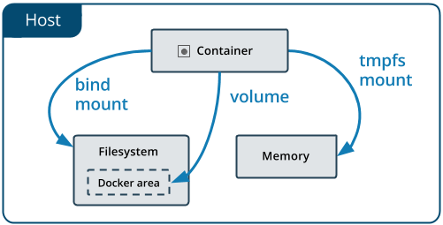
Docker Storage mount points

Slide 4
Docker Storage -- Volumes
Volumes are easier to back up or migrate than bind mounts.
You can manage volumes using Docker CLI commands or the Docker API.
Volumes work on both Linux and Windows containers.
Volumes can be more safely shared among multiple containers.
Volume drivers let you store volumes on remote hosts or cloud providers, to encrypt the contents of volumes, or to add other functionality.
New volumes can have their content pre-populated by a container.

Slide 5
Docker Storage – Volumes - Command
Syntax → “-v”
Create volume: $ docker volume create my-vol
List Volumes: → $ docker volume ls
Remove Volumes: → $ docker volume rm my-vol

Slide 6
Docker Storage – Volumes - Command
Start a container with a volume
$ docker run –d --name devtest -v my-vol:/app tomcat:latest
Use a read-only volume
$ docker run –d --name devtest -v my-vol:/app:ro tomcat:latest

Slide 7
Docker Storage – Bind mounts
Bind mounts have limited functionality compared to Volumes.
The file or directory is referenced by its full or relative path on the host machine.
The file or directory does not need to exist on the Docker host already.
You can’t use Docker CLI commands to directly manage bind mounts.

Slide 8
Docker Storage – bind mounts - Command
Start a container with a bind mounts
$ docker run –d --name devtest -v “$(pwd)”/target:/app tomcat:latest
Use a read-only bind mounts
$ docker run –d --name devtest -v “$(pwd)”/target:/app:ro tomcat:latest

Slide 9
Docker Storage – tmpfs mounts
The container can create files outside the container’s writable layer.
tmpfs mount is temporary and only persisted in the host memory.
When the container stops, the tmpfs mount is removed, and files written there won’t be persisted.

Slide 10


