Slide 1
Docker Networking
VishwanaTH m s
VISHWACLOUDLAB.com

Slide 2
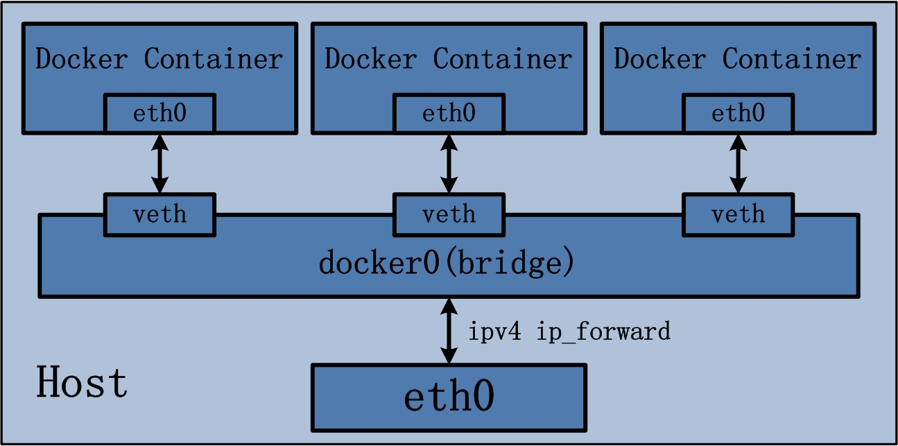
Docker Default Networking

Slide 3
Virtual Machine – Linux Centos
docker0
Network Interface on VM
192.168.118.148
HTTP – 80
172.17.0.2
Container 1
V-eth0
172.17.0.1
Eth0
8000 – container1:80
8001 – container2:80
HTTP – 80
172.17.0.3
Container 2
V-eth0
Laptop

Slide 4
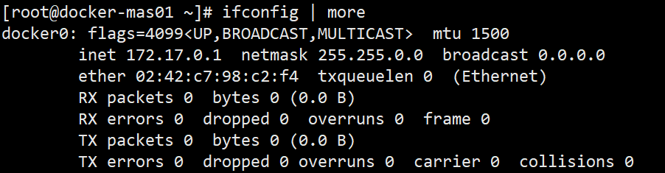
Basic Commands
$ docker network ls
The bridge network represents the docker0 network present in all Docker installations.
NETWORK ID NAME DRIVER
7fca4eb8c647 bridge bridge
9f904ee27bf5 none null
cf03ee007fb4 host host

Slide 5
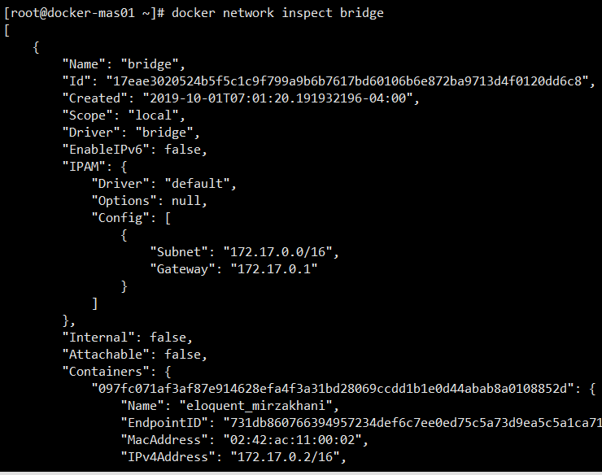
$ docker network inspect bridge

Slide 6
To Disable the default Bridge port Network
Add the below in the “daemon.json” file to disable the use of Default Bridge port Network on the LINUX HOST.
“bridge”: “none”,
“iptables”: “false”
Note: -- Don’t forget to restart the docker service for the changes to be effected.

Slide 7
User-defined networks (UDN)
User Defined networks are best suited in most cases,
This gives better control over the network for controlling the communication between Containers.
Docker provides default network drivers for creating the networks.
There is NO limit to create the number of networks.
Containers can be connected and disconnected to networks on the fly.
Note: -- Since the Communication of Containers within the UDN is by default, using “linking” is not supported.

Slide 8
Types of User-Defined Network (UDN)
Bridge Networks
Overlay network
MACVLAN Network

Slide 9
Bridge Networks - UDN
To create a new Bridge network
$ docker network create --driver bridge <<N/W Name>>
To Check the network
$ docker network inspect <<N/W Name>>
To launch the container with the new bridge network
$ docker run --network=<<N/w Name>> -itd --name=cont3 <<imageName>>

Slide 10
More with network Commands
$ docker network create
$ docker network connect
$ docker network ls
$ docker network rm
$ docker network disconnect
$ docker network inspect

Slide 11
Network connect and disconnect
$ docker network connect --ip <host ip to be reserved> <<n/w name>> <<containername>>
$ docker network disconnect <<n/w name>> <<containername>>

Slide 12
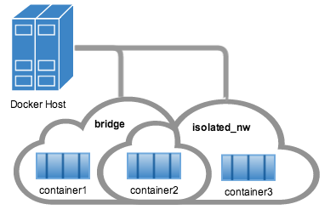
Some Container Network Diagram…

Slide 13
Must reads links
Networking examples
https://docs.docker.com/v17.09/engine/userguide/networking/work-with-networks/#basic-container-networking-example

Slide 14


