Slide 1
Docker Compose
VishwanaTH m s
VISHWACLOUDLAB.COM

Slide 2
Problem with Docker!!!
Web
APP
DB APP
Container-1
Port: 80
Container-2
Port: 3389
Virtual Machine

Slide 3
Solution: Docker Compose
Docker Compose
Web
APP
DB APP
Container-1
Port: 80
Container-2
Port: 3389
Virtual Machine

Slide 4
What is Docker Compose?
Docker compose is “a tool for defining and running complex applications with Docker”.
Run multiple containers from a single config file.
Defines Services, Networks and Volumes for a Docker application

Slide 5
What is Docker Compose?
Make your development environments:
Repeatable
Isolated
Fast

Slide 6
What is Docker Compose?
Define and run multi-container applications
All of that can be done by Docker Compose in the scope of a single host.
Specify images and configuration in a simple YAML file: $ docker-compose.yml
One command to get it all running: $ docker-compose up

Slide 7
What is Docker Compose?
docker-compose up:
Builds images from Dockerfiles
Pulls images from registries
Creates and starts containers
Streams their logs

Slide 8
Build image with Docker Compose
docker-compose build:
Builds images from Dockerfiles
Pulls images from registries

Slide 9
Docker Compose – Scale it…
Docker Compose
Web
APP
Web
APP
DB APP
Container-4
Port: 80
Web
APP
Container-1
Port: 80
Container-2
Port: 3389
Container-3
Port: 80
Virtual Machine

Slide 10
Scale with Docker Compose
docker-compose scale SERVICE=3
SERVICE == the name of the service defined in the YAML file
Can easy increase the no of environment that can be replicated and decreased
docker-compose up –-no-recreate
Re-running containers that have stopped.

Slide 11
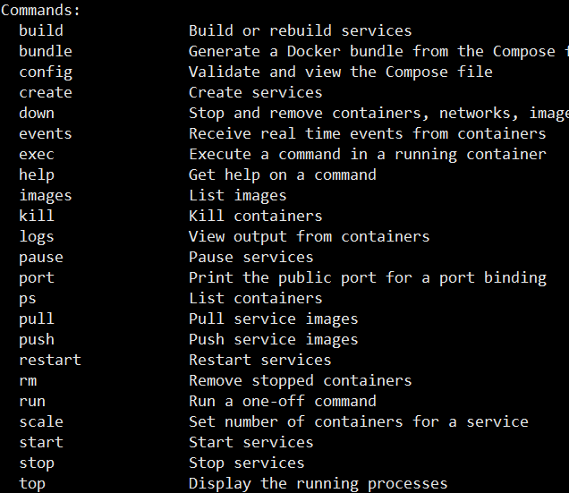
docker-compose --help

Slide 12
Docker Compose Workflow
There are three steps to using Docker Compose:
Define each service in a Dockerfile.
Define the services and their relation to each other in the docker-compose.yml file.
Use docker-compose up to start the system

Slide 13
What is the structure of the YAML file?
version: "3"
services:
webapp:
build:
context: ./dir
dockerfile: Dockerfile-alternate
args:
buildno: 1

Slide 14
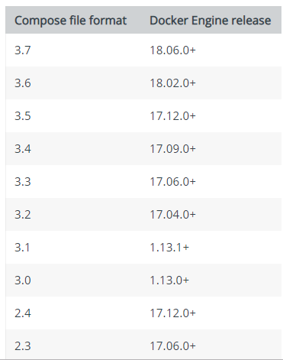
What is the structure of the YAML file?
Designed to be compatible b/w Compose and Docker Engine
version: "3"
services:
webapp:
build:
context: ./dir
dockerfile: Dockerfile-alternate
args:
buildno: 1

Slide 15
What is the structure of the YAML file?
version: "3"
services:
webapp:
build:
context: ./dir
dockerfile: Dockerfile-alternate
args:
buildno: 1
Containers in Production
A Service only runs one image
Defines →
What image to run ?
What port it would use ?
How many Replicas ?
Network details !!
Resource limits !!
Which Dockerfile for build?
………….. Any Much More

Slide 16
What is the structure of the YAML file?
version: "3"
services:
webapp:
build:
context: ./dir
dockerfile: Dockerfile-alternate
args:
buildno: 1
Custom name for the service, that hold all the details of the container to be run

Slide 17
What is the structure of the YAML file?
version: "3"
services:
webapp:
build:
context: ./dir
dockerfile: Dockerfile-alternate
args:
buildno: 1
Key Value pair, that contains maps and list

Slide 18
What is the structure of the YAML file?
version: "3"
services:
webapp:
build:
context: ./dir
dockerfile: Dockerfile-alternate
args:
buildno: 1
Details for the Container creation

Slide 19
Docker Compose file with Example - 1
version: '3'
services:
web:
build: .
ports:
- “8000:8000"
redis:
image: "redis:alpine"
First part, to Build and Create custom webserver from the Dockerfile and map the Container port 8000 to Host machine port 8000
Plain and Simple, ready made Redis Container,

Slide 20
More Reads…..
Versioning → https://docs.docker.com/compose/compose-file/compose-versioning/

Slide 21
What’s new in 1.3.0?
Performance and stability improvements
Lots more config option support
New feature (experimental!): Smart Recreate Only recreate containers whose configuration has been changed $ docker-compose up --x-smart-recreate Will eventually be the default behavior

Slide 22


