Slide 1
AWS IAM users
Present by Vishwanath M S
Cloud Architect

Slide 2
Agenda
What is AWS IAM?
What is policy
What are Roles
Your Questions
What is MFA?
Demo
User Creation?

Slide 3

What is AWS IAM?
AWS IAM can be used to securely control individual and group access to your AWS resources
Permissions in the policies determine whether the request is allowed or denied.
AWS supports six types of policies: identity-based policies, resource-based policies, permissions boundaries, Organizations SCPs, ACLs, and session policies.
Notes:
AWS Policy Types – Speaker Notes
AWS provides multiple types of policies to manage permissions and security across accounts and resources. These policies define what actions can be performed, by whom, and under what conditions.
1. Identity-Based Policies
These policies are attached to IAM users, groups, and roles.
Define permissions for identities (who can do what).
Example: Allowing an IAM role to access an S3 bucket.
Use Case: Grant a developer access to EC2 and Lambda.
2. Resource-Based Policies
Attached directly to AWS resources (e.g., S3 buckets, Lambda functions).
Define who (which IAM identities, AWS accounts) can access the resource.
Example: An S3 bucket policy that allows another AWS account to access the bucket.
Use Case: Share an S3 bucket between multiple AWS accounts.
3. Permissions Boundaries
Defines the maximum permissions that an IAM role or user can have.
Even if an identity-based policy grants full access, it cannot exceed the permissions boundary.
Example: A developer role has "AdministratorAccess" but is restricted from deleting resources.
Use Case: Prevent users from creating EC2 instances beyond a certain size.
4. AWS Organizations Service Control Policies (SCPs)
Used to manage permissions at the organizational level.
Applied to AWS accounts in an Organization but do not grant permissions themselves (only restrict).
Example: Prevent all accounts in an Organization from creating IAM users.
Use Case: Ensure compliance by blocking specific actions across multiple AWS accounts.
5. Access Control Lists (ACLs)
Used for network and resource access control.
Unlike identity-based policies, ACLs do not use IAM roles or users.
Example: S3 ACLs define access permissions at the object level for other AWS accounts.
Use Case: Share an S3 object with an external AWS account without using a full policy.
6. Session Policies
Temporary permissions assigned to federated users or roles.
Used when assuming a role using AWS STS (Security Token Service).
Example: A federated user assumes a role but has restricted permissions for only certain actions.
Use Case: Grant temporary permissions to an external contractor for specific tasks.

Slide 4
User Creation
Programmatic Access used for AWS API, CLI and SDK’s and works on
Access Key ID
Secret Access key
While creating the user, AWS creates an one time show of “Secret Access key” similar to your private keys.
Console Access used to login to AWS via GUI works on
Username
Password

Slide 5
User Creation
For GUI user access the below link is used.
https://signin.aws.amazon.com/console
We need to provide, Account number, Username and Password
While creation a users, 3 options are
Assign it to a Group
Copy the Existing permission from one of the user
Assign the policy on the user Directly.

Slide 6
What is policy?
IAM Policies define permissions for an action to be performed.
The same policy is applicable for Management Console, AWS CLI and AW API.

Slide 7
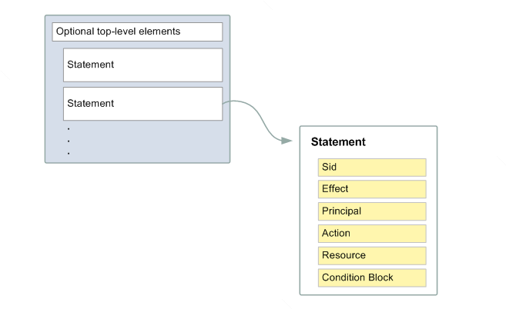
Policy Details

Slide 8
Policy Details – Principle ex
{
"Effect": "Allow",
"Principal": {
"AWS": "arn:aws:iam::987654321098:root"
},
"Action": "s3:PutObject",
"Resource": "arn:aws:s3:::my-bucket/*"
}

Slide 9
Policy – Condition - Example
{
"Effect": "Allow",
"Action": "s3:*",
"Resource": "arn:aws:s3:::my-secure-bucket/*",
"Condition": {
"IpAddress": {
"aws:SourceIp": "192.168.1.0/24"
}
}
}

Slide 10
What is Roles?
IAM Roles are used to gain access to one of the AWS service via another AWS service.
Simple terms, AWS is going to authorize the access between 2 of the AWS service in your account on behalf of YOU.

Slide 11
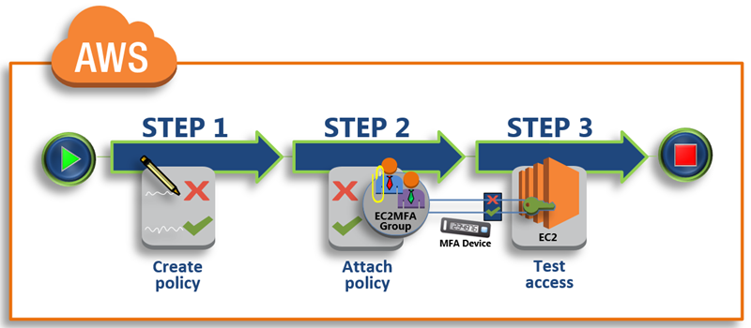
What is MFA?
An extra Authentication code along with the username and password.
We could use hardware MFA device or Virtual MFA device.

Slide 12
Questions?

Slide 13
DEMO

Slide 14
AWS Reference links for further read
https://aws.amazon.com/iam/faqs/

