Slide 1
AWS Storage & DB Services
Present by Vishwanath M S
Cloud Architect

Slide 2
Agenda
Amazon Image
S3-LAB
Your Questions
Storage

Slide 3
AWS Storage Services
S3 – Simple Storage Service → its an Object Storage
S3 Glacier → Arching and Long-term backup.
Storage Gateway → Hybrid Cloud Storage with Local Caching
File Gateway
Volume Gateway
Tape Gateway
EBS → Elastic block Storage – Works as Virtual disk for the EC2 instances, Options are
SSD, Throughput HDD, Cold HDD
EFS → Elastic File Storage – Works as centralized file storage, that allows multiple EC2 instance to share the data. It can be mounted on multiple EC2 instances at the same time.

Slide 4
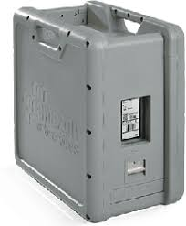
AWS Storage Services
Snowball → Its an offline migration Technic. Physically migrate the data 80TB at a time with the storage box.
Snowball Edge → Better version of Snowball and bigger data migration.
SnowMobile → Snipping container, pulled by a semi-trailer truck – 100 PB

Slide 5
AWS Image
AMI is where we can create our custom image either from a VM or from an EBS Volume.

Slide 6
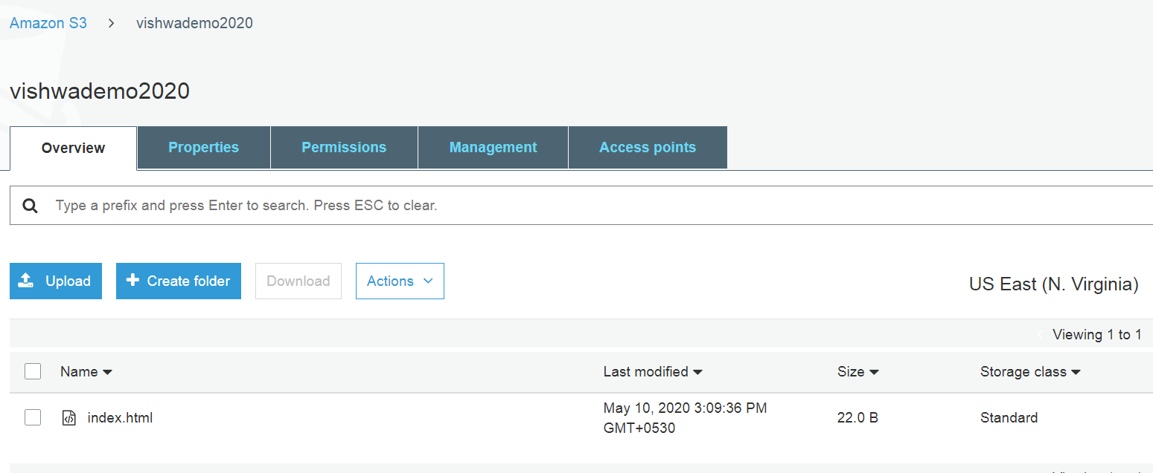
S3 - LAB
Create S3 bucket
Upload a file
Make it public for accessible

Slide 7
Questions?

Slide 8
Sample Questions
Which service stores objects, provides real-time access to those objects, and offers versioning and lifecycle capabilities?
A. Amazon Glacier
B. AWS Storage Gateway
C. Amazon S3
D. Amazon EBS

