Slide 1

OWASP Fundamentals
Building Secure Applications by Design
A comprehensive guide to web application security using OWASP standards and best practices for developers and security professionals.

Slide 2
Session Agenda
01
02
OWASP Introduction
OWASP Top 10 Vulnerabilities
Understanding the organization and its mission in web security
Critical security risks every developer must know
03
04
Secure Coding Practices
Threat Modeling Basics
Essential principles for building secure applications
Systematic approach to identifying security risks
05
06
Input Validation & Output Encoding
Authentication & Session Management
Preventing injection attacks and data corruption
Securing user access and maintaining sessions
07
08
Security Configuration
Logging & Monitoring
Avoiding common misconfigurations
Detecting and responding to security incidents

Slide 3
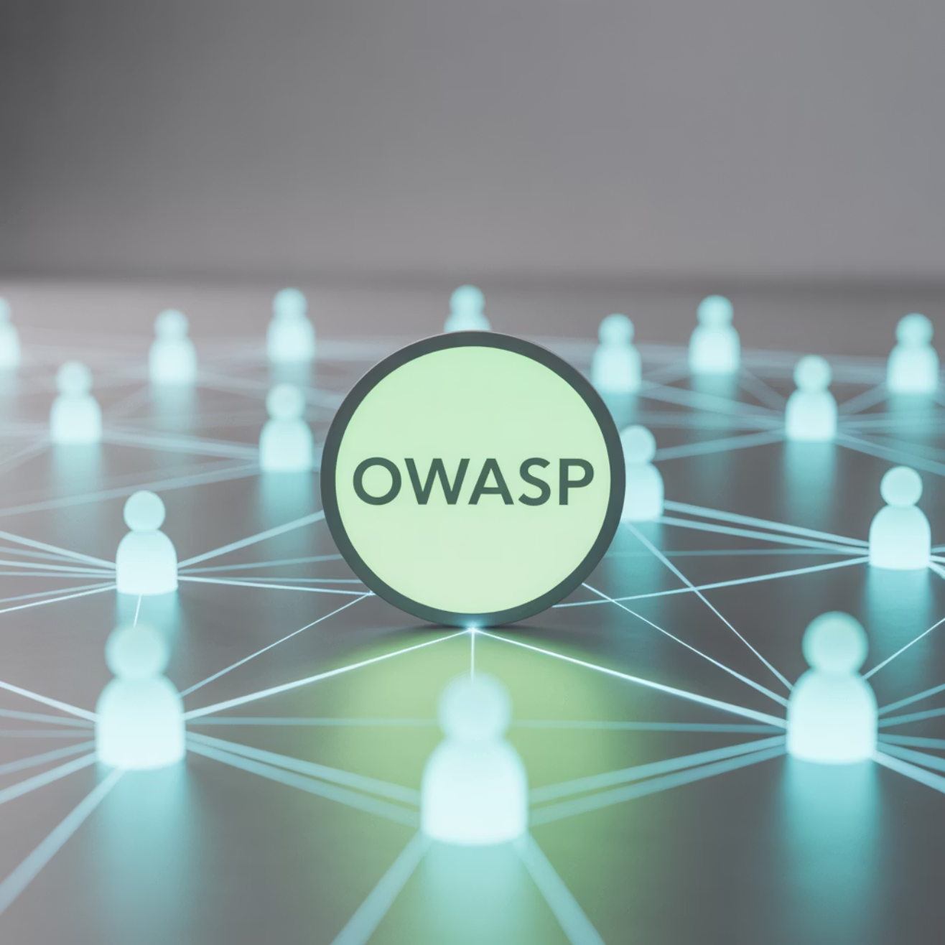

What is OWASP?
OWASP stands for the Open Web Application Security Project - a non-profit, community-driven organization dedicated to improving software security worldwide.
Founded in 2001, OWASP produces free, vendor-neutral security resources including documentation, tools, and educational materials that have become industry standards for web application security.
The organization operates with complete transparency, making all materials freely available under open source licenses. This approach has made OWASP the most trusted source for application security guidance globally.
OWASP resources are used by developers, security professionals, and organizations in over 100 countries worldwide.

Slide 4
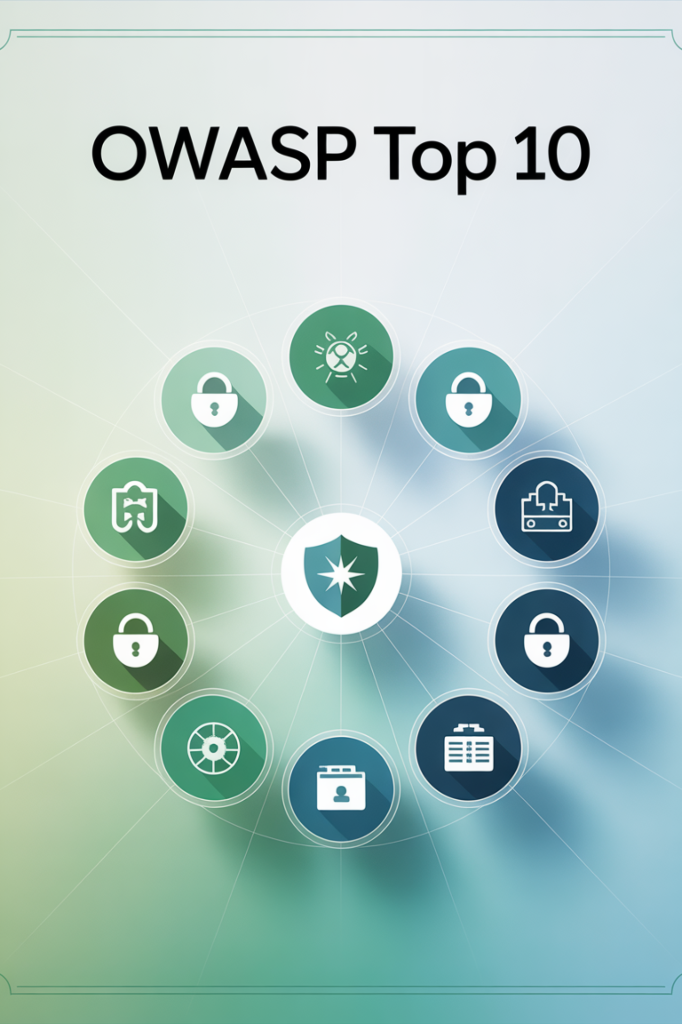
OWASP Top 10 Overview
The OWASP Top 10 is a globally recognized awareness document that represents the most critical security risks to web applications. This standard reference is updated every 3-4 years based on comprehensive data analysis and expert consensus.
Global Standard
Data-Driven
Adopted by auditors, CISOs, developers, and security teams worldwide as the baseline for application security
Based on analysis of over 500,000 applications and input from security experts across the industry
Actionable Guidance
Provides specific prevention techniques and detection methods for each vulnerability category

Slide 5
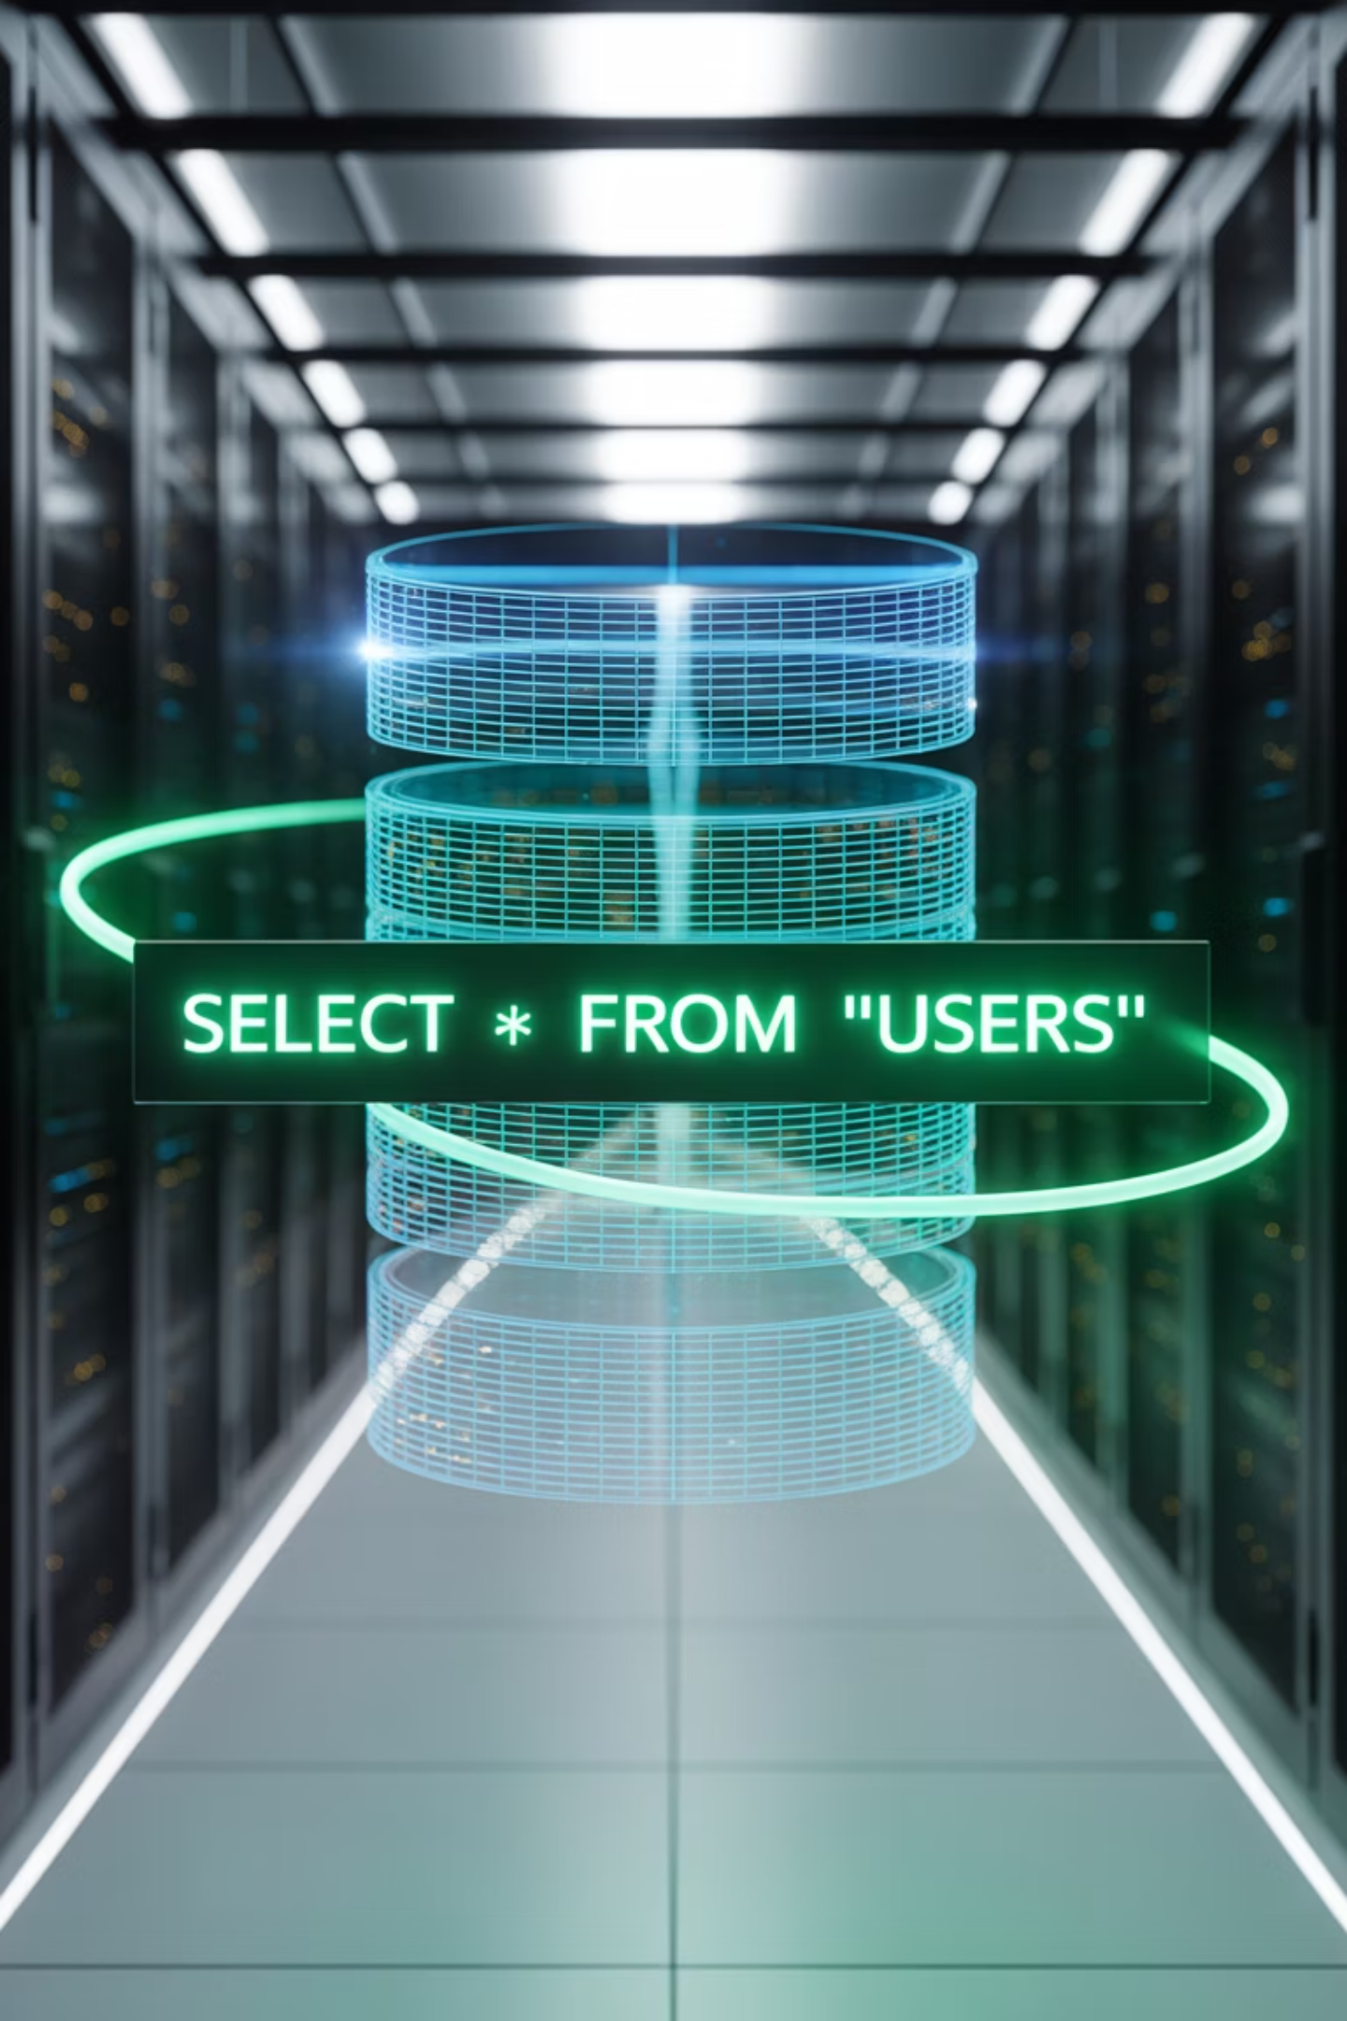
OWASP Top 10: Injection & Authentication
A01: Injection
A02: Broken Authentication
Occurs when untrusted data is sent to an interpreter as part of a command or query. SQL injection is the most common form, where attackers can execute malicious SQL commands.
Application functions related to authentication and session management are often implemented incorrectly, allowing attackers to compromise passwords, keys, or session tokens.
SQL injection attacks
NoSQL injection
OS command injection
Weak password policies
LDAP injection
Session fixation
Credential stuffing
Example: SELECT * FROM users WHERE id = '1' OR '1'='1'
Missing MFA
Example: Default credentials like admin/admin still active in production

Slide 6
OWASP Top 10: Data & Access Control
A03: Sensitive Data Exposure
A04: XML External Entities (XXE)
A05: Broken Access Control
Many applications don't properly protect sensitive data such as financial information, healthcare records, or personal data. Attackers may steal or modify such weakly protected data.
Restrictions on authenticated users are often not properly enforced. Attackers can exploit these flaws to access unauthorized functionality or data.
Poorly configured XML processors evaluate external entity references within XML documents, leading to disclosure of internal files, internal port scanning, and remote code execution.
Unencrypted data transmission
Privilege escalation
Weak encryption algorithms
Insecure direct object references
Missing HTTPS enforcement
File disclosure attacks
Missing authorization checks
Server-side request forgery
Denial of service

Slide 7
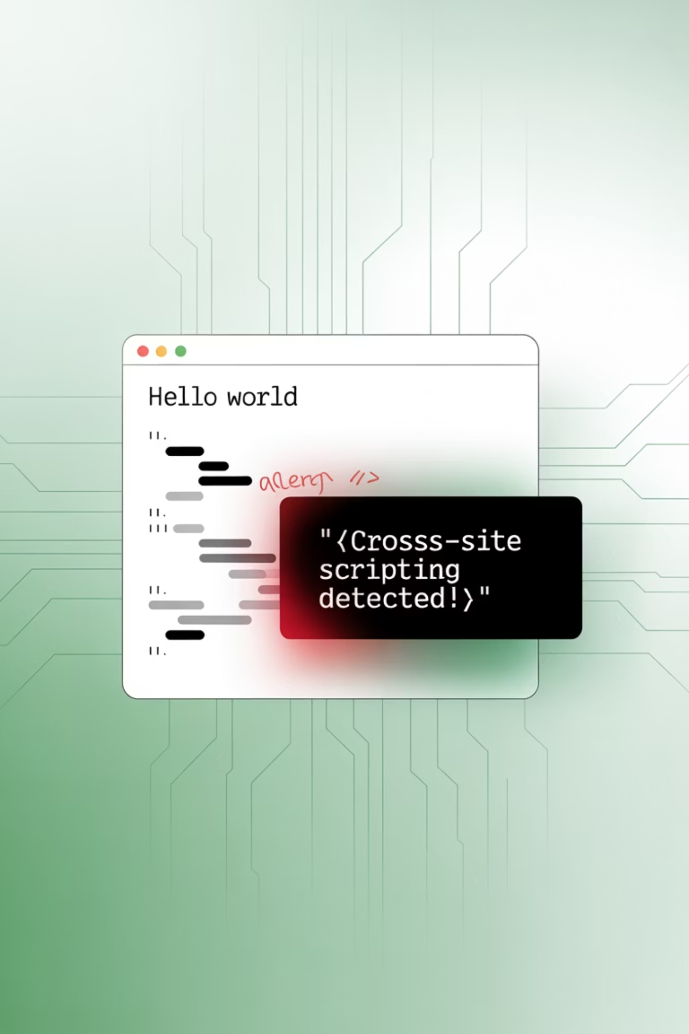
OWASP Top 10: Configuration & Scripting
A06: Security Misconfiguration
A07: Cross-Site Scripting (XSS)
A08: Insecure Deserialization
Security misconfiguration is the most commonly seen issue, often resulting from insecure default configurations, incomplete setups, or ad hoc configurations.
XSS flaws occur when applications include untrusted data in web pages without proper validation or escaping, allowing attackers to execute scripts in victims' browsers.
Insecure deserialization often leads to remote code execution, replay attacks, injection attacks, and privilege escalation attacks.
Object injection
Data tampering
Default accounts enabled
Reflected XSS
Remote code execution
Stored XSS
Unnecessary features enabled
DOM-based XSS
Missing security headers

Slide 8
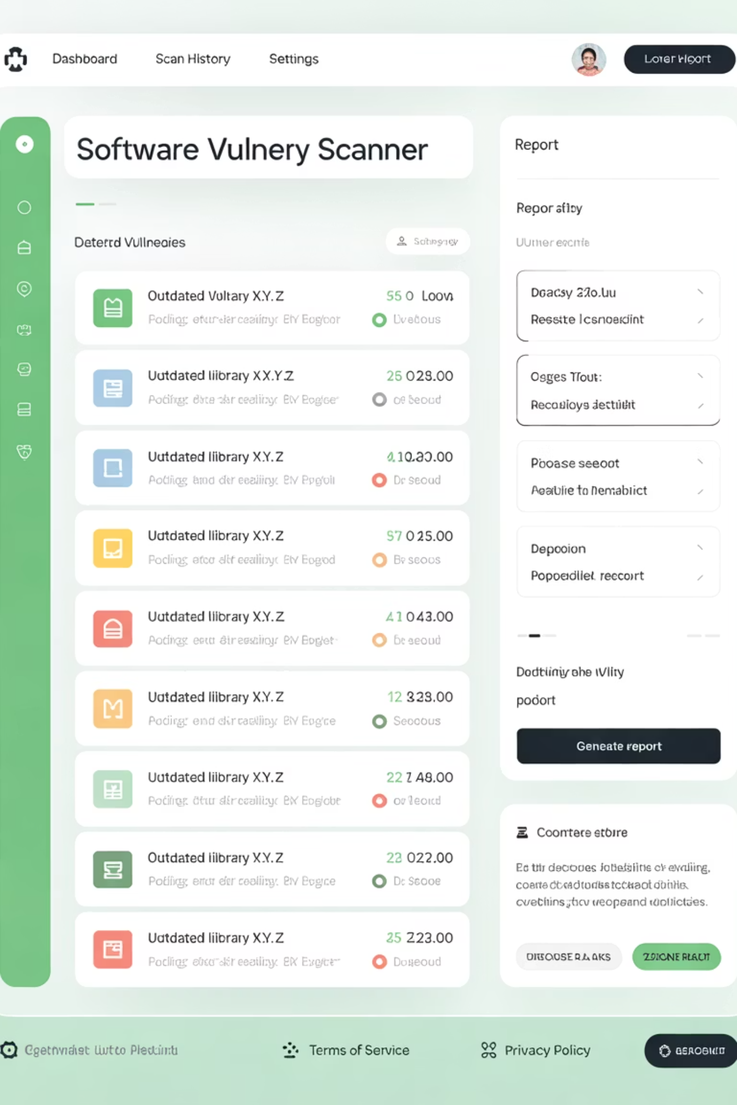


OWASP Top 10: Components & Monitoring
A09: Using Components with Known Vulnerabilities
Components such as libraries, frameworks, and other software modules run with the same privileges as the application. If a vulnerable component is exploited, such an attack can facilitate serious data loss or server takeover.
Prevention: Maintain inventory of all components, monitor for vulnerabilities, and establish patching processes.
A10: Insufficient Logging & Monitoring
Insufficient logging and monitoring, coupled with missing or ineffective integration with incident response, allows attackers to further attack systems and maintain persistence.
Prevention: Implement comprehensive logging, real-time monitoring, and automated alerting for suspicious activities.

Slide 9








Secure Coding Principles
Secure coding is the practice of developing computer software in a way that guards against the accidental introduction of security vulnerabilities. These fundamental principles guide developers in creating robust, secure applications.
Least Privilege
Fail Securely
Grant users and processes only the minimum access rights needed to perform their functions. This limits potential damage from compromised accounts or components.
When systems fail, they should fail to a secure state. Error conditions should not expose sensitive information or grant unauthorized access.
Code Reviews
Defense in Depth
Regular peer reviews and automated security testing help identify vulnerabilities early in the development lifecycle.
Implement multiple layers of security controls. If one layer fails, others continue to provide protection against attacks.

Slide 10
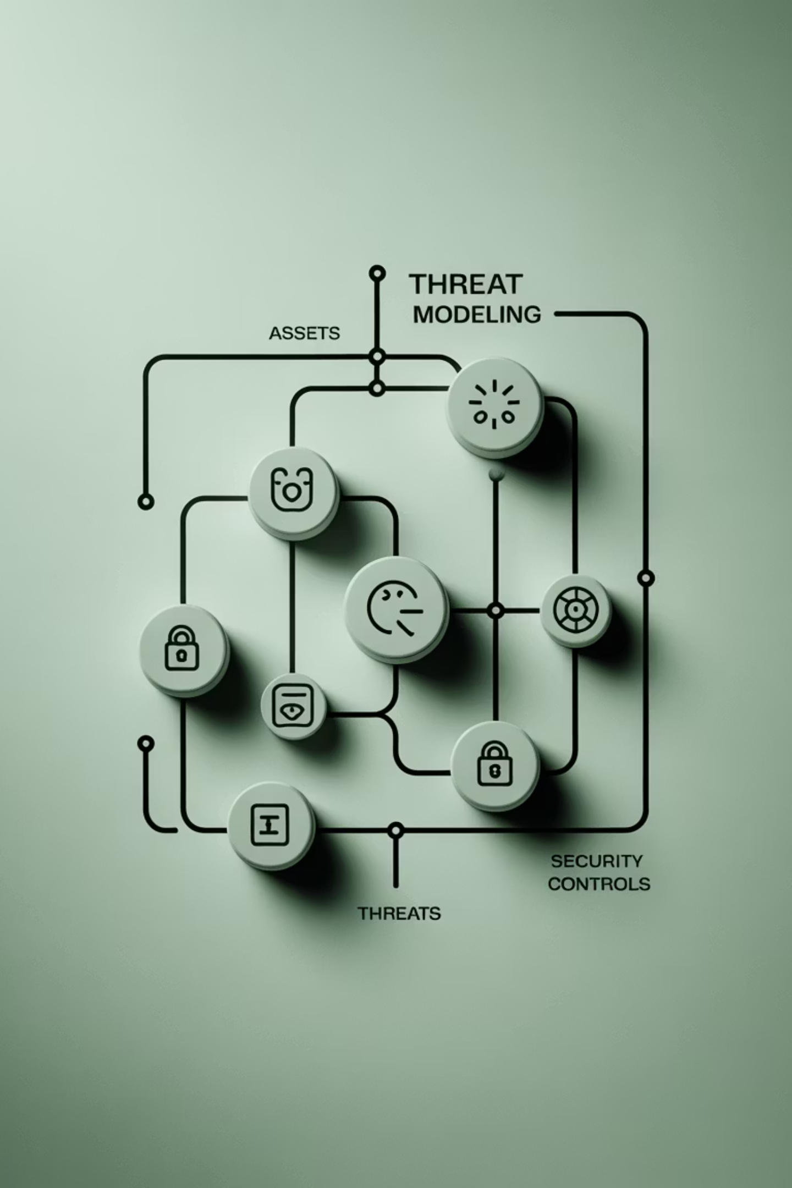
Threat Modeling Fundamentals
Threat modeling is a structured approach to identifying, quantifying, and addressing security risks in applications. It helps teams understand potential attack vectors and implement appropriate countermeasures.
01
Identify Assets
Catalog valuable data, systems, and processes that need protection
02
STRIDE Methodology
Identify Threats
Spoofing identity
Determine potential attackers and their motivations
Tampering with data
Repudiation
03
Information disclosure
Identify Vulnerabilities
Denial of service
Find weaknesses that threats could exploit
Elevation of privilege
04
Implement Controls
Deploy security measures to mitigate identified risks

Slide 11
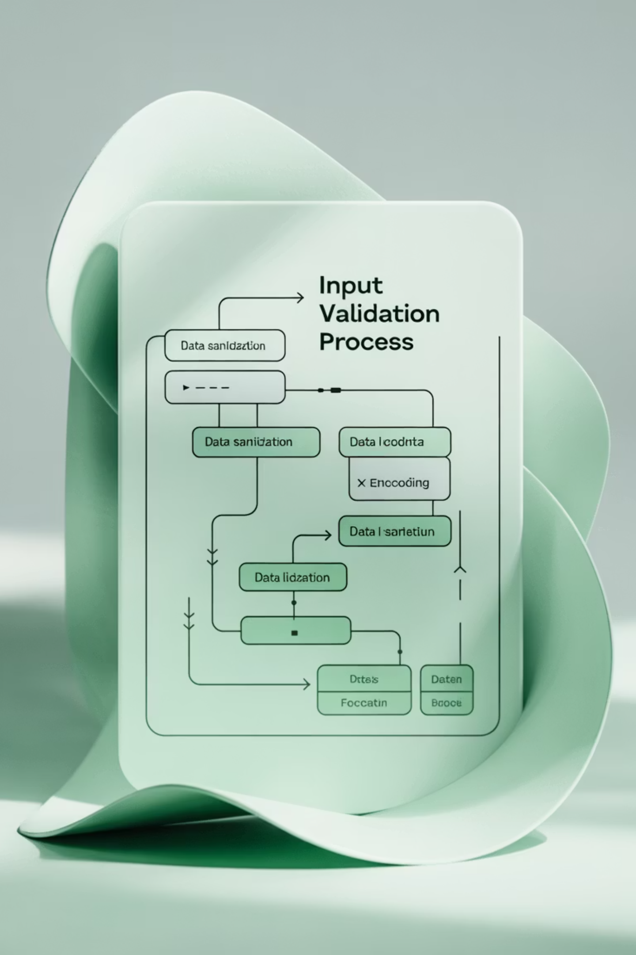
Input Validation & Output Encoding
Input validation and output encoding are critical security controls that prevent injection attacks and ensure data integrity. These techniques form the foundation of secure data handling in web applications.
Input Validation
Whitelist Approach: Define acceptable input patterns and reject everything else
Data type validation
Length and format checks
Range validation
Business logic validation
Example: Email validation using regex patterns
Output Encoding
Context-Aware Encoding: Encode data based on where it will be used
HTML entity encoding
JavaScript encoding
URL encoding
SQL parameterization
Example: Converting <script> to &lt;script&gt;

Slide 12

Authentication & Session Management
Proper authentication and session management are crucial for protecting user accounts and maintaining secure application state. Weak implementation in these areas is a primary target for attackers.
Authentication Best Practices
Session Management
Strong Password Policies: Minimum length, complexity requirements, and regular updates
Secure Cookie Flags: HttpOnly, Secure, and SameSite attributes
Multi-Factor Authentication: Something you know, have, and are
Session Expiration: Automatic timeout for inactive sessions
Session Renewal: Generate new session IDs after authentication
Account Lockout: Prevent brute force attacks with progressive delays
Logout Functionality: Properly invalidate sessions on logout
Secure Password Storage: Use bcrypt, scrypt, or Argon2 for hashing
Set-Cookie: sessionid=abc123; HttpOnly; Secure; SameSite=Strict
Never store passwords in plain text or use weak hashing algorithms like MD5 or SHA1.

Slide 13
Security Misconfiguration Prevention
Security misconfiguration is one of the most common vulnerabilities, often resulting from default settings, incomplete configurations, or lack of maintenance. A systematic approach to configuration management is essential.
1
2
3
Eliminate Default Credentials
Disable Unnecessary Features
Keep Systems Updated
Change all default usernames and passwords before deployment. Implement strong, unique credentials for all accounts and services.
Remove or disable unused features, services, ports, and accounts. Follow the principle of least functionality.
Establish regular patching schedules for operating systems, frameworks, libraries, and applications.
4
5
Implement Security Headers
Secure Cloud Configurations
Configure proper HTTP security headers like HSTS, CSP, X-Frame-Options, and X-Content-Type-Options.
Review cloud service settings, especially storage bucket permissions and network access controls.

Slide 14


Logging & Monitoring for Security
Effective logging and monitoring are essential for detecting security incidents, conducting forensic analysis, and maintaining compliance. Without proper visibility, organizations cannot detect or respond to attacks effectively.
What to Log
Authentication Events: Login attempts, password changes, privilege escalations
Never Log Sensitive Data
Access Control: Failed authorization attempts, privilege violations
Avoid logging passwords, credit card numbers, social security numbers, or other sensitive information.
Input Validation: Malformed requests, injection attempts
System Events: Application starts/stops, configuration changes
Monitoring Best Practices
Centralized log collection and analysis
Real-time alerting for critical events
Regular log review and analysis
Secure log storage and retention
200
68
$4.45M
Days Average
Days Average
Average Cost
Time to detect a security breach without proper monitoring
Time to contain a breach once detected
Global average cost of a data breach in 2023

Slide 15

Security is a Process, Not a Product
OWASP provides the frameworks, tools, and community knowledge needed to build secure applications. Remember that developers are the first line of defense in application security.
Continuous Learning
Security by Design
Community Collaboration
Stay updated with the latest security threats, vulnerabilities, and best practices through OWASP resources and community engagement.
Integrate security considerations from the earliest stages of development rather than treating it as an afterthought.
Participate in the OWASP community, contribute to projects, and share knowledge with fellow security professionals.
Thank you for your attention. Questions and discussion welcome!

