Slide 1
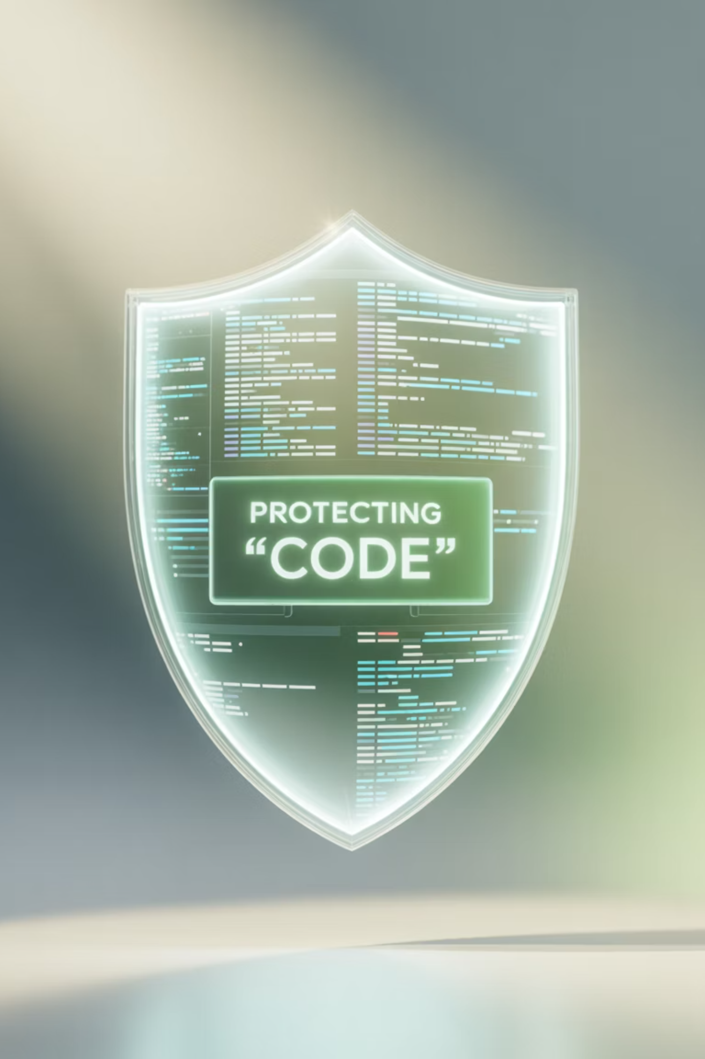
Static Application Security Testing (SAST)
Mastering automated security analysis for secure development workflows

Slide 2
Today's Journey
01
02
SAST Fundamentals
Tool Ecosystem
Understanding static analysis and its security benefits
SonarQube, Semgrep, and CodeQL comparison
03
04
CI/CD Integration
Custom Rules
Seamless pipeline integration patterns
Writing tailored security policies
05
06
Results Management
Automation
Triaging findings and reducing false positives
Automated remediation and developer enablement

Slide 3

What is SAST?
Static Application Security Testing analyzes source code, bytecode, or binaries to detect vulnerabilities without executing the program. It's a white-box security method designed for early detection in the Software Development Life Cycle.
SAST provides tremendous value by finding critical issues like injection attacks, cross-site scripting (XSS), hard-coded secrets, and insecure APIs before deployment. It aligns with OWASP and CWE standards for comprehensive, policy-driven security scanning.
Early Detection
Precise Location
Developer Feedback
Catches vulnerabilities during development, not production
Identifies exact vulnerable code lines with root cause analysis
Accelerates security awareness through pull request integration

Slide 4




How SAST Works Under the Hood
Code Parsing
Converts source code into Abstract Syntax Trees (AST) and Control Flow Graphs (CFG) for structural analysis
Flow Analysis
Performs control-flow and data-flow analysis with taint tracking from sources to sinks
Rule Application
Applies security rules and policies through pattern matching and semantic analysis
Findings Generation
Produces detailed findings with precise locations and remediation guidance
Effectiveness depends on rule quality, language support, and build configuration. SAST works across many programming languages but requires proper framework understanding and configuration for optimal results.

Slide 5



SAST Tools Comparison
SonarQube
Semgrep
CodeQL
Comprehensive Platform: Combines SAST with code quality analysis, technical debt tracking, and reliability metrics.
Developer-Centric: Fast, pattern-based analysis with easy YAML rule creation and community-driven rule registry.
Query-Based Analysis: Powerful semantic analysis using QL query language for custom security research and variant analysis.
Quality gates for governance
Simple YAML rule syntax
Deep dataflow modeling
Broad build system integration
Autofix capabilities
GitHub-native integration
Enterprise-grade reporting
Multi-language support
Advanced taint tracking

Slide 6


CI/CD Integration Patterns
Pre-commit Hooks
CI Pipeline Gates
Quick security checks before code commits to catch obvious issues early
Automated gatekeeping that fails builds on High/Critical findings
1
2
3
4
Pull Request Scanning
Scheduled Scans
Comprehensive analysis with developer feedback through inline comments
Full repository analysis on default branch for comprehensive coverage
Best Practice: Fail on High/Critical findings, allow warnings on Medium/Low. Cache rules and parallelize by language for optimal performance. Maintain audit trails in pipeline logs for governance.

Slide 7
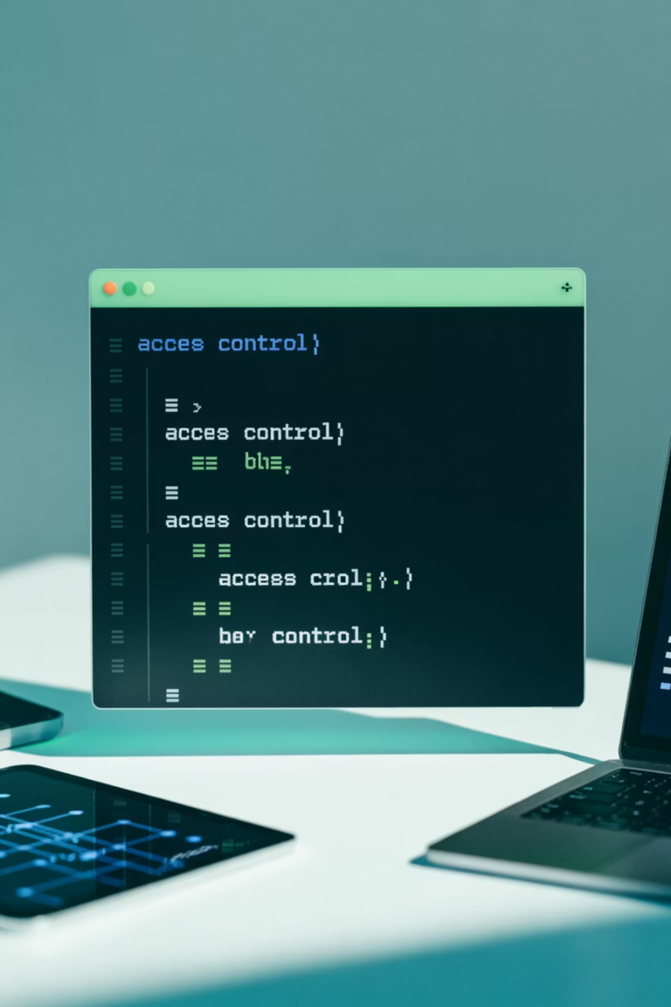
Writing Custom Semgrep Rules
Rule Structure
Advanced Patterns
rules: - id: detect-md5-usage message: "MD5 is cryptographically broken" severity: HIGH languages: [python] pattern: hashlib.md5(...) fix: hashlib.sha256(...)
pattern-either: - pattern: os.system($CMD) - pattern: subprocess.call($CMD, shell=True)pattern-not: - pattern-inside: | if validate_input($CMD): ...
Semgrep uses YAML with intuitive pattern matching. Compose complex rules with pattern-either, pattern-not, and metavariables for flexible detection.
Use path filters for monorepos and regex for complex string matching. Autofix enables safe automatic remediation for simple security issues.

Slide 8



CodeQL Query Fundamentals
CodeQL uses a powerful query language for semantic code analysis. Queries follow a from/where/select structure with rich dataflow libraries.
import pythonfrom Call call, Name funcwhere call.getFunc() = func and func.getId() = "eval"select call, "Dangerous eval() call detected"
Query Structure
Dataflow Libraries
Sources & Sinks
Declarative queries that treat code as a database with rich semantic relationships
Built-in taint tracking across functions and modules for complex vulnerability detection
Model untrusted input sources and sensitive operation sinks for comprehensive analysis

Slide 9
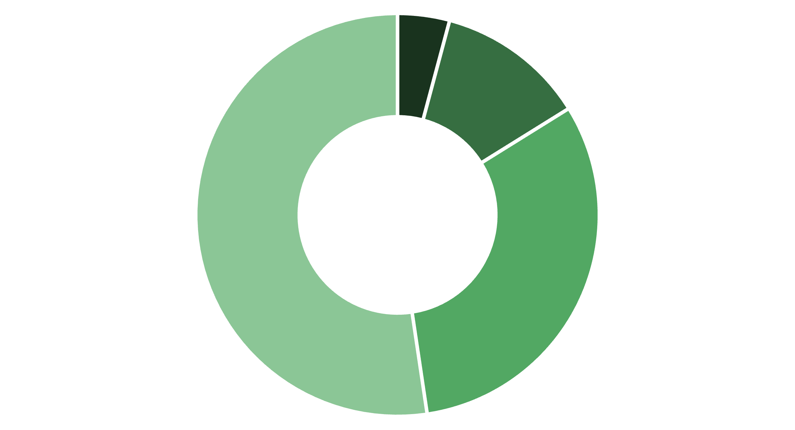
Interpreting and Triaging Results
Critical
High
Medium
Low
1
Prioritization Strategy
2
Developer Workflow
3
Metrics & Reporting
Map findings to CWE classifications, assess exploitability and reachability. Focus on tainted paths reaching sensitive sinks first.
Provide inline PR annotations with remediation guidance. Assign to code owners with time-bound SLAs by severity level.
Track Mean Time to Resolution (MTTR), false-positive rates, and coverage gaps to continuously refine rule effectiveness.

Slide 10

Reducing False Positives
Rule Tuning
Dataflow Accuracy
Process Improvements
Add pattern-not exclusions
Model validation functions
Implement triage feedback loops
Scope to specific contexts
Define custom sources/sinks
Document accepted risks
Reference framework sanitizers
Avoid generic regex-only rules
Exclude generated/vendor code
Calibrate severity levels
Use semantic analysis
Regular rule refinement
"The goal isn't zero false positives—it's achieving the right balance between security coverage and developer productivity."

Slide 11




Automating Remediation Suggestions
Intelligent Guidance
Policy-Driven Fixes
Developer Enablement
Provide contextual code examples and secure API references in rule messages. Include fix diffs for simple cases like cryptographic upgrades (MD5 → SHA256).
Enforce secure defaults in frameworks and add clear CI failure messages with step-by-step remediation instructions and secure API references.
Implement PR comment bots with suggested changes, security-focused code review automation, and automatic code owner assignment for sensitive modules.
Pro Tip: Start with safe, automated fixes for common issues like deprecated cryptographic functions, then gradually expand to more complex remediation patterns.

Slide 12

Live Demo: Semgrep Rule Creation
Detecting Insecure MD5 Usage
rules: - id: insecure-md5-usage message: | MD5 is cryptographically broken and should not be used. Consider using SHA-256 instead: hashlib.sha256() severity: HIGH languages: [python] pattern: hashlib.md5(...) fix: hashlib.sha256(...)
TLS Verification Enforcement
rules: - id: require-tls-verify message: "TLS verification must be enabled" severity: CRITICAL languages: [python] patterns: - pattern: requests.$METHOD(..., verify=False, ...) - pattern-not-inside: | # Allow in test files def test_$FUNC(...): ...

Slide 13


CI/CD Integration Examples
GitHub Actions
GitLab CI
Jenkins Pipeline
- name: Run Semgrep uses: returntocorp/semgrep-action@v1 with: config: auto generateSarif: "1"
sast: stage: test include: - template: Security/SAST.gitlab-ci.yml artifacts: reports: sast: gl-sast-report.json
stage('SAST') { steps { sh 'semgrep --config=auto --sarif .' publishHTML([allowMissing: false, alwaysLinkToLastBuild: true, keepAll: true, reportDir: 'reports', reportFiles: 'semgrep.html']) }}

Slide 14

Best Practices & Common Pitfalls
✓ Best Practices
✗ Common Pitfalls
Start with curated rule sets from OWASP
Overly broad regex-based rules
Ignoring framework-specific sanitizers
Shift-left with PR integration
Implement quality gates gradually
Scanning generated or vendor code
Track MTTR and false-positive metrics
Failing builds on all severity levels
No developer training or context
Continuously tune rules based on feedback
Treating SAST as a silver bullet
Provide clear remediation guidance
Developer Fatigue
Maturity Path
Avoid overwhelming teams with low-quality findings that erode trust in the security process
Begin in advisory mode → gate on High/Critical → add custom rules → integrate auto-remediation

Slide 15
Key Takeaways
Early Detection
Tool Synergy
Developer Empowerment
SAST delivers code-centric security analysis using AST, dataflow, and taint tracking to accelerate secure development when integrated into PRs and CI pipelines.
Combine off-the-shelf rules with custom Semgrep and CodeQL logic tailored to your technology stack. Tune continuously to reduce noise and prioritize high-impact issues.
Enable developers with actionable guidance and safe autofixes. Govern with quality gates, documented exceptions, and metrics for continuous security improvement.
Questions & Discussion
Let's explore how SAST can transform your security posture

