Slide 1
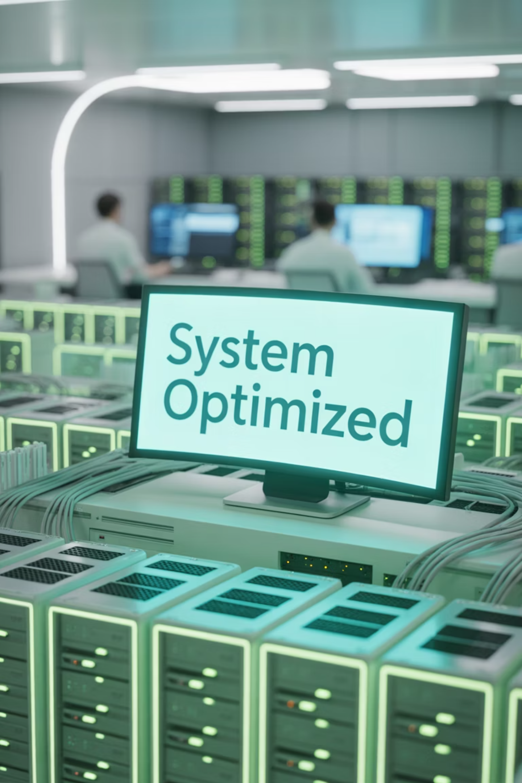
Application Performance Monitoring (APM)
Mastering Modern Application Performance & Infrastructure Monitoring

Slide 2
4-Hour Learning Journey
01
02
Introduction to APM & Infrastructure
Dashboards & Visualization
Foundation concepts, key metrics, and industry landscape overview
Building effective dashboards for real-time visibility and reporting
03
04
Alerting & NRQL Mastery
Distributed Tracing & Integration
Incident management workflows and advanced query techniques
Advanced monitoring with real-world case studies and best practices

Slide 3
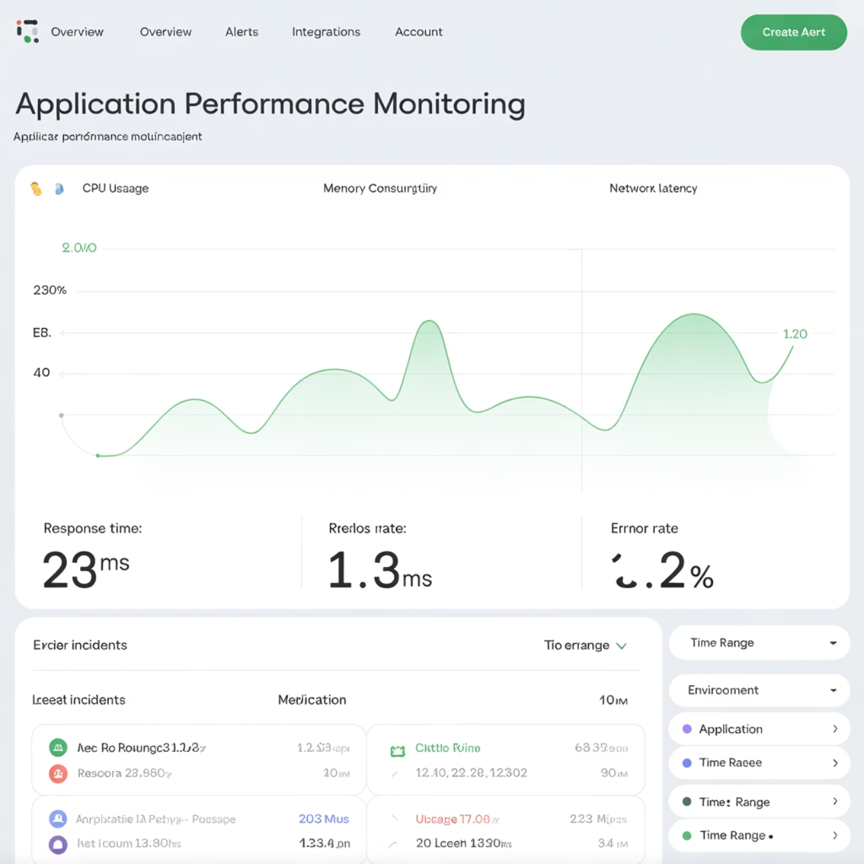
What is Application Performance Monitoring?
APM provides comprehensive visibility into application performance, user experience, and infrastructure health. It's essential for modern distributed systems including microservices, cloud environments, and containerized applications.
APM differs from traditional logging and monitoring by focusing on end-to-end application performance, user experience metrics, and business impact rather than just system health indicators.

Slide 4
Essential APM Metrics
Response Time
Throughput
How quickly applications respond to user requests, directly impacting user satisfaction
Number of requests processed per unit time, indicating system capacity
Error Rate
Apdex Score
Percentage of failed requests, critical for reliability assessment
User satisfaction metric based on response time thresholds
These metrics span three monitoring layers: Infrastructure health, Application performance, and User experience - each providing unique insights into system behavior.

Slide 5
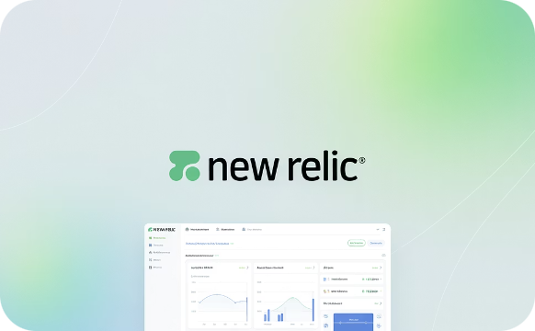
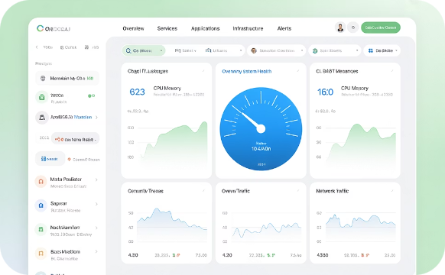
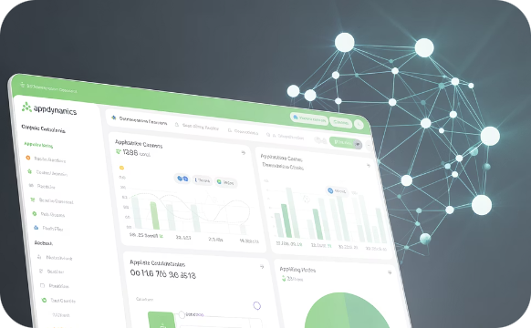
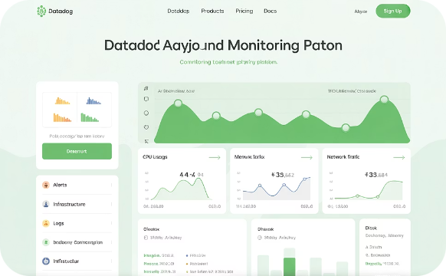
Leading APM Tools in the Market
New Relic
Dynatrace
AppDynamics
Datadog
Comprehensive observability platform with advanced analytics and AI-powered insights
AI-driven performance monitoring with automatic root cause analysis
Business-focused APM with strong application topology mapping
Unified monitoring platform combining infrastructure, applications, and logs

Slide 6


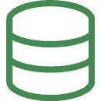

Why Infrastructure Monitoring Matters
Application performance is fundamentally dependent on infrastructure health. Servers, containers, databases, and networks form the foundation that supports application delivery.
Server Health
Container Monitoring
CPU utilization, memory consumption, and disk I/O directly impact application response times and user experience
Track container health, resource allocation, and orchestration platform performance in containerized environments
Database Performance
Network Latency
Monitor query performance, connection pools, and database resource utilization for optimal data access
Track network performance, bandwidth utilization, and connectivity issues affecting distributed systems

Slide 7
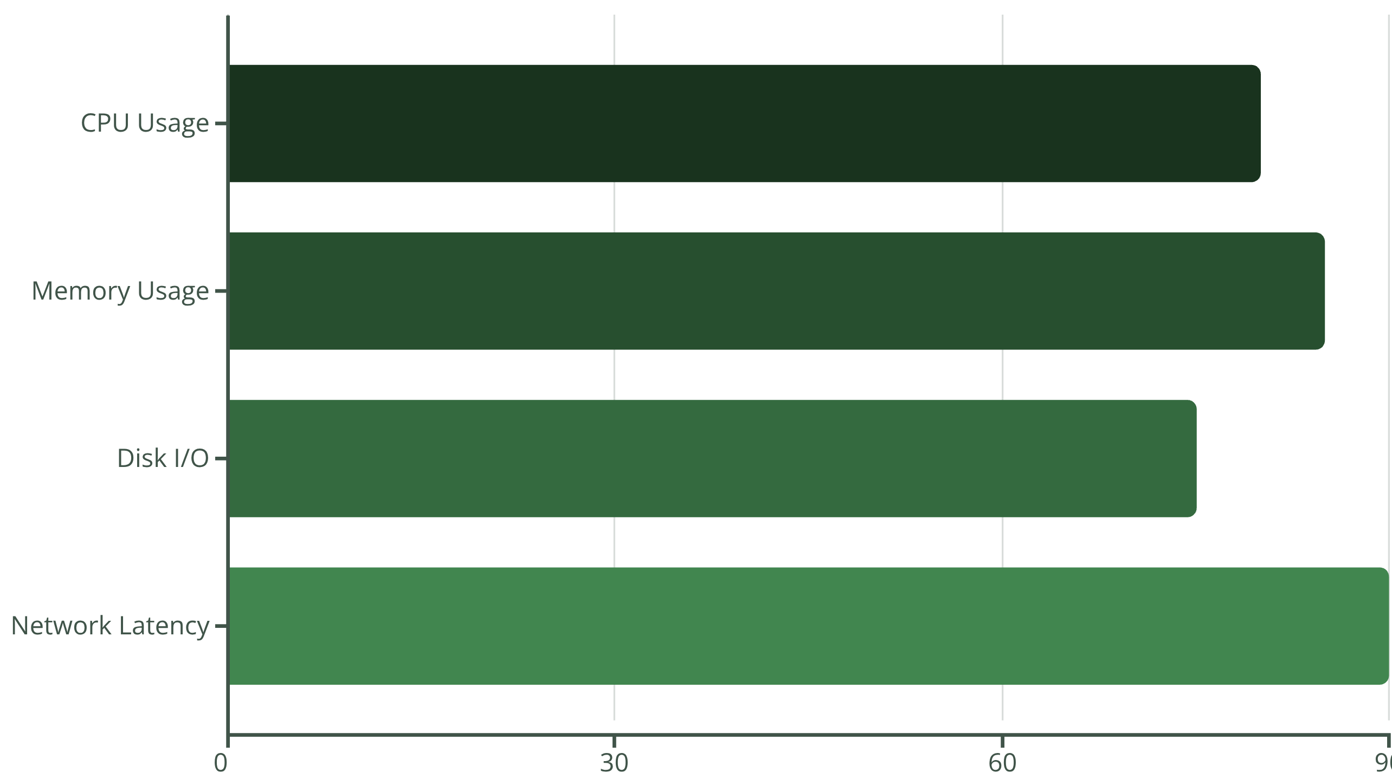
Critical Infrastructure Metrics
These thresholds represent typical alert levels where performance degradation becomes noticeable. Best practices include defining SLAs and SLOs, implementing auto-scaling policies, and establishing auto-remediation workflows to maintain optimal performance.

Slide 8
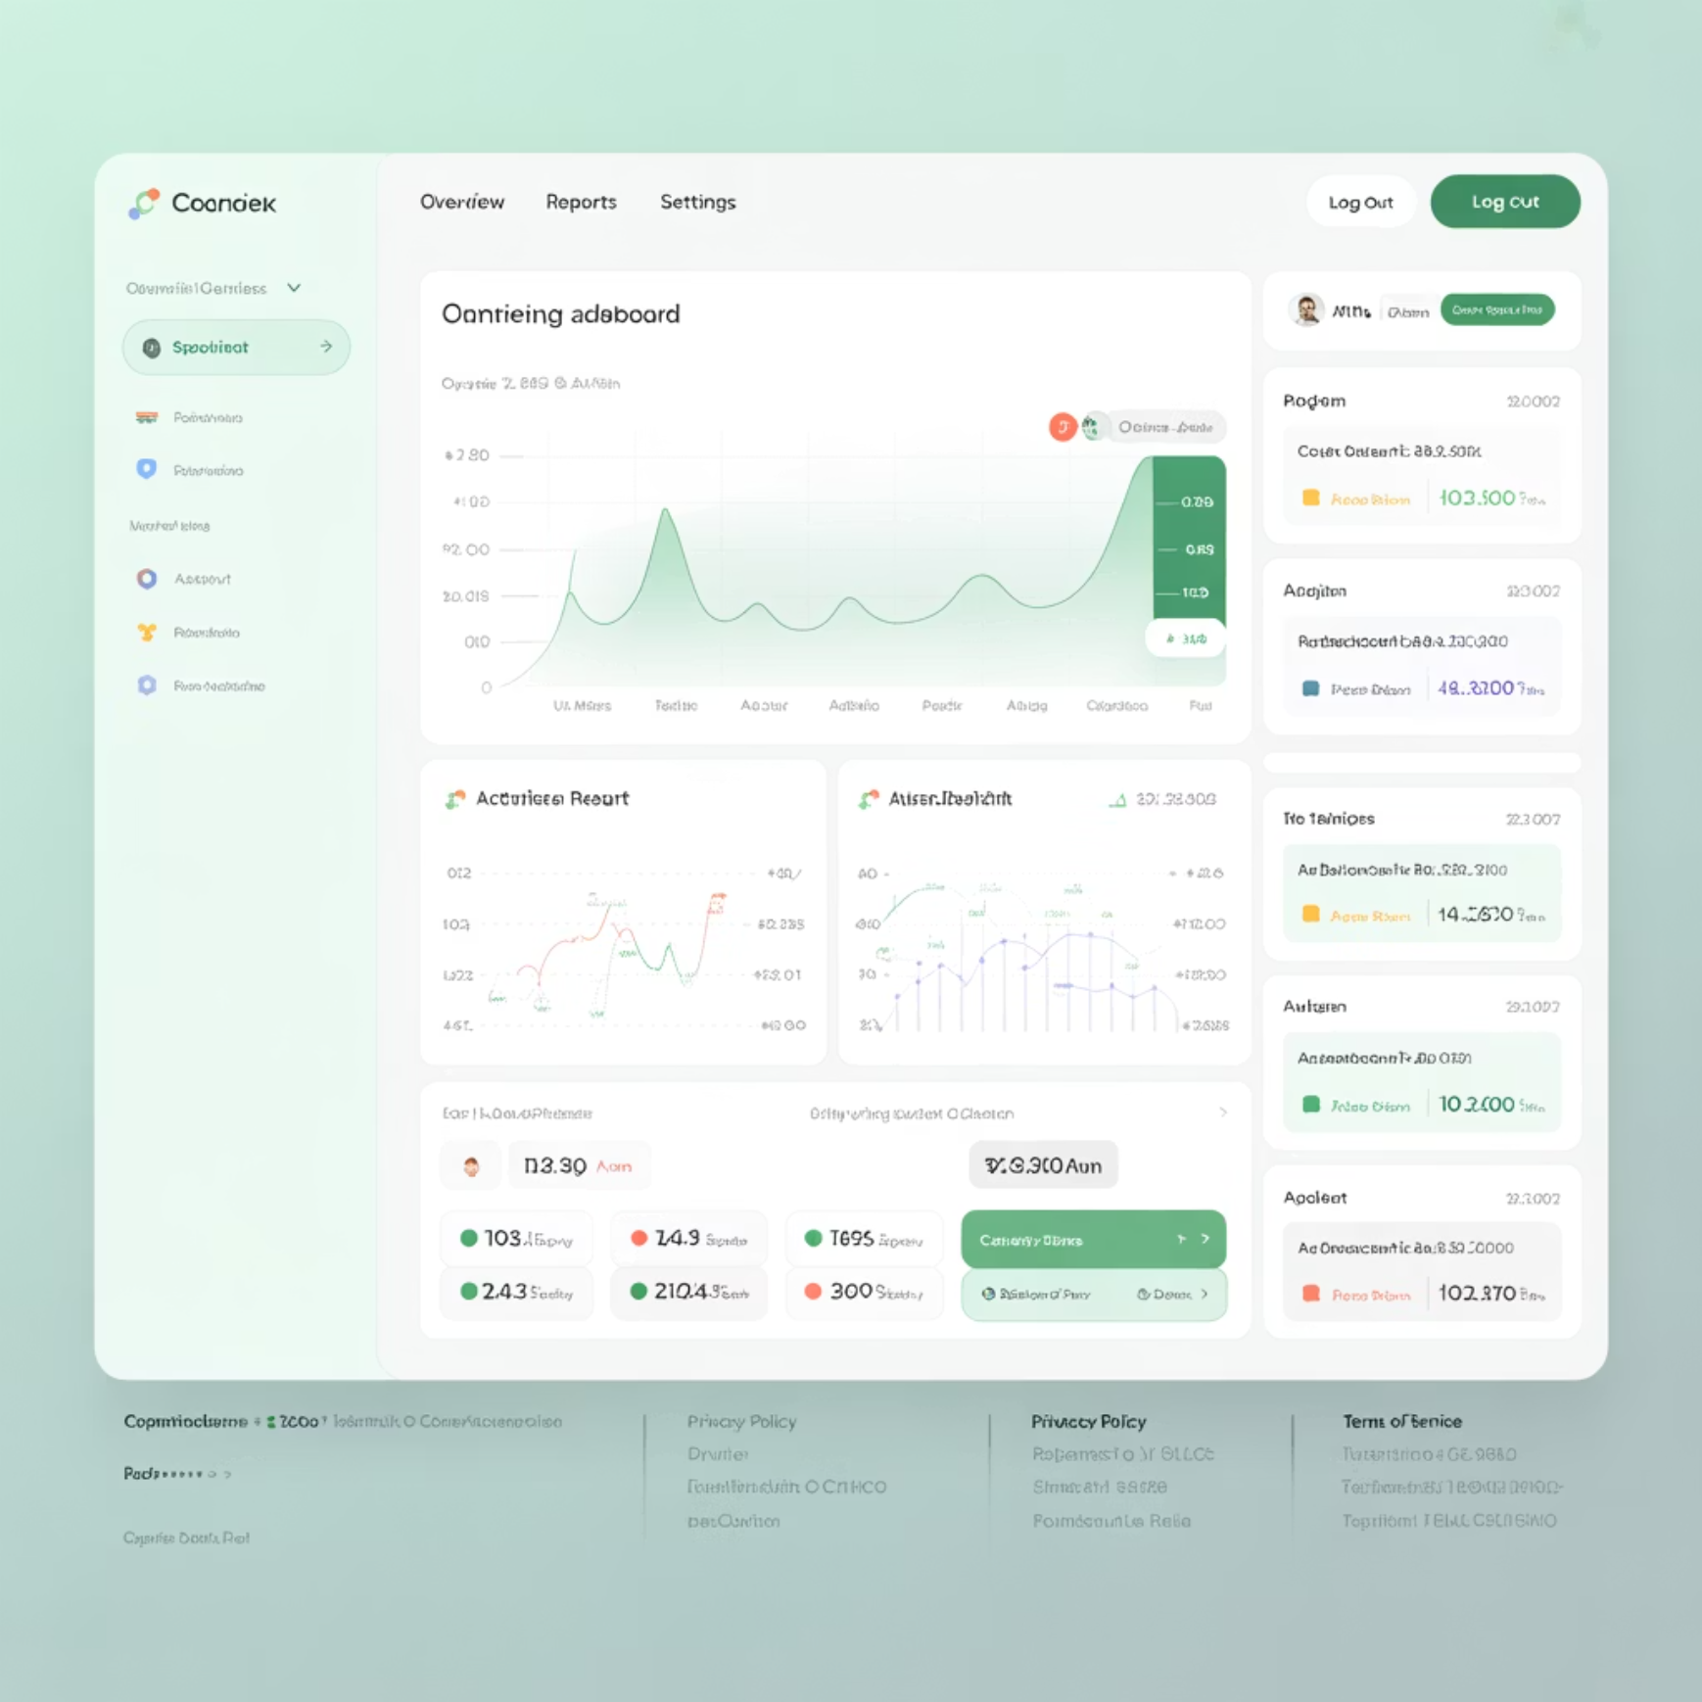



Dashboard Design & Visualization
Purpose-Driven Dashboards
Effective dashboards serve three primary functions: providing real-time operational visibility, enabling executive reporting with business context, and facilitating rapid troubleshooting during incidents.
Key features include drill-down capabilities for detailed analysis and correlation across multiple data sources to identify relationships between metrics.
Infrastructure Health
Application Performance
Business KPIs
Server metrics, resource utilization
Response times, error rates, throughput
Revenue impact, user satisfaction

Slide 9

Dashboard Best Practices
Avoid Visual Clutter
Persona-Based Design
Contextual Information
Focus on essential metrics that drive decision-making. Too many widgets reduce effectiveness and increase cognitive load.
Align dashboards with specific user needs:
Include relevant context like deployment markers, maintenance windows, and historical baselines to aid interpretation.
DevOps teams need technical metrics and alerts
Business stakeholders require KPI summaries
Security teams focus on threat indicators

Slide 10
Alerting & Incident Management
Detection
1
Threshold-based, anomaly detection, and predictive alerts identify issues
2
Notification
Multi-channel alerts via email, Slack, PagerDuty, and webhooks
Diagnosis
3
Root cause analysis using correlated metrics and distributed tracing
4
Resolution
Automated or manual remediation with documented procedures
Postmortem
5
Learning from incidents to prevent future occurrences
Effective alerting reduces alert fatigue through proper tuning, aggregation, and severity level definitions. Automated response workflows can handle routine issues without human intervention.

Slide 11
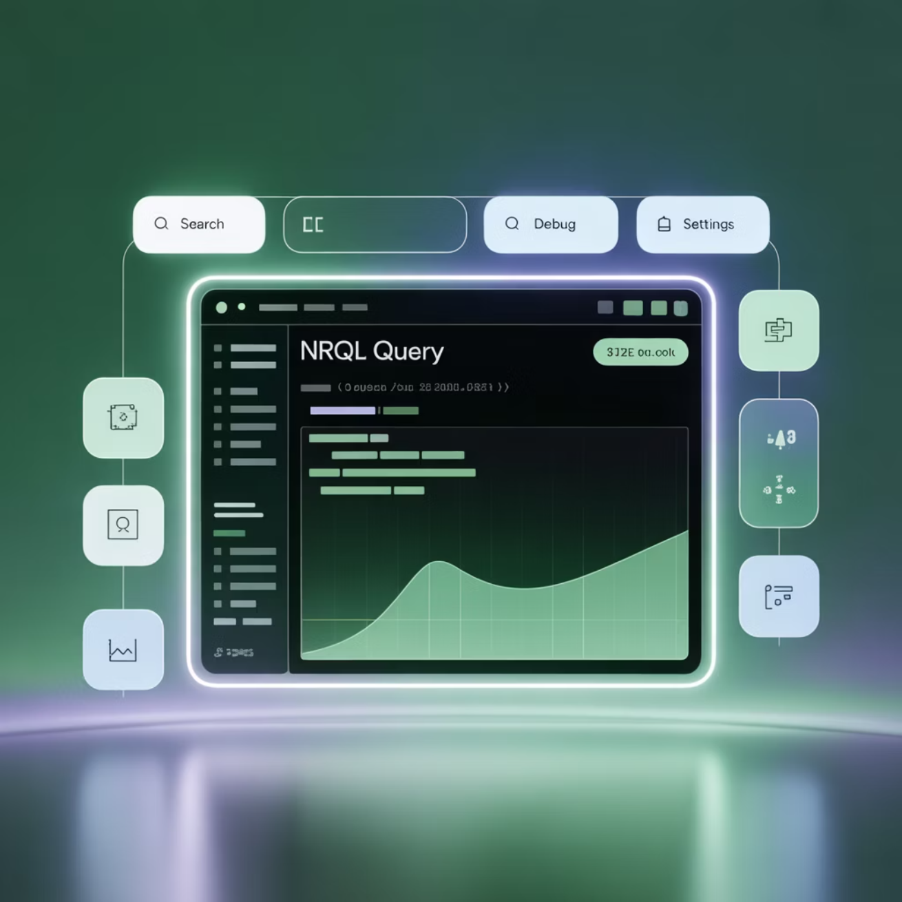
NRQL: New Relic Query Language
NRQL is a SQL-like query language designed for telemetry data analysis. It enables powerful data exploration and custom dashboard creation.
Basic Query Structure
SELECT average(duration) FROM Transaction SINCE 30 minutes ago
Advanced Features
FACET - Group results by attributes
TIMESERIES - Create time-based charts
WHERE - Filter data with conditions
COMPARE WITH - Historical comparisons
NRQL powers custom dashboards and enables deep analysis of application performance patterns, user behavior, and system trends.

Slide 12
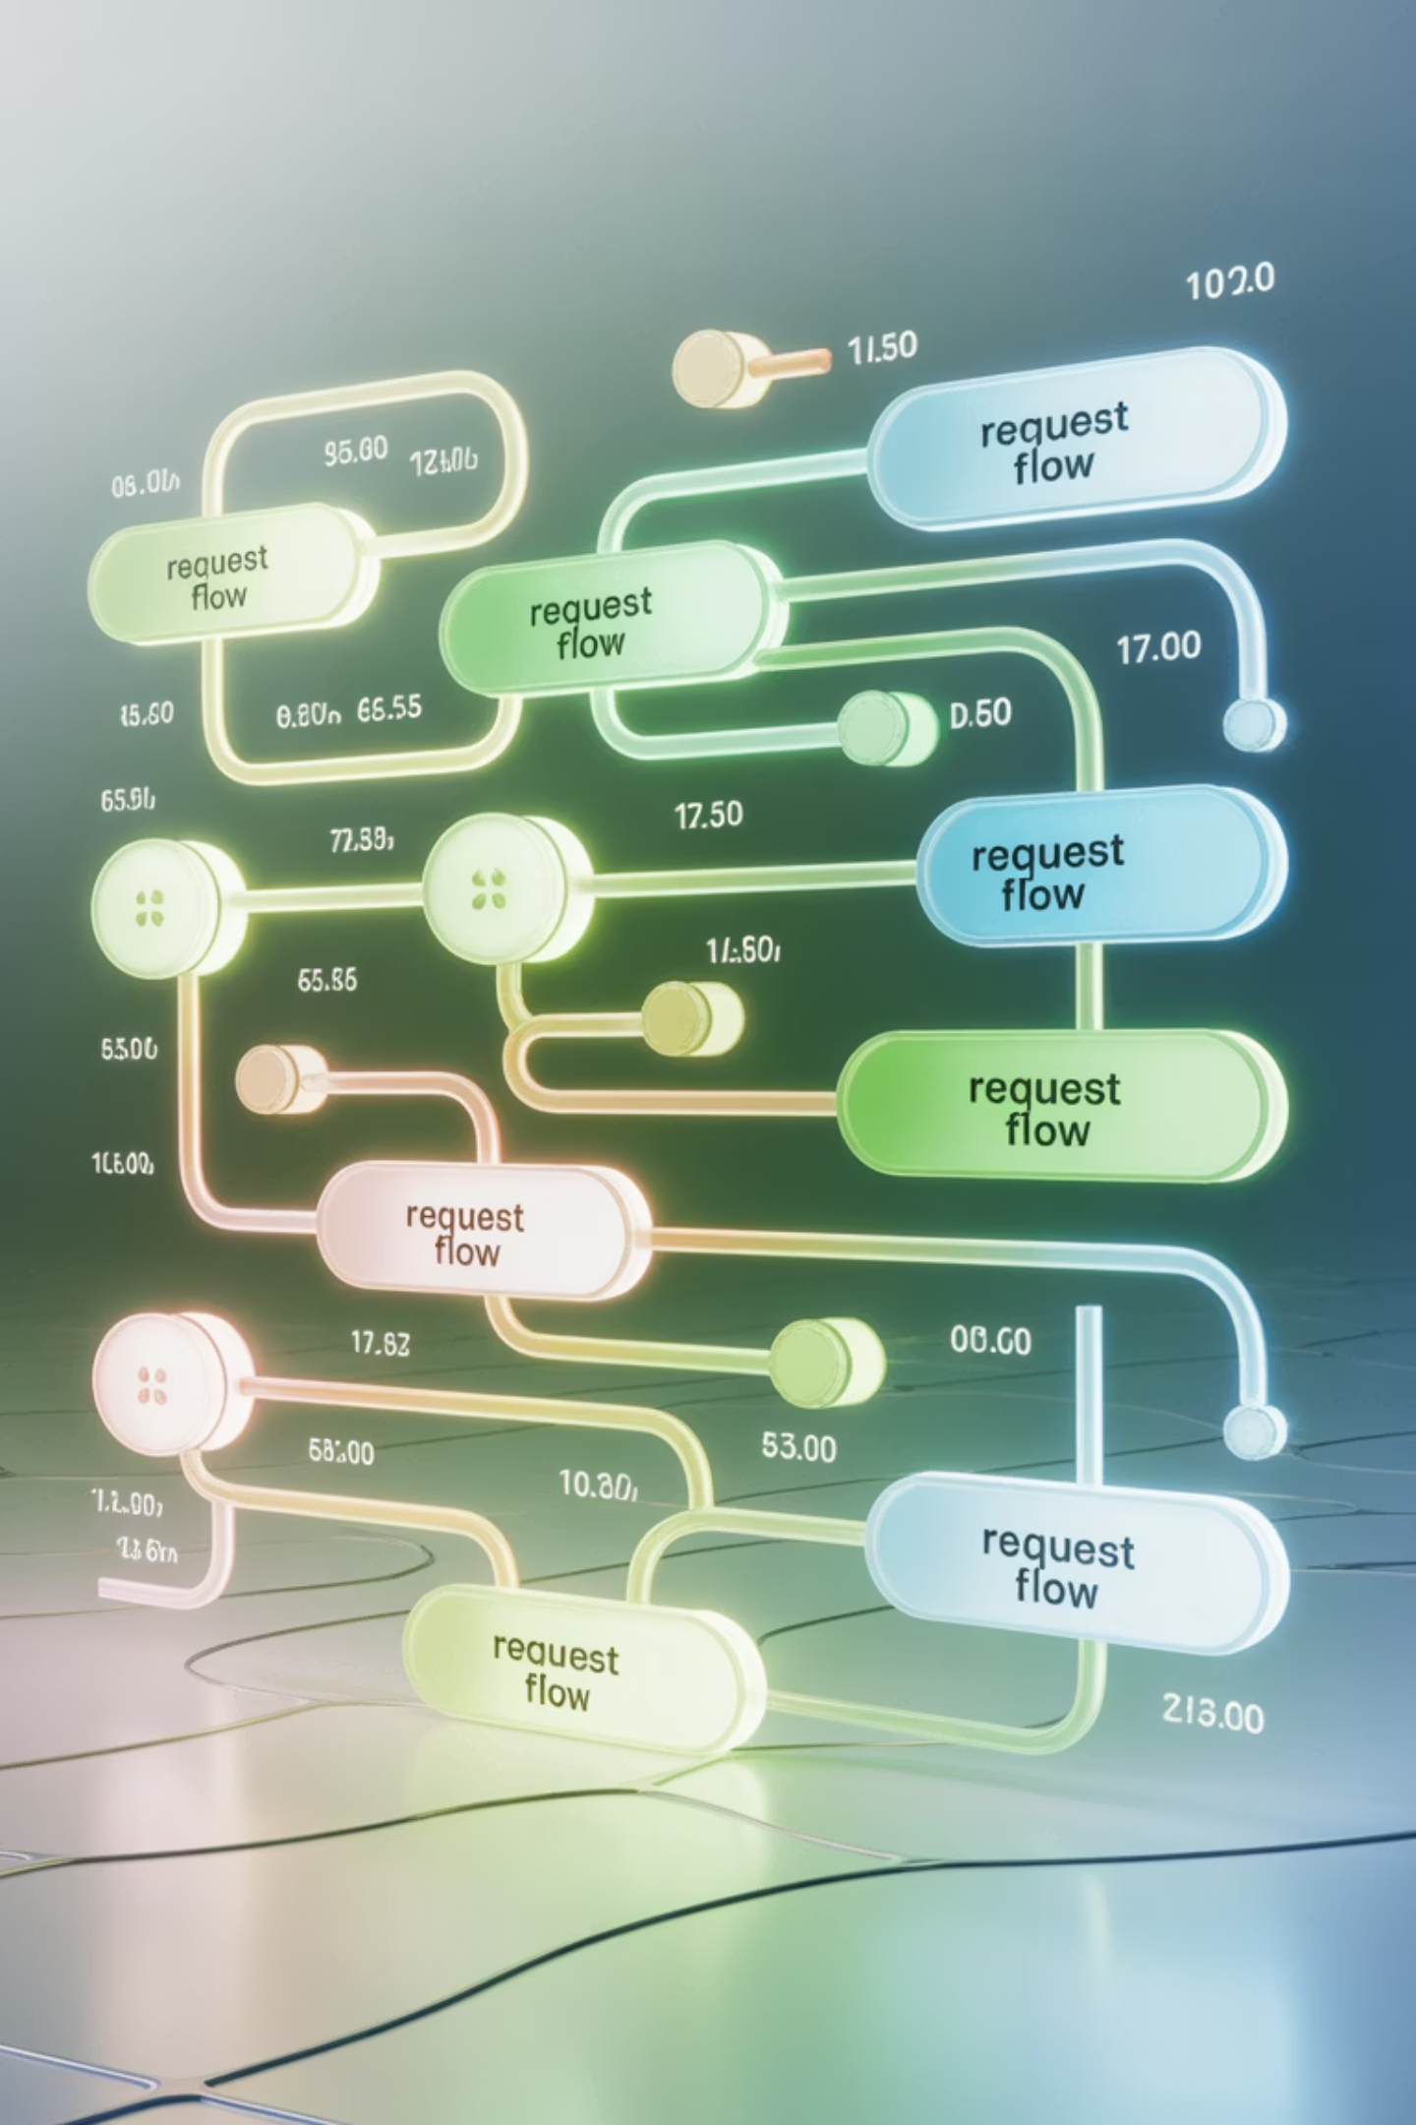
Distributed Tracing Fundamentals
Distributed tracing tracks requests as they flow through microservices architectures, providing end-to-end visibility into complex distributed systems.
Trace Initiation
User request enters the system and receives a unique trace ID
Span Creation
Each service creates spans representing work units with timing data
Context Propagation
Trace context passes between services maintaining request correlation
Analysis & Optimization
Complete trace reveals bottlenecks and dependency issues

Slide 13










Integration Ecosystem
Monitoring Tools
Cloud Providers
Prometheus, Grafana, Elasticsearch, Splunk
AWS CloudWatch, Azure Monitor, GCP Operations Suite
Incident Management
PagerDuty, ServiceNow, Jira Service Management
Automation
Ansible, Terraform, Kubernetes operators
Communication
Slack, Microsoft Teams, email, webhooks
Integrations enable centralized monitoring, automated workflows, and seamless data flow between tools, creating a unified observability platform.

Slide 14



Real-World Case Studies
E-commerce Platform
Banking Application
Media Streaming
Monitoring checkout performance during Black Friday traffic spikes. Implemented auto-scaling based on response time thresholds, reducing cart abandonment by 23%.
Ensuring 99.99% uptime for mobile banking services. Used distributed tracing to identify database bottlenecks, improving transaction processing by 40%.
Scaling video delivery infrastructure for millions of concurrent users. Predictive alerting prevented service degradation during viral content events.
These examples demonstrate how APM drives business outcomes through improved reliability, performance optimization, and proactive issue resolution.

Slide 15
APM Best Practices Checklist
01
02
03
Define KPIs
Monitor Continuously
Alert Intelligently
Establish clear performance indicators aligned with business objectives and user experience goals
Implement comprehensive monitoring across infrastructure, applications, and user experience layers
Configure meaningful alerts with proper thresholds, reduce noise, and ensure actionable notifications
04
05
Automate Response
Review & Improve
Implement automated remediation for common issues and streamline incident response workflows
Conduct regular performance reviews, analyze trends, and continuously optimize monitoring strategies
"Effective APM transforms reactive firefighting into proactive performance optimization, enabling teams to deliver exceptional user experiences consistently."

