Slide 1
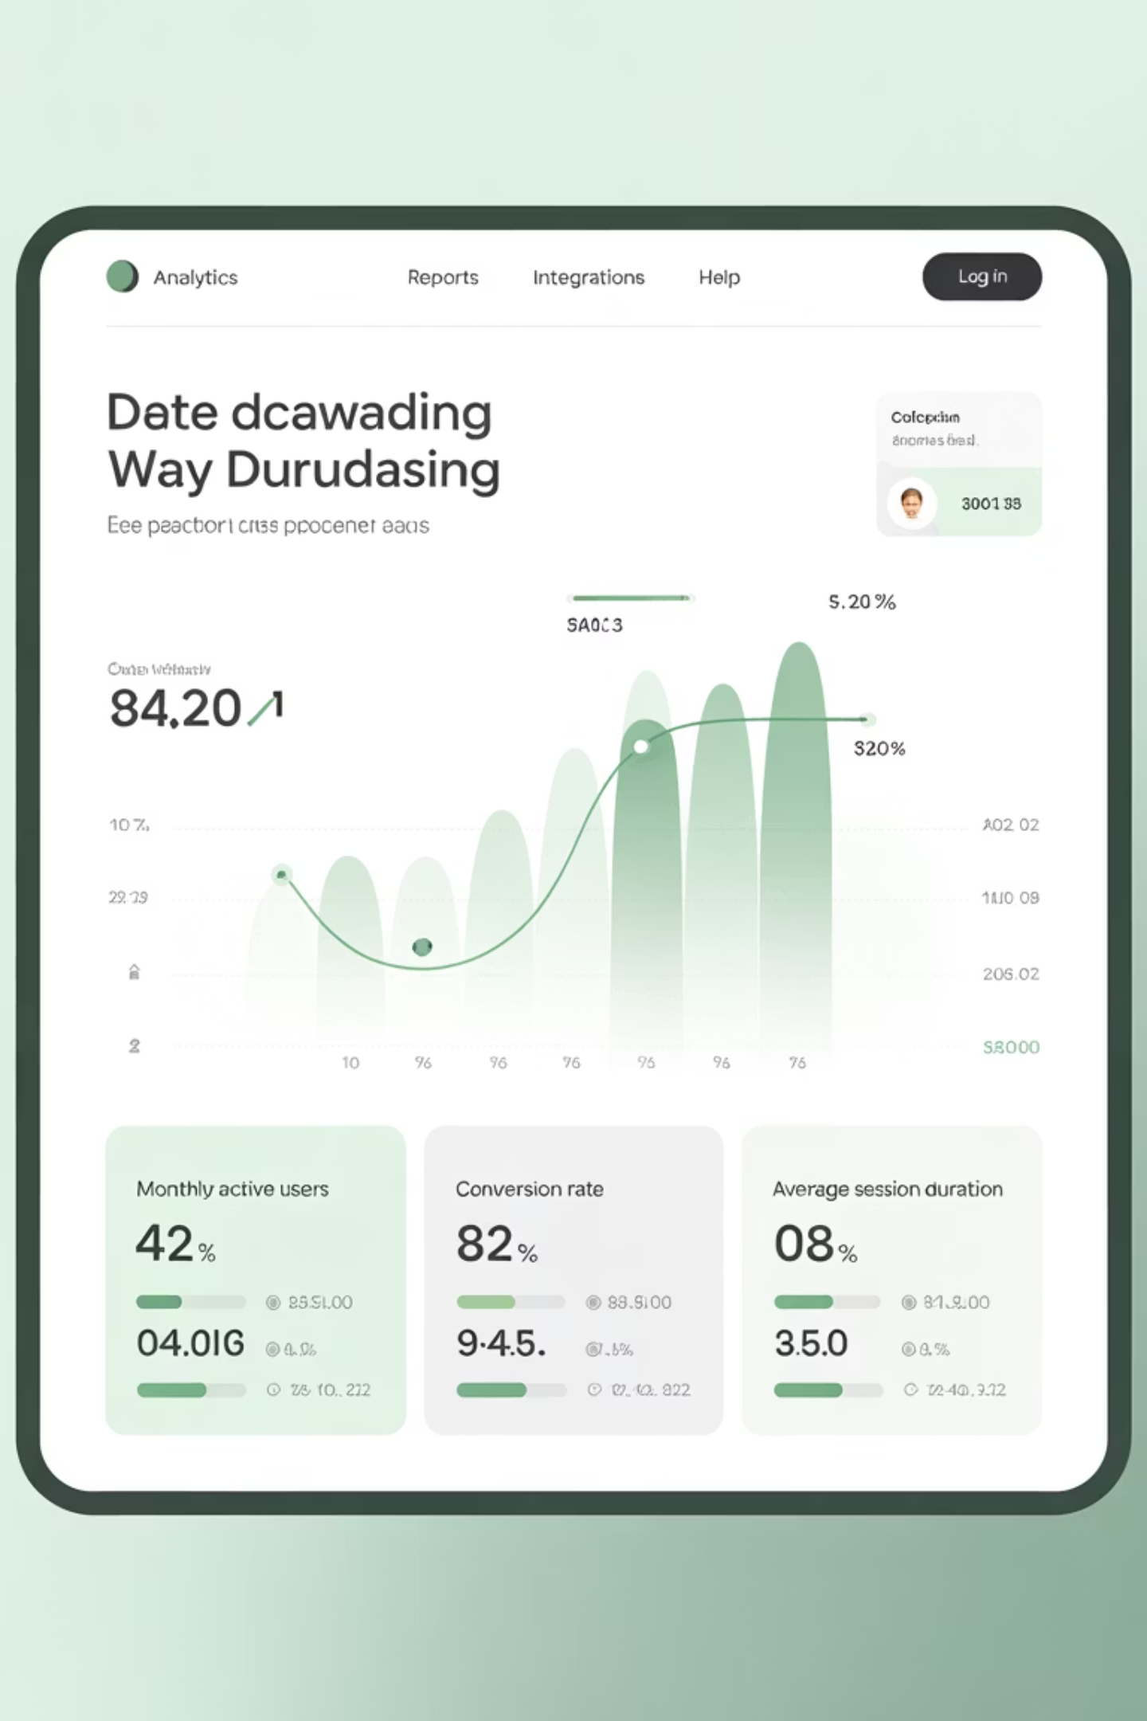
Dashboards & Visualization
Transform raw monitoring data into actionable insights through strategic dashboard design. This module explores how to build effective dashboards that serve different personas while maintaining clarity and purpose.

Slide 2

The Strategic Purpose of Dashboards
Dashboards serve as the command center for modern IT operations, providing three critical functions that drive organizational success.
Real-time visibility enables teams to monitor system health continuously, identifying issues before they impact users. This proactive approach reduces mean time to detection (MTTD) and prevents minor incidents from escalating into major outages.
Executive reporting translates technical metrics into business language, helping leadership understand system performance impact on revenue, customer satisfaction, and operational efficiency.
Troubleshooting acceleration provides context-rich views that help engineers quickly isolate root causes, reducing mean time to resolution (MTTR) significantly.

Slide 3
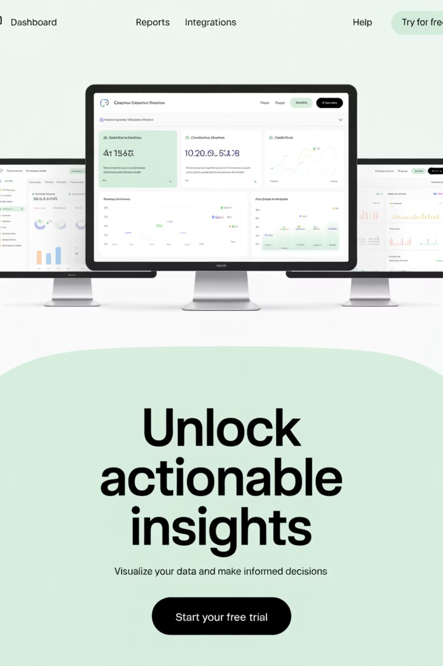
Dashboard Types: Matching Tools to Needs
Infrastructure Health
Application Performance
Server metrics, network performance, resource utilization, and capacity planning. Focus on CPU, memory, disk I/O, and network throughput trends.
Response times, error rates, throughput, and user experience metrics. Essential for maintaining SLAs and optimizing application delivery.
System resource monitoring
Response time analysis
Network performance tracking
Error rate monitoring
Capacity planning insights
Transaction tracking
Business KPIs
Revenue impact, customer satisfaction scores, conversion rates, and operational efficiency metrics that connect IT performance to business outcomes.
Revenue correlation
Customer impact metrics
Operational efficiency

Slide 4
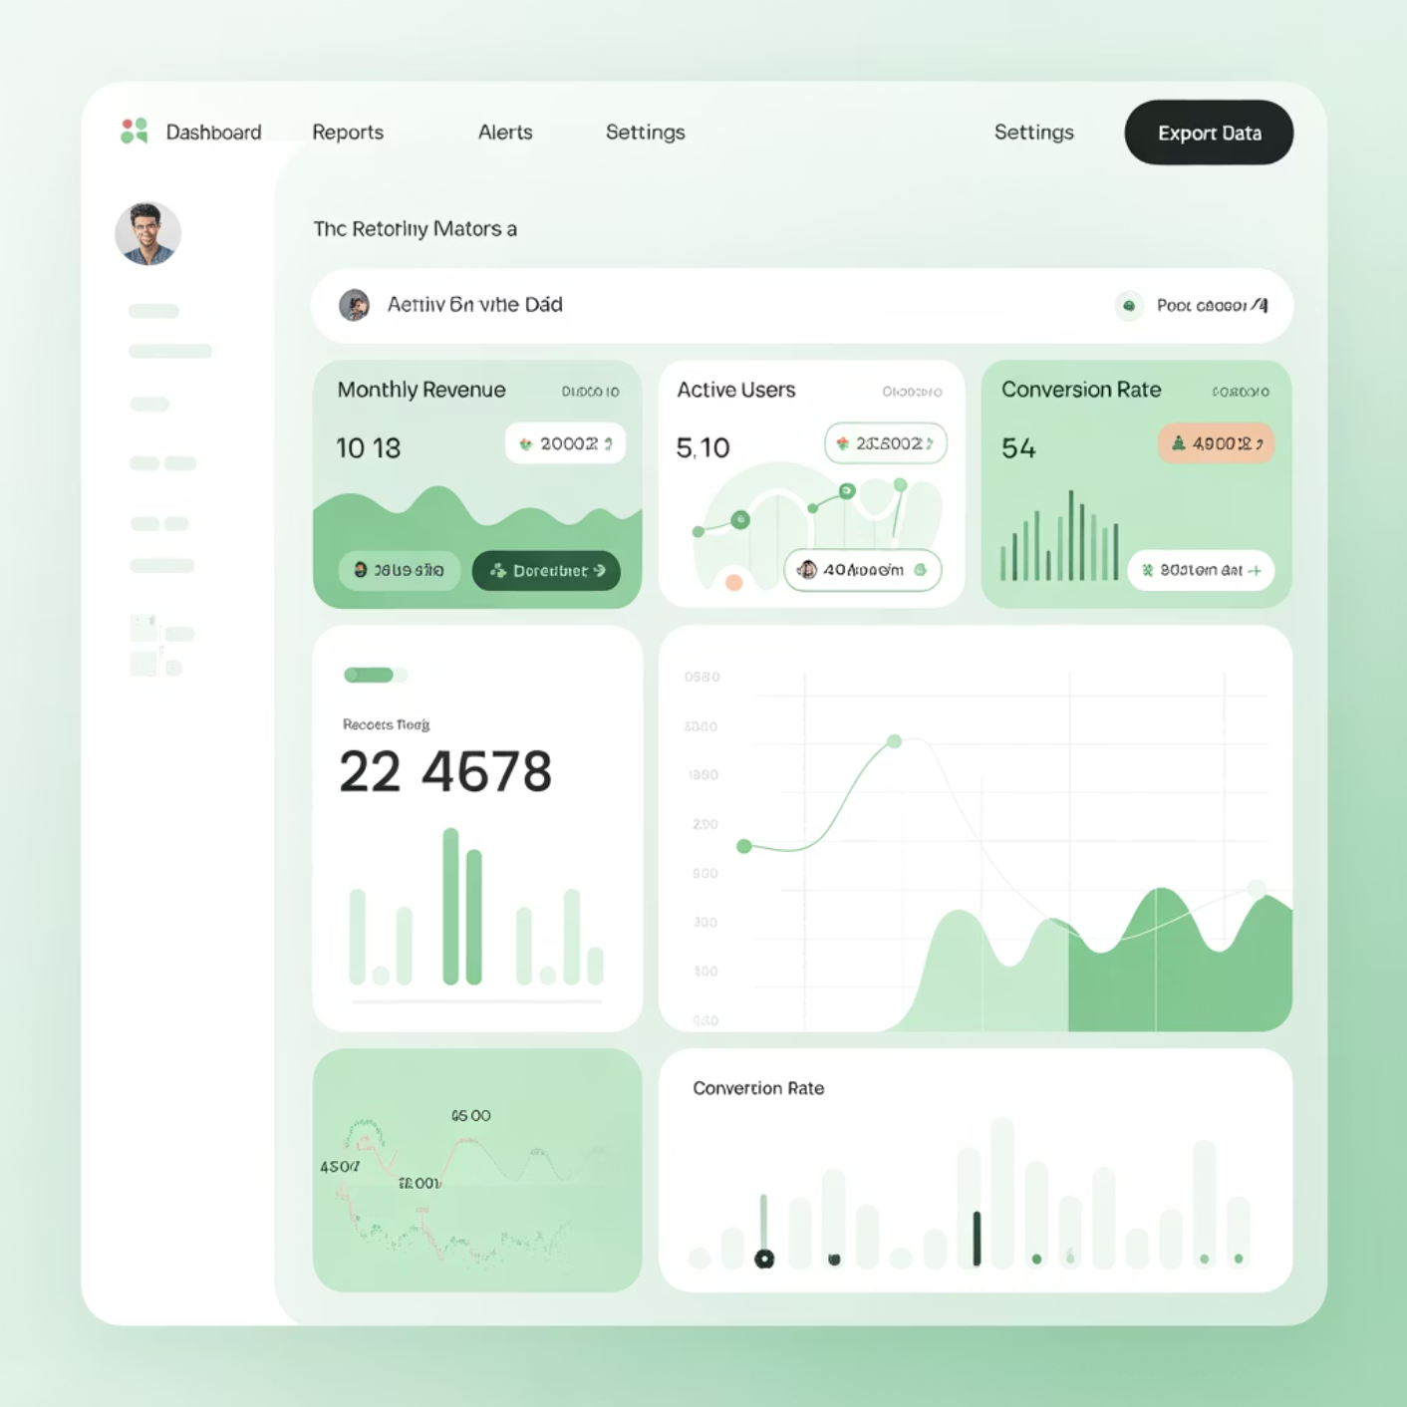

Essential Dashboard Features
Drill-Down Capability
Effective dashboards provide multiple levels of detail, allowing users to start with high-level overviews and progressively drill down to specific metrics, time ranges, or system components. This hierarchical approach supports both executive summaries and detailed technical investigations.
Implement intuitive navigation that preserves context while enabling deeper analysis. Users should be able to click from a service overview to individual server metrics without losing their investigation thread.
Cross-Source Correlation
Modern systems generate data across multiple tools and platforms. Advanced dashboards correlate metrics from infrastructure monitoring, application performance tools, log aggregation systems, and business analytics platforms to provide holistic insights.
This correlation capability is crucial for understanding complex system interactions and identifying cascade failures that span multiple layers of your technology stack.

Slide 5
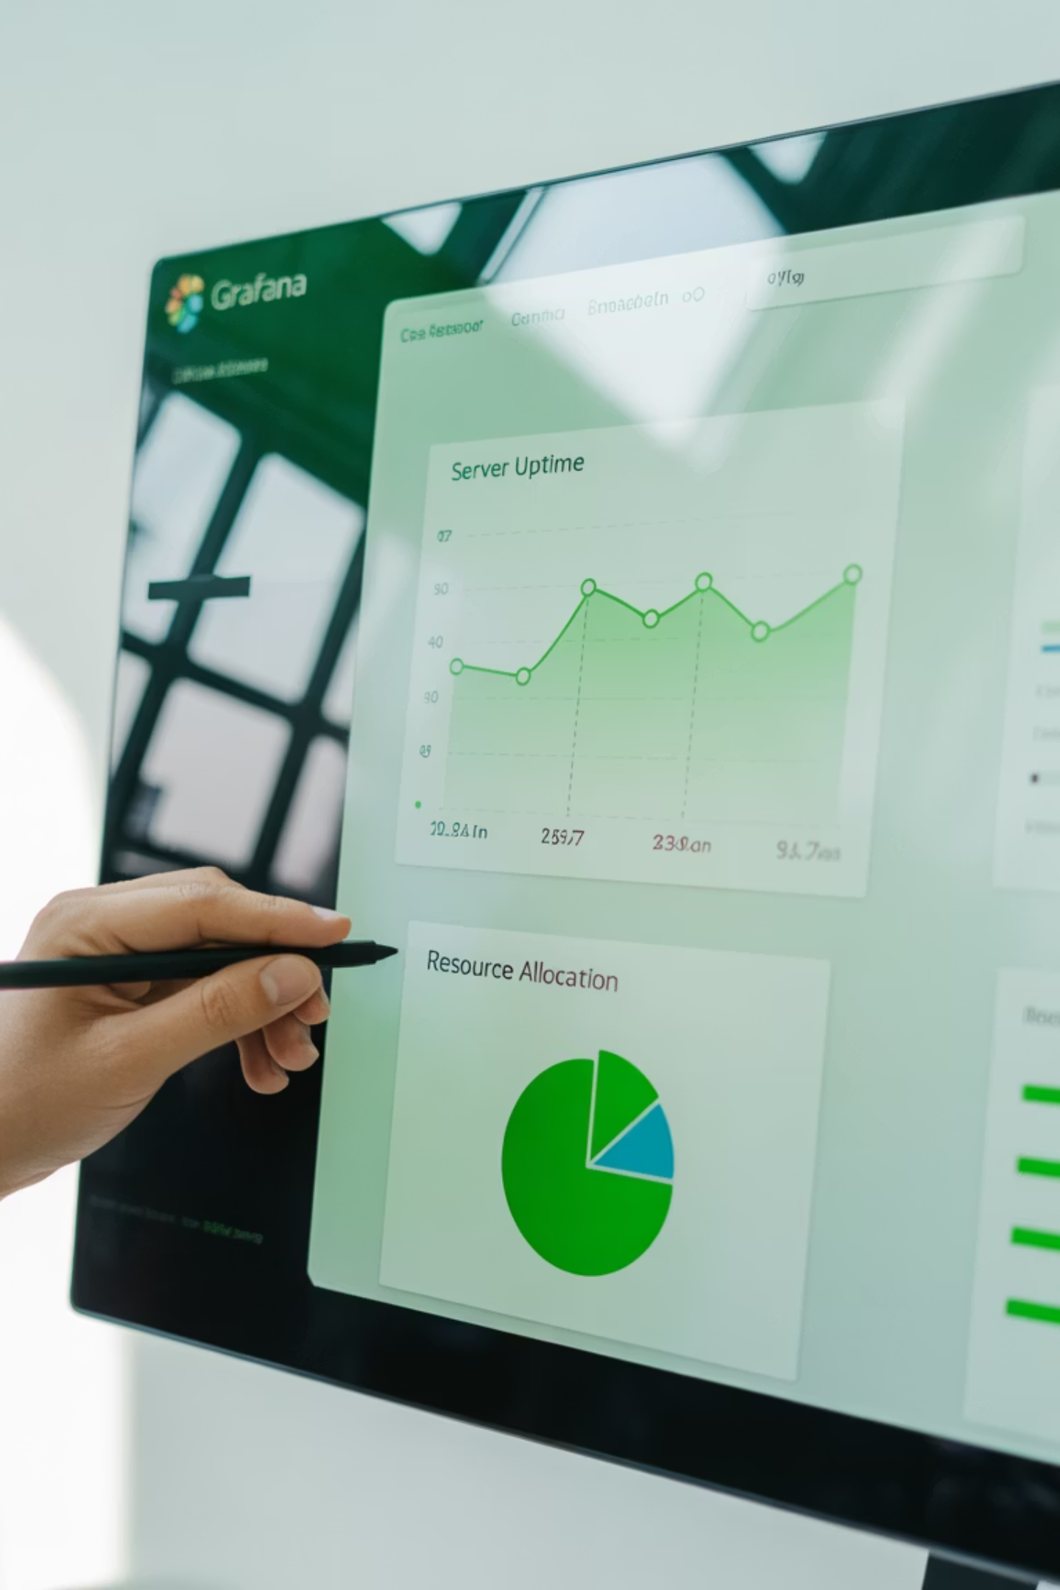
Dashboard Demo: Building Your First Monitoring View
Let's walk through creating a comprehensive dashboard using industry-standard tools. We'll demonstrate both New Relic Insights and Grafana approaches to showcase different methodologies.
01
Data Source Configuration
Connect to your monitoring tools, databases, and APIs. Establish authentication and validate data connectivity before proceeding with visualization.
02
Widget Selection & Layout
Choose appropriate visualization types (time series, gauges, tables) based on data characteristics and user needs. Plan your layout for logical flow.
03
Query Optimization
Write efficient queries that balance data richness with dashboard performance. Consider caching strategies for expensive calculations.
04
Alerting Integration
Configure dashboard-driven alerts that trigger notifications when metrics exceed defined thresholds, enabling proactive incident response.

Slide 6
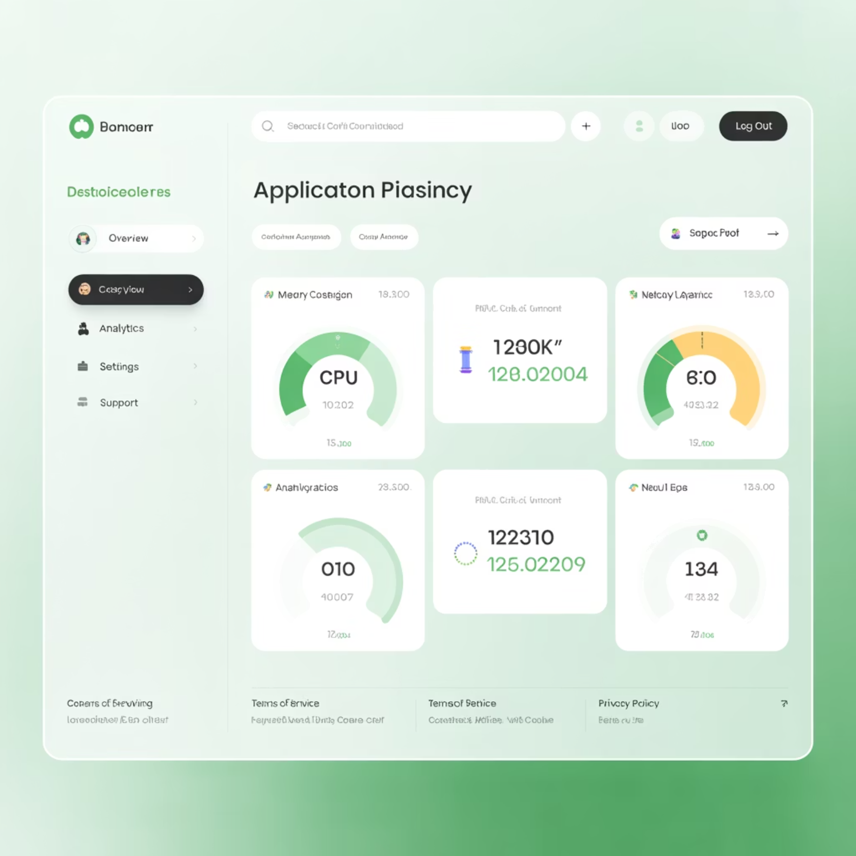
New Relic Insights: APM-Focused Dashboards
Application-Centric Approach
New Relic excels at application performance monitoring with built-in dashboard templates that automatically surface key metrics like Apdex scores, error rates, and transaction traces.
The platform's strength lies in its ability to correlate application performance with infrastructure metrics, providing end-to-end visibility from user experience down to server resources.
Custom insights dashboards can be built using NRQL (New Relic Query Language) to create sophisticated visualizations that combine multiple data streams into cohesive operational views.

Slide 7

Grafana: Flexible Open-Source Visualization
Grafana provides unparalleled flexibility for creating custom dashboards that integrate with dozens of data sources. Its open-source nature makes it popular among engineering teams who need complete control over their monitoring stack.
Multi-Source Integration
Advanced Templating
Connect Prometheus, InfluxDB, Elasticsearch, CloudWatch, and many other data sources in a single dashboard view.
Use variables and templating to create dynamic dashboards that adapt to different environments, services, or time ranges.
Community Plugins
Leverage thousands of community-contributed panels, data sources, and apps to extend functionality beyond core features.

Slide 8

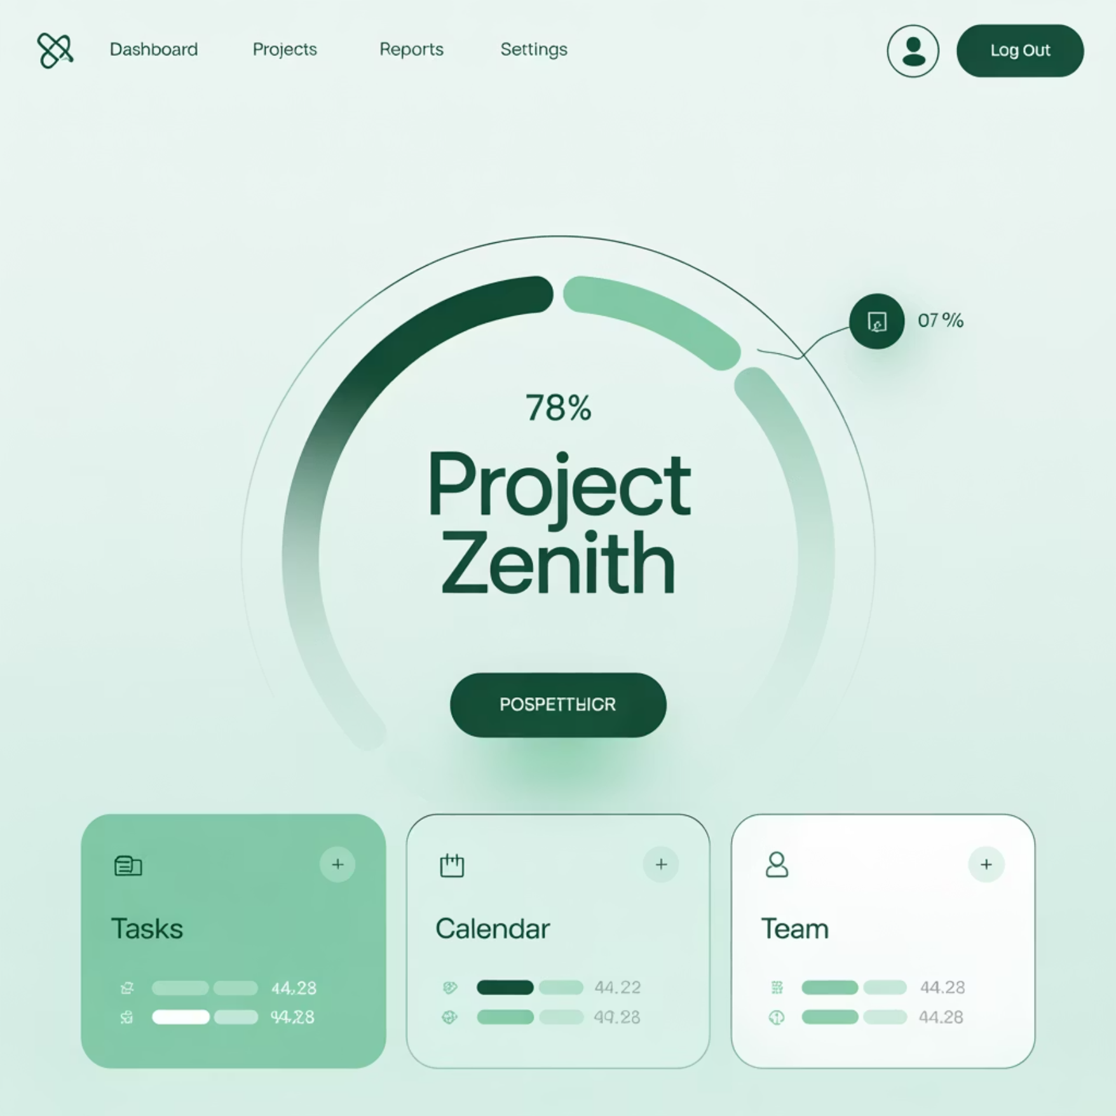
Dashboard Best Practices: Design for Clarity
Avoid Visual Clutter
❌ Overwhelming Design
✅ Clean, Focused Design
Effective dashboards follow the "5-second rule" - users should understand the current system state within five seconds of viewing. This requires ruthless prioritization of information and strategic use of white space.
Limit each dashboard to 6-8 key metrics maximum. Use color coding consistently - red for critical issues, yellow for warnings, green for healthy states. Group related metrics logically and maintain consistent time ranges across related visualizations.

Slide 9




Persona-Aligned Dashboard Design
DevOps Engineers
Focus on deployment metrics, infrastructure health, and automation pipeline status. Include detailed technical metrics with drill-down capabilities for troubleshooting. Emphasize trends and historical data for capacity planning.
Business Stakeholders
Highlight system availability, customer impact metrics, and cost optimization opportunities. Use executive summary formats with clear indicators of business risk and performance against SLAs.
Security Teams
Emphasize threat detection, compliance metrics, and incident response times. Include security event correlation and risk assessment visualizations with clear escalation indicators.

Slide 10

Key Takeaways: Dashboard Excellence
1
Purpose-Driven Design
Every dashboard should solve specific problems for clearly defined user personas. Resist the temptation to create "everything dashboards" that serve no one well.
2
Actionable Insights Over Pretty Charts
Focus on metrics that enable decision-making and action. Beautiful visualizations are worthless if they don't drive operational improvements or business outcomes.
3
Iterate Based on User Feedback
Dashboard effectiveness is measured by user adoption and problem resolution speed. Continuously gather feedback and refine your visualizations based on real-world usage patterns.
Master these principles to transform your monitoring data into strategic business assets that drive informed decision-making across your organization.

