Slide 1

Splunk Architecture & Data Ingestion
Mastering Indexers, Forwarders, Search Heads, and Core Indexing Concepts
A comprehensive guide for IT professionals navigating enterprise data management and analytics infrastructure

Slide 2
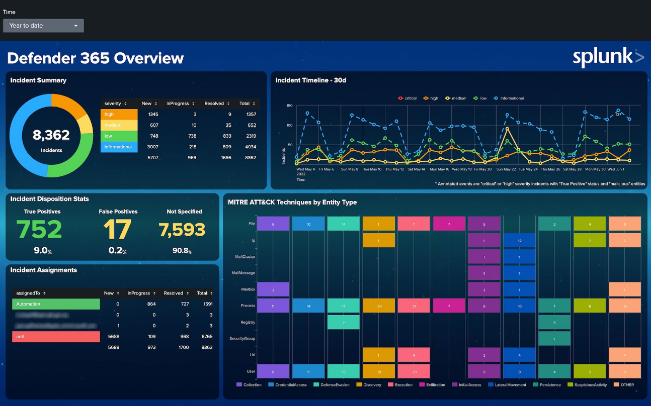
Introduction to Splunk Platform
Splunk is a powerful platform designed for searching, monitoring, and analyzing machine-generated data at scale. It transforms raw data from applications, servers, and network devices into actionable insights through advanced search capabilities and real-time analytics.
Core Use Cases
Log management and infrastructure monitoring
Security information and event management (SIEM)
Application performance monitoring and troubleshooting
Business intelligence and operational analytics
The platform consists of four primary components: Forwarders for data collection, Indexers for processing and storage, Search Heads for user interaction, and Deployment Servers for configuration management.

Slide 3




Splunk Architecture Overview
Forwarders
Lightweight agents that collect and transmit data from source systems to indexers with minimal resource overhead
Indexers
Core processing engines that parse, index, and store incoming data in searchable formats with compression
Search Heads
User interface layer providing search capabilities, dashboards, alerts, and visualization tools for data analysis
This distributed architecture enables horizontal scaling, high availability, and efficient data processing across enterprise environments. Optional components like Deployment Servers and Cluster Masters provide centralized management for large-scale deployments.

Slide 4
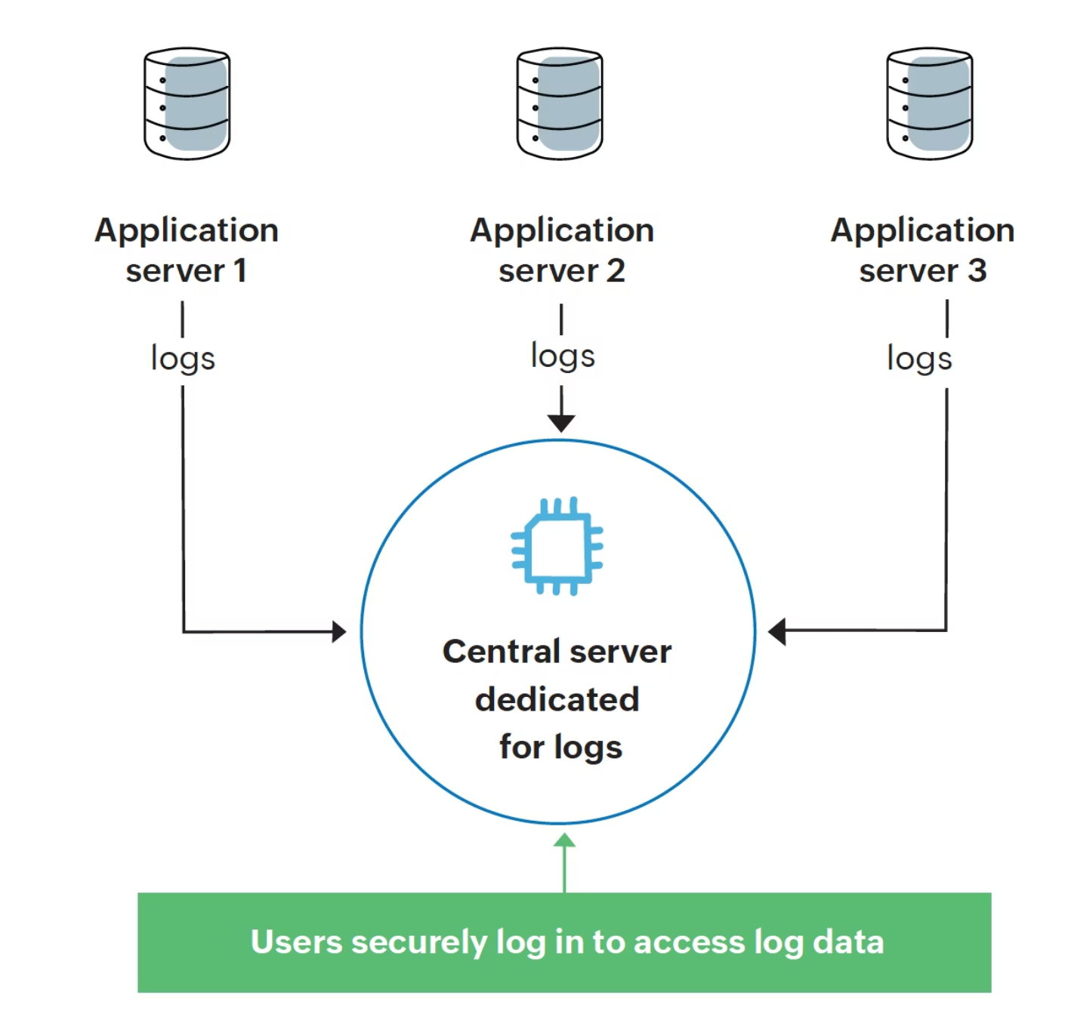
Understanding Splunk Forwarders
Forwarders are lightweight software agents installed on source machines to collect and transmit data efficiently. They serve as the data collection layer in Splunk's architecture, ensuring secure and reliable data transmission to indexers.
Universal Forwarder (UF)
Minimal footprint agent that forwards raw data without processing. Ideal for production servers where resource consumption must be minimized. Handles compression and secure transmission automatically.
Heavy Forwarder (HF)
Full Splunk instance capable of parsing, filtering, and transforming data before forwarding. Used when data preprocessing is required or when acting as an intermediate aggregation point.
Common deployment scenarios include collecting application logs, system metrics, security events, and network device data. Forwarders support load balancing across multiple indexers and automatic failover for high availability.

Slide 5
Splunk Indexers: The Processing Engine
Indexers form the backbone of Splunk's data processing infrastructure. They receive raw data from forwarders, parse it into searchable events, and store the results in compressed, indexed formats optimized for fast retrieval and analysis.
Data Ingestion
Event Processing
Index Storage
Receives data streams from multiple forwarders simultaneously, handling various data formats and sources with configurable parsing rules and data transformation pipelines.
Breaks raw data into individual events, extracts timestamps, assigns metadata, and performs field extraction according to sourcetype configurations and parsing rules.
Stores processed events in compressed buckets with efficient indexing structures, enabling fast search operations and optimized storage utilization across hot, warm, and cold tiers.
Indexer clustering provides data replication and high availability, ensuring business continuity and search performance even during hardware failures or maintenance windows.

Slide 6
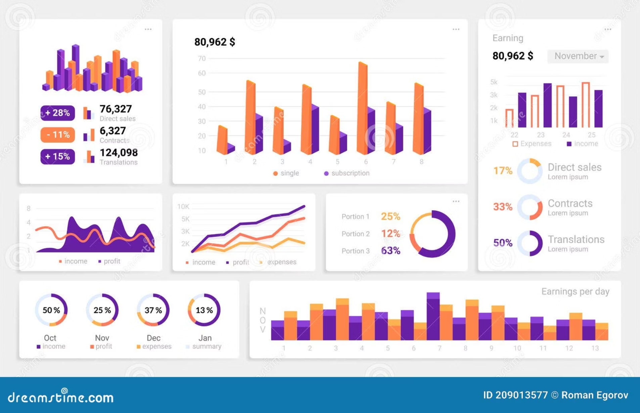
Search Heads: User Interface Layer
Search Heads provide the primary user interface for Splunk, enabling search queries, dashboard creation, alert configuration, and data visualization. They coordinate distributed searches across multiple indexers and present consolidated results to users.
Key Capabilities
SPL (Search Processing Language) query execution
Dashboard and visualization creation
Real-time monitoring and alerting
Report scheduling and distribution
User access control and role management
Search Head clustering ensures redundancy and load balancing, allowing multiple users to perform complex searches simultaneously without performance degradation.

Slide 7





Data Ingestion Workflow
Data Sources
Collection & Forwarding
Parsing & Indexing
Various input sources including log files, databases, APIs, network streams, metrics, and custom applications generate machine data for analysis.
Forwarders monitor source systems, collect data in real-time or batch mode, and transmit securely to indexers with compression and encryption.
Indexers parse raw data into discrete events, extract timestamps and fields, apply sourcetype rules, and store in optimized index structures.
Storage Management
Search & Analysis
Processed events are stored in time-based buckets with lifecycle management, moving through hot, warm, cold, and frozen states based on retention policies.
Search heads enable users to query indexed data, create visualizations, build dashboards, and configure alerts for proactive monitoring and analysis.

Slide 8
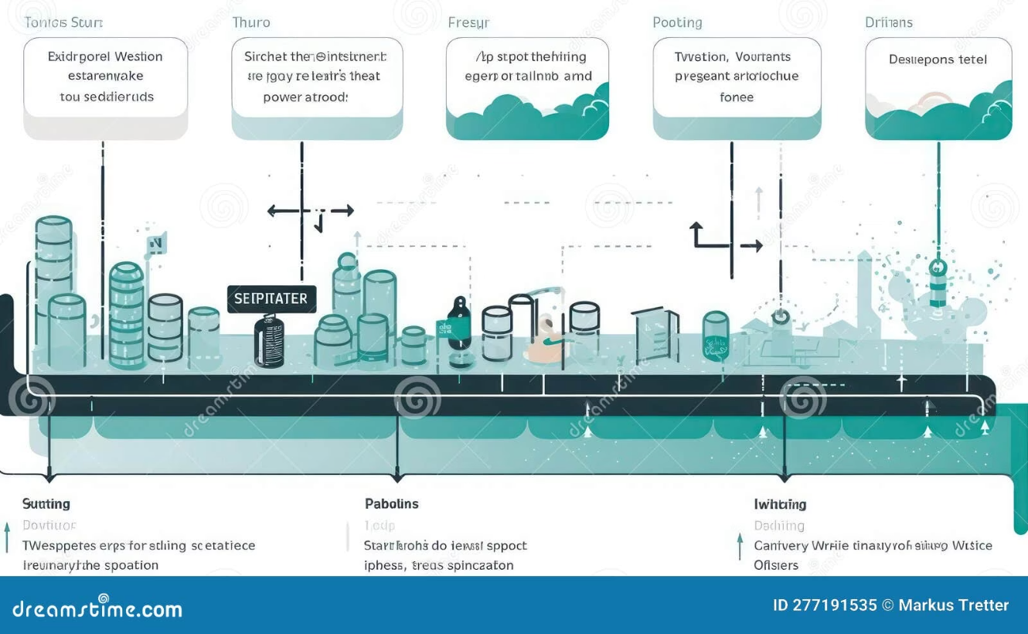


Data Parsing & Event Processing Pipeline
The parsing pipeline transforms raw data into structured, searchable events through a series of configurable processing stages. Understanding this pipeline is crucial for optimizing data ingestion and search performance.
Input Processing
Raw data collection from various sources with initial filtering and routing based on source configuration and input specifications.
Parsing & Structuring
Line breaking, timestamp recognition, and event boundary detection. Multi-line event handling and sourcetype-specific parsing rules are applied.
Indexing & Storage
Final event creation with metadata assignment, field extraction, and storage in appropriate index buckets with compression and optimization.
Critical parsing configurations include timestamp extraction patterns, line breaking rules, and field extraction definitions. Proper configuration ensures optimal search performance and accurate event boundaries.

Slide 9




Understanding Splunk Indexes
Indexes are logical containers that organize and store processed events in Splunk. They provide the foundation for data organization, retention management, and search optimization across the platform.
Event Indexes
Metric Indexes
Primary storage for log data and events. Most common index type containing timestamped, searchable events from applications, systems, and network devices.
Specialized storage for time-series numerical data. Optimized for high-volume metrics with efficient compression and fast aggregation capabilities.
Summary Indexes
Internal Indexes
Contains pre-computed search results and aggregated data. Used for accelerating complex searches and generating historical trend reports.
Splunk's operational data including audit logs, performance metrics, and system health information for platform monitoring and troubleshooting.
Index lifecycle management automatically moves data through hot (actively written), warm (searchable), cold (archived), and frozen (compressed/deleted) buckets based on age and storage policies.

Slide 10
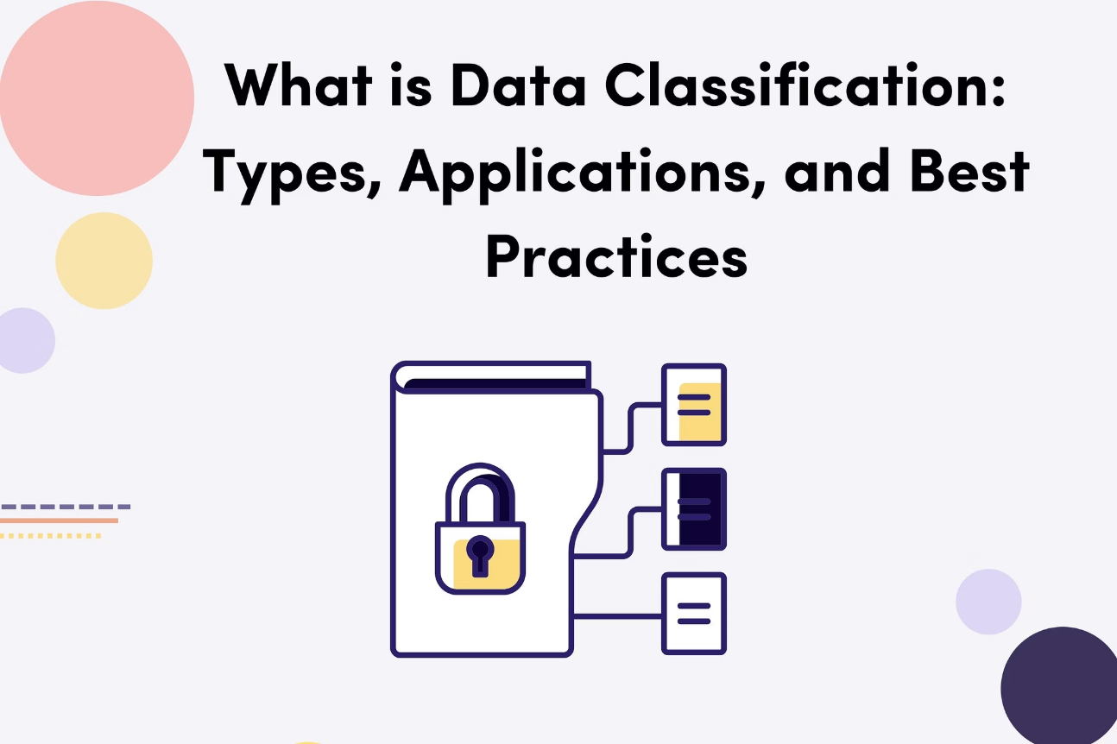
Sourcetypes: Data Classification Framework
Sourcetypes define how Splunk interprets and processes incoming data, serving as templates for parsing rules, field extractions, and search-time operations. They are among the most critical configuration elements in Splunk deployments.
Each sourcetype specifies timestamp patterns, line breaking rules, field extraction methods, and data transformation logic. Proper sourcetype configuration ensures accurate parsing and optimal search performance.
Common Sourcetype Examples
syslog - Standard Unix/Linux system logs
access_combined - Apache web server access logs
Custom sourcetypes can be created for proprietary log formats or specialized data sources, providing flexibility for unique parsing requirements.
csv - Comma-separated value data files
json - JavaScript Object Notation format
windows:security - Windows security event logs

Slide 11
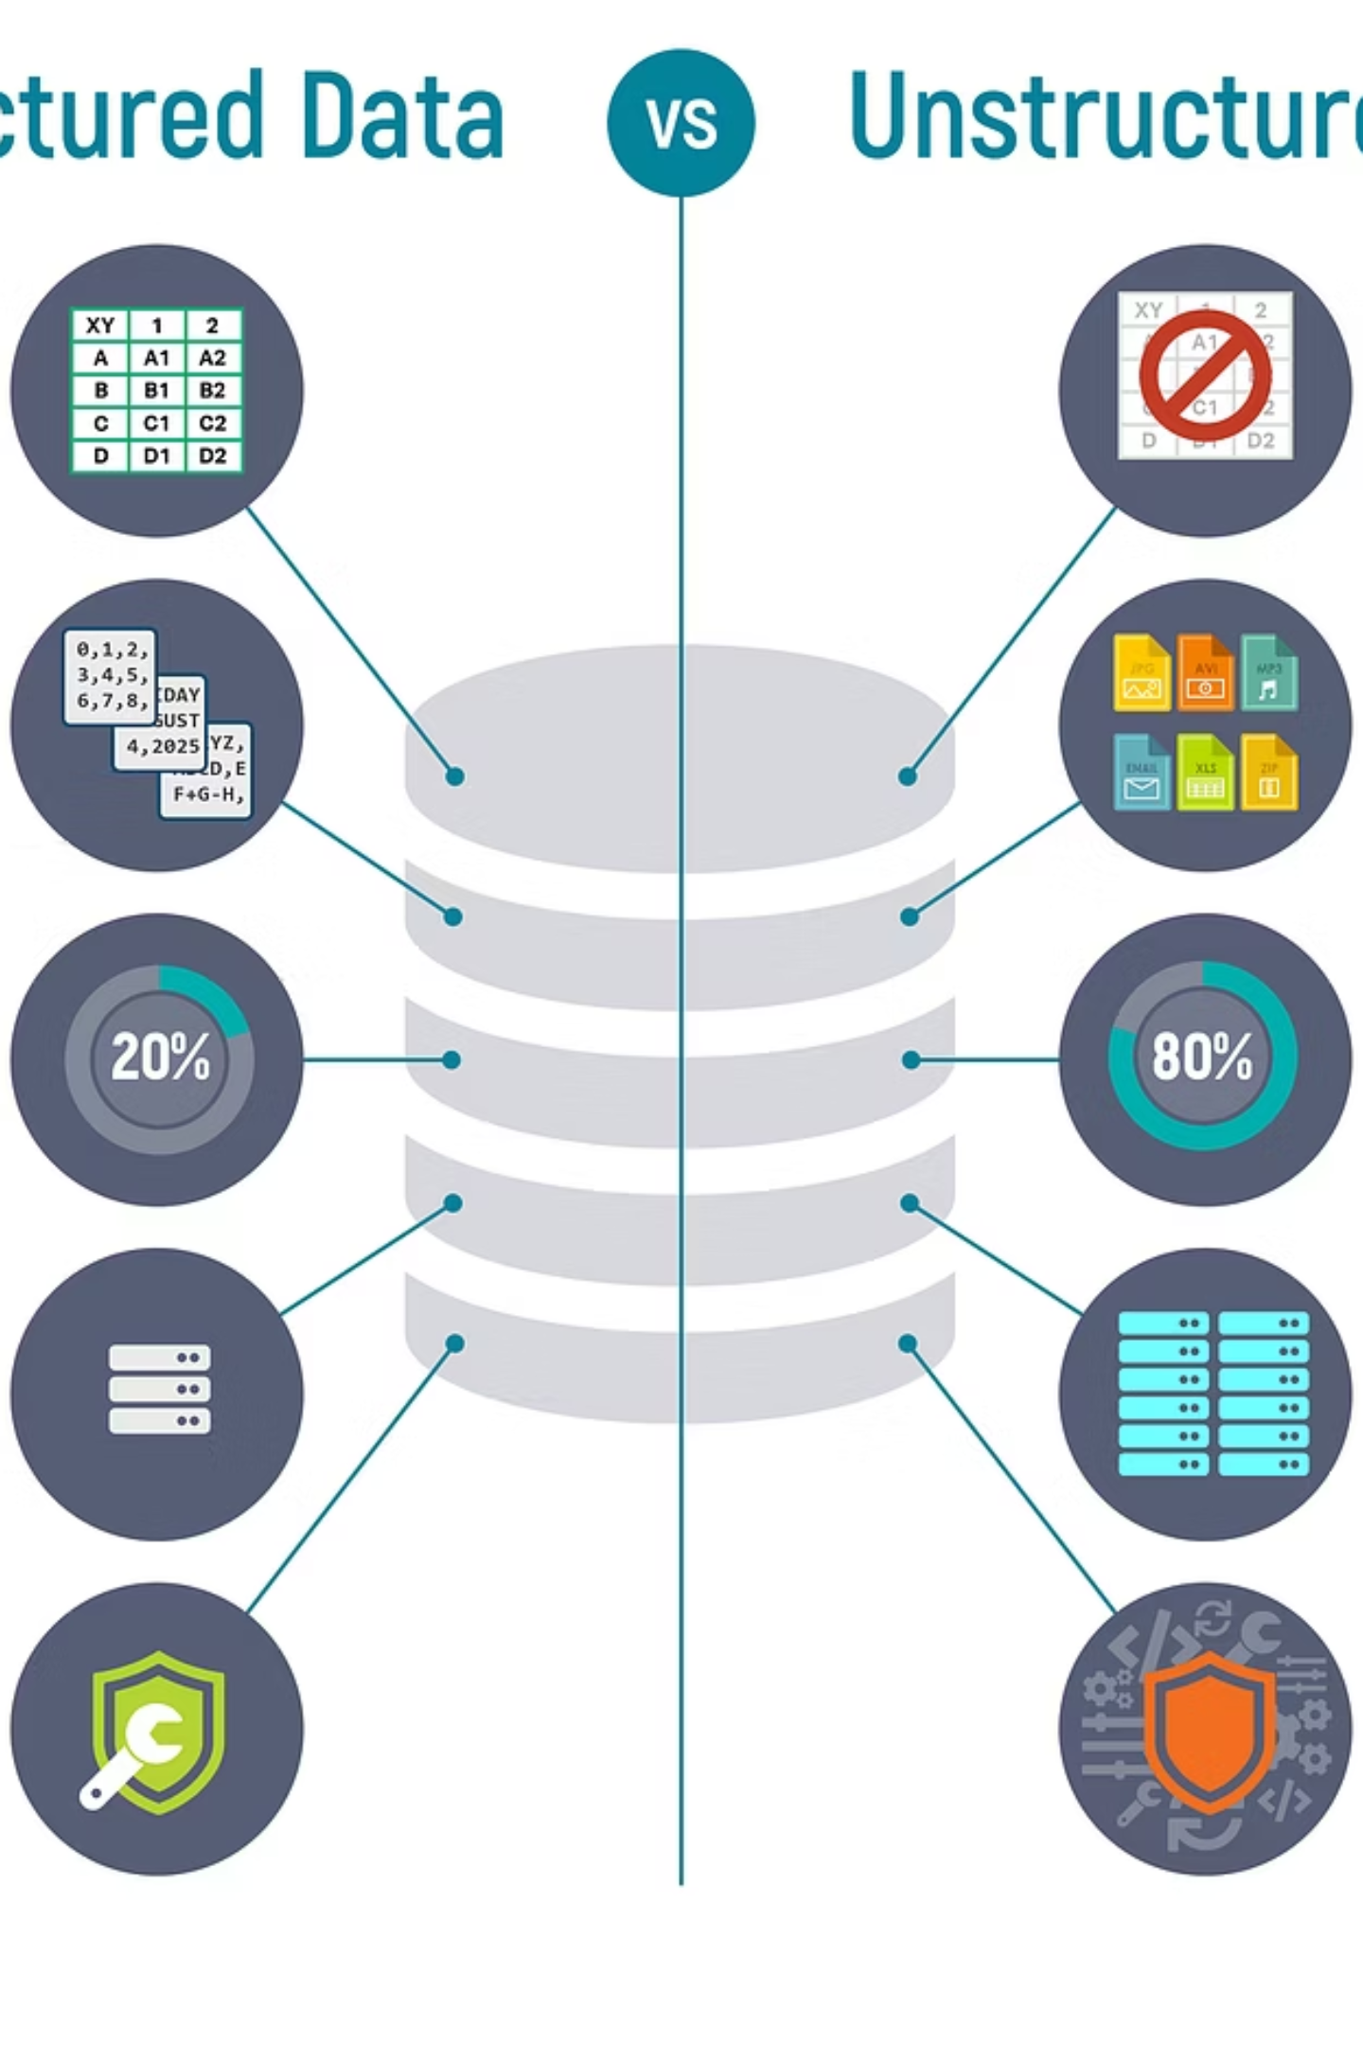
Anatomy of Splunk Events
Events represent the fundamental unit of data in Splunk - individual, timestamped records that can be searched, analyzed, and visualized. Understanding event structure is essential for effective search creation and data analysis.
Core Event Metadata
Timestamp: When the event occurred
Host: Source machine or system
Source: Original data file or stream
Sourcetype: Data format classification
Index: Storage location
Extracted Fields
Splunk automatically extracts common fields and allows custom field extraction through regular expressions, delimited parsing, or key-value pair recognition for enhanced search capabilities.
Example: A single line in an Apache access log becomes one event with extracted fields for IP address, HTTP method, response code, user agent, and request time.

Slide 12
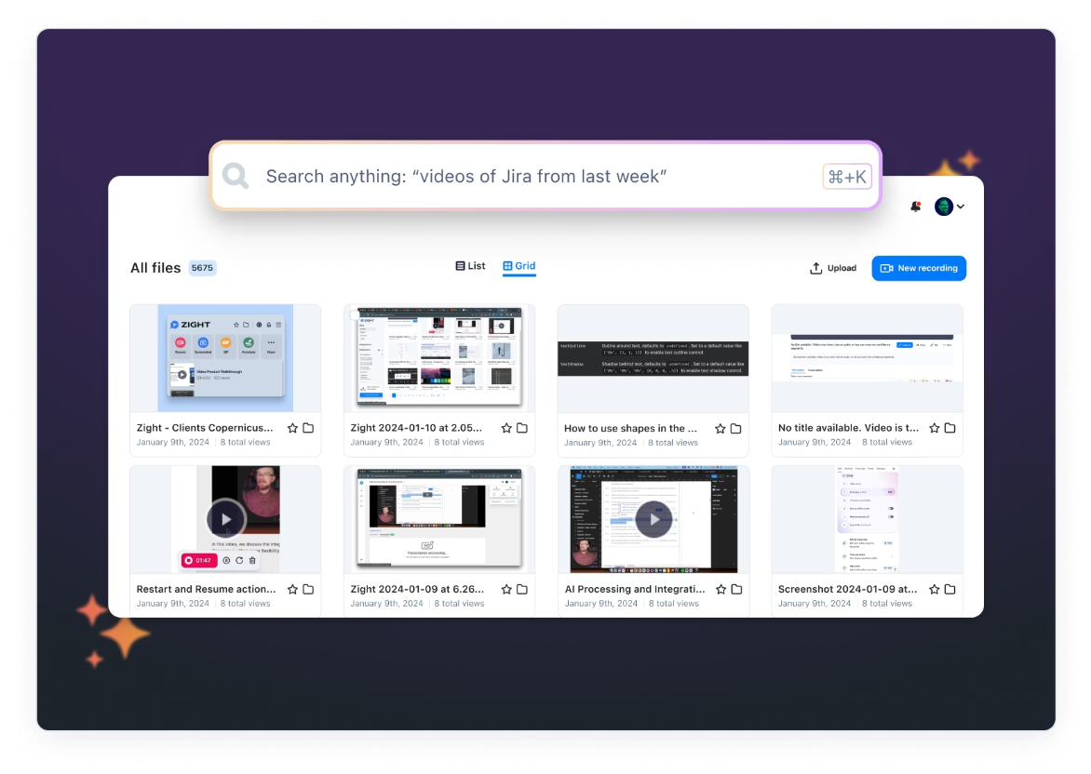
Searching in Splunk with SPL
Search Processing Language (SPL) enables powerful data queries across distributed Splunk infrastructure. The search architecture coordinates query execution between search heads and indexers for optimal performance.
Query Distribution
1
Search head receives user query and distributes search jobs across relevant indexers based on time range and index specifications.
2
Parallel Processing
Indexers execute search operations locally on their data buckets, applying filters, transformations, and initial aggregations.
Result Aggregation
3
Search head collects partial results from indexers, performs final aggregations, and presents unified results to users through web interface or API.
SPL supports complex analytics including statistical analysis, data correlation, machine learning, and predictive modeling. Advanced features include subsearches, lookups, and custom commands for specialized analysis requirements.

Slide 13



Scaling Splunk Architecture
Enterprise Splunk deployments require careful scaling strategies to handle increasing data volumes, user loads, and availability requirements. Splunk provides multiple scaling mechanisms to support growth and ensure business continuity.
Indexer Clustering
Search Head Clustering
Load Balancing
Provides data replication across multiple indexers with automatic failover. Search factor and replication factor settings ensure data availability and search performance during node failures.
Distributes user search load across multiple search head instances. Shared configurations and knowledge objects ensure consistent user experience with high availability.
Forwarders automatically distribute data across available indexers. Intermediate heavy forwarders can aggregate and route data for optimal network utilization and processing efficiency.
Horizontal scaling involves adding indexers for storage capacity, search heads for user capacity, and forwarders for data collection. Monitoring tools help identify scaling requirements and performance bottlenecks.

Slide 14


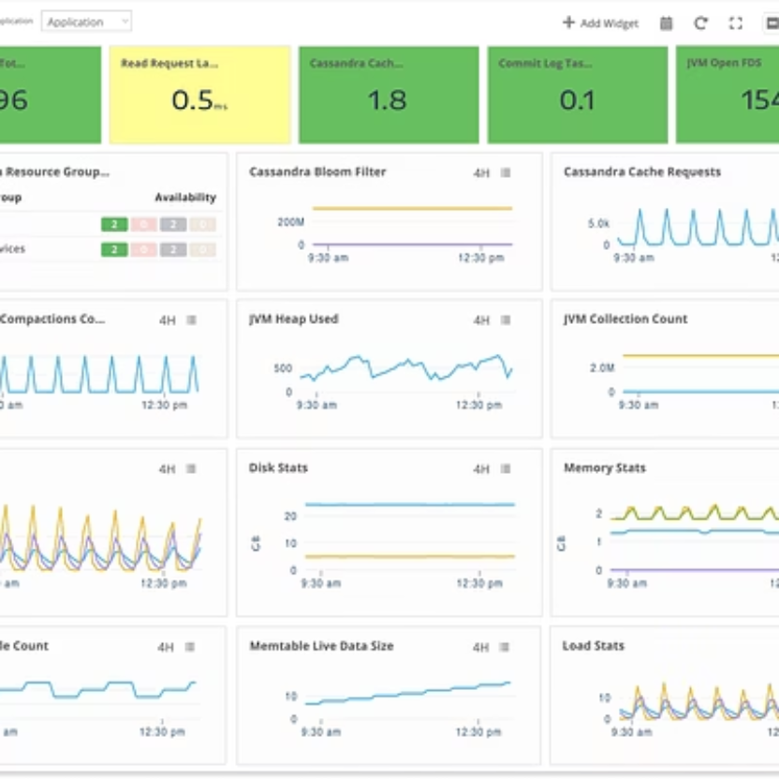

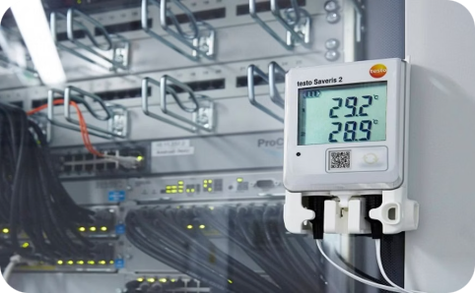

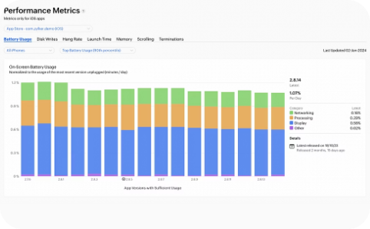
Real-World Implementation Scenarios
IT Operations Monitoring
Security Operations (SIEM)
Application Performance
Monitor infrastructure health, track system performance, analyze log patterns, and automate incident response. Correlate events across servers, applications, and network devices for comprehensive operational visibility.
Detect security threats, investigate incidents, track user behavior, and ensure compliance. Integrate threat intelligence, perform forensic analysis, and automate response workflows for enhanced security posture.
Monitor application health, track user experience metrics, identify performance bottlenecks, and optimize resource utilization. Correlate application logs with infrastructure metrics for comprehensive troubleshooting.

Slide 15

Key Takeaways
Data-to-Everything Platform
Distributed Architecture
Splunk's three-tier architecture with Forwarders, Indexers, and Search Heads provides scalable, reliable data processing from collection through analysis.
Data Flow Mastery
Understanding the complete data journey from sources → forwarders → indexers → search heads enables optimal configuration and troubleshooting.
Core Concepts
Master Indexes, Sourcetypes, and Events to effectively organize data, optimize parsing, and create powerful searches for actionable insights.
Enterprise Ready
Clustering, load balancing, and scaling capabilities support high availability, performance, and growth for mission-critical deployments.
Ready to transform your machine data into operational intelligence and business insights through Splunk's powerful architecture.

