Slide 1
Kubernetes
VishwanaTH m s
VISHWACLOUDLAB.com

Slide 2
Agenda
What is Kubernetes?
Kubernetes Primitives
Configuration and Cluster Setup Pointers
Demo – Using MiniKube

Slide 3
What is Kubernetes?
Kubernetes is a container orchestration platform for applications that run on containers.
A collaborative Open Source project Originally Conceived by Google.
Sometimes also called:
Kube
K8s (That’s ‘k’ + 8 letters + ‘s’)

Slide 4
What is Kubernetes?
Start, stop, update, and manage a cluster of machines running containers in a consistent and maintainable way.
Particularly suited for horizontally scalable, stateless, or 'microservices' application architectures.
Does not mean others will not work or are ignored
Kubernetes does NOT and will not expose all of the 'features' of the docker command line.

Slide 5
Kubernetes Key Words
Physical Components
Master
Minon/Node
Virtual Components
Pod
Replication Controller
Service
Label
Namespace

Slide 6
Master contains…..
Consists of..
kube-apiserver
kube-scheduler
kube-controller-manager
etcd
May Also Contain
Kube-proxy
Network Mgmt utility
Notes:
API Server
Kubernetes is an API server which provides all the operation on cluster using the API. API server implements an interface, which means different tools and libraries can readily communicate with it.
Scheduler
This is the mechanism responsible for allocating pods to available nodes. The scheduler is responsible for workload utilization and allocating pod to new node.
Controller Manager
This component is responsible for most of the collectors that regulates the state of cluster and performs a task. In general, it can be considered as a daemon which runs in non terminating loop and is responsible for collecting and sending information to API server.
etcd
It stores the configuration information which can be used by each of the nodes in the cluster. It is a high availability key value store that can be distributed among multiple nodes.

Slide 7
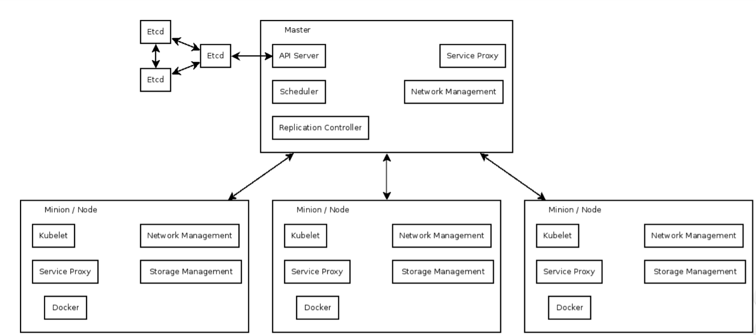
Kubernetes Components
Kubectl

Slide 8
Minon/Node contains…..
Consists of..
kubelet
kube-proxy
cAdvisor
Network Mgmt utility
Notes:
API Server
Kubernetes is an API server which provides all the operation on cluster using the API. API server implements an interface, which means different tools and libraries can readily communicate with it.
Scheduler
This is the mechanism responsible for allocating pods to available nodes. The scheduler is responsible for workload utilization and allocating pod to new node.
Controller Manager
This component is responsible for most of the collectors that regulates the state of cluster and performs a task. In general, it can be considered as a daemon which runs in non terminating loop and is responsible for collecting and sending information to API server.
etcd
It stores the configuration information which can be used by each of the nodes in the cluster. It is a high availability key value store that can be distributed among multiple nodes.

Slide 9
POD contains…..
Single schedulable unit of work
Can not move between machines
Can not span machines
One or more containers
Shared network namespace
Metadata about the container(s)
Env vars – configuration for the container
Every pod gets an unique IP
Assigned by the container engine, not kube!
Notes:
API Server
Kubernetes is an API server which provides all the operation on cluster using the API. API server implements an interface, which means different tools and libraries can readily communicate with it.
Scheduler
This is the mechanism responsible for allocating pods to available nodes. The scheduler is responsible for workload utilization and allocating pod to new node.
Controller Manager
This component is responsible for most of the collectors that regulates the state of cluster and performs a task. In general, it can be considered as a daemon which runs in non terminating loop and is responsible for collecting and sending information to API server.
etcd
It stores the configuration information which can be used by each of the nodes in the cluster. It is a high availability key value store that can be distributed among multiple nodes.

Slide 10
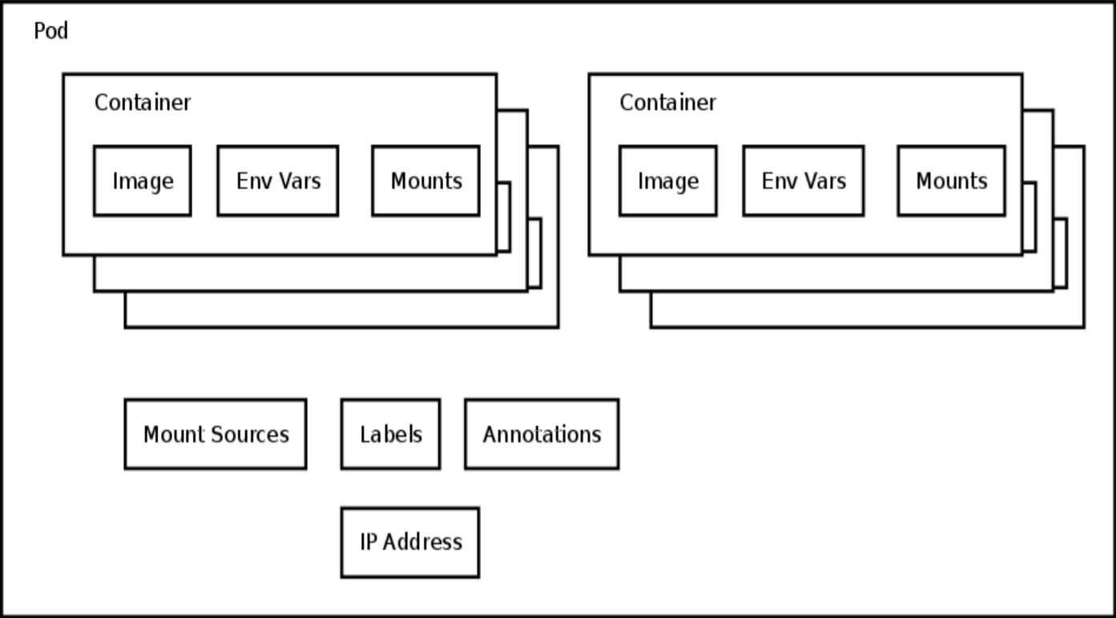
POD

Slide 11
Replication Controller contains…..
Consists of
Pod template
Count
Label Selector
Kube will try to keep $count copies of pods matching the label selector running
If too few copies are running the replication controller will start a new pod somewhere in the cluster
Notes:
API Server
Kubernetes is an API server which provides all the operation on cluster using the API. API server implements an interface, which means different tools and libraries can readily communicate with it.
Scheduler
This is the mechanism responsible for allocating pods to available nodes. The scheduler is responsible for workload utilization and allocating pod to new node.
Controller Manager
This component is responsible for most of the collectors that regulates the state of cluster and performs a task. In general, it can be considered as a daemon which runs in non terminating loop and is responsible for collecting and sending information to API server.
etcd
It stores the configuration information which can be used by each of the nodes in the cluster. It is a high availability key value store that can be distributed among multiple nodes.

Slide 12
Services contains…..
How 'stuff' finds pods which could be anywhere
Define:
What port in the container
Labels on pods which should respond to this type of request
Can define:
What the 'internal' IP should be
What the 'external' IP should be
What port the service should listen on
Notes:
API Server
Kubernetes is an API server which provides all the operation on cluster using the API. API server implements an interface, which means different tools and libraries can readily communicate with it.
Scheduler
This is the mechanism responsible for allocating pods to available nodes. The scheduler is responsible for workload utilization and allocating pod to new node.
Controller Manager
This component is responsible for most of the collectors that regulates the state of cluster and performs a task. In general, it can be considered as a daemon which runs in non terminating loop and is responsible for collecting and sending information to API server.
etcd
It stores the configuration information which can be used by each of the nodes in the cluster. It is a high availability key value store that can be distributed among multiple nodes.

Slide 13
Label contains…..
List of key=value pairs
Attached to all objects
Currently used in 2 main places
Matching pods to replication controllers
Matching pods to services Can define:
Objects can be queried from the API server by label
Notes:
API Server
Kubernetes is an API server which provides all the operation on cluster using the API. API server implements an interface, which means different tools and libraries can readily communicate with it.
Scheduler
This is the mechanism responsible for allocating pods to available nodes. The scheduler is responsible for workload utilization and allocating pod to new node.
Controller Manager
This component is responsible for most of the collectors that regulates the state of cluster and performs a task. In general, it can be considered as a daemon which runs in non terminating loop and is responsible for collecting and sending information to API server.
etcd
It stores the configuration information which can be used by each of the nodes in the cluster. It is a high availability key value store that can be distributed among multiple nodes.

Slide 14
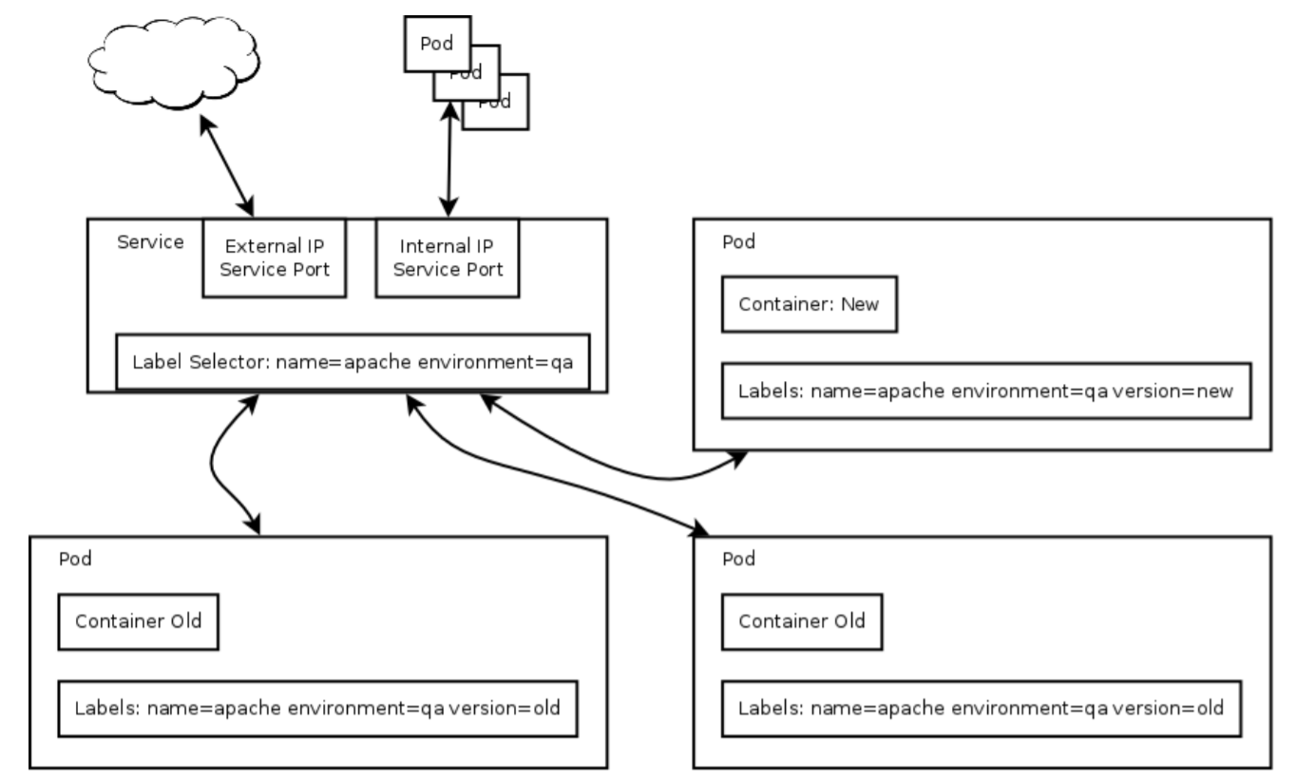
Services and Labels

Slide 15
Namespace contains…..
Attached to every object
Pods in ns1 will not get service variable from ns2
Users with permission to CRUD objects in ns1 may not have permissions to CRUS object in ns2
The network is not segregated!
Notes:
API Server
Kubernetes is an API server which provides all the operation on cluster using the API. API server implements an interface, which means different tools and libraries can readily communicate with it.
Scheduler
This is the mechanism responsible for allocating pods to available nodes. The scheduler is responsible for workload utilization and allocating pod to new node.
Controller Manager
This component is responsible for most of the collectors that regulates the state of cluster and performs a task. In general, it can be considered as a daemon which runs in non terminating loop and is responsible for collecting and sending information to API server.
etcd
It stores the configuration information which can be used by each of the nodes in the cluster. It is a high availability key value store that can be distributed among multiple nodes.

Slide 16
Configuration differences
Configuration Changes:
Systemd and /etc/kubernetes/ file formatting
Kubelet takes: –api_servers=
Controller-manager takes –machines=
Notes:
API Server
Kubernetes is an API server which provides all the operation on cluster using the API. API server implements an interface, which means different tools and libraries can readily communicate with it.
Scheduler
This is the mechanism responsible for allocating pods to available nodes. The scheduler is responsible for workload utilization and allocating pod to new node.
Controller Manager
This component is responsible for most of the collectors that regulates the state of cluster and performs a task. In general, it can be considered as a daemon which runs in non terminating loop and is responsible for collecting and sending information to API server.
etcd
It stores the configuration information which can be used by each of the nodes in the cluster. It is a high availability key value store that can be distributed among multiple nodes.

Slide 17
Networking Setup
Networking is a problem in docker BUT NOT IN KUBE
If any two docker containers on any two hosts can talk over IP, and kube will just work.
Kube makes those problems disapper.
We use Flannel Framework for Networking.
Easy Configuration
Can create a vxlan overlay network
Can configure docker to launch pods in this overlay

Slide 18
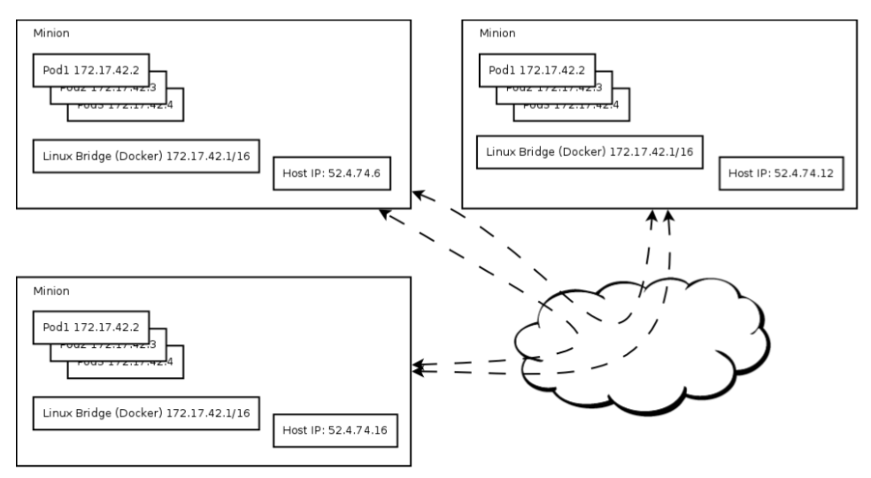
Kube Networking out of the box

Slide 19
Custom Networking setup
We use Flannel Framework for Networking.
Easy Configuration
Can create a vxlan overlay network
Can configure docker to launch pods in this overlay
Inter communication of the PODs.

Slide 20
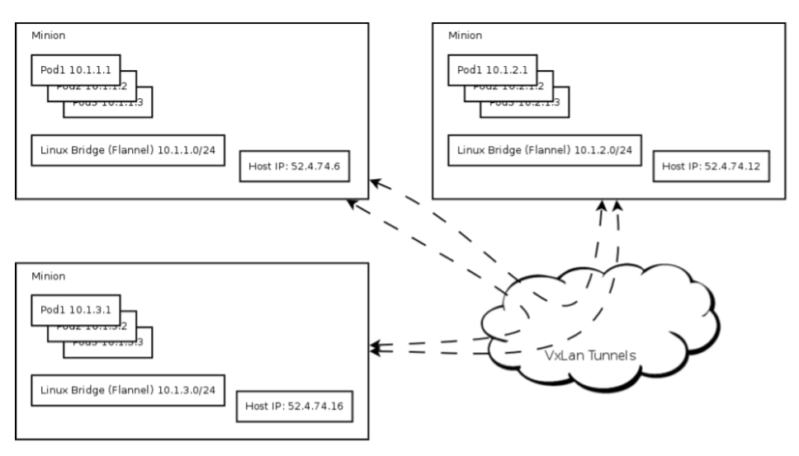
Networking with an overlay network

Slide 21


