Slide 1
Kubernetes Execution
VishwanaTH m s
VISHWACLOUDLAB.com

Slide 2
Agenda
Docker compose vs Kubernetes
Preparing Kube Env Pre-Requisite
Configuration and Cluster Setup Pointers
Demo – Using MiniKube

Slide 3
Docker Compose vs Kubernetes
Docker Compose | Kubernetes
Each entry can optionally get docker-compose to build an image | Kubernetes expects all images to already be built
Each Entry represents a container we want to create | One config file per object we want to create
Each entry defines the networking requirements (ports) | We have to manually set up all networking and in detail.

Slide 4
Preparing the Kube Env
Make sure the images are hosted on Docker hub.
Make one config file to create the container
Make one config file to set up networking settings

Slide 5
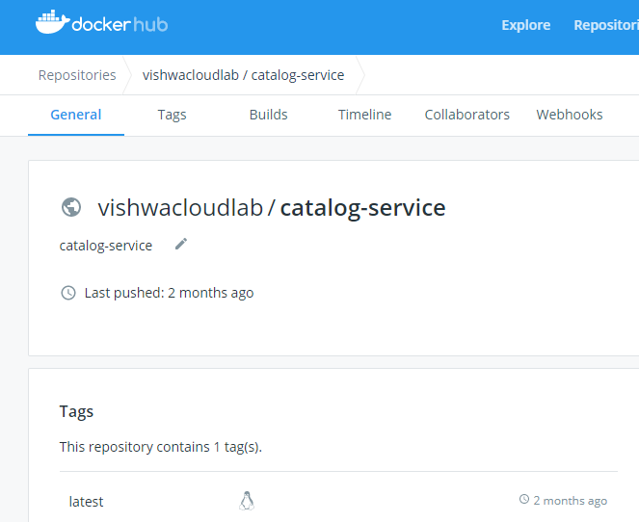
Image is already uploaded in the docker hub

Slide 6
Details on apiVersion
apiVersion: apps/v1
ControllerRevision
StatfullSet
apiVersion: v1
This allows us to access below objects
Componentstatus
configMap
End Points
Event
Pod
Service
Namespace ….. Much more
Different apiVersion gives us different objects to be used

Slide 7
2 types of Deployment
Imperative Deployment
Declarative Deployment

Slide 8
Imperative Deployment
Lets understand the flow of it.

