Slide 1
Kubernetes – Service Creation
VishwanaTH m s
VISHWACLOUDLAB.ORG

Slide 2
What is Services?
Problem statement
Kubernetes portal are Mortal.
Every time the POD gets a new IP address.
This would be a trouble if we want inter POD communication.
Also to keep a track of the IP’s of the POD.
Solution:
SERVICES

Slide 3
Creating Services
---
apiVersion: v1
kind: Service
metadata:
name: node-port
spec:
type: NodePort
ports:
– port: 88
targetPort: 8000
nodePort: 30303
selector:
app: web

Slide 4
Let’s look at each piece closer
---
apiVersion: v1
kind: Service
metadata:
name: node-port
Object type is Service.
The Service object has sub objects
ClusterIP
NodePort
LoadBalancer
Ingress

Slide 5
Let’s look at each piece closer
---
apiVersion: v1
kind: Service
metadata:
name: node-port
Metadata for the Service
We Could have anykind of Key:Value pair for labels.

Slide 6
Let’s look at each piece closer
……..
spec:
type: NodePort
ports:
– port: 800
targetPort: 8000
nodePort: 30303
selector:
app: web
Actual Objects that defines the Service.

Slide 7
Let’s look at each piece closer
……..
spec:
type: NodePort
ports:
– port: 88
targetPort: 8000
nodePort: 30303
selector:
component: rss-site
The NodePort exposes the container to the outside world
Very Useful for Dev Environment

Slide 8
Let’s look at each piece closer
……..
spec:
type: NodePort
ports:
– port: 8000
targetPort: 8000
nodePort: 30303
selector:
component: rss-site
Service port
Container Port
Host (VM) Port
Port range could be (30000-32767)
Random number would be assign, if we don’t mention it.

Slide 9
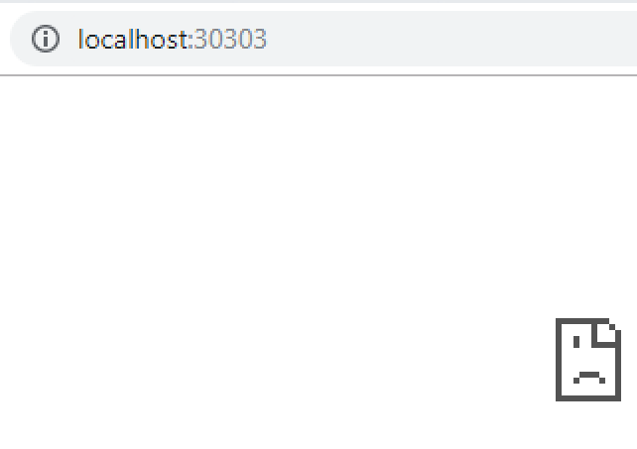
BLOCK DIAGRAM
Service NodePort
Kube-Proxy
POD
CONTAINERS
Port 88

Slide 10
Let’s look at each piece closer
……..
spec:
type: NodePort
ports:
– port: 8000
targetPort: 88
nodePort: 30303
selector:
app: web
This is in pair with “Labels” declared in the “POD”.

Slide 11
kubectl commands
# To run the yml file on the Kube Cluster.
$ kubectl apply -f <yml filename>
# To check the pod status
$ kubectl get services

Slide 12


