Slide 1
Application Performance Monitoring with New Relic

Slide 2
Training Agenda
01
02
Why New Relic?
Observability Basics
Understanding the platform's value proposition and core capabilities
The three pillars: metrics, logs, and traces
03
04
Architecture & Setup
APM Monitoring
How New Relic works and getting started
Deep dive into application performance monitoring
05
06
Infrastructure & Logs
Dashboards & NRQL
Monitoring hosts, containers, and centralized logging
Creating custom dashboards and writing queries
07
08
Alerts & Incident Management
Use Cases & Demo
Setting up proactive monitoring and notifications
Real-world examples and hands-on demonstration
This comprehensive 60-minute training will equip you with practical knowledge to implement and leverage New Relic for your applications.

Slide 3
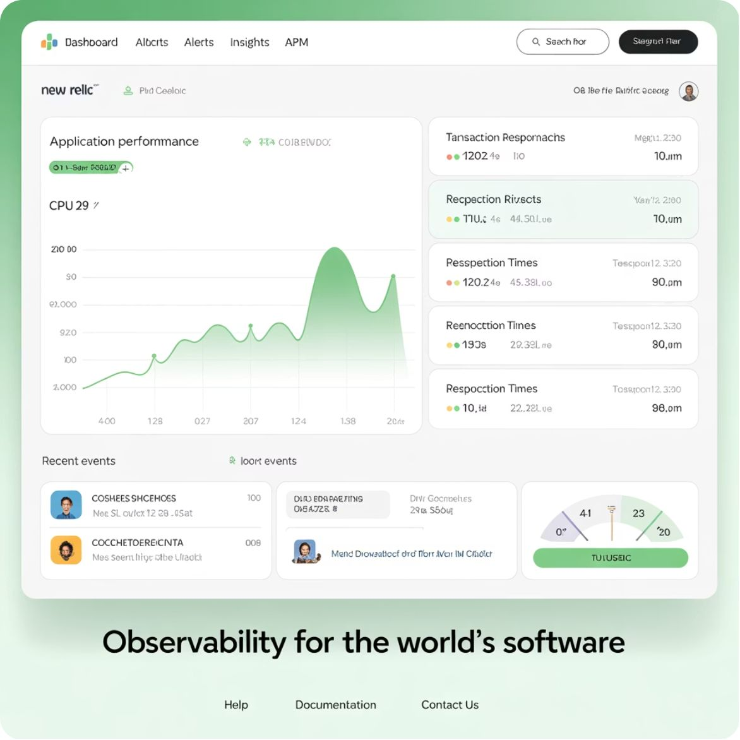
What is New Relic?
New Relic is a SaaS-based observability and monitoring platform that provides comprehensive insights into your applications, infrastructure, and user experience.
APM
Application Performance Monitoring for code-level insights
Infrastructure
Monitor hosts, containers, and cloud services
Logs
Centralized log management and analysis
Distributed Tracing
Real-World Impact: Netflix monitors microservices performance while Uber tracks real-time latency across their global platform.
End-to-end request flow visualization

Slide 4







The Three Pillars of Observability
Logs
Detailed records of application and system events with timestamps and context
Application logs
System logs
Error messages
Audit trails
Metrics
Quantitative measurements like CPU usage, memory consumption, and response times
CPU utilization
Memory usage
Response time
Throughput
Traces
End-to-end journey of requests through your distributed systems
Request flow
Service dependencies
Bottleneck identification
Performance correlation
Example: A user request takes 200ms total - metrics show the timing, logs reveal "DB query executed in 180ms", and traces identify the database as the bottleneck.

Slide 5





New Relic Architecture Overview
Application
Agent
Your running applications with business logic
Language-specific agents (Java, Python, Node.js) that instrument your code
New Relic Platform
Dashboards & Alerts
Telemetry Data Platform that collects and processes all data
Visualization and notification systems
The architecture ensures minimal performance impact while providing comprehensive monitoring. Agents automatically collect telemetry data and send it securely to New Relic's platform for analysis and visualization.

Slide 6
Getting Started with New Relic
Node.js Example Setup
01
Sign Up
npm install newrelic
// Add to top of app.js
require('newrelic')
// Configure in newrelic.js
exports.config = {
app_name: ['My App'],
license_key: 'your-license-key'
}
Create a free New Relic account - no credit card required for the free tier
02
Install Agent
Add the appropriate language agent to your application
03
Configure License Key
Set up your unique license key for data collection
04
Deploy & Monitor
Deploy your instrumented application and start monitoring
After setup, you'll immediately see API response times, throughput, and errors in your New Relic dashboard.

Slide 7
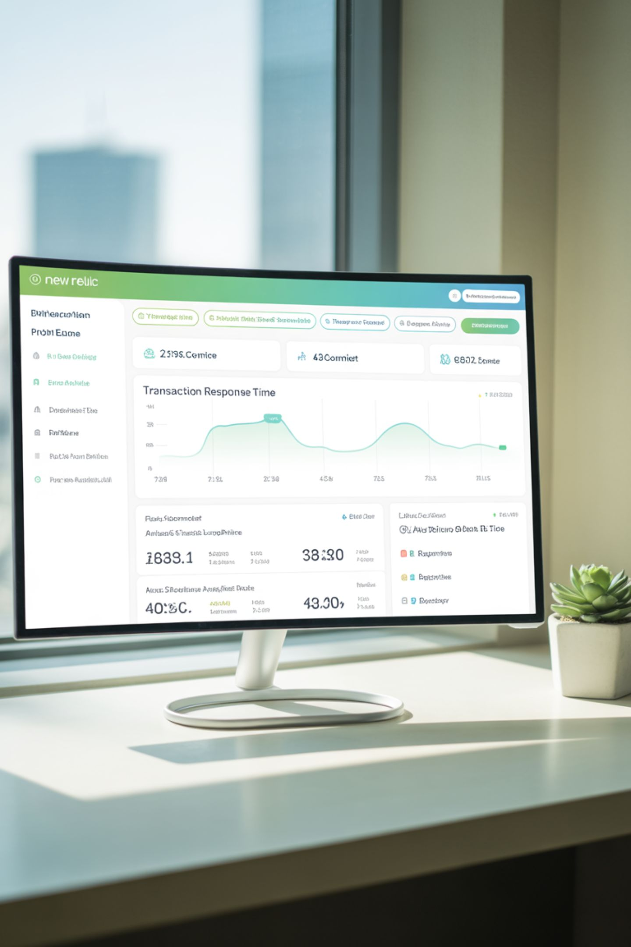

APM Deep Dive: Key Metrics
450ms
1.2K
8%
Response Time
Throughput (RPM)
Error Rate
Average request duration for checkout API
Requests per minute during peak hours
Percentage of failed requests (payment service issues)
0.65
Apdex Score
User satisfaction index (poor experience)
These metrics provide immediate insights into application health. An Apdex score below 0.7 indicates user dissatisfaction, while error rates above 5% typically require immediate attention.
E-commerce Example: During Black Friday, the checkout API showed 450ms average response time with 8% error rate, indicating payment service failures that needed immediate resolution.

Slide 8

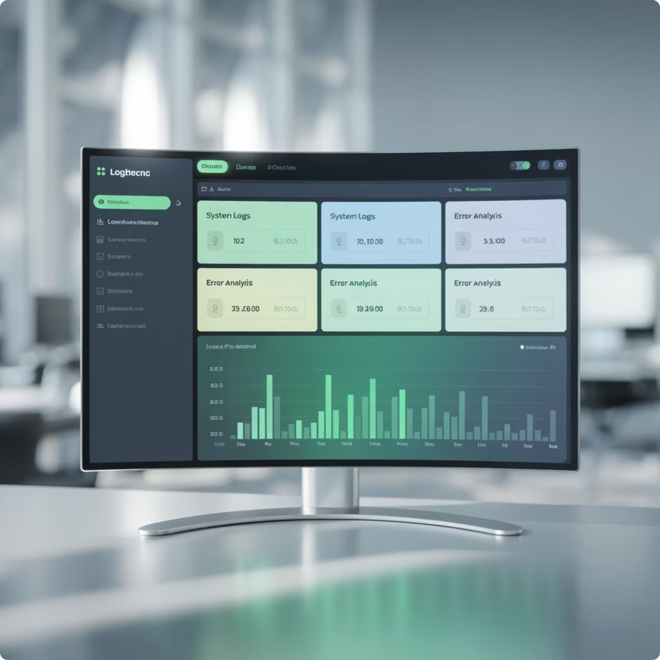


Infrastructure & Logs Monitoring
Infrastructure Monitoring
Centralized Logs
Hosts & VMs
Monitor physical and virtual machines with detailed system metrics
Docker & Kubernetes
Container-level monitoring with pod health and resource usage
Network & Storage
Track network performance, disk I/O, and storage utilization
Correlate logs with performance metrics and traces for complete visibility into system behavior.
Real Scenario: Kubernetes Pod running out of memory → Infrastructure dashboard shows 90% memory usage → Logs reveal "OOMKilled" event → Immediate scaling action taken.

Slide 9
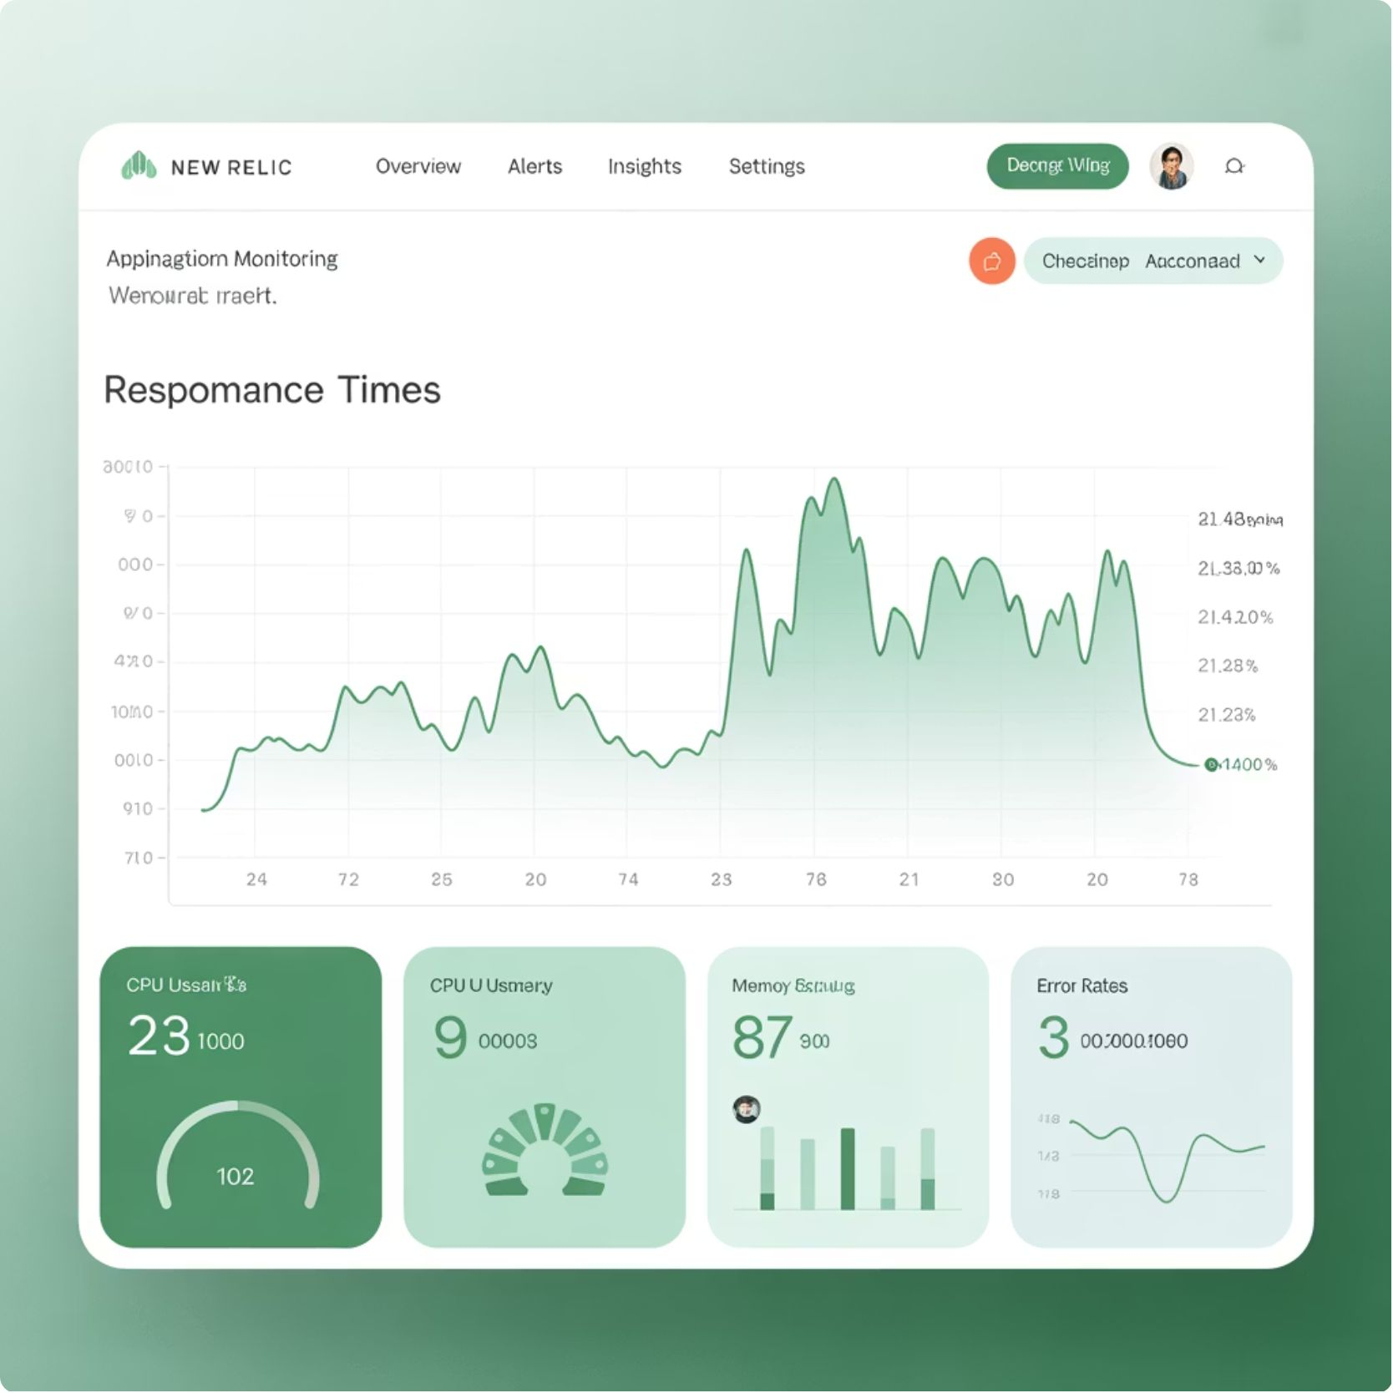
Dashboards & NRQL Queries
Dashboard Types
Pre-built: APM, Infrastructure, Database dashboards
Custom: Tailored views using NRQL queries
Team: Shared dashboards for collaboration
NRQL Example
SELECT average(duration)
FROM Transaction
FACET appName
SINCE 30 minutes ago
This query shows average response time per application over the last 30 minutes.
API Latency
Database Performance
Real-time response times across all endpoints
Query execution times and connection pools
User Geography
Performance metrics by geographic location

Slide 10
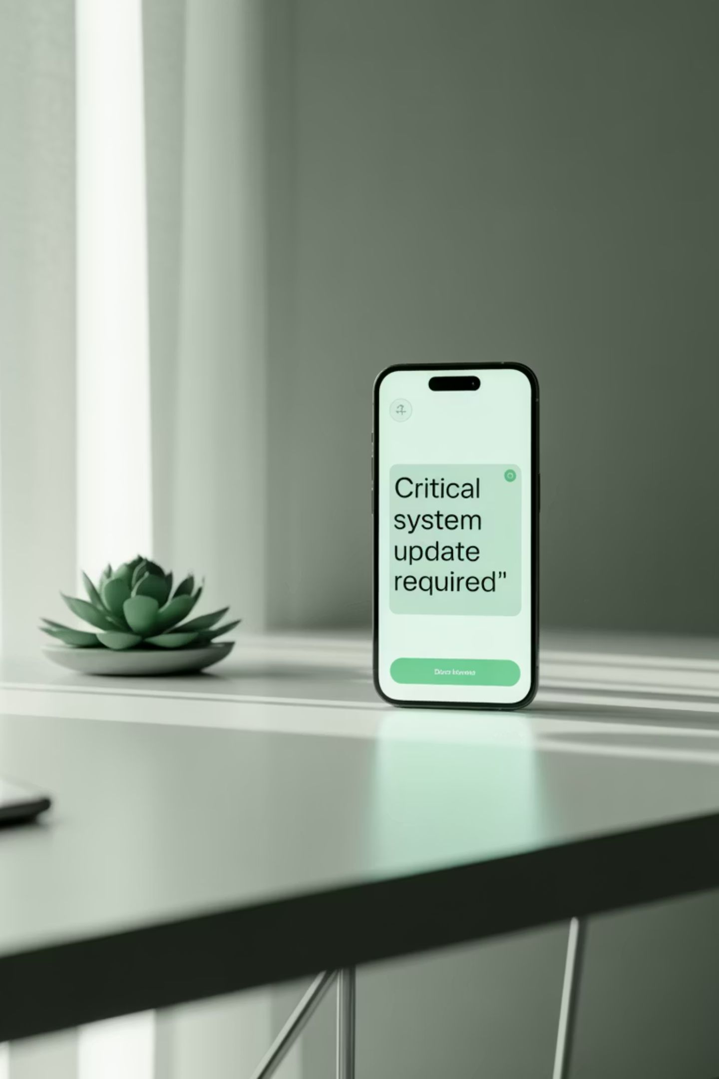

Alerts & Incident Management
01
Define Condition
Set specific thresholds like "CPU usage > 80%" or "Error rate > 5%"
02
Set Duration
Specify how long the condition must persist: "Sustained for 5 minutes"
03
Configure Notifications
Choose channels: Slack, email, PagerDuty, or webhook integrations
04
Incident Response
Automatic ticket creation and escalation workflows
Example Workflow: API error rate exceeds 5% for 10 minutes → Slack alert sent to DevOps team → Auto-ticket created in Jira → On-call engineer notified via PagerDuty

Slide 11




Security & Best Practices
API Key Management
Role-Based Access
Rotate license keys regularly and use environment-specific keys for different deployment stages
Implement granular permissions - developers get read access while admins control configurations
Data Encryption
Cost Optimization
Encrypt sensitive data in logs and ensure PII is properly masked or excluded
Filter unnecessary metrics, set appropriate log retention periods, and monitor data ingestion
Log Security Example
// Good: Hide sensitive data
{"user": "admin", "password": "***", "action": "login"}
// Bad: Exposing credentials
{"user": "admin", "password": "secret123", "action": "login"}

Slide 12
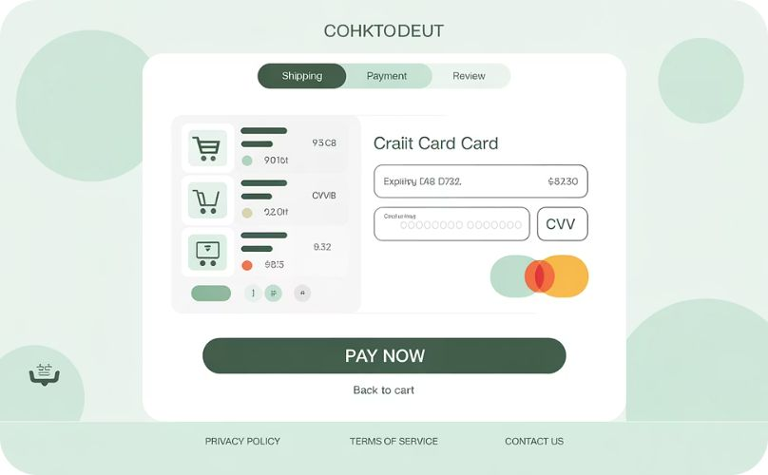
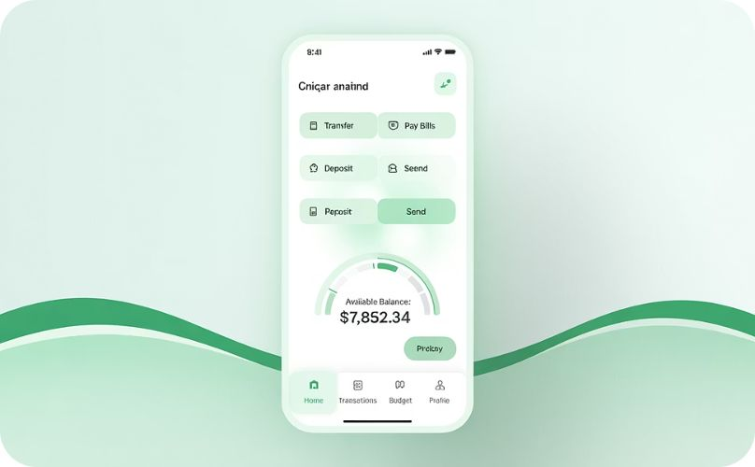
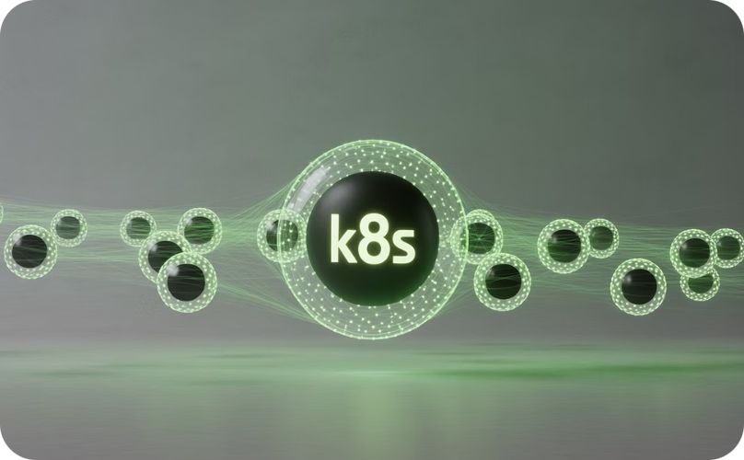
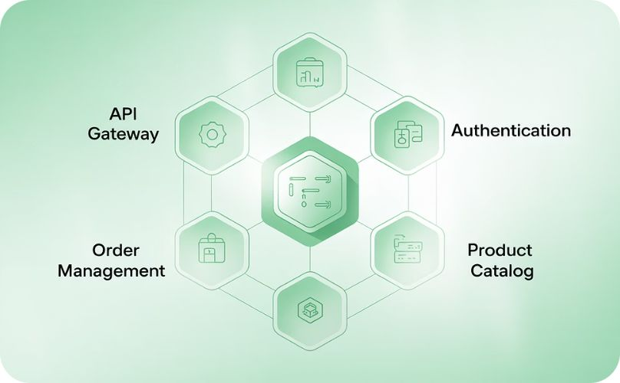
Real-World Use Cases
E-commerce
Banking
Kubernetes
Microservices
Monitor checkout latency and failed transactions during peak shopping periods like Black Friday
Track slow database queries in payment systems and ensure transaction processing meets SLA requirements
Detect pod crashes, monitor container CPU usage, and track resource allocation across clusters
Trace request paths across services and identify bottlenecks in distributed architectures
Microservices Trace Example: Frontend → API Gateway (50ms) → Payment Service (800ms) → Database (700ms bottleneck identified)

Slide 13
Training Summary & Next Steps
What We Covered
Recommended Next Steps
New Relic fundamentals and architecture overview
01
Application Performance Monitoring (APM) deep dive
Try Free Tier
Set up a demo application with New Relic monitoring
Infrastructure monitoring and centralized logging
02
Custom dashboards and NRQL query language
Practice NRQL
Alert configuration and incident management
Experiment with custom queries and data exploration
Security best practices and cost optimization
03
Build Team Dashboard
Real-world use cases across different industries
Create shared dashboards for your development team
04
Configure Alerts
Set up proactive monitoring for critical applications

Slide 14
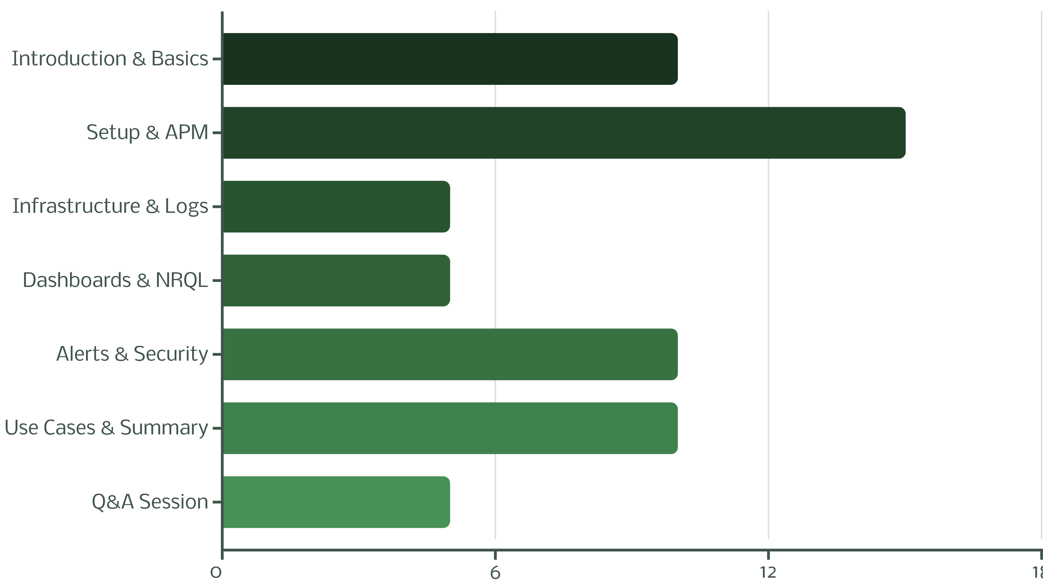
Session Time Breakdown
This structured 60-minute format ensures comprehensive coverage while maintaining engagement through varied content delivery and interactive elements.

Slide 15
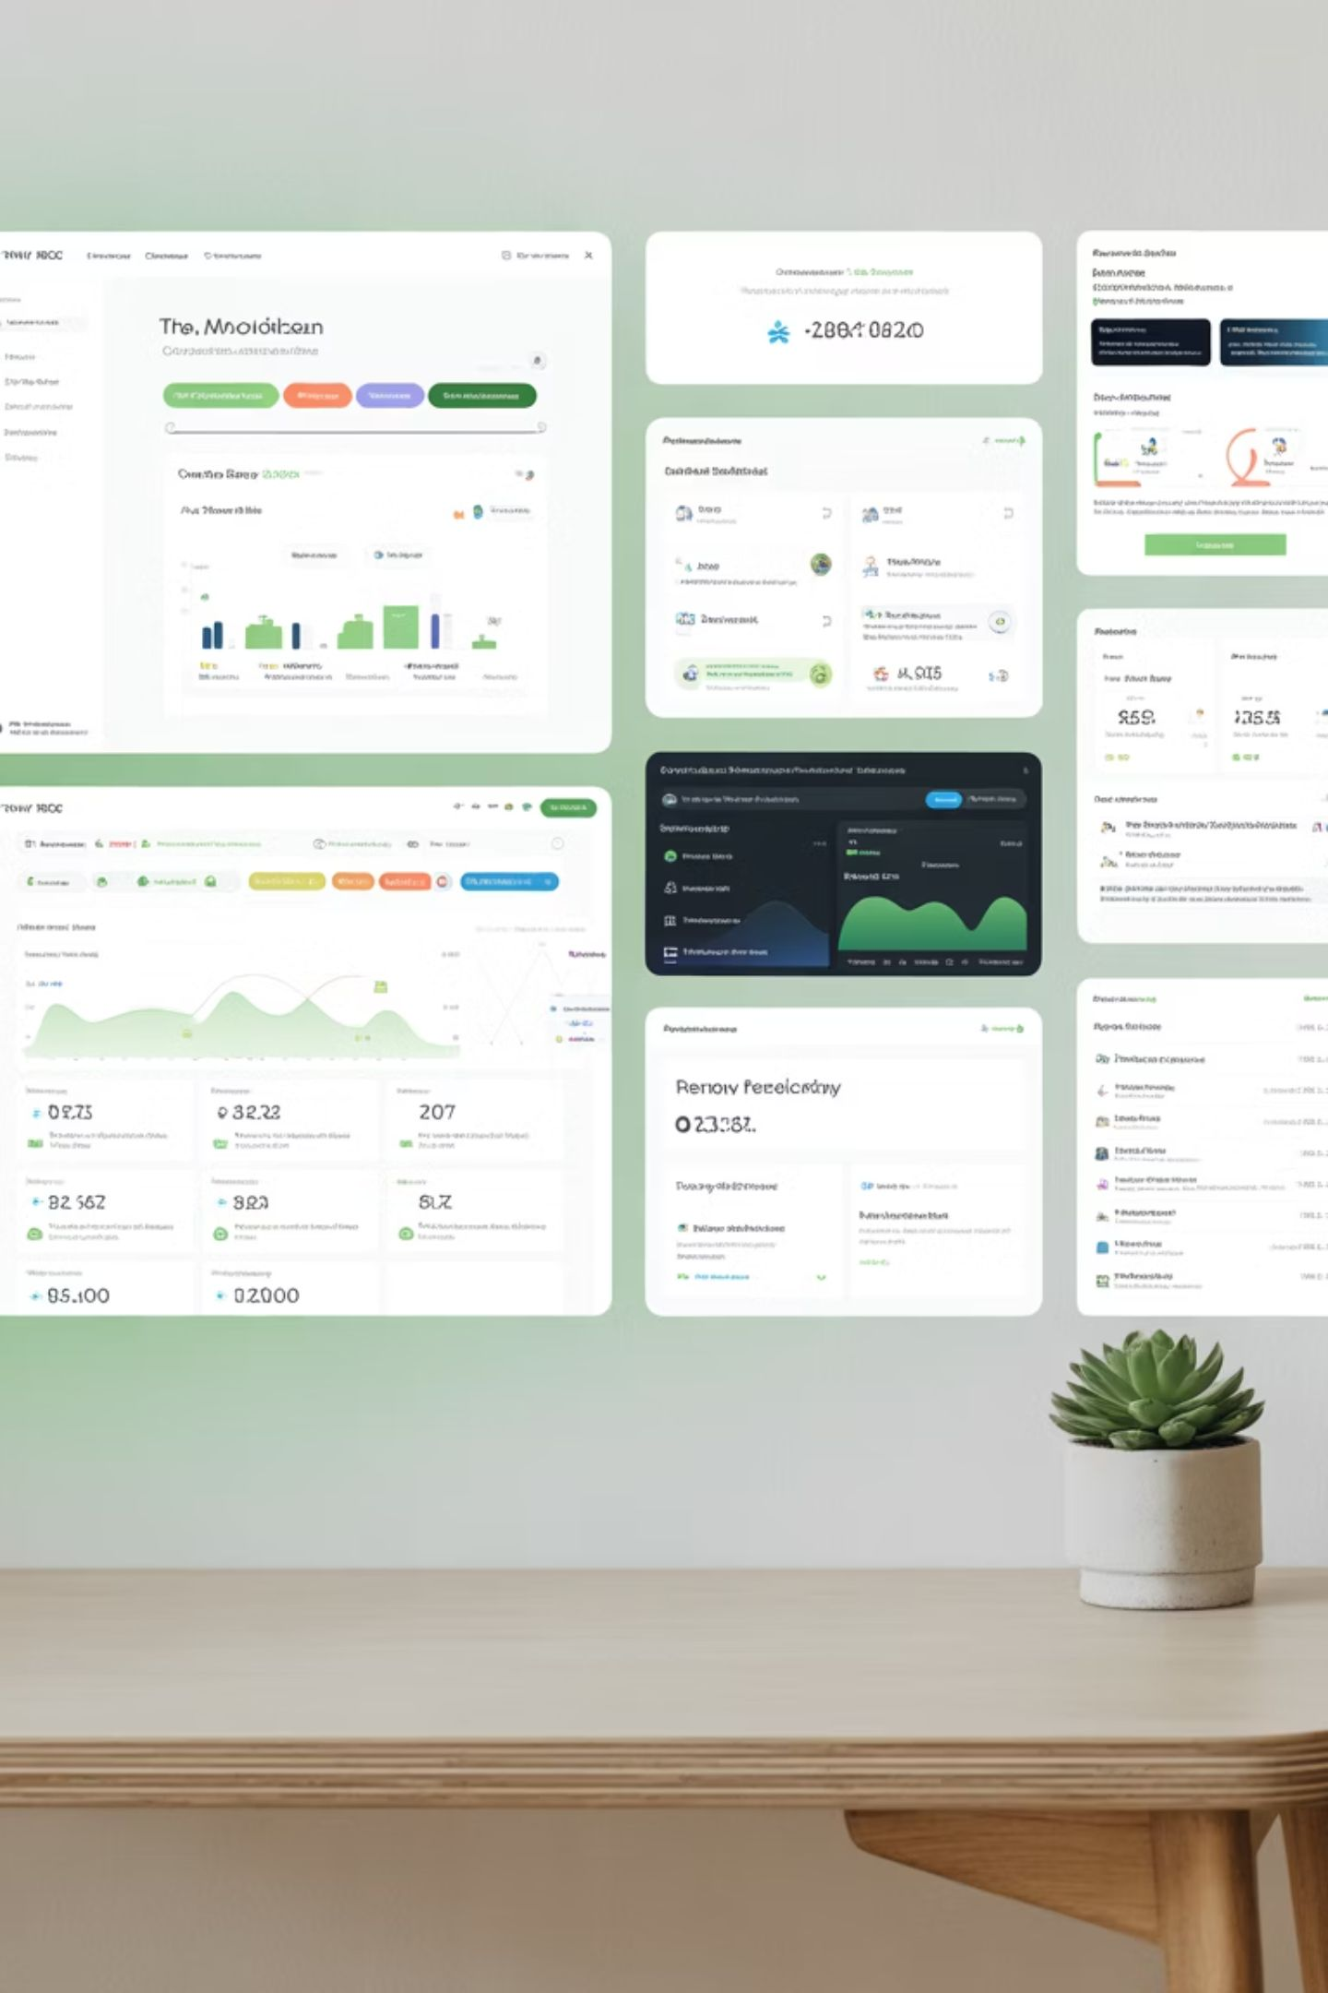





Essential Screenshots to Include
New Relic APM Dashboard
Show the main APM overview with response times, throughput, and error rates for a sample application
Infrastructure Monitoring
Display Kubernetes pods monitoring or EC2 instance metrics with CPU, memory, and network usage
NRQL Query Results
Demonstrate a custom NRQL query with results showing application performance data
Slack Alert Example
Show a real Slack notification triggered by New Relic alert with incident details and context
These visual examples will help participants understand the practical application of concepts covered in the training session.

Slide 16
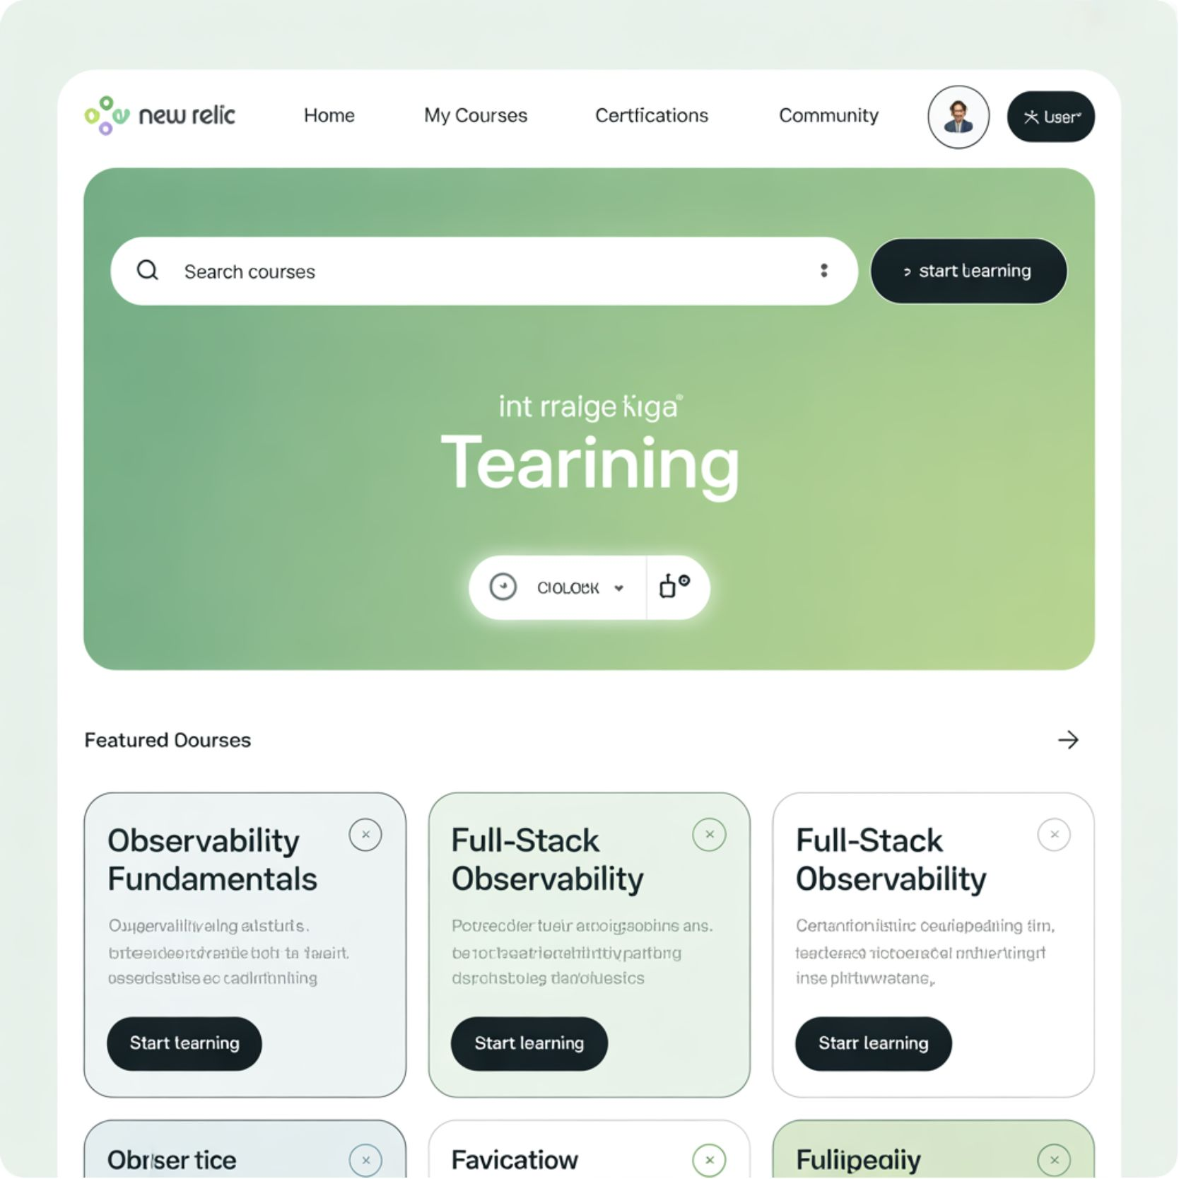
Additional Resources & Documentation
Official Resources
New Relic University: Free online courses and certifications
Documentation Hub: Comprehensive guides for all features
Community Forum: Peer support and best practices sharing
GitHub Examples: Sample applications with New Relic integration
Learning Path
Complete New Relic Fundamentals course
Practice with sample applications
Explore advanced NRQL techniques
Implement in production environment
Pro Tip: Start with the free tier to explore features before committing to a paid plan. The free tier includes 100GB of data ingestion per month.

Slide 17
Thank you

