Slide 1
Gitlab CI-CD

Slide 2

What is CI-CD
Tools for CI-CD
Why GitLab CI-CD
What is GitLab CI-CD
Gitlab CI-CD features
Use Case & Best Practices
Demo

Slide 3
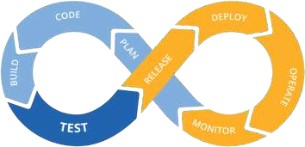
What is CI -CD
Continuous Integration (CI) : Continuous Integration is the consistent and automated practice of compiling, testing, and merging code changes into a shared code repository.
Continuous Delivery (CD) : It is the automated procedure of deploying software updates to either a staging or production environment after they have been effectively built and tested.
Continuous Deployment (CD) : Continuous Deployment resembles Continuous Delivery but uniquely involves the automatic release of changes to the production environment as soon as they are deemed ready, without an intermediary staging phase.

Slide 4
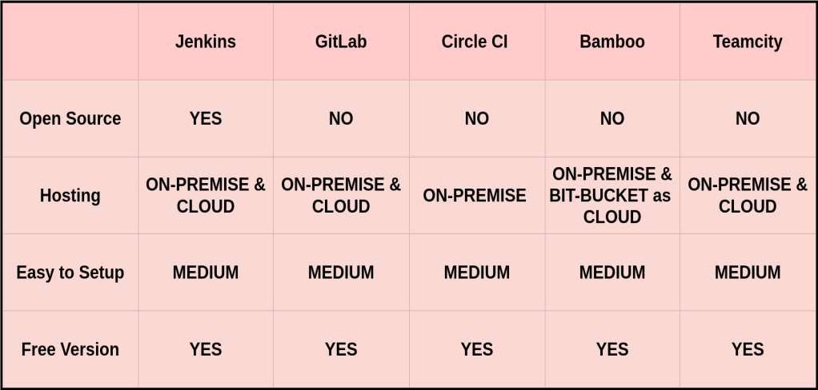
Tools for CI-CD

Slide 5
Comparison Table: Jenkins vs GitLab CI vs CircleCI vs Bamboo vs TeamCity
Feature / Tool | Jenkins | GitLab CI | CircleCI | Bamboo (Atlassian) | TeamCity (JetBrains)
Type | Open Source | Open Source + SaaS | SaaS + Self-hosted | Commercial | Commercial
Ease of Setup | Complex (manual plugin setup) | Easy (integrated into GitLab) | Very Easy (SaaS) | Medium (on-premises) | Medium (on-premises)
UI/UX | Basic (improved with Blue Ocean) | Modern, integrated UI | Modern, clean UI | Good UI | Excellent UI with JetBrains quality
Pipeline as Code | Yes (Jenkinsfile) | Yes (.gitlab-ci.yml) | Yes (config.yml) | Yes (YAML + GUI) | Yes (Kotlin DSL, also GUI based)
Scalability | Very High (plugin-based, master-agent) | High (Auto-scaling runners) | High (Docker-based, parallel jobs) | Medium (agent-based) | Medium (agent-based)

Slide 6
Comparison Table: Jenkins vs GitLab CI vs CircleCI vs Bamboo vs TeamCity
Feature / Tool | Jenkins | GitLab CI | CircleCI | Bamboo (Atlassian) | TeamCity (JetBrains)
Docker Support | Strong (via plugin) | Native | Excellent (Docker-first) | Good (Docker agent) | Good (Docker and Kubernetes support)
Kubernetes Support | Yes (via plugin) | Yes (via GitLab K8s executor) | Yes (orbs or custom runners) | Limited (not native) | Yes (K8s plugin or custom runners)
Parallel Execution | Yes (manual config with agents) | Yes (matrix jobs, dynamic pipelines) | Yes (easy parallelism setup) | Yes | Yes
Secrets Management | Plugin-based (Vault, credentials) | Built-in (masked CI/CD variables) | Built-in (env vars, contexts) | Built-in | Built-in
Plugin Ecosystem | Very large (~1800+) | Smaller, focused | Small, focused | Limited | Moderate
Notifications | Via Plugins (Slack, Email, etc.) | Built-in | Built-in (Slack, Email) | Built-in | Built-in (customizable)
Test Reporting | Via Plugins | Built-in (JUnit, Code coverage) | Built-in | Built-in | Built-in

Slide 7
Comparison Table: Jenkins vs GitLab CI vs CircleCI vs Bamboo vs TeamCity
Feature / Tool | Jenkins | GitLab CI | CircleCI | Bamboo (Atlassian) | TeamCity (JetBrains)
Test Reporting | Via Plugins | Built-in (JUnit, Code coverage) | Built-in | Built-in | Built-in
Manual Approval / Gates | Plugin-based | Built-in (Environments / approvals) | Built-in (with workflows) | Built-in | Built-in
Security | Requires hardening | Good (RBAC, project/group level) | Good (context-based) | Good (integrates with LDAP/SSO) | Good (LDAP, RBAC)
Maintenance Overhead | High (self-managed) | Low (SaaS) to Medium (self-hosted) | Very Low (SaaS) | Medium to High | Medium
Cost | Free (self-hosted) | Free tier + paid runners | Free tier + paid usage | Paid | Paid (free tier for OSS)
Best for | Custom, complex pipelines | GitLab users; integrated DevOps | Quick CI/CD setup, Docker-heavy apps | Jira/Bitbucket users | JetBrains ecosystem or .NET-heavy teams

Slide 8

What is Gitlab CI-CD
GitLab CI/CD is a built-in Continuous Integration and Continuous Deployment (CI/CD) tool provided by GitLab, a popular web-based Git repository manager.
GitLab CI/CD automates building, testing, and deploying code changes.
CI/CD pipelines are defined using a version-controlled .gitlab-ci.yml file.
GitLab CI/CD is tightly integrated with GitLab's collaboration and source
code management features.
It supports parallel job execution, speeding up testing and deployment processes.
GitLab CI/CD facilitates container-based development and deployment using Docker.

Slide 9
Key Components of Gitlab CI-CD
GitLab CI/CD consists of several key components that work together to automate the software development lifecycle. The main components are :
Runner
Pipeline
Gitlab CI file
Artifacts
Triggers
CI-CD Variables

Slide 10
Why Gitlab CI-CD
GitLab CI/CD is a popular choice for many development teams and organizations for several reasons:
Automated and Consistent Build and Deployment Process
Faster Time-to-Market
Continuous Integration and Testing
Improved Collaboration
Enhanced Security and Stability

Slide 11
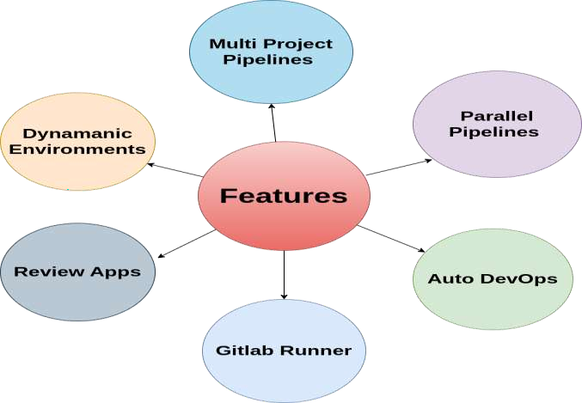
Gitlab CI-CD features

Slide 12

Use Case and Best practices
Use Case -
Continuous integration and deployment for web applications
Infrastructure automation
Data pipelines
Automated Testing
Containerized Applications
Best Practise -
Security and secrets management
Parallelization and caching
Infrastructure as code
Pipeline testing

Slide 13
DEMO

Slide 14


For more information and any queries contact to Deeksha.Tripathi@nashtechglobal.com

