Slide 1
Solidity Simplified
Based on Solidity release document version 0.4.18
- Vishwas Anand Bhushan
Software Engineer | Blockchain and Ethereum enthusiast

Slide 2
Introduction
Solidity is a language used to build Smart contracts on Ethereum.
Javascript like language , easy to understand and code.
I will not focus on concepts of Blockchain or Ethereum or Smart Contract, I will directly jump into coding of Smart Contract
Viewer should have basic understanding of Blockchain, Ethereum and Smart Contract.
This PPT is for very beginner.
Note: All screen shots are taken from Solidity official doc. And if from else where, I will mention it right there.

Slide 3
One Basic Example
- Just to show you how a Smart Contract looks like
pragma solidity ^0.4.0;
contract SimpleStorage {
uint storedData;
function set(uint x) {
storedData = x;
}
function get() constant returns (uint) {
return storedData;
}
}

Slide 4
What it is?
Like I said, it’s a JS like language used to build SC in Ethereum.
What is Smart Contract ? Contracts in Solidity are similar to classes in object-oriented languages. Each contract can contain declarations of State Variables, Functions, Function Modifiers, Events, Structs Types and Enum Types. Furthermore, contracts can inherit from other contracts.
A contract in the sense of Solidity is a collection of code (its functions) and data (its state) that resides at a specific address on the Ethereum blockchain
Don’t worry about Modifiers, Enum, Structs, Eventt etc. I would talk about them later in the presentation….. They are very easy to understand ☺

Slide 5
Installing Solidity
There are many ways to Install solidity complier, I would suggest you to use Remix Solidity Bowser.
Why Remix?
You don’t have to install any thing in your computer to compile your Solidity Code.
Very easy to compile and deploy your contract and see the output behaviour
Most importantly, you will not waste your time installing and setting up your Solidity Compiler (however its very easy to do that), as beginner you are very egger to jump into code.
You can eaisly find many videos on youtube, how to use Remix. May be I will put a link of such video in description.

Slide 6
Those who are from Coding background like, c#, javas etc. they will find Solidity very easy to understand.
Writing Contracts are similar to writing Classes in c#, java… most of the things are same (like member variables, member functions, logs, conditions, loops etc.) except they have different terminology here in Solidity.

Slide 7
Lets jump into Code now
Notice the first of code,
Its called Version Pragma : to reject being compiled with future compiler versions that might introduce incompatible changes.
Such a source file will not compile with a compiler earlier than version 0.4.0 and it will also not work on a compiler starting from version 0.5.0.
pragma solidity ^0.4.0;

Slide 8
Importing Source File
import "filename"; This statement imports all global symbols from “filename” into the current global scope.
import * as symbolName from "filename"; import all global member from “filename” into a new global member “symbolName”.
Comments
// This is a single-line comment.
/* */ Multiline comment.
Natspec Commment(///) : I don’t know about it. Mostly used right before any function declaration to explain functionality of that method.

Slide 9
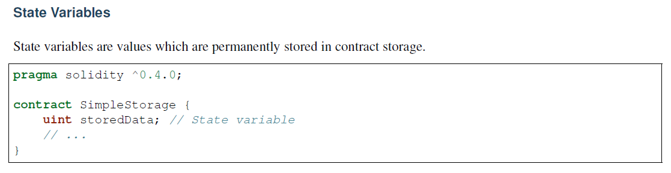
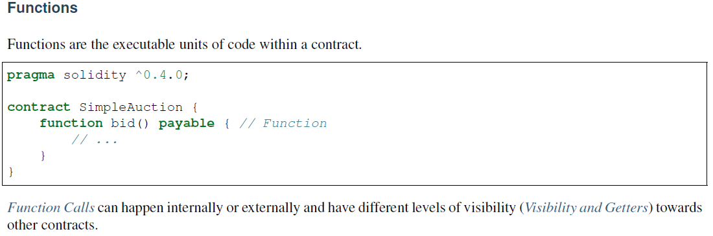
Member variable and Member Function
As you can see state variables and functions are self explanatory, they are just like member variable and member functions of c# or java

Slide 10
Function Modifiers
Concider this scenario, lets say we have to write one contract with two functions, SetValue() and GetValue() which is nothing but setter and getter functions and will set and get value of member variable 'count'. Also concider this condition, one who is owner of this contract, can only do thses operations.
How can we implement this condition? we can put a if statement right?? Yep, you are right.
We need to put this 'if' condition is all of our functions - CODE DUPLICASY.
To avoid duplicay - we can write a another function and put our 'if' condtion there and then call it from where ever required, right? - That is what the functionality of Modifier is but in slightly different way. see the two codes in next slide.
In short : Modifiers can be used to easily change the behaviour of function, for example, they can be used to automatically check the condition prior to execute the function. And these conditions may check conditions before even calling the function since they are they have been declared in definitions. So they can reject the function calls before you actually submit the function for execution.

Slide 11
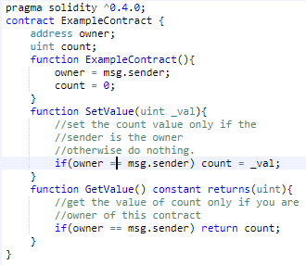
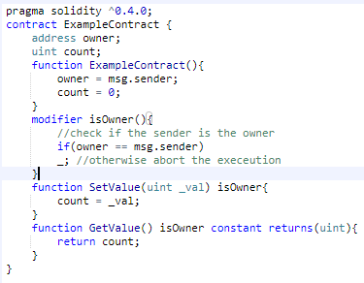
But What is the benefit of using modifiers ? - Saving Gas. Yes saving gas. For each and every computation you do on Blockchain, there is cost associated to it. And that is called, Gas. So more complex your transaction is, more Gas is required.
Note : Please igonre the syntax as of now, if its confusing. just focus on concepts.

Slide 12
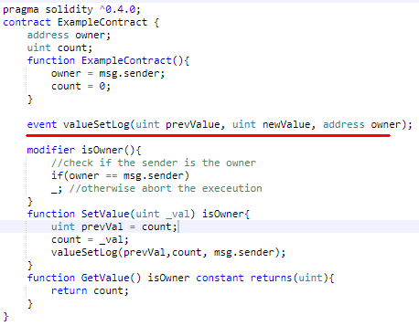
Events
Events are used to capture logs(as per my understanding).
Let's say, you want to set the value of 'count' from your web/mobile application(yes its possible to call smart contract functions from otside of blockchain network, like any web/mobile apps using Web3 Js). So once the value set, you want to get an aknowledgement that the value setting is successfull. - Here we need Events in Smart Contract to output log.

Slide 13
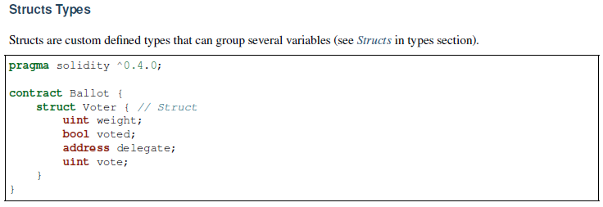
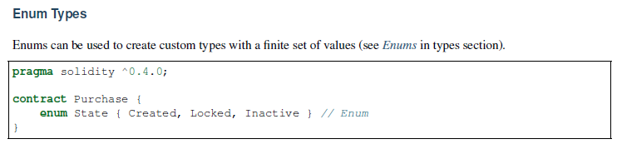
Structs Types and Enums

Slide 14
Types
Solidity is strictly typed language, which means that the type of each variable is required.
Booleans : bool
Integers : int/uint
Fixed point numbers : not sure about it, looks something like floating point number.

Slide 15
Types – 2 (Address Type)
Address : Holds a 20 byte value (size of an Ethereum address). Address types also have members and serve as a base for all contracts.
Fixed Size byte arrays
Dynamically-sizes arrays
Balance and Transfer and Send:
<address>.balance (uint256): balance of the Address in Wei
<address>.transfer(uint256 amount): send given amount of Wei to Address, throws on failure.
<address>.send(uint256 amount) returns (bool): send given amount of Wei to Address, returns false on failure.
Call, Callcode and Delegatecall :
Did not understand

Slide 16
Types – 3 (Array Type)
2 Types
Fixed-size byte arrays
bytes1, bytes2, bytes3, ..., bytes32
byte is an alias for bytes1.
Dynamically-sized byte array s
bytes: Dynamically-sized byte array. Not a value-type!
string: Dynamically-sized UTF-8-encoded string. Not a value-type!
As a rule of thumb, use bytes for arbitrary-length raw byte data and string for arbitrary-length string (UTF-8) data. Isf you can limit the length to a certain number of bytes, always use one of bytes1 to bytes32 because they are much cheaper

Slide 17
Types – 4 (Function Type)
2 Types
Internal
can only be called inside the current contract.
Exernal

Slide 18
Types – 5 (Mapping Type)
Mapping types are declared as mapping(_KeyType => _ValueType)
Here _KeyType can be almost any type except for a mapping, a dynamically sized array, a contract, an enum and a struct. _ValueType can actually be any type, including mappings.
Example : mapping(address => uint) public balances;
Mappings are not iterable, but it is possible to implement a data structure on top of them

Slide 19
Error Handling
assert(bool condition): throws if the condition is not met - to be used for internal errors.
require(bool condition): throws if the condition is not met - to be used for errors in inputs or external components.
revert(): abort execution and revert state changes

Slide 20
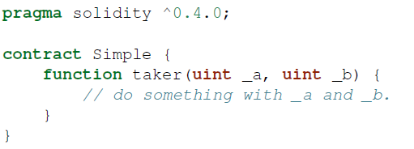
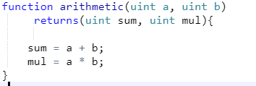
Input Parameters and Output Parameters
Input Parameters
The input parameters are declared the same way as variables are.
Output Parameters
The output parameters can be declared with the same syntax after the returns keyword.
Wished to return two results – Possible.
Return parameters are initialized to zero; if they are not explicitly set, they stay to be zero.

Slide 21
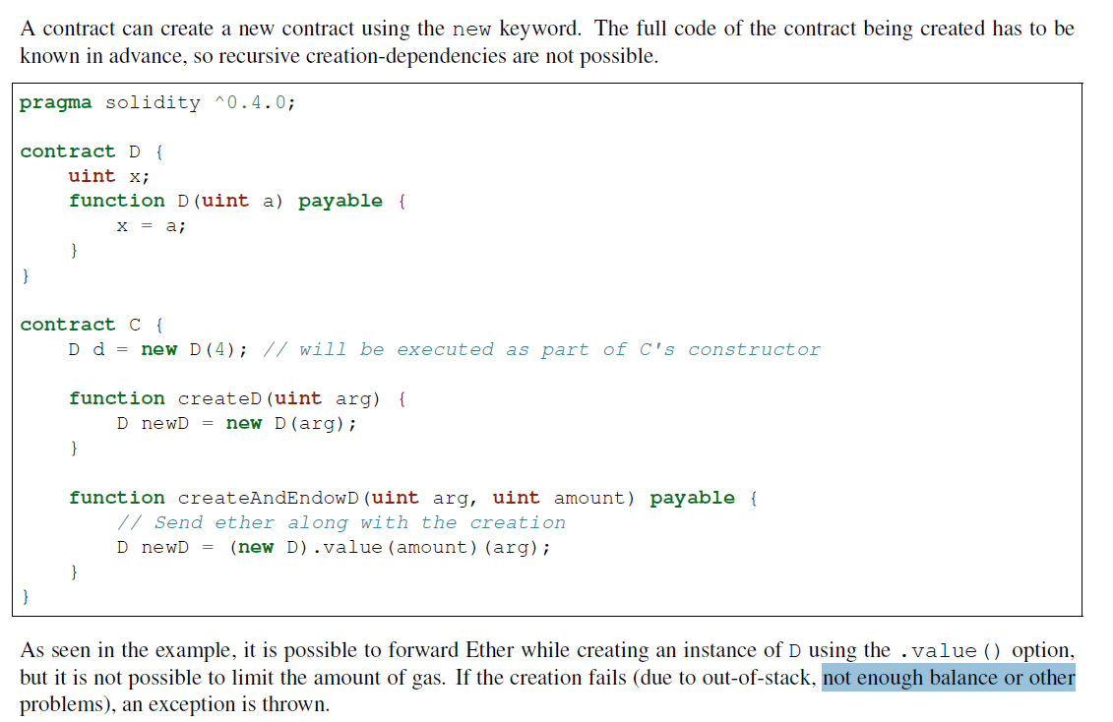
Creating Contracts via new

Slide 22
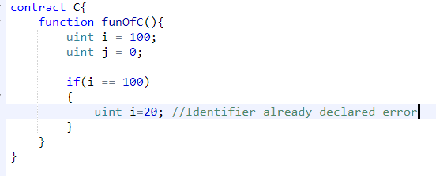
Scoping and Declarations
A variable which is declared will have an initial default value whose byte-representation is all zeros.
A variable declared anywhere within a function will be in scope for the entire function, regardless of where it is declared.
This is in contrast to many languages where variables are only scoped where they are declared until the end of the semantic block.

Slide 23
Error Handling
Catching exceptions is not yet possible.
Solidity uses state-reverting exceptions to handle errors. Such an exception will undo all changes made to the state in the current call (and all its sub-calls) and also flag an error to the caller.
The convenience functions assert and require can be used to check for conditions and throw an exception if the condition is not met.
The assert function should only be used to test for internal errors, and to check invariants.
The require function should be used to ensure valid conditions, such as inputs, or contract state variables are met, or to validate return values from calls to external contracts.
2 Ways to trigger exception
The revert function can be used to flag an error and revert the current call.
The throw keyword can also be used as an alternative to revert() [will be depreciated in future].

Slide 24
Fallback Function
A contract can have exactly one unnamed function.
This function cannot have arguments and cannot return anything.
It is executed on a call to the contract if none of the other functions match the given function identifier (i.e this fucntion will gets called if you are trying to call the function that does not matches with any function in the contract)
function is executed whenever the contract receives plain Ether.
In order to receive Ether, the fallback function must be marked payable.

