Slide 1
ERC20 Token Standard Simplified

Slide 2
What is it?
The ERC20 token standard describes the functions and events that an Ethereum token contract has to implement.
It’s a standard that every token contract developer has to follow while writing token contract for an ICO.
There are few methods that must be implemented in your contract in order for your contract to valid for Ethereum exchange.

Slide 3
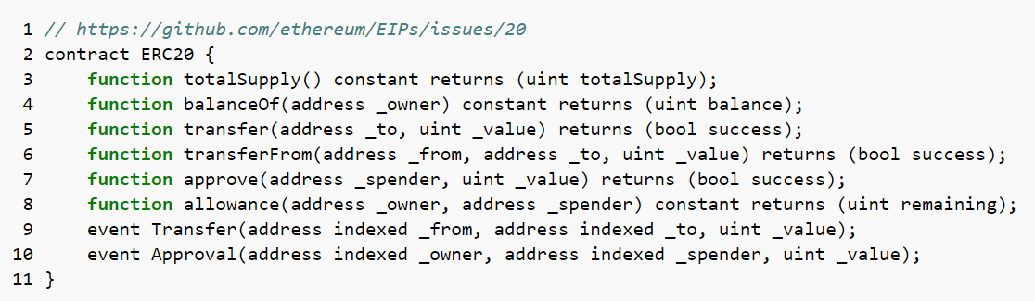
What are those methods/APIs?
More on :
https://theethereum.wiki/w/index.php/ERC20_Token_Standard
https://www.ethereum.org/token
https://steemit.com/ethereum/@maxnachamkin/how-to-create-your-own-ethereum-token-in-an-hour-erc20-verified
https://github.com/ethereum/EIPs/issues/20

Slide 4
Lets take a look on each of these APIs

Slide 5
function balanceOf(address _owner) constant returns (uint balance);
Returns balance(no of tokens he owns) of a particular owner.

Slide 6
https://etherscan.io/tokens has list of all Ethereum tokens that have been created so far.
There are a total of 18153 Erc20 Token Contracts.
We will understand by case study of an ICO, “TokenCard”, (TKN)
Next slide to see the TKN deployed at Ethereum Scan.

Slide 7
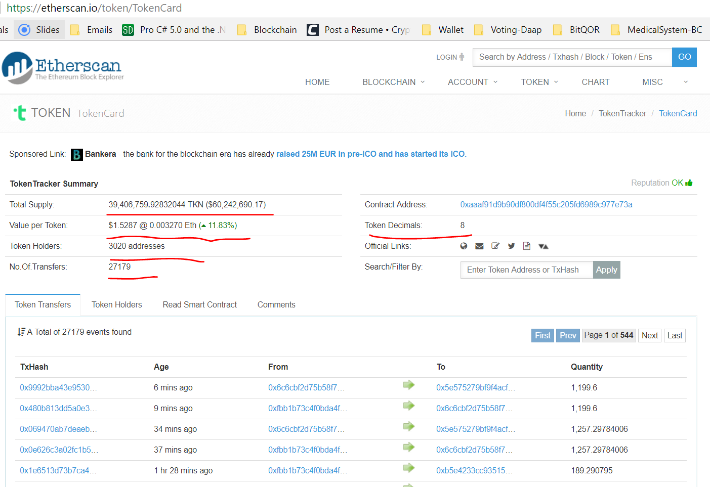
Example of a token (TKN) at Etherscan.io – e.g.1.0

Slide 8
Example of a token (TKN) at Etherscan.io – e.g.1.0
Questions:
How is value per token determined?
How to set token decimal?

Slide 9
How to deploy the token contract on Ropsten Network?

Slide 10
First of all create the token contract with ERC20 token standards
Install Metamask in your chrome browser
Create few accounts by simply specifying a password
Now you have more than one accounts created on the Ethereum Blockchain network which can be seen on Metamask. But you don’t have any ehter into it.

Slide 11
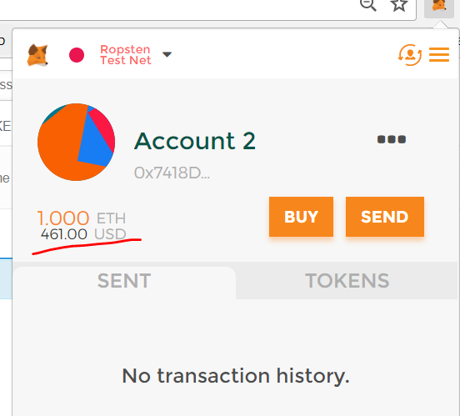
To get some free ether, go to https://faucet.metamask.io/ and click on button “request 1 ether from faucet”.
You will see some ether into your selected account in metamask. As I got 1 ehter from faucet

Slide 12
Deploy Token Contract on Remix
Now you have to deploy token contract on Remix and selcect the account that you want to deploy (notice that, those 2 account(which are present in metamask) are showing into Remix as well)
Now press the create button with initial value (say 1000) passed to it and create the contract.It will open the metamask -> simple press submit button in metamask window -> It will take some time to be created.
Once you got the Smart contract address -> copy it and open the metamask again.

Slide 13
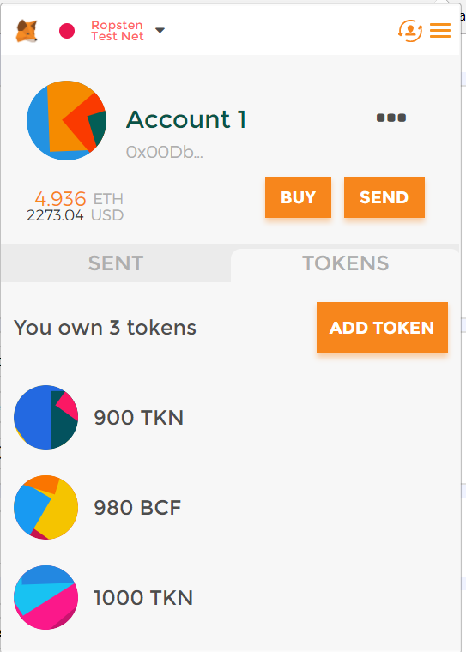
Add token to Metamask account
Open metamask -> go to Tokens tab and and clikc on “Add Token” button. Provide the cocntract address and press the “Add” button.
Now your token is added into Metamask.

Slide 14
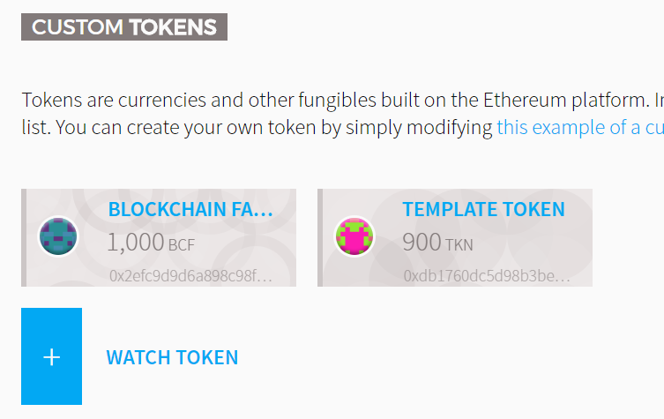
Deploying Contract into Wallet
Go to https://wallet.ethereum.org/ and press on Contracts
Scroll down and click on Watch Token -> provide the contract address there -> Click on Ok button.
you will see your token will be listed like this :

Slide 15
Send token from one account to another
Select “From” account from the Metamask.
Go to https://wallet.ethereum.org/ and press Send.
Fill in the requried detail along with “To” address and press on Send button
It will again open up the Metamask window and will ask you for your permission -> Press Submit -> Wait for some time and your transaction will be processed.

Slide 16
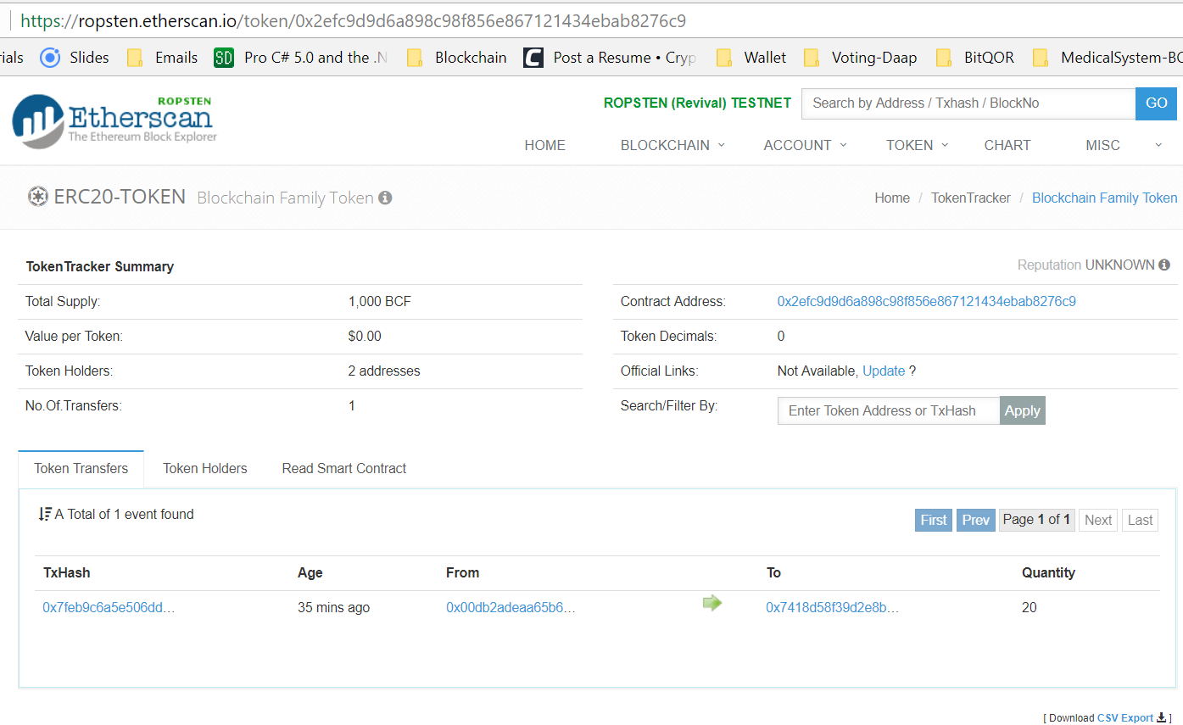
Find your ERC20 token on Network
Go to https://ropsten.etherscan.io/token-search and type the symbol or name of your token in the text box and press search. You will see your token successfully deployed on test network.

