Slide 1

Exploratory Data Analysis on Titanic Dataset
Vishwas K
Using Python (Pandas, Matplotlib, Seaborn)

Slide 2
Objective & Tools
Objective:
Extract insights using visual and statistical exploration.
Tools Used:
Python, Pandas, Matplotlib, Seaborn

Slide 3
Dataset Overview
Dataset: Titanic Dataset
Rows: 891
Columns: 12
Contains missing values in Age, Cabin, and Embarked columns.

Slide 4
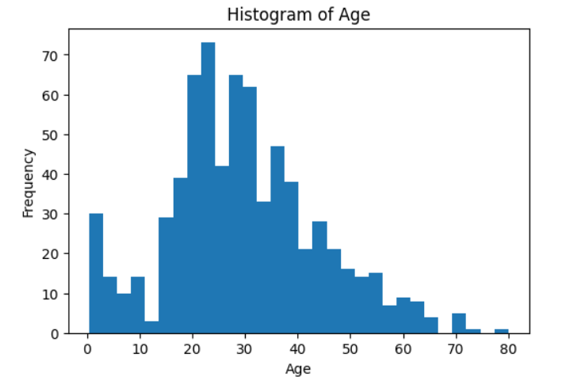
Histogram – Age Distribution
Insert Histogram Image Here
Observation:
Most passengers are between 20–40 years.
Few passengers above 60 years.

Slide 5
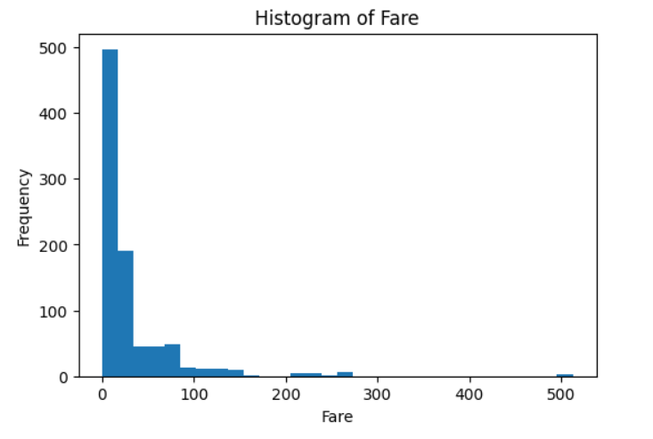
Histogram – Fare Distribution
Insert Histogram Image Here
Observation:
Fare is right-skewed with many low values and few high-value outliers.

Slide 6
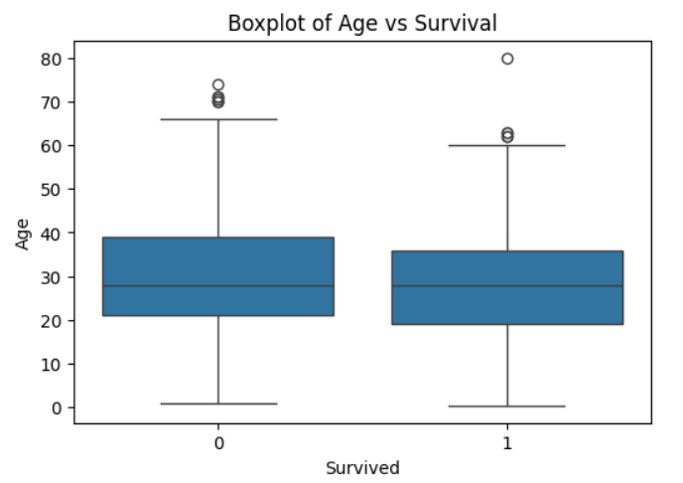
Boxplot – Fare vs Survival
Insert Boxplot Image Here
Observation:
Survivors have higher median fare compared to non-survivors.

Slide 7
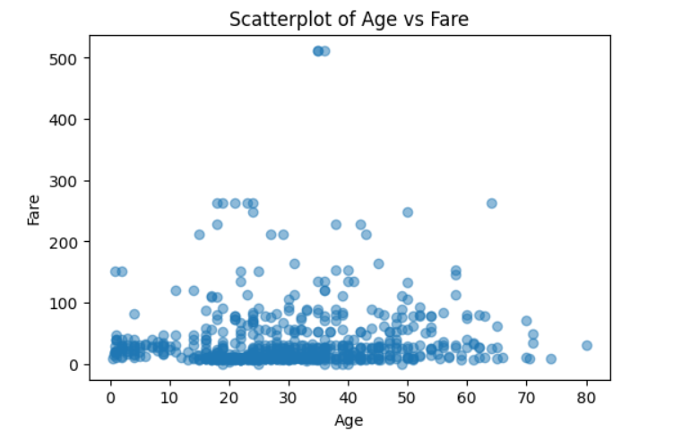
Scatterplot – Age vs Fare
Insert Scatterplot Image Here
Observation:
No strong linear relationship between Age and Fare.
Survivors cluster more in high-fare region.

Slide 8
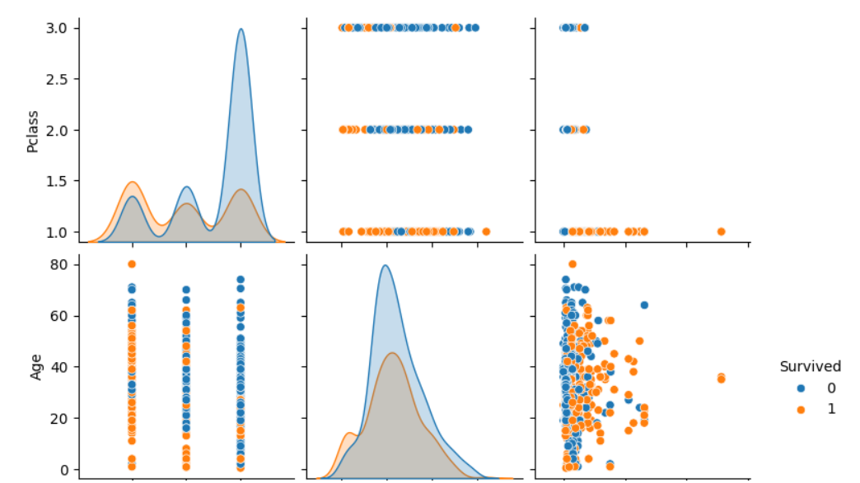
Pairplot – Feature Relationships
Insert Pairplot Image Here
Observation:
Fare and Pclass show strong relationship with survival.
Age shows weak relationship.

Slide 9
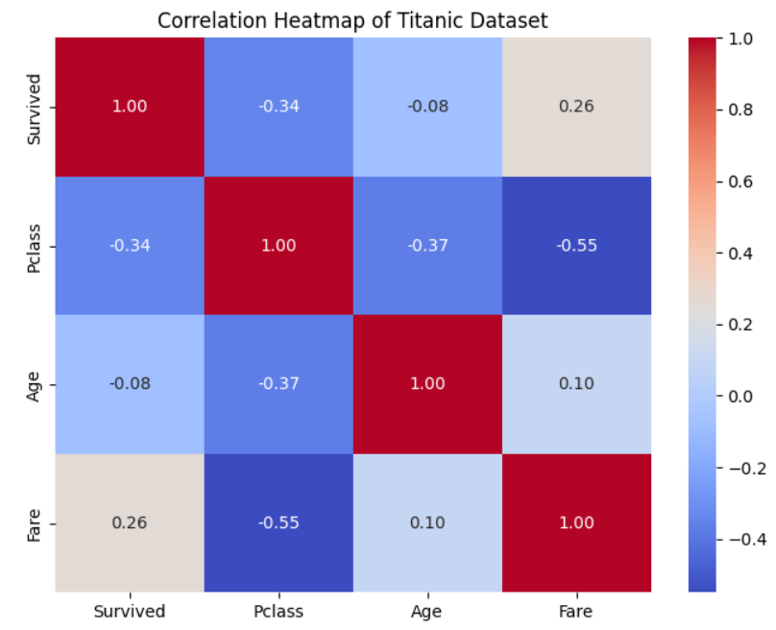
Heatmap – Correlation Matrix
Insert Heatmap Image Here
Observation:
Survival positively correlated with Fare and negatively with Pclass.

Slide 10
Relationships and Trends
1. Relationship between Passenger Class and Survival
Strong negative correlation between Pclass and Survived.
Passengers in 1st class had a much higher survival rate than those in 2nd and 3rd class.
Interpretation:
Higher socio-economic status increased the chance of survival.
🔹 2. Relationship between Fare and Survival
Positive correlation between Fare and Survived.
Passengers who paid higher fares were more likely to survive.
Interpretation:
Fare is indirectly linked to passenger class and access to lifeboats.
🔹 3. Relationship between Age and Survival
Weak correlation between Age and Survived.
However, children had a slightly higher survival probability than older adults.
Interpretation:
Age alone is not a strong predictor, but young passengers benefited from rescue priority.

Slide 11
Relationships and Trends
🔹4. Gender Trend (from value_counts & known patterns)
Females had a much higher survival rate compared to males.
Interpretation:
“Women and children first” policy influenced survival outcomes.
🔹 5. Combined Feature Trends (from Pairplot)
High Fare + 1st Class → High Survival
Low Fare + 3rd Class → Low Survival
Survivors cluster more in higher fare ranges.
🔹 6. Correlation Heatmap Summary
Survived vs Pclass: moderate negative correlation
Survived vs Fare: moderate positive correlation
Survived vs Age: weak correlation

Slide 12
Summary of Findings
Summary of Findings
The dataset contains missing values, particularly in the Age, Cabin, and Embarked columns, indicating the need for data cleaning before modeling.
The overall survival rate is approximately 38%, showing that most passengers did not survive the disaster.
Passenger class (Pclass) has a strong relationship with survival:
  First-class passengers had the highest survival rate.
  Third-class passengers had the lowest survival rate.
Fare is positively correlated with survival:
  Passengers who paid higher fares were more likely to survive.
  Fare distribution is highly right-skewed with several high-value outliers.
Gender plays a significant role in survival:
  Female passengers survived at a much higher rate than male passengers.
Age has a weak correlation with survival:
  Children and younger passengers had slightly better survival chances.
  Age alone is not a strong predictor compared to class and fare.
Visual analysis (pairplot and scatterplots) shows clear clustering of survivors in the high-fare and first-class groups.
Correlation heatmap confirms that Pclass and Fare are the most influential numerical features related to survival, while Age shows minimal impact.

Slide 13

Conclusion
EDA shows that survival on Titanic depended mainly on:
Passenger Class, Fare, and Gender.
These insights can guide predictive modeling.

