Slide 1
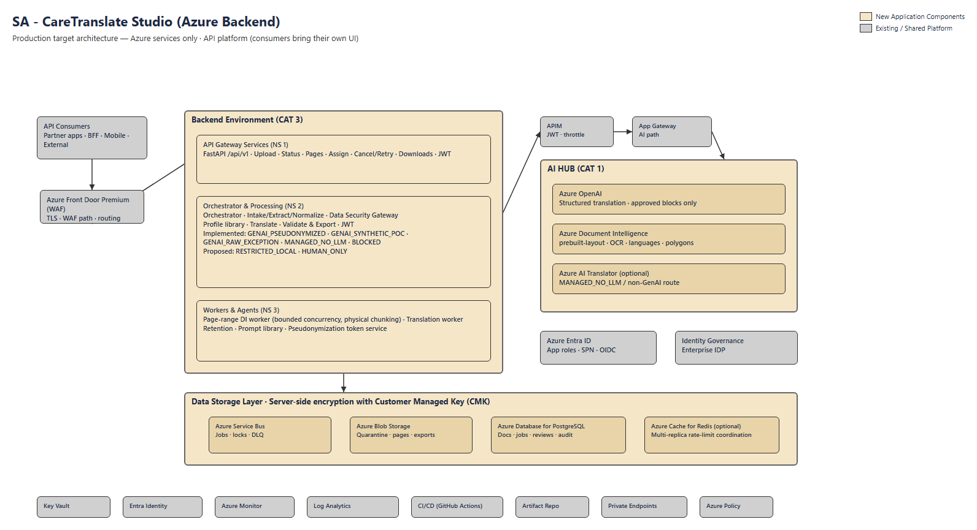
SA - CareTranslate Studio (Azure Backend)

Slide 2
Editable component map (drag shapes / replace icons)
New Application
Shared Platform
API Consumers
Partner · BFF · Mobile · External
Backend Environment (CAT 3)
APIM
JWT · throttle
App Gateway
AI path
NS1 · API Gateway Services
FastAPI /api/v1 · Upload · Status · Pages · Cancel/Retry · Downloads · JWT
AI HUB (CAT 1)
Azure OpenAI
GPT structured translation
Azure Front Door Premium (WAF)
TLS · WAF · routing
NS2 · Orchestrator & Processing
Intake/Extract -> Gateway/Profiles -> Translate -> Export Implemented: GENAI_PSEUDONYMIZED, GENAI_SYNTHETIC_POC, GENAI_RAW_EXCEPTION, MANAGED_NO_LLM, BLOCKED Proposed: RESTRICTED_LOCAL, HUMAN_ONLY
Document Intelligence 4.0
prebuilt-layout · OCR · languages
Azure AI Translator (optional)
MANAGED_NO_LLM route
NS3 · Workers & Agents
Page-range DI worker · Translation worker · Retention · Prompt library · Token service
AZ Entra ID
App roles · SPN
Identity Governance
Enterprise IDP
Data Storage Layer · CMK encryption
Service Bus
Blob Storage
Azure Database for PostgreSQL
Cache for Redis (optional)
Key Vault
Entra Identity
Azure Monitor
Log Analytics
CI/CD (GitHub Actions)
Artifacts
Private EP

Slide 3
How to use / edit this deck
Slide 1 — Presentation board: high-fidelity architecture image for customer reviews.
Slide 2 — Editable map: native PowerPoint shapes + Azure icons (drag, recolor, rename).
Icons source: Microsoft Azure Architecture Center official SVG pack (when downloaded into docs/diagrams/icons).
Sell as backend-only: customers bring UI; they integrate via Front Door / APIM.
CAT 3 = backend namespaces (API - Orchestrator - Workers). CAT 1 = AI Hub via APIM.
Data plane: Service Bus - Blob - Azure Database for PostgreSQL - (optional) Cache for Redis, all CMK-encrypted.
Every component on this board is an Azure service; there is no non-Azure infrastructure in this architecture.
Also editable in diagrams.net: Multilingual-Translation-Studio-Backend-Architecture.drawio
Regenerate: backend\.venv\Scripts\python.exe scripts\generate_backend_architecture_pptx.py

