Slide 1
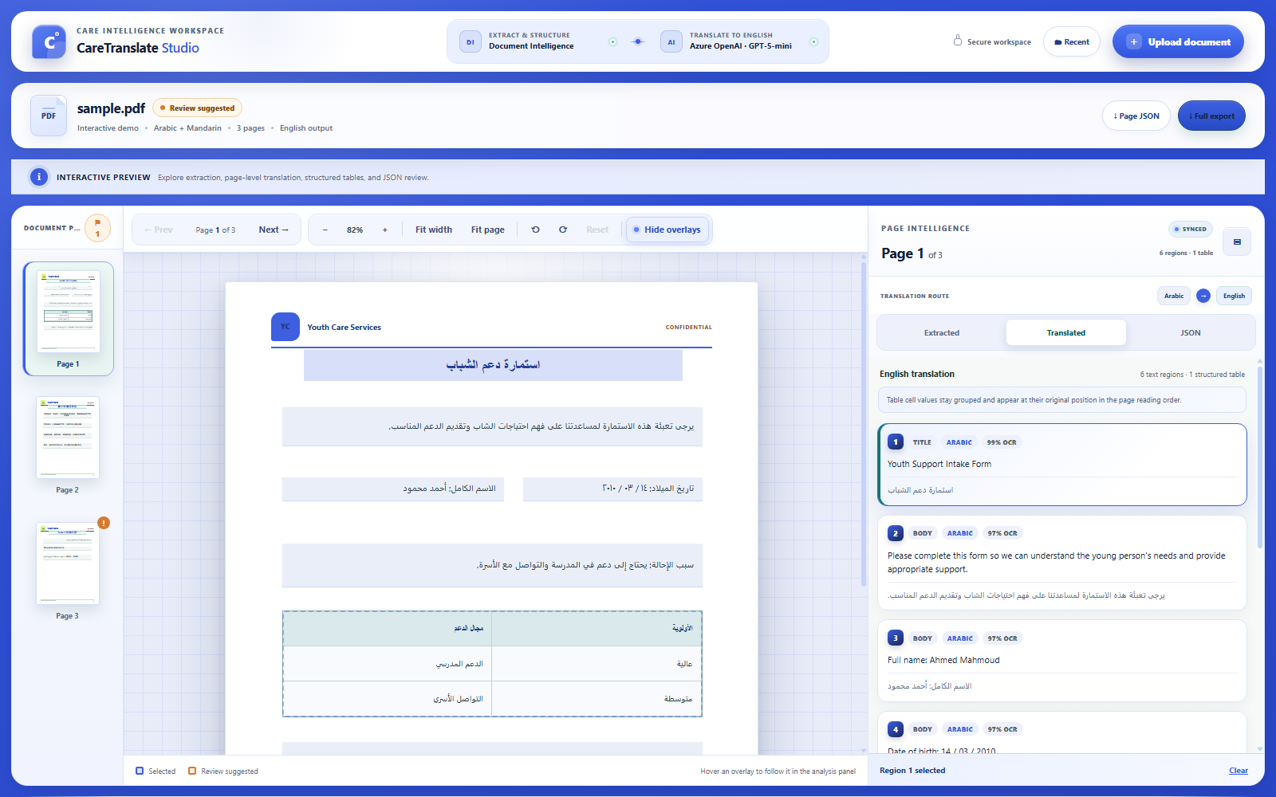
PRODUCT + SECURITY OVERVIEW
CareTranslate
Studio
Secure multilingual document intelligence
with human-controlled translation
Runnable POC
Production path
Human control
Working studio experience
Security gates documented
Review before downstream use
Arabic + Mandarin → English • Azure Document Intelligence • Azure OpenAI
CARETRANSLATE STUDIO
01 / 07
Notes:
Open with the outcome: the team already has a runnable review studio and a documented path to production. Emphasize that the POC and production target are intentionally separated throughout the deck.
[Sources]
- ./README.md
- ./docs/PRD.md
[/Sources]

Slide 2
THE PRODUCT
One workspace closes the document-review gap
From foreign-language files to structured, traceable English review—without losing page context.
The operational problem
Reviewers must connect
three views at once
Upload
Extract
Translate
Trace
Review
PDF or image
Layout + regions
Approved route
Page-wise JSON
Human decision
What the original page says
How each region was translated
Product promise
Every translated block remains connected to its source page, geometry and export record.
What structured data will be exported
CONTEXT • TRACEABILITY • CONTROL
CARETRANSLATE STUDIO
02 / 07
Notes:
Describe the product in one sentence: a studio that keeps source page, translation and structured output synchronized. This is the core manager-level value proposition.
[Sources]
- ./docs/PRD.md
- ./README.md
[/Sources]

Slide 3
CURRENT STATE
CURRENT POC
The POC already proves the core review experience
A complete three-page demo works without Azure credentials; provider-backed processing is available when configured.
Structure extraction
Pages, blocks, tables and geometry
Structured translation
Arabic / Mandarin → English
Synchronized review
Thumbnails, overlays and result cards
Traceable exports
Page JSON + bilingual artifact
POC boundary
Synthetic or approved de-identified data only
LIVE STUDIO CAPTURE
CARETRANSLATE STUDIO
03 / 07
Notes:
Use the screenshot to ground the conversation in working software. Call out that the POC is not production-approved for confidential records; its security boundary is synthetic or explicitly approved de-identified data.
[Sources]
- ./README.md
- ./docs/PRD.md
- ./docs/DATA-SECURITY.md
[/Sources]

Slide 4
END-TO-END WORKFLOW
PRODUCTION TARGET
Security and human review are part of the processing flow
The production path adds policy decisions before any generative-AI request.
1
2
3
4
Authenticate
Quarantine
Extract
Policy gateway
Entra ID + APIM
Validate + scan
Document Intelligence
Classify + minimize
Default deny: prohibited or low-confidence content uses a non-LLM / local / manual route
8
7
6
5
Export + delete
Human review
Validate
Translate
Retention evidence
Approve / correct
IDs + protected tokens
Approved route only
CARETRANSLATE STUDIO
04 / 07
Notes:
Walk through the eight stages. The key production addition is stage four: the Data Security Gateway makes a default-deny processing decision before any Azure OpenAI request. Low-confidence or prohibited jobs use a non-LLM, local or manual route.
[Sources]
- ./docs/ARCHITECTURE.md
- ./docs/DATA-SECURITY.md
[/Sources]

Slide 5
DATA EXPOSURE
Azure processing ≠ automatic LLM exposure
Each service sees only what the application explicitly sends to it.
Azure Document Intelligence
Data Security Gateway
Azure OpenAI
FULL DOCUMENT
APPROVED BLOCKS
Receives the complete file
Receives extracted text internally
Receives approved prompt blocks
OCR + layout extraction
Policy + PII + tokenization
Generative translation
LLM: NO
LLM: NO
LLM: YES
Does DI send data to Azure OpenAI automatically?
Is the original PDF/image sent to Azure OpenAI in the target design?
No — the backend must explicitly submit text.
No — only policy-approved text blocks.
Are Azure OpenAI prompts used to train foundation models by default?
Can raw content ever reach the LLM?
Microsoft states no, without customer permission.
Only through a signed, time-bound exception.
CARETRANSLATE STUDIO
05 / 07
Notes:
Make the distinction explicit: managed-service processing and generative-LLM processing are different boundaries. Document Intelligence needs the full document to extract it, but it does not automatically call Azure OpenAI. Azure OpenAI processes only the prompt content the application sends. Microsoft states prompts and outputs are not used to train foundation models without permission; abuse-monitoring configuration must still be verified for the approved deployment.
[Sources]
- https://learn.microsoft.com/en-us/azure/foundry/responsible-ai/document-intelligence/data-privacy-security
- https://learn.microsoft.com/en-us/azure/foundry/responsible-ai/openai/data-privacy
- https://learn.microsoft.com/en-us/azure/foundry/openai/concepts/abuse-monitoring
- ./docs/DATA-SECURITY.md
[/Sources]

Slide 6
PRODUCTION ARCHITECTURE
PRODUCTION TARGET
Layered controls protect every data boundary
Private networking, managed identity, policy routing and evidence-driven deletion work together.
EDGE + IDENTITY
APP + ORCHESTRATION
AI PROCESSING
DATA + OPERATIONS
Microsoft Entra ID
Container Apps
Document Intelligence
Blob + PostgreSQL
MFA, roles, access reviews
Authorized API + private workers
Private regional extraction
Tenant isolation + encryption
Front Door + APIM
Service Bus
Security Gateway
Key Vault
WAF, token checks, rate control
Durable, idempotent stages
Classify, minimize, tokenize
Keys, secrets, token maps
Azure OpenAI
Monitor + Sentinel
Approved blocks only
Content-free audit + detection
GENAI_PSEUDONYMIZED
MANAGED_NO_LLM
RESTRICTED_LOCAL
GENAI_RAW_EXCEPTION
HUMAN_ONLY
Normal AI route
Azure, no GenAI
Controlled boundary
Signed exception
Manual review
CARETRANSLATE STUDIO
06 / 07
Notes:
Explain defense in depth by boundary rather than by service list. Entra ID and the edge protect entry; Container Apps and Service Bus create a durable private processing plane; Document Intelligence, the policy gateway and Azure OpenAI have explicit data contracts; storage, keys, monitoring, retention and deletion create evidence. The five immutable processing profiles prevent a retry or failure from silently changing the approved route.
[Sources]
- ./docs/ARCHITECTURE.md
- ./docs/DATA-SECURITY.md
[/Sources]

Slide 7
DECISION AND ROADMAP
Production is a sequence of evidence gates—not a single launch
Move from contained POC to approved real-data processing only when each gate is proven.
MANAGEMENT DECISIONS
Approve the default processing policy
0
1
2
3
4
5
Pseudonymized AI by default; raw data requires exception.
POC containment
Security foundation
Pseudonymized AI pilot
No-LLM alternatives
Raw exception
Production readiness
Approve all five processing profiles
Every classification has a safe, explicit route.
Synthetic / de-identified only
Identity, network, storage
Gateway + leakage tests
Translator / local route
Optional + time-bound
Assurance + operations
Assign accountable owners
Security, privacy and legal reviewers own the evidence gates.
Authorize Gate 1 implementation
Recommended next step
Identity, private networking, storage and audit foundation.
Run a Gate 1 architecture workshop and turn every control into an owner, acceptance test and evidence artifact.
CARETRANSLATE STUDIO
07 / 07
Notes:
Close with a concrete decision. The recommended next step is not to process real confidential records immediately; it is to authorize Gate 1 and translate the documented security plan into owned, testable implementation work. Gates 2–5 then provide controlled expansion.
[Sources]
- ./docs/DATA-SECURITY.md
- ./docs/PRD.md
[/Sources]

