Slide 1

HYBRID INFORMATION MIXING MODULE FOR STOCK MOVEMENT PREDICTION
CVR COLLEGE OF ENGINEERING (An UGC Autonomous Institute, Accredited by NAAC with ‘A’ Grade) Department of CSE B. Tech CSE-D III Year II Semester
Industrial Oriented Mini Project
PROJECT SUPERVISOR:
Mr.N.Srinu,Associative Proffesor,
CSE Department
Presented By:-
S Amrutha, 23B81A05K7
K Sri Karan Reddy, 23B81A05P9
N Vishwas ,23B81A05R2
III B.Tech (CSE-D) Industrial Oriented Mini Project (IOMP) Presentation Review-2,
CSE Dept, CVR college of Engineering

Slide 2

Contents
Use Case Diagram
Class Diagram
Sequence Diagram
Activity Diagram
Deployment Diagram
Conclusion
Future Scope
References
Abstract
Introduction
Problem Statement
Literature Review and Objective
Objectives
Existing Systems
Functional and Non-Functional Requirements
Hardware and Software Requirements
Proposed Methodology
System Architecture
III B.Tech (CSE-D) Industrial Oriented Mini Project (IOMP) Presentation Review-2,
CSE Dept, CVR college of Engineering

Slide 3
Abstract
Predicting whether a stock price will go up or down is a major challenge, especially in a highly volatile market. To make accurate predictions, it is essential to consider not just the historical price data but also relevant news articles that can influence investor behavior. Combining these two different types of information, or modalities, can provide a much stronger signal about future market movements than using either one alone.
The Hybrid Information Mixing Module (HIMM) blends time-series price features with semantic news features using two MLP blocks. It captures complex interactions between price patterns and news by learning across rows and columns of combined data. This strengthens the connection between both information types to identify important market signals. The result is more robust and accurate stock movement predictions.
III B.Tech (CSE-D) Industrial Oriented Mini Project (IOMP) Presentation Review-2,
CSE Dept, CVR college of Engineering

Slide 4
Introduction
Stock markets are affected by multiple factors including historical price data, financial news, and social media sentiment.
Traditional methods using LSTM or BERT focus on either price or text separately, missing valuable connections between them.
Complex transformer models require heavy computing power and are not always practical for real-world use.
The proposed Hybrid Information Mixing Module (HIMM) uses two MLP blocks - one for feature mixing and one for interaction mixing - to blend data effectively.
This project introduces HIMM that combines both data types efficiently using simple MLP blocks to improve stock movement prediction accuracy.
III B.Tech (CSE-D) Industrial Oriented Mini Project (IOMP) Presentation Review-2,
CSE Dept, CVR college of Engineering

Slide 5
Problem Statement
Stock price prediction is difficult because markets are volatile and influenced by price trends, news, and social media. Most existing methods use either price data or news text separately, missing valuable connections between them. Traditional models like LSTM cannot understand news sentiment, while sentiment analysis fails to capture price patterns. Complex transformer models need heavy computing power and are not practical. A simple approach is needed that combines both data types to improve prediction accuracy
III B.Tech (CSE-D) Industrial Oriented Mini Project (IOMP) Presentation Review-2,
CSE Dept, CVR college of Engineering

Slide 6
Literature Review and Objectives:
S.NO | Key Papers & Authors | Implementations /limitations | Major Research Gap Identifier
1 | Xu & Cohen (2018) – Stock Movement Prediction from Tweets and Historical Prices | Combined Twitter sentiment with historical stock prices using machine learning models. Limitation: Social media noise and weak interaction between textual and numerical features. | Need for better feature interaction mechanisms between text and price data.
2 | Lin et al. (2017) – Hybrid Neural Networks for Learning Time-Series Trends | Used hybrid neural networks to capture time-series trends in stock markets. Limitation: Focused mainly on numerical time-series data without textual information. | Lack of multimodal integration with financial news or sentiment data.
3 | Jang et al. (2020) – Stock Prediction Using BERT Sentiment Analysis and Macroeconomic Index | Applied BERT for financial sentiment analysis combined with macroeconomic indicators. Limitation: Limited interaction between semantic text features and stock price features. | Need for improved feature fusion between NLP features and numerical indicators.
4 | Sawhney et al. (2020) – Deep Attentive Learning for Stock Movement Prediction | Used attention-based models to analyze social media text and company correlations. Limitation: High computational complexity and heavy dependency on attention mechanisms. | Need for efficient architectures that reduce complexity while preserving feature interaction.
5 | Ding et al. (2015) – Deep Learning for Event-Driven Stock Prediction | Analyzed financial events and news articles to predict stock price movements. Limitation: Event-driven approaches may miss hidden patterns in historical price trends. | Need for models that combine event-driven insights with historical time-series learning.
6

Slide 7
Literature Review and Objective
Objectives:-
To design an automated system for stock movement prediction using multimodal data.
To analyze historical stock price data using GRU-based time-series modeling.
To extract meaningful semantic features from financial news using BERT.
To develop a Hybrid Information Mixing Module for effective integration of numerical and textual features.
To improve prediction accuracy compared to traditional single-source models.
To evaluate model performance using Accuracy, F1-Score, and MCC metrics.
III B.Tech (CSE-D) Industrial Oriented Mini Project (IOMP) Presentation Review-2,
CSE Dept, CVR college of Engineering

Slide 8
Existing Systems
ARIMA Model – Uses only historical price data for forecasting and cannot handle complex non-linear patterns.
LSTM & GRU Models – Capture time-series patterns but focus only on numerical stock data.
Sentiment Analysis Models – Analyze financial news or social media separately without integrating price trends.
Simple Feature Concatenation Methods – Combine price and text data directly, leading to weak feature interaction and information loss.
Attention-Based Models – Improve feature fusion but increase computational complexity and still fail to fully capture multimodal relationships.
III B.Tech (CSE-D) Industrial Oriented Mini Project (IOMP) Presentation Review-2,
CSE Dept, CVR college of Engineering

Slide 9
Functional And Non-Functional Requirements:
Functional Requirements
Non-Functional Requirements
Collection of historical stock price data from reliable financial sources.
Collection and preprocessing of financial news and textual data.
Time-series feature extraction using GRU model.
Text feature extraction using BERT model.
Integration of numerical and textual features using Hybrid Information Mixing Module.
Prediction of stock movement (Up/Down classification).
Performance evaluation using Accuracy, F1-Score, and MCC metrics.
High prediction accuracy and reliable forecasting results.
Efficient model training and reduced computational complexity.
Scalable architecture to handle large financial datasets.
Secure and reliable data handling.
Modular and maintainable system design.
Fast processing for near real-time prediction capability.
III B.Tech (CSE-D) Industrial Oriented Mini Project (IOMP) Presentation Review-2,
CSE Dept, CVR college of Engineering

Slide 10
Hardware & Software Requirements
Hardware Requirements
Software Requirements
➤ System with minimum 4 GB RAM (8 GB recommended for better deep learning performance)
➤ Intel i5 processor or higher for efficient model training and execution
➤ Minimum 500 MB free disk space
➤ Stable internet connection (for downloading financial data and BERT models)
➤ Optional: GPU support for faster training of GRU and BERT models
➤ Programming Language:Python
➤ Data Processing: NumPy, Pandas
➤ Machine Learning: Scikit-learn
➤ Deep Learning: TensorFlow / PyTorch
➤ NLP Module: HuggingFace Transformers (BERT)
➤ Visualization: Matplotlib / Seaborn
III B.Tech (CSE-D) Industrial Oriented Mini Project (IOMP) Presentation Review-2,
CSE Dept, CVR college of Engineering

Slide 11
Proposed Methodology
Collect historical stock price data and financial text data (news/social media).
Preprocess data by cleaning, normalizing numerical values, and preparing text inputs.
Extract time-series features using GRU to capture stock price patterns.
Extract semantic features using BERT to understand financial text context.
Combine both features using a Hybrid Information Mixing Module (MLPs) to improve interaction between numerical and textual data.
Use a prediction layer to classify stock movement as Upward or Downward.
Evaluate model performance using Accuracy, F1-Score, and MCC
III B.Tech (CSE-D) Industrial Oriented Mini Project (IOMP) Presentation Review-2,
CSE Dept, CVR college of Engineering

Slide 12
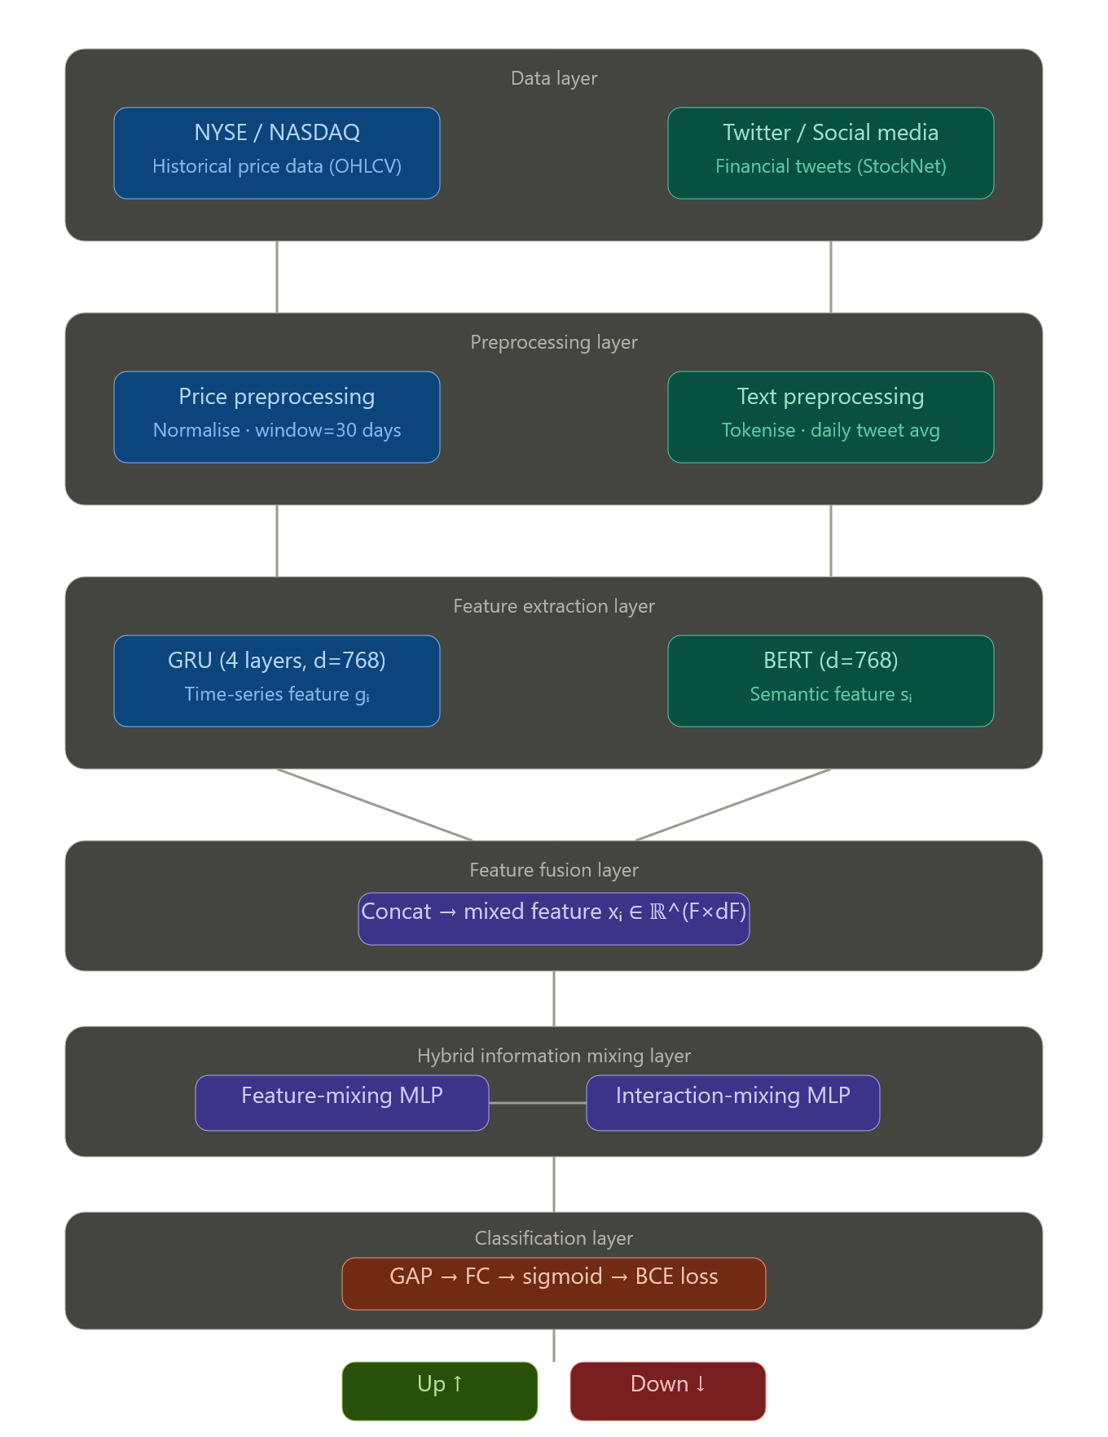
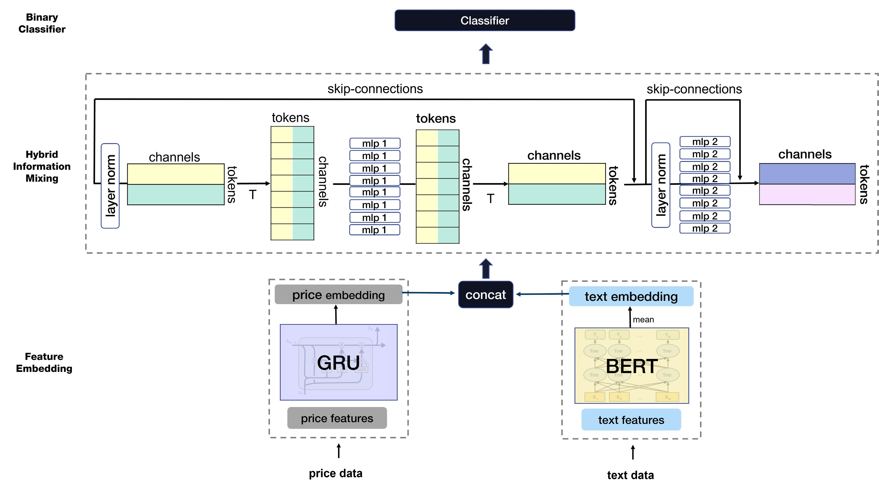
System Architecture

Slide 13
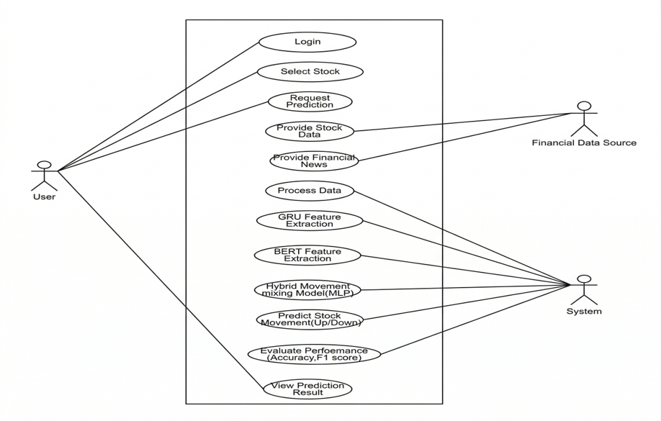
Use Cases Diagram

Slide 14
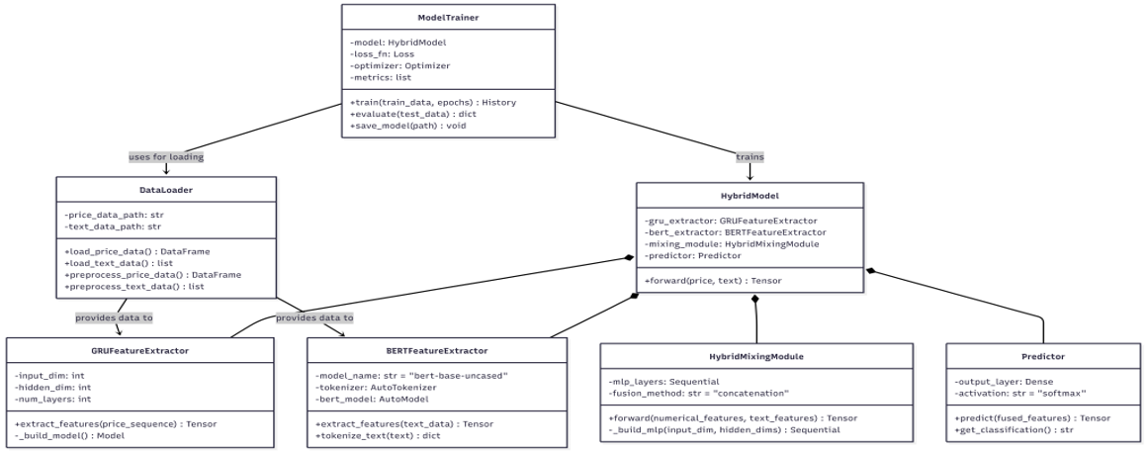
Class Diagram

Slide 15
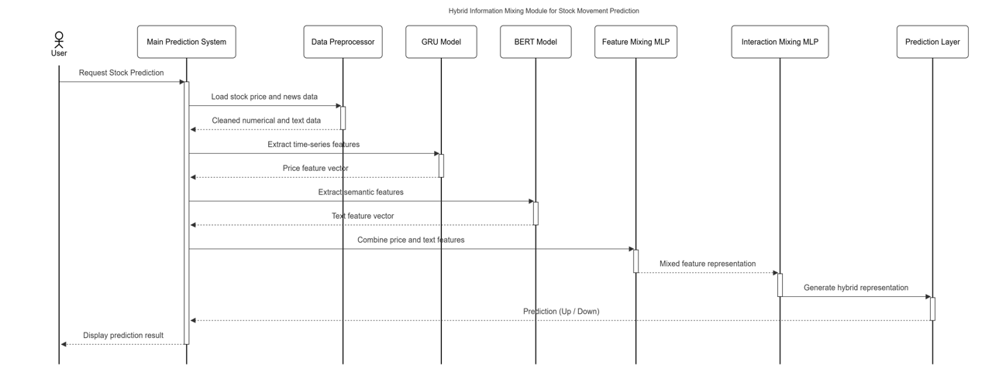
Sequence Diagram

Slide 16
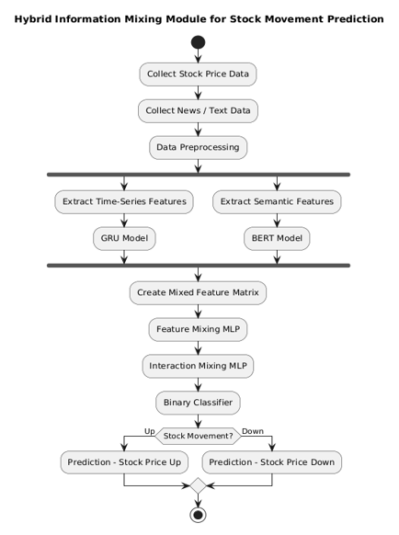
Activity Diagram (Login System)

Slide 17
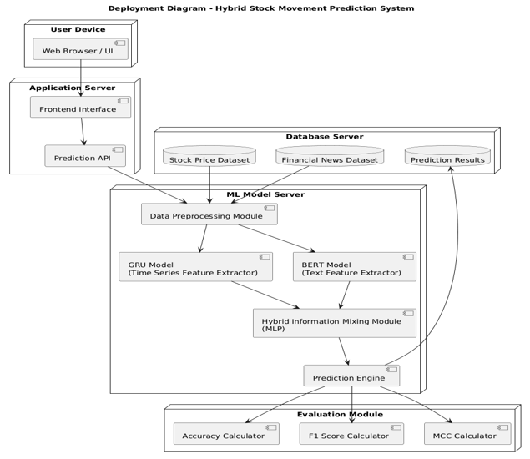
Deployment Diagram
III B.Tech (CSE-D) Industrial Oriented Mini Project (IOMP) Presentation Review-2,
CSE Dept, CVR college of Engineering

Slide 18
Implementation – Module Description
ModuleTextual Branch (BERT):
Utilizes a pre-trained Bidirectional Encoder Representations from Transformers (BERT) model to process real-time financial news headlines. It extracts deep semantic embeddings ($s_i$) that capture market sentiment and external event impact.
Numerical Branch (GRU): Employs a Gated Recurrent Unit (GRU) network to analyze the last 60 periods of historical price data. It captures the temporal dependencies and volatility patterns ($g_i$) inherent in the stock’s time series
III B.Tech (CSE-D) Industrial Oriented Mini Project (IOMP) Presentation Review-2,
CSE Dept, CVR college of Engineering

Slide 19
Implementation – Module Description
AI-Powered Chatbot System
Provides instant responses to user queries
Handles queries about:
Exam schedules
Faculty details
Classroom locations
Circulars
Built using Flask+ Groq API
Reduces administrative workload
Available 24/7
III B.Tech (CSE-D) Industrial Oriented Mini Project (IOMP) Presentation Review-2,
CSE Dept, CVR college of Engineering

Slide 20
Implementation – Module Description
Faculty / Teacher Portal
Manage courses and subjects
Upload assignments or HomeWorks.
Record and manage attendance
Upload and manage results
View student profiles and performance
Communicate with students via chat
Student Portal
View personal and academic details
Check attendance records
Access exam schedules and results
Download circulars and notifications
Communicate with faculty
Access chatbot for queries
Admin Portal
Manage users (students, teachers)
Create, update, and delete accounts
Manage academic schedules and calendar
Publish circulars and notifications
Uploads Results
Full system access and control
III B.Tech (CSE-D) Industrial Oriented Mini Project (IOMP) Presentation Review-2,
CSE Dept, CVR college of Engineering

Slide 21
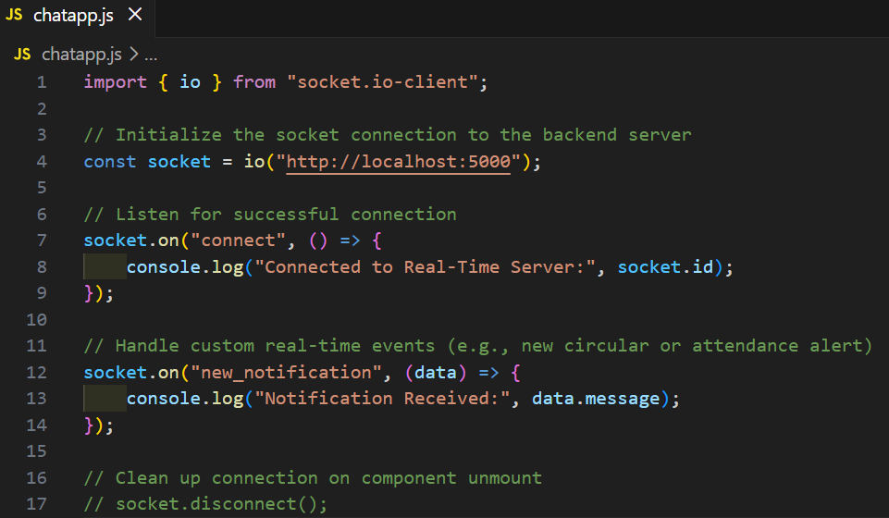
Coding
Real-Time Communication with WebSockets
The application uses Socket.io to establish a persistent, bidirectional connection between the client and the server. This replaces traditional HTTP requests for features that require instant data delivery, ensuring the "AI Integrated CMS" feels responsive and modern.
III B.Tech (CSE-D) Industrial Oriented Mini Project (IOMP) Presentation Review-2,
CSE Dept, CVR college of Engineering

Slide 22
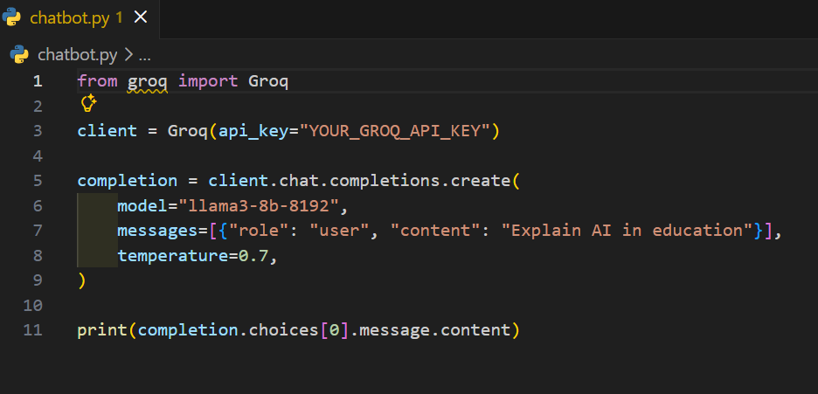
Coding
AI Integration via Groq API
The system leverages the Groq Cloud API to power its intelligent features (such as the AI Chatbot). By using the Llama-3 model hosted on Groq's LPU (Language Processing Unit) architecture, we achieve high-speed inference for user queries.
III B.Tech (CSE-D) Industrial Oriented Mini Project (IOMP) Presentation Review-2,
CSE Dept, CVR college of Engineering

Slide 23
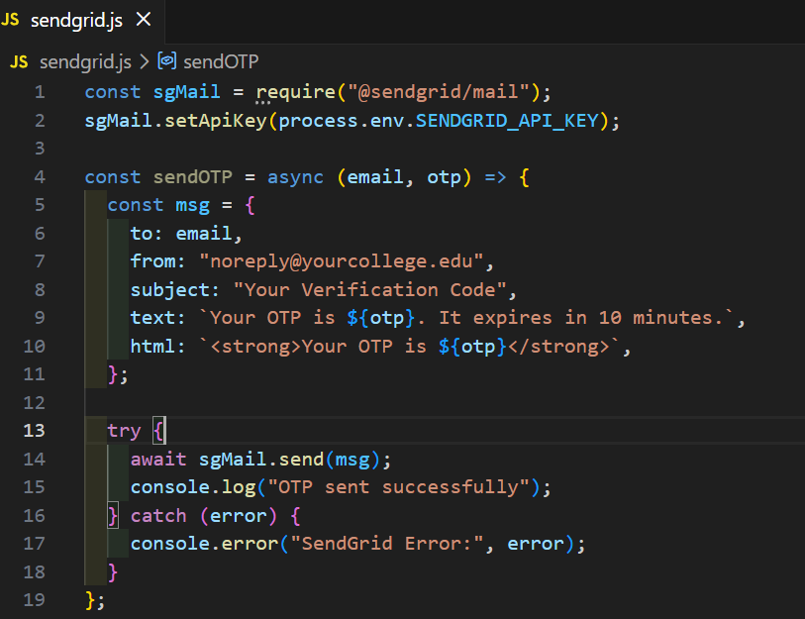
Coding
Secure Authentication: OTP via SendGrid
Security is maintained through a Multi-Factor Authentication (MFA) layer. We utilize the SendGrid Mail API to deliver time-sensitive One-Time Passwords (OTPs) to login student and faculty college email address.
III B.Tech (CSE-D) Industrial Oriented Mini Project (IOMP) Presentation Review-2,
CSE Dept, CVR college of Engineering

Slide 24
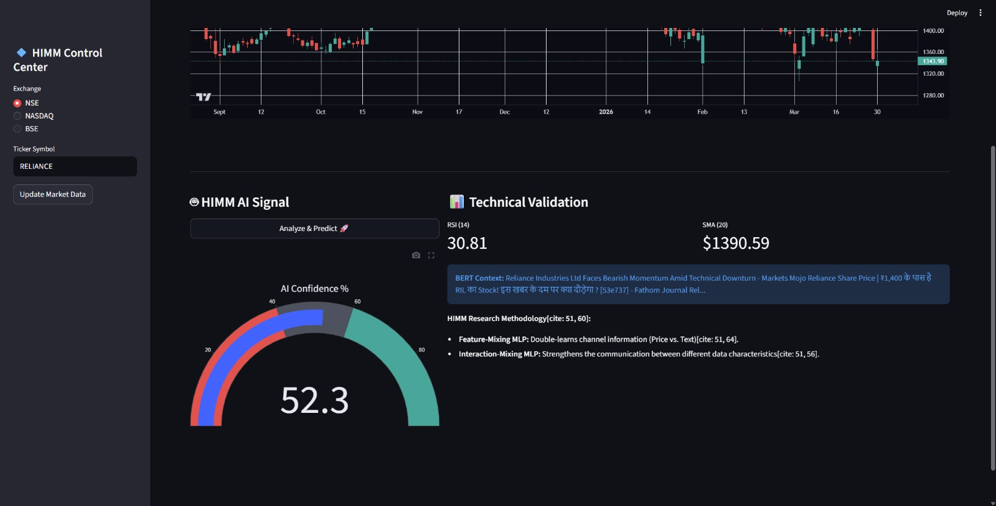
Results (Expected output)
nnn
III B.Tech (CSE-D) Industrial Oriented Mini Project (IOMP) Presentation Review-2,
CSE Dept, CVR college of Engineering

Slide 25
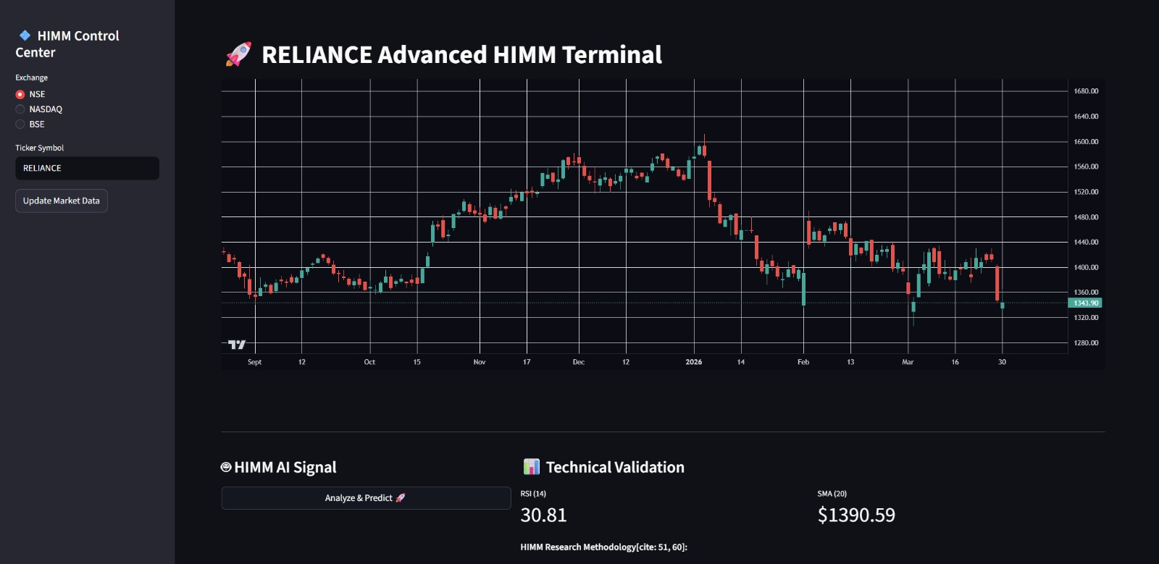
Results (Expected output)
III B.Tech (CSE-D) Industrial Oriented Mini Project (IOMP) Presentation Review-2,
CSE Dept, CVR college of Engineering

Slide 26
Results (Expected output)
Dashboards:
III B.Tech (CSE-D) Industrial Oriented Mini Project (IOMP) Presentation Review-2,
CSE Dept, CVR college of Engineering

Slide 27
Conclusion
The AI Integrated College Management System provides a centralized platform to manage academic and administrative activities efficiently.
It reduces manual work and paperwork by digitizing student records, attendance, results, and academic information.
The system improves communication between students, faculty, and administrators through a real-time chat system.
The AI-powered chatbot helps users get instant answers to college-related queries such as exam schedules, faculty details, and room locations.
With features like role-based access, secure login, and centralized data management, the system ensures better security and organized data handling.
Overall, the proposed system offers a modern, efficient, and intelligent solution for college management.

Slide 28
Future Course of Actions
Integration of company relationship data to capture inter-company stock influences.
Incorporation of social media platforms like Twitter for richer sentiment analysis.
Testing during high volatility periods like the COVID-19 pandemic.
Exploration of graph-based models to improve company and information connections.
III B.Tech (CSE-D) Industrial Oriented Mini Project (IOMP) Presentation Review-2,
CSE Dept, CVR college of Engineering

Slide 29
References
[1]. Cho, K., Van Merriënboer, B., Gulcehre, C., et al. Learning Phrase Representations using RNN Encoder–Decoder for Statistical Machine Translation (GRU) https://arxiv.org/abs/1406.1078
[2]. Devlin, J., Chang, M. W., Lee, K., & Toutanova, K. BERT: Pre-training of Deep Bidirectional Transformers for Language Understanding https://arxiv.org/abs/1810.04805
[3]. Hochreiter, S., & Schmidhuber, J. Long Short-Term Memory (LSTM) https://www.bioinf.jku.at/publications/older/2604.pdf
[4]. Vaswani, A., et al. Attention Is All You Need (Transformer Model) https://arxiv.org/abs/1706.03762
[5]. Xu, Y., & Cohen, S. B. Stock Movement Prediction from Tweets and Historical Prices (StockNet Dataset) https://aclanthology.org/P18-1183/
[6]. Kim, R., So, C. H., Jeong, M., et al. HATS: A Hierarchical Graph Attention Network for Stock Movement Prediction https://arxiv.org/abs/1908.07999
[7]. Pedregosa, F., et al. Scikit-learn: Machine Learning in Python https://scikit-learn.org/stable/about.html#citing-scikit-learn
[8]. Paszke, A., et al. PyTorch: An Imperative Style, High-Performance Deep Learning Library https://pytorch.org (Cite as: Paszke et al., NeurIPS 2019)
[9]. Yangjia, Z., Xia, L., Junteng, M., & Yuan, C. Fundamental Analysis based Neural Network for Stock Movement Prediction https://aclanthology.org/2022.ccl-1.86/
[10]. N, S., Indradevi, R., & Gayathri, R. Enhancing Stock Market Predictions Using Hybrid Deep Learning Models with Sentiment Analysis https://doi.org/10.31449/inf.v49i33.8079

Slide 30
THANK YOU

