Slide 1

Digital Wallet Transactions Analysis
Insights and Trends from Transaction Data

Slide 2
Understanding Digital Wallets
Total sales By Merchant Name
Count of Product Category By Device Type
Total Fees And Total Sales By year
Total Sales By Time
Target Value And Actual Value
Total Sales Decomposition Tree

Slide 3
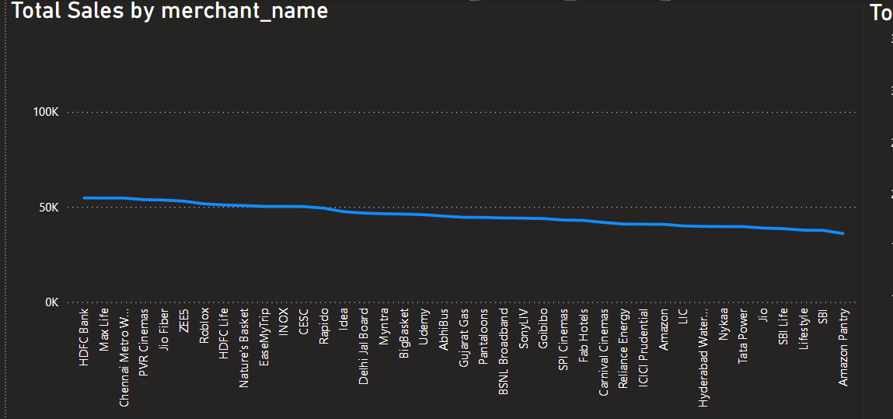
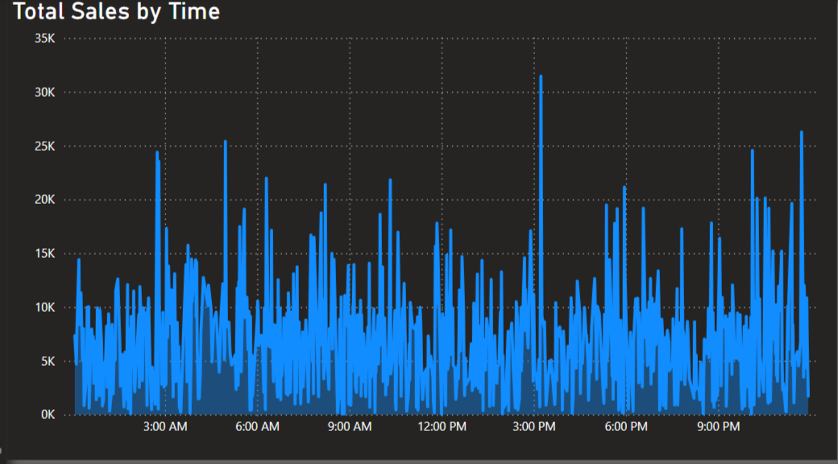
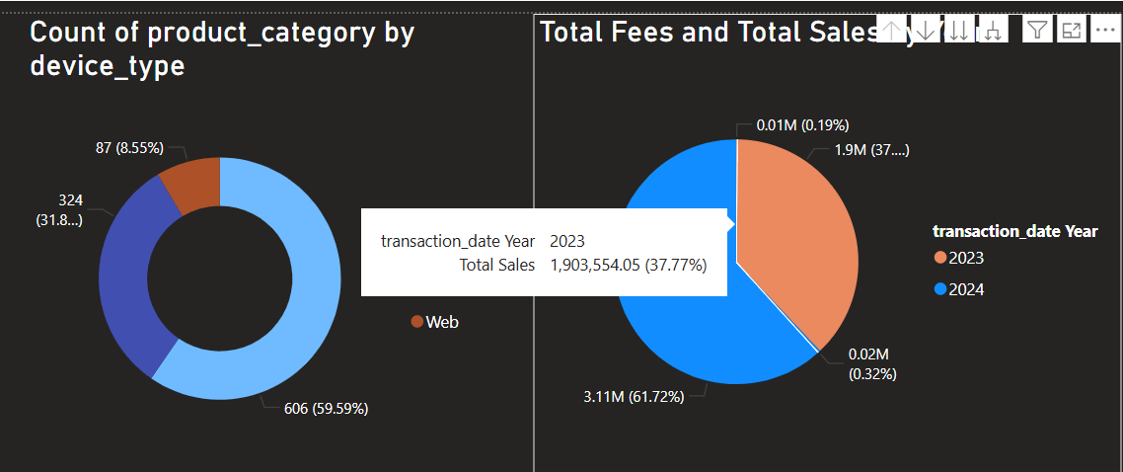
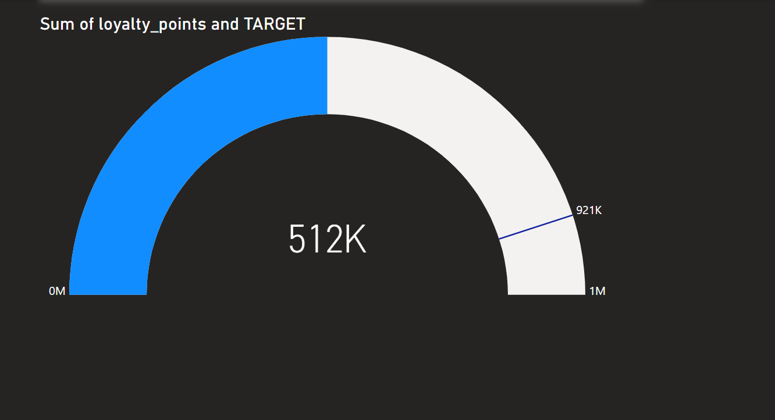
Transaction Data: A Glimpse
5.01M
25.80K
1017
Total Sales
Total Sales
Pay Count

Slide 4
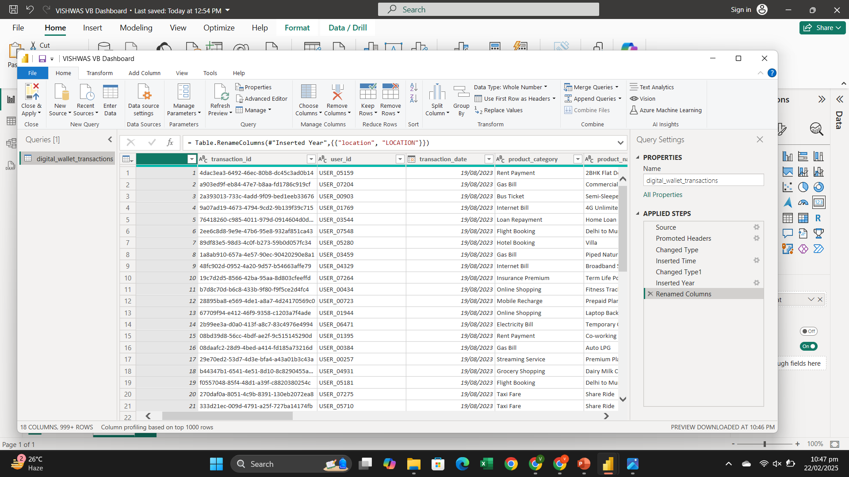

Slide 5
Uncovering User Preferences
Food and beverage emerged as the most popular product category, followed by retail and travel.
The average transaction amount ranged from 20K to 60K, with higher spending observed for travel bookings. Cashback offers showed significant impact on user behavior, driving higher transaction volumes and repeat purchases.

Slide 6

Key Takeaways and Recommendations
Digital wallets are driving a significant shift in payment behavior. The data reveals clear preferences for specific product categories at Specific Area like Urban ,Rural , SubUrban and merchants, highlighting opportunities for targeted marketing strategies.
Optimizing cashback and loyalty Points as reward structures can further incentivize user engagement. Optimizing transaction fees and simplifying the user interface can improve overall user experience.

